Slide 1



Spring AOP
Session
9
Chaim Turkel
Ido Barash

Slide 2


Last session – Spring IOC
Introduction to Spring
Spring core
Inversion Of Control
Bean injection using Spring
Spring IOC annotations
Annotations vs XML

Slide 3
Spring - AOP
Spring Core structure
Aspect Oriented Programming
AOP solutions
Spring AOP – Dynamic proxy
AOP – Joinpoints, Pointcuts,
Aspects via XML.
Aspects via Annotations.

Slide 4





Spring structure
AOP is one of the key components of Spring core.
Projects Templates
LDAP
XD
Data
Batch
Templates
Security
MVC
Web-Services
Roo
Shell
Social
Mobile
Boot
Web-flow
Test
Integration
Core
IOC container
AOP

Slide 5
AOP
Lets try to break down an app handling clients and payments to distinct logical parts:

Slide 6






AOP
Lets try to break down an app handling clients and payments to distinct logical parts:
Clients Service
Payments Service
Clients Logic
Payments Logic
Clients DB Handler
Payments DB Handler

Slide 7
AOP
But there are operations we need to do cross application:
Transaction (read only) opening before executing logics code to only selects data from the DB.
Transaction (Write) opening before executing logics code to update DB.
Transaction commit after finishing executing the logic code.
Logging
etc…

Slide 8
AOP
Clients Service
Payments Service
Clients Logic
Payments Logic
Clients DB Handler
Payments DB Handler

Slide 9
AOP
Now we need something like this:
Transaction handling:
Clients Service
Payments Service
Transaction Handle
Clients Logic
Payments Logic
Clients DB Handler
Payments DB Handler

Slide 10
AOP
Now we need something like this:
Transaction handling:
Clients Service
Payments Service
Logging2
Clients Logic
Payments Logic
Clients DB Handler
Payments DB Handler

Slide 11
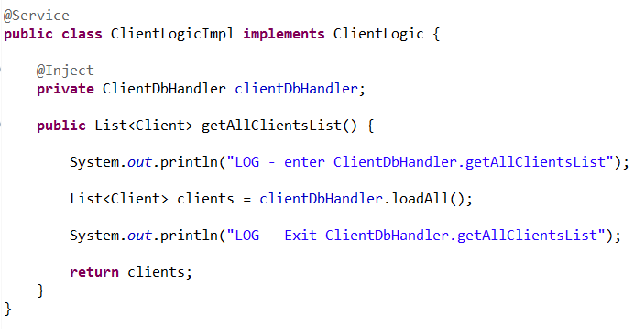
AOP
We can add code for logging or transactions handling wherever we need:

Slide 12
AOP
We can add code for logging or transactions handling wherever we need:

Slide 13
AOP
This is possible but not so elegant.
Adding these lines to every object in every layer in a large project could be messy.
We mix code responsible for administrative stuff into pure logic code – this is wrong!
Eventually, we get lots of ugly code wrapping our logics.
Changes in this administrative code might require changes in many classes.

Slide 14
AOP
Now we need something like this:
Transaction handling:
Log enter
Logging
Clients Service
Payments Service
Log exit
Clients Logic
Payments Logic
Clients DB Handler
Payments DB Handler

Slide 15
AOP
Solution: Aspects.
Aspects are modules containing API to handle cross-cutting requirements.
Aspects are totally separated from the classes business logic.
Aspects allow us to handle cross-cutting behavior code at one place only.
Sometimes they are also called triggers.

Slide 16
Terminology
AOP has an unusual terminology:
Join points
Advice
Pointcuts
Introduction
Weaving

Slide 17
Terminology - Join points
Represents a point in the application where we can assign an aspect.
This is the actual place in the application where an action will be performed using cross-cutting handling.

Slide 18
Terminology - Join points
Represents a point in the application where we can assign an aspect.
This is the actual place in the application where an action will be performed using cross-cutting handling.
Join points can be:
Method call Method execution Field set
Constructor call Constructor execution Field get
Object initialization Static initializer execution Annotations

Slide 19
Terminology - Advice
The actual action to be taken before or after (or both) the join-point.
This is the actual piece of code that invoked during the excution by the AOP framework.

Slide 20
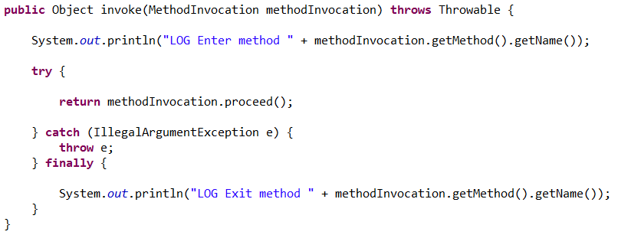
Terminology - Advice
The actual action to be taken before or after (or both) the join-point.
This is the actual piece of code that invoked during the excution by the AOP framework.

Slide 21
Terminology - Advice
The actual action to be taken before or after (or both) the join-point.
This is the actual piece of code that invoked during the excution by the AOP framework.
Method invoke!

Slide 22
Terminology - Advice
Advices:
Before: Run advice before method execution.
After: Run advice after method execution, regardless the outcome.
After returning: Run advice after execution only if method completed successfully.
After throwing: Run advice after execution only if exception was thrown.
Around: Run advice both before and after execution.

Slide 23
Terminology - Pointcut
A set of one or more join-points where an advice should be executed.
A pointcut connect between a join point and an advice.
We use a special expression languages to tell the advice on which pointcut to run.

Slide 24
Terminology - extra
Introduction: Allows us to add new methods and new properties to existing classes on runtime.
Weaving: The process of linking aspects with object to create “advised object”. This can be done at compile time, deployment time and runtime.

Slide 25
AOP frameworks
The ability to write and implement aspects is given to us by an AOP framework.
AOP is not a part of JEE - no specific specification
There are several frameworks:
AspectJ
JBoss AOP
Spring AOP

Slide 26
Spring AOP
Spring already in charge of creating and instantiating our object.
During creation process, each bean is wrapped with a delegation proxy generated dynamically by Spring.
The proxy implements the same interface as the object and it will be injected to other beans.
If we use spring-transactions support, we should use spring-aop as well.

Slide 27



Spring AOP
Interface
implements
implements
Contains
Proxy
Object

Slide 28
Spring AOP
Interface
implements
implements
Proxy
Contains
Object
Before()
Invoke real object’s method()
After()

Slide 29


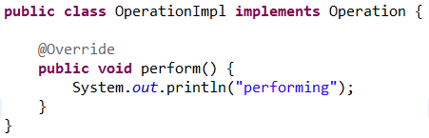
Proxy design pattern
Proxy: A wrapper class that wraps the actual object and adds functionality without changing the object’s code. For example: Logger – add time of entrance and exit to an interface method:

Slide 30
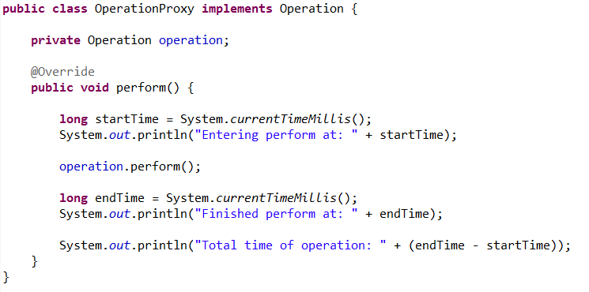
Proxy design pattern
The proxy class implements the same interface, but in it’s own implementation, it add functionality and call the actual object’s operation.

Slide 31
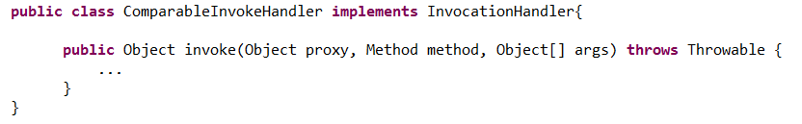
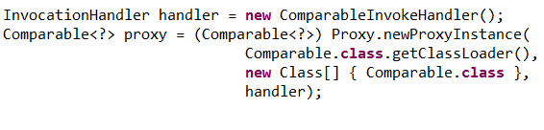
Proxy design pattern
Delegation proxy – Creating proxies dynamically using reflection.

Slide 32
Aspect-J
The most common AOP framework.
Considered as some sort of a standard for AOP.
Instead of creating proxy, Aspect-J uses it’s own compiler and changes the actual bytecode of the class.
Considered as the most powerful AOP framework, but also the heaviest.

Slide 33
Aspect-J vs Spring
Spring is pure-java and does not change the bytecode of the class.
Spring is more lightweight
Spring supports only methods as joinpoints.
Aspect-J uses external compiler
Aspect-J is more powerful – supports constructors, fields getters / setters and static joinpoints.

Slide 34
Why Spring?
We already use Spring as an IOC container.
Most of the cross-cutting operations we need aspects to solve are methods.
Spring AOP will suffice 95% of the times.
We can always use another AOP framework – Spring integrates just fine.

Slide 35
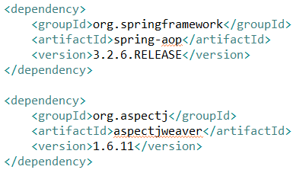
Using Spring AOP
We need to import “spring-aop” and aspect J weaver JAR files:

Slide 36
Using Spring AOP
We need to import “spring-aop” and aspect J weaver JAR files:
Spring AOP framework
Joinpoint object and functionallity for advice

Slide 37
Using Spring AOP
<aop:aspect>: defines an aspect class
<aop:config>: top-level xml tag for aspects configuration.
<aop:after>: defines an “After” joinpoint
<aop:after-returning>: defines an “After” joinpoint if method ran successfully.

Slide 38
Using Spring AOP
<aop:after-throwing>: defines an “After: joinpoint if method threw exception.
<aop:around>: defines a joinpoint for both “Before” and “After”.
<aop:pointcut>: defines a pointcut.
<aop:aspectj-autoproxy/>: enable AspecJ annotations support.

Slide 39
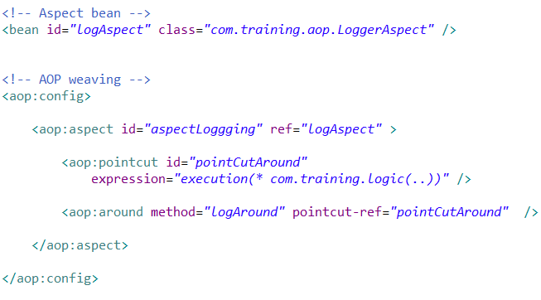
Using Spring AOP
Example: “Around Aspect” configuration

Slide 40
Using Spring AOP
Example: “Around Aspect” configuration
Aspect actual class

Slide 41
Using Spring AOP
Example: “Around Aspect” configuration
AOP configuration

Slide 42
Using Spring AOP
Example: “Around Aspect” configuration
Marking bean as Aspect

Slide 43
Using Spring AOP
Example: “Around Aspect” configuration
Marking bean as Aspect

Slide 44
Using Spring AOP
Example: “Around Aspect” configuration
Define pointcut

Slide 45
Using Spring AOP
Example: “Around Aspect” configuration
Weav

Slide 46
Using Spring AOP
Example:
Method to run around the pointcut

Slide 47
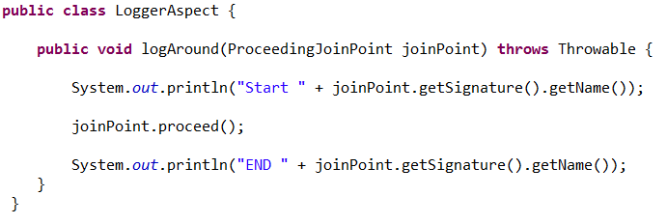
Using Spring AOP
Example: “Around Aspect” configuration

Slide 48
Using Spring AOP
Example: “Around Aspect” class code
Method Invoke

Slide 49


Using Spring AOP
Example 2: “Before Aspect” configuration
Notice that this aspect’s method is simpler (because there is nothing to run after the proxy’s invocation.

Slide 50
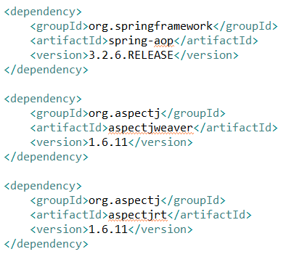
Using Spring AOP
Spring supports Aspect-J annotations for simple AOP definition:
Import Aspec-j “aspectjrt” JAR file:

Slide 51
Using Spring AOP
Spring supports Aspect-J annotations for simple AOP definition:
Import Aspec-j “aspectjrt” JAR file:
AOP annotations

Slide 52
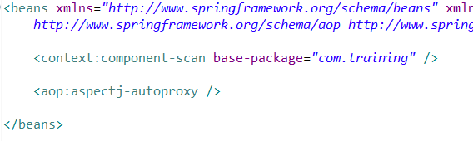
Using Spring AOP
Application context is quite simple:
We tell spring to automatically create the proxies using Aspect-J annotations.

Slide 53
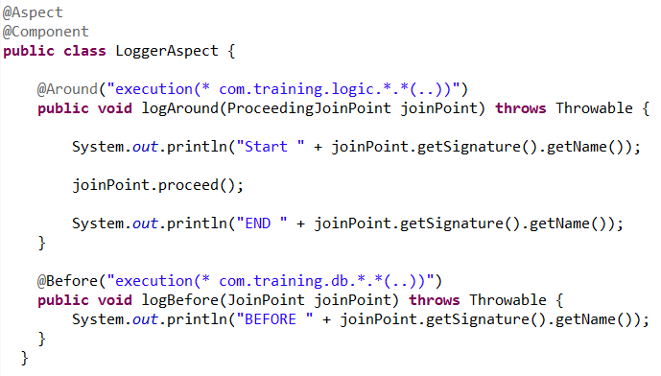
Using Spring AOP
AOP metadata is on the class:

Slide 54
Using Spring AOP
AOP metadata is on the class:

Slide 55
AOP disadvantages
Voodoo Suddenly things are happening with no code calling for it in the class.
Maintenance
Debugging might be quite difficult.
Runtime / compile time is slower.

Slide 56

Using Spring AOP
Exercise:
Using spring-aop with annotations, create a stopwatch After a method finished running, print to system out how much time in milliseconds this method was running.
*Get time in millis:
*Delay process:

Slide 57
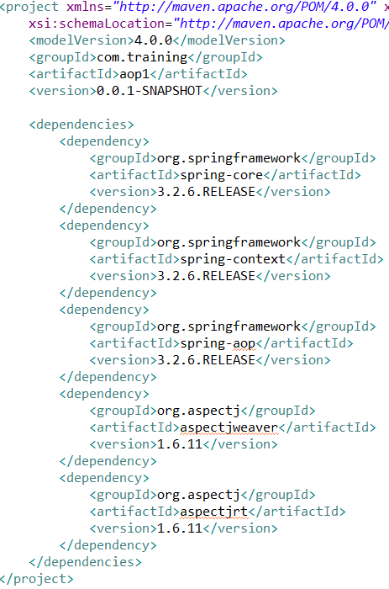
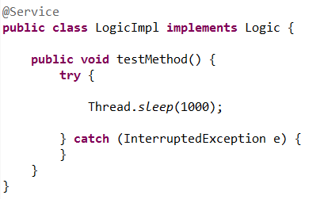
Using Spring AOP

Slide 58
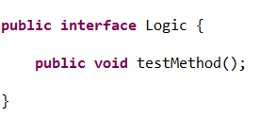
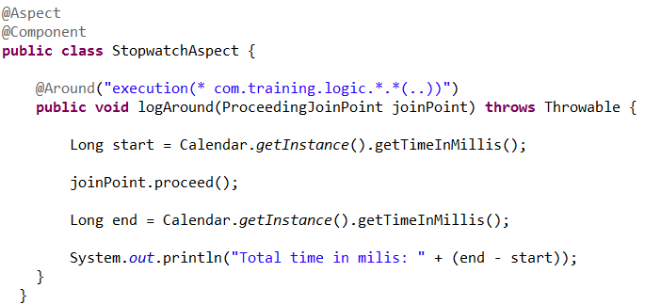
Using Spring AOP

Slide 59
Spring - AOP
Spring Core structure
Aspect Oriented Programming
AOP solutions
Spring AOP – Dynamic proxy
AOP – Joinpoints, Pointcuts,
Aspects via XML.
Aspects via Annotations.

Slide 60
Next session – Spring extras
Templtes
Webapp using Spring
Session
10

Slide 61


THANK YOU
Ido Barash
Email: ido.barash@tikalk.com

