Slide 1

zkML-DvP Engine Sathya Krishnasamy https://github.com/chainaim3003/zkML-DvPGiza

Slide 2
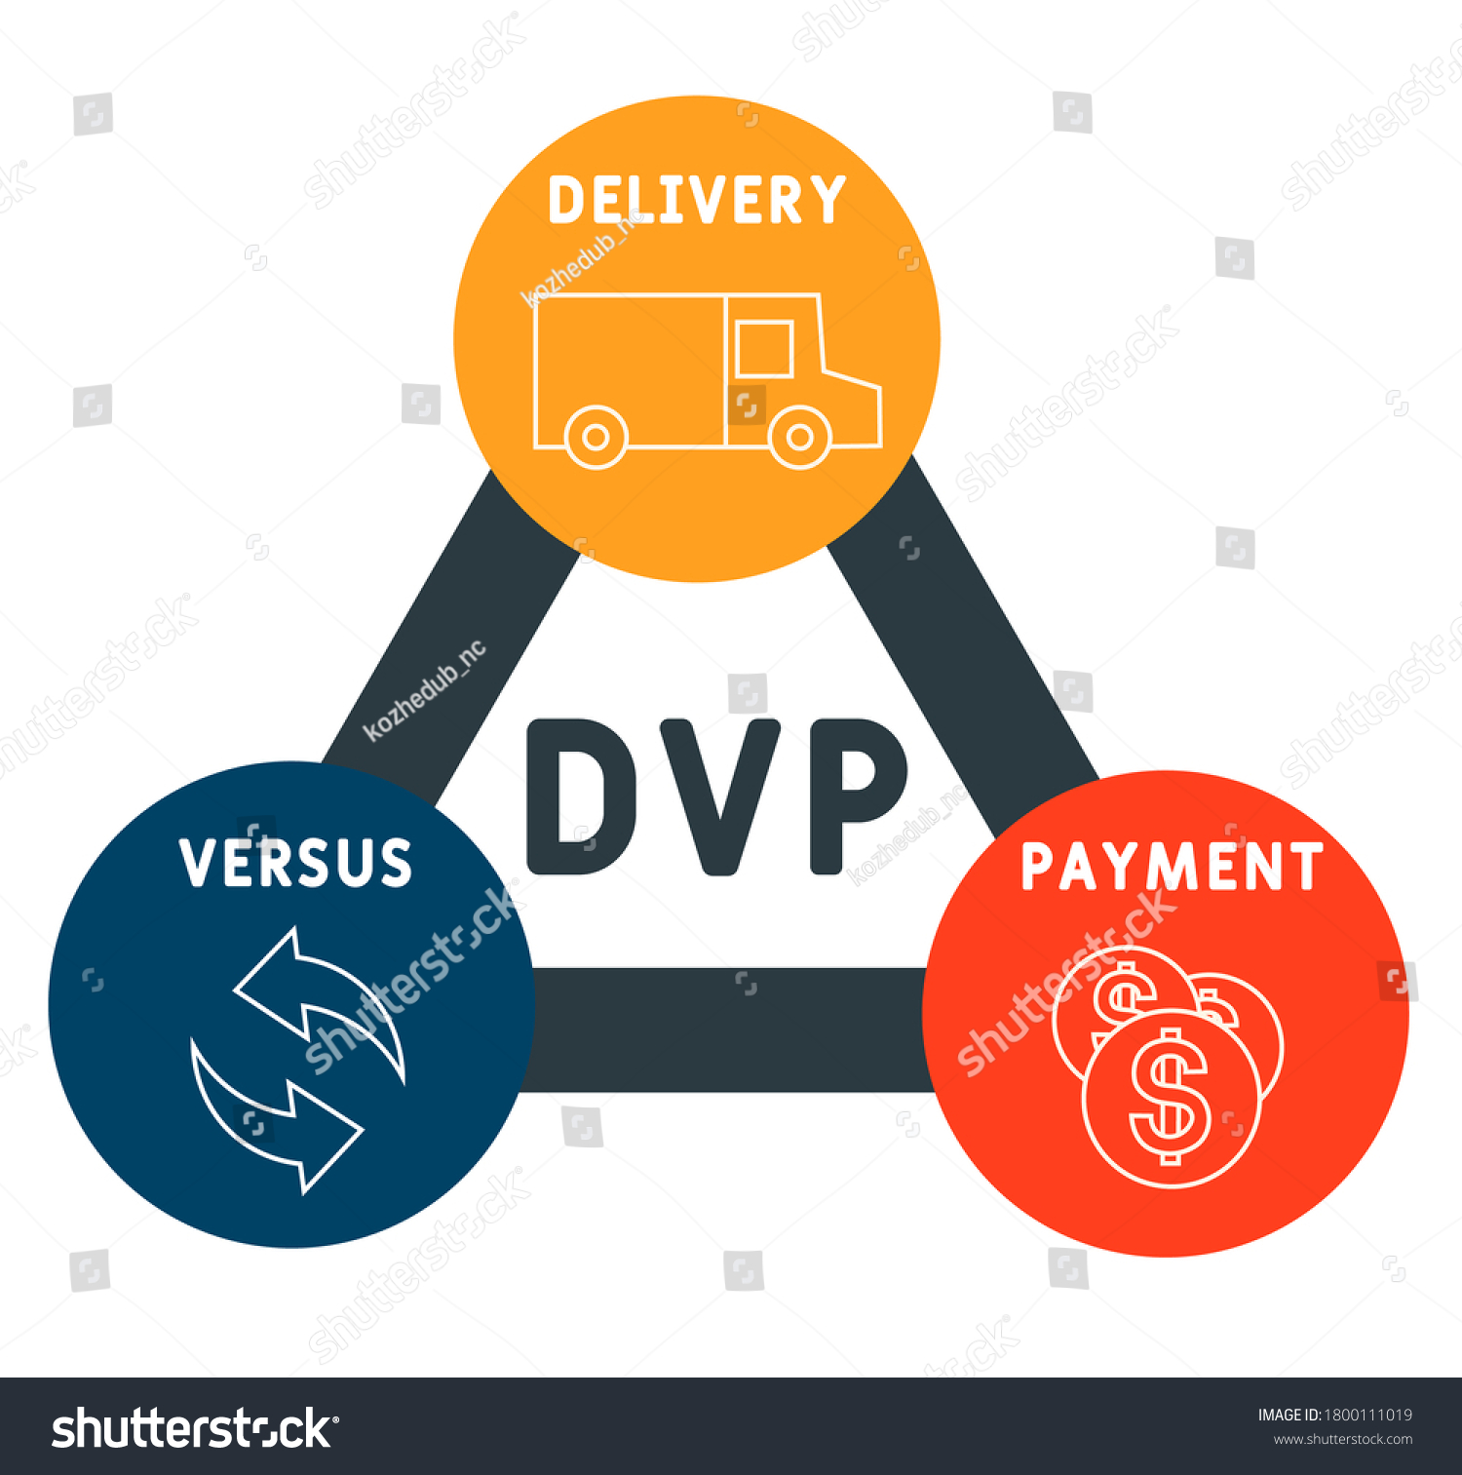
Delivery Versus Payment
DvP is a business concept in contracts and payments that
ascertains what the payment is for?
key for all parties to be clear about deliveries for payment when payments are done, including predicted payments and periodic reconciliations
increases payment integrity
Current Web 2 DvP processes
are centralized, heavily-batched and Opaque
has Friction between parties ( mostly non-value added)
most systems have excessive and expensive re-verifications
leads to excessive overheads, arbitrations, write-offs
What is needed is a process for Trust But Quick Verify
ZKML has the potential to help, with adequate business templating for business processes - “zkML-DvP Engine”

Slide 3
Scenarios
Scenario 1 – Public Business Process Transparency For Consumers
Health price Transparency :
What should be my premium?
Explain my Medical Bill.
Scenario 2 – B2B and B2B2C Adjudications and Settlements
Insurance Claims Settlements
Who pays Primary-Secondary
Value-Based Payments ( predictive ) and Trueups
Scenario 3 – Supply Chain Operations
Who pays for late charges?
What is common in these? – These start with predicted payments, and the deliveries could get true-up ( Which needs reasonable explanation)
Perfect for :
“Agreed on Models” and Proof s - Verification can be limited.
Configured agents reacting to ML models and verifications

Slide 4
Problem and Solution
Most companies use ML/AI but do not explain it to consumers or counter-parties, which leads to excess verification, mistrust, and disputes.
Can be moved to collaborative trust based on ZKML / Agents to improve efficiencies.
Solution :
Public reference models ( Health Transparency for consumers)
Models that can be agreed on ( for predictive payments)
Proof of “payments” based on “delivery” parameters
The PAYMENT FOR DELIVERY aspect can be contained, and the focus can be on just OPERATIONAL improvement ( improving delivery ) and re-modeling for the future instead of disputes.
REDUCES FRICTION

Slide 5
Implementation / Plan of Action
Complete for Scenario 1 on GIZA – ETH Sepolia
For insurance premium prediction model and smart contract to settle
in ETH ( Full End to End Process)
Some transactions were tried in ZK Sync.
Scenario 2 : Sample contract deployed in Starknet.
Connecting to the sample contract from Giza through Starknet.py( in progress)
Scenario 3 / Others : Business ML models identified / Agent configurations identified. Will be abstracted and extended.

Slide 6
Scenarios – Why are these Important
Scenario 1 – Public Business Process Transparency For Consumers
Health price Transparency :
https://www.lugpa.org/americans-wanthealthcare-price-transparency
Scenario 2 – B2B and B2B2C Adjudications and Settlements
https://curatepartners.com/industry-expertise/the-importance-of-healthcare-paymentintegrity/#:~:text=One%20of%20the%20significant%20challenges,lead%20to%20significant%20financial%20losses.
Scenario 3 – Supply Chain Operations
https://www.carlsonssolicitors.com/news/2024/2/29/supply-chain-conflicts-resolve-supplier-disputes#:~:text=Payment%20disputes%3A%20Financial%20matters%20often,terms%20can%20strain%20supplier%20relationships.
Perfect for :
“Agreed on Models” and Proof s - Verification can be limited.
Configured agents reacting to ML models and verifications

