Slide 1


Reimagined Supply Chain Finance
ZK Proof Engine for Tokenization (ZK – PRET)
SATHYA KRISHNASAMY
sathya@chainaim.com
Background:
Emerging Tech Executive and Architect – DLT/ AI
Supply Chain/ International Trade/ Payment Innovation Experience
Industry Workgroups and Standards Advisor

Slide 2
Problem Statement
Inefficient Financial Access for Sellers ( Most are local heritage preserving entrepreneur Workers – GI recognized)
A majority of global SMEs in developing economies (Exporters) do NOT have access to formal finance.
Working capital Gaps. Input Tax Credit Receivables, and Export Duty subsidies eventually arrive causes cash flow deficit.
Alternate options are of high interest rates and predatory. This is a high barrier for MSME Trade finance Inclusivity.
Mostly Exporters - Nuetraceuticals, Textiles, Food. Imports – Raw Material
Badges: Identity, Compliance, Supply chain operational Excellence, participation in high-performing supply chain
Financiers / Buyers face Validation Risk
Decentralized solutions are emerging but risks are high and validations are still very difficult
Buyers / Financiers do not know Sellers well enough and hence is still a barrier.
Need for Trust Minimized and access controlled yet transparent
and traceable solutions
For reducing Buyer and Financier risk,
For reducing the multi-party discrepancies ( starting with the financing need functions)
and Seller( MSMe) Financial options – Ideal end state is multi-financiers

Slide 3

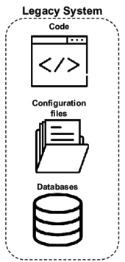
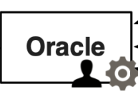
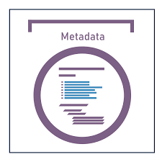

SCF - TRADE FINANCE
Exporter MSME
Review/Arbitration
dApp
Tokenization ( Composable Data Integrity )
Auto Agents DvP
Consolidated Proof
COUNTER-PARTIES
( IMPORTERS)
Prover
Verifier
Smart Contract
Edge AI
Smart Contract
Multi-Sig
Proof 1:Reg/Badge
Funds
Proof 2: ExIM Compliance
Proof 3:Global LEI
Proof 4 : Financial Health
Proof 5: Operational Exellence
………..
Title
Funds
Title
Proof n: Deep SCF Financeing
FINANCIERS

Slide 4
THE SCF – RWA MINA solution - IMPACT
WHY SO CRITICAL:
Institutional Defi looking at SCF financing. (2 -3 T in International demand
alone) but handicapped so far. Centralized systems have failed/are not adequate.
Financiers are NOT interested in single invoice factoring. Need many inputs and risk-minimized aggregation bundles
Buyers also would prefer multi-financier funding ( to spread risk )
Risk mapping and reduction calibration
Days outstanding ( DSO reduction), Effective Working Capital Management
For Buyers/Sellers: Working capital optimization, For Financiers: Risk reduction.
Why is this a big deal? Why is this important ( 1 corridor)
Unmet demand for trade finance in Africa is US$ 120 billion (one-third of the continent’s trade finance market) and US$ 700 billion in developing Asia.
Total of 63.4 Million MSMEs in India. Contributes 45% of overall exports. 90-120 Days Receivables Cycle
Almost 90% of small business in india still have no links with formal financial institutions. IFC estimates debt demand gap of Rs 36.7 lakh crores.
If we have to bring the next one billion people into crypto, the use cases that are going to be helpful are the ones that are inter-twined with the lives of most people day-to-day, which is precisely the opportunity that Supply chain Finance brings. Supply chain finance is the lifeblood of working capital for SMEs and MSMEs in most economies.

Slide 5
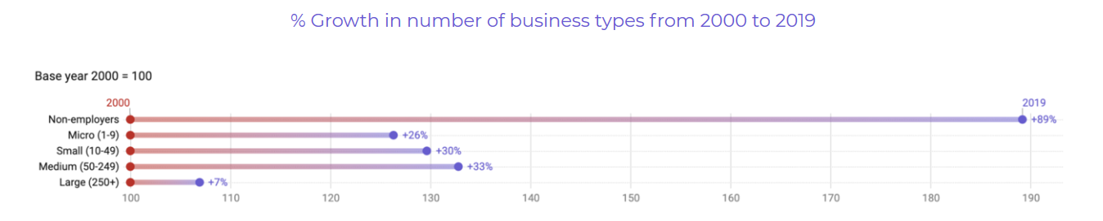
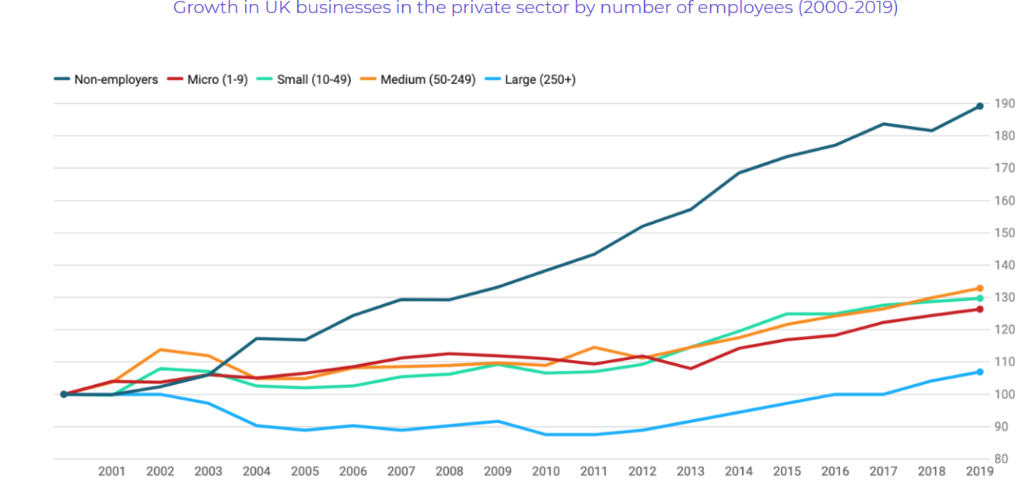
How important are MSMEs
MSMEs are important globally (Davies, Narayanan and Balasubramanian 2021):
Over 95% of all companies are UK & US are MSMEs
90% of all businesses globally are MSMEs, they employ over 50% of all workers
88% of EU companies exporting to USA are MSMEs
They are even more important in developing countries like India, particularly in the context of exports/imports (Chakravarthy, Bharathi, Khire, and Narayanan, 2023): 30% of GDP (40% of emerging economies income globally).
Roughly the total addressable market is about 16 trillion USD – that’s the income generated SMEs globally!

Slide 6






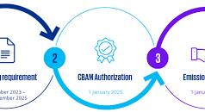
SCF – Reference Implementation - RISK Framework: Mapping and Mitigation
Instruments Classification
Verification : ENTITY
EXIM Risk : 100
Verification Entity
Tier 3
Verification : Financial Health
AAA
SCF -
TRADFI
Institutional Defi
ORACLES
Verification : Fin Audits
Income Tax – India
ITR 3 / GSTN
Tier 2
Verification Data Integrity
ZK - RISK Engine
Tier 1
Verification EXIM Process
Verification: EXPORT/CBAM
Auth
EXIM Risk : 30

Slide 7

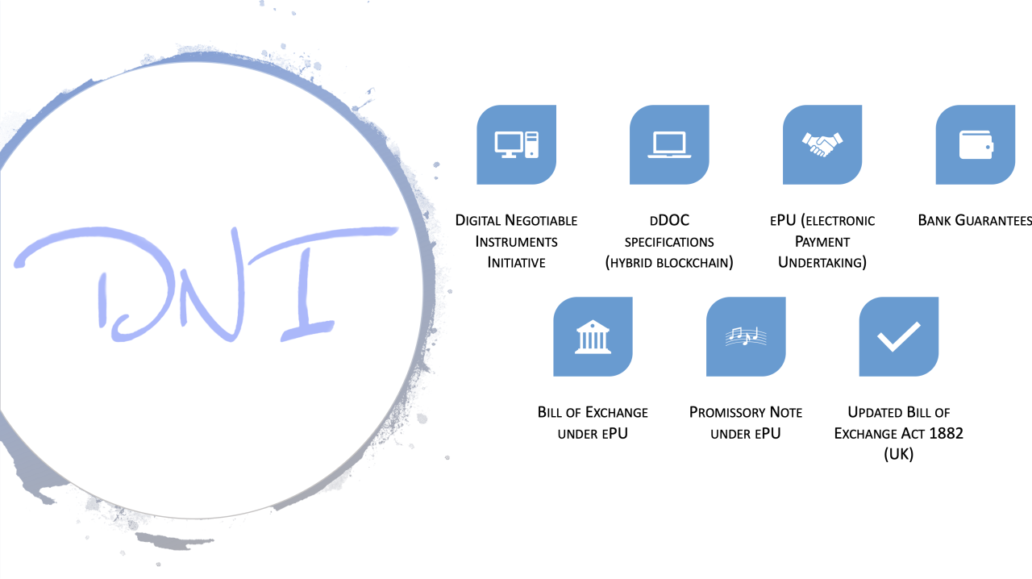


ZK PET – ARCHITECTURE
ZK PET – SCF Re-imagined
ZK PET- ZK PROOF ENGINE FOR TOKENIZATION
ZK-PET DOMAIN ORACLE REGISTRY
ZK PET- DEEP COMPOSITION ENGINE
Risk Model Proofs
ZK PET- RISK
MINA
EVM CHAINS
OTHER
AAA
Composed Identity Proofs
Composed Compliance Proofs
ZK PET- BPMN
Composed Business Process Proofs
Composed Data Integrity
Customization Proofs
ZK PET- Verification / RISK templates
configurable
TRADFI
Institutional Defi
PROVERS VERIFIERS

Slide 8
Transformation: EXIM Digitization/Tokenization, Compliance
Supply Chain/ International Trade Finance :
Web 3 Digitization of SCF / Trade documents with compliance to evolving bills and standards ( Electronic Trade Bill, Model Law for Electronic Traceable Records, CBAM )
BUT MOST solutions today are SIMPLY doing an electronic version of the broken paper processes.
Seller Identity through evolving Identity schemes and Decentralized IDs.
Compliance is NOT just KYC for Wallets ( crypto native )
BUT for RWA, like SCF finance, are more profound.
Enterprise connectivity to SupplyChain/Trade, ESG
APIs / ORACLEs BUT with Privacy-Protection.
End2End Hyper-Efficiencies
Cash Flow Cycle shortening
Proof of Best Practices – Operational Excellence
.

Slide 9
THE SCF – Tokenization
THE SOLUTION : VALIDATION RISKS by COMPOSED PROOFs
COMPOSED PROOFS
RECURSION BY NATURE :
PROOF 1 : VALID CORPORATE REGISTRATION ; GOOD STANDING
PROOF 2 : ACTIVE INTERNATIONAL TRADE COMPLIANCE, GOOD STANDING
TRUTH TABLE IMPLEMENTATION
The Recursion continues to
Global LEI , Financial Health, Supply chain operational Exellence
PROOF 3 – PROOF 4 – PROOF 5
Further extends to
Deep supply chain financing ( for others in the chain based on primary) -
SCF INSTRUMENTS BUNDLING ( Negotiable Instruments ).
PROOF BUNDLES 6 - PROOF BUNDLES 7 and on …………
What does this lead to Local /Global compliance like MCA/GLEIF / new age RISK MITIGATION frameworks in contracts in MLETR / eBL / PEPPOL / DCSA compliant
PROOF1 | PROOF2 | RECURSIVE
INDIVIDUAL | INDIVIDUAL | COMPOSED
1 | 1 | 1
1 | 0 | 0
0 | 1 | 0
0 | 0 | 0

Slide 10

Accolades
https://x.com/onXDCNetwork/status/1722734452353204672 : TradeSync Accolade : For Quality of trade document metadata
https://ethglobal.com/showcase/trafiguard-96ge8 : Trade Finance Insurance
https://devpost.com/software/secure-social-share: Privacy and Data provenance
WORKING ON EXTENDING SCF FINANCE THIS WITH PRIVACY PROTECTION IN ZK FOR ORACLES, AND RISK MODELS AS
Enterprise TradFi/Defi and Risk management frameworks are trying to enter this new tokenization space that is underpenetrated.

Slide 11

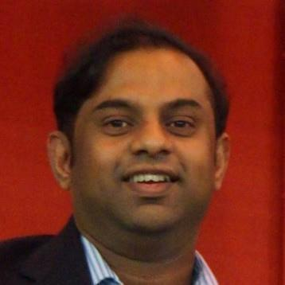
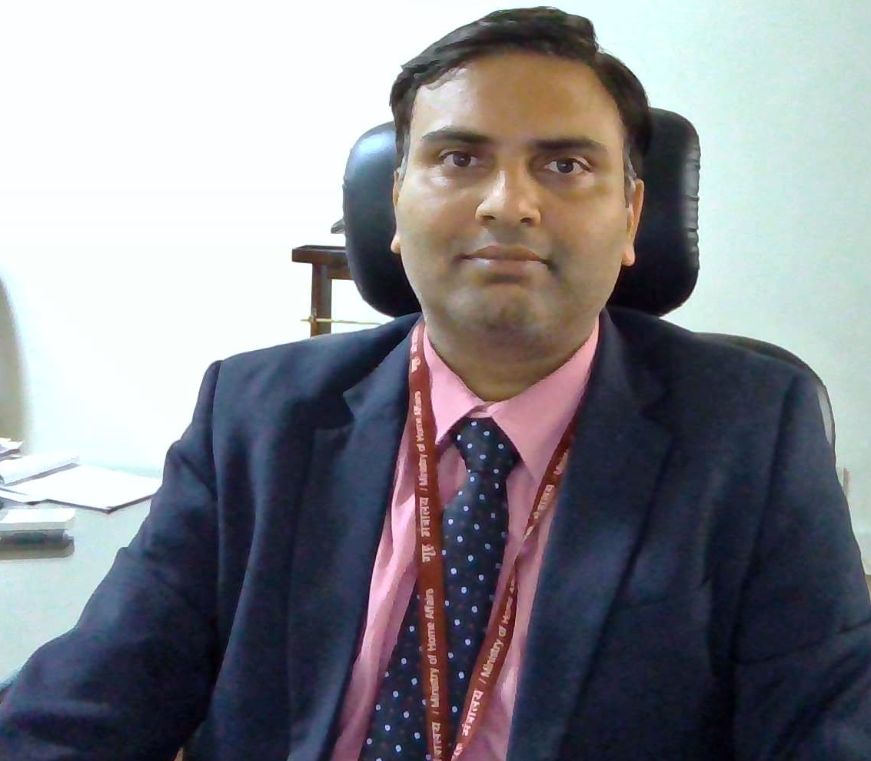

Meet the team
Sathya Krishnasamy
Architect, Technology Management Executive, Domain Expert in Supply chain, International trade logistics, and Payment Integrity and innovation in Health supply chains
Advisor
Dr Badri Narayanan Ph D
Renowned Economist, Consultant to many entities including WTO, World Bank, IMF, Governments ( ASIA pacific, UK ), and corporates and NGOs worldwide including McKinsey .

Slide 12

Any Questions

Slide 13
Next steps / Action Items
In progress: Continued Evangelism with government agencies, MSMEs
In progress: Influencing standards groups, including working relationships
Continued Transformation consulting
Ecosystem Partnerships
Incubation – Legal, Entity setups, and Regulatory followups
What are we looking for ?
Grants / Access to capital for further enhancements
Extending Working relationships

