Slide 1


XRPL GRANT APPLICATION
SATHYANARAYANAN KRISHNASAMY (Primary)
krisat3003@gmail.com / 978-387-9464
Dr BADRINARAYANAN GOPALAKRISHNAN(collaborator)
badrig@uwu.edu
/

Slide 2

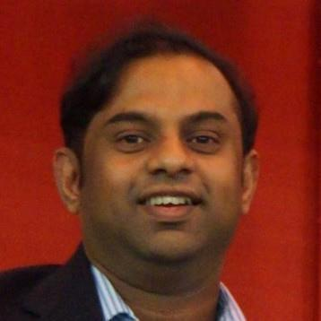
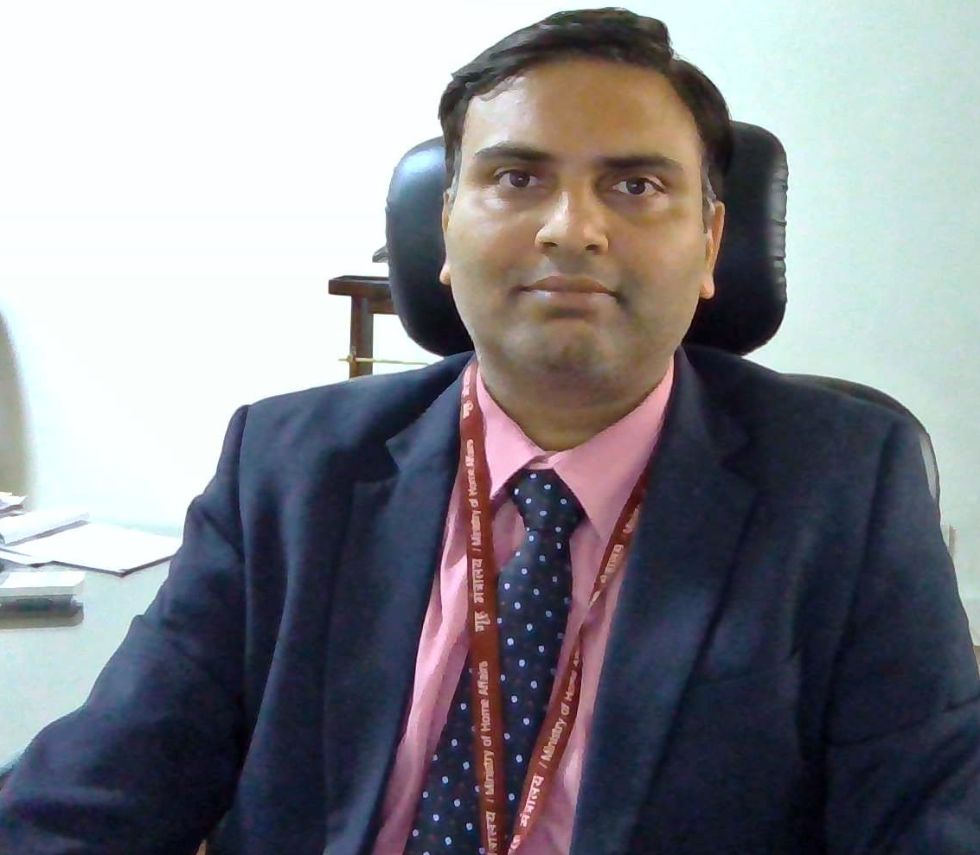

Meet the team
Sathya Krishnasamy
Architect, Technology Management Executive, Domain Expert in Supply chain, International trade logistics, and Payment Integrity and innovation in Health supply chains
Badri Narayanan Ph D
Renowned Economist, Consultant to many entities including WTO, World Bank, IMF, Governments ( ASIA pacific, UK ), and corporates and NGOs worldwide including McKinsey .

Slide 3
APPLICANT : SATHYA KRISHNASAMY / Dr BADRI NARAYANAN
Focuses on MicroSmallandMediumEnterprises
Proprietorship business – 10 K to 1 M USD Loans
At the Low end of Goods and Service Tax( India ) or NOT yet in GST
Exports - Nuetraceuticals, Textiles, Food. Imports – Electronics, Chemicals, Raw Material
Needs access to formal finance
Specific painpoints
Working capital gaps and “Export/ Import” Credits.
Input Tax Credit Receivables, and Export Duty subsidies eventually arrive but puts lot of short-term cash flow deficit
Most of these businesses are operations-oriented and current options for them
are very high in interest rates ( predatory )

Slide 4
Problem Statement
Inefficient Financial Access for Sellers ( Most are local heritage preserving entrepreneur Workers – GI recognized)
A majority of global SMEs in developing economies (Exporters) do NOT have access to formal finance. Alternate options are of high interest rates. This is a high barrier for MSME Trade finance Inclusivity. Per year cross-border trade finance gaps are in Trillions. Please refer to studies by team member – Dr BadriNarayanan.
Financiers / Buyers face Validation Risk
Decentralized solutions are emerging but risks are high and validations are still very difficult
Buyers / Financiers do not know Sellers well enough
Need for Trust Minimized and access controlled yet transparent and traceable solutions
For reducing Buyer and Financier risk,
For reducing the multi-party discrepancies ( starting with the financing need functions)
and Seller( MSMe) Financial options – Ideal end state is multi-financiers

Slide 5
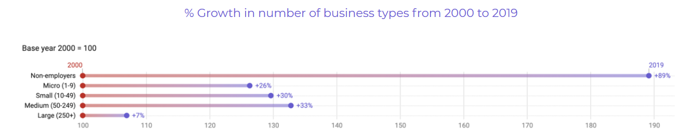
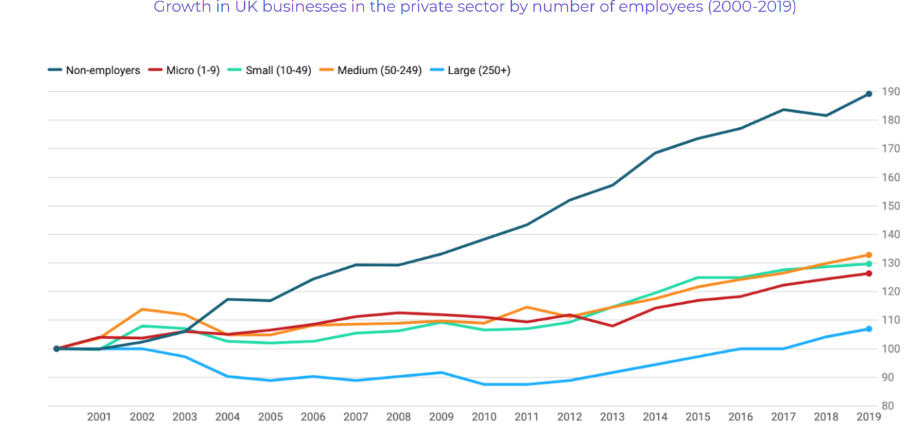
How important are MSMEs
MSMEs are important globally (Davies, Narayanan and Balasubramanian 2021):
Over 95% of all companies are UK & US are MSMEs
90% of all businesses globally are MSMEs, they employ over 50% of all workers
88% of EU companies exporting to USA are MSMEs
They are even more important in developing countries like India, particularly in the context of exports/imports (Chakravarthy, Bharathi, Khire, and Narayanan, 2023): 30% of GDP (40% of emerging economies income globally).
Roughly the total addressable market is about 16 trillion USD – that’s the income generated SMEs globally!

Slide 6
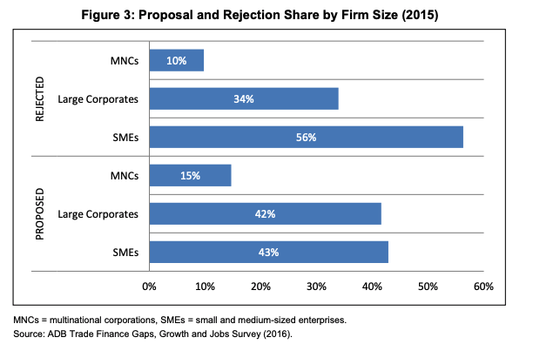
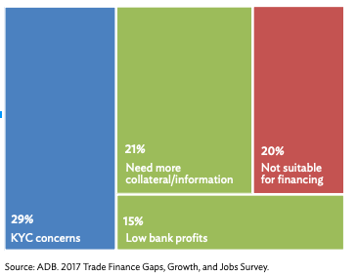
Pain-points in export cash cycle for MSMEs Indication of Opportunity and How Big it is.
EXIM Bank in India, while working on Factoring solutions, found that the export cash cycle was 60-120 days post shipment in India. This is purely for transaction, after all the work has been done.
MSME Finance gap ranges from 10% of GDP in South Africa to 27% of GDP in Brazil, as informal SMEs for 34-58% of formal SMEs in these countries (Narayanasamy, Narayanan and Shivakumar, 2023)
Our research (Dicaprio, Narayanan, McDaniel and Norberg, 2020) finds that using blockchain to solve this trade finance issue could save at least 2-3 trillion USD globally, most gains coming from exports promoted in the developing countries.

Slide 7

Social Cause
Most MSMEs are in industries like agriculture, handicrafts, food processing, weaving etc., which represent heritage activities, livelihoods for the poor, sustainability with implications for emissions and biodiversity
They need systems to collect reliable data and show proof that they are ecofriendly and sustainable.
Scientifically and analytically, this is all done long ago– Narayanan (2003) suggests 20-50% reduction in Todal Dissolved Solids (TDS) if we move to traditional natural dyes developed by MSMEs, instead of chemical synthetic dyes. ➔ time to get into action on the ground

Slide 8
Terminology and current state
Bill of Lading :
The shipping invoice, also called a bill of lading, is a legal document that is required any time a company sends a freight shipment of goods.
A bill of lading is a document of title, a receipt for shipped goods, and a contract between a carrier and shipper. This document must accompany the shipped goods and must be signed by an authorized representative from the carrier, shipper, and receiver. Current paper are and electronic processes are error-prone, costly, and just does not work for inclusivity, as it involves time-sensitive decision making for MSMEs and no tools to support them.
Current State :
A considerable proportion of international trade is financed through banks
Buyer initiated credits though the buyers bank.
Sellers applying for export credit loans
In order to draw this credit
the seller is required to ship the contracted goods and then submit ( most times THROUGH SNAIL MAIL COURIER )appropriate documents to the bank
and eventually importers to take the consignment out from the port of delivery. The loaning companies need insurance on the loan and the insurers underwrite.
The current system only works for Big Buyers.
Hence MOST of the lending for MSMEs in developing nations are INFORMAL with no access to formal credit – and the options are very expensive for the borrowers – Inclusivity for MSME Supply Chain Trade Finance is a big focus item per WEF and WTO.

Slide 9
Focus Areas and Roadmap: EXIM Tokenization, Compliance
Supply Chain/ International Trade Finance :
Web 3 Digitization of SCF / Trade documents with compliance to evolving bills and standards ( Electronic Trade Bill, Model Law for Electronic Traceable Records, CBAM )
Seller Identity though evolving Identity schemes and Decentralized IDs.
Compliance – KYC Needs
Enterprise connectivity to SupplyChain/Trade, ESG
APIs, XRPL Hooks / EVM Sidechains as needed. Oracles for Enterprise connectivity. DCSA standards.
ESG Favorable settlement layer – XRPLedger
End2End Hyper-Efficiencies
Cash Flow Cycle shortening
Proof of Best Regenerative Practices
TradeInclusive solution
Active engagement with multiple trade orgs ( WTO, Global services coalitions, Multiple governments – India, UK, Saudi Arabia etc., and academic / top 3 consulting.
Technical Proof points and prototypes built out based on XRP Ledger
Working with MSMes on pre-launch onboarding for effective MSMe trade finance options.
.

Slide 10
Trade Sync Solution Architecture
DLT based MSME focused SupplyChain / EXIM Financial Inclusivity
Compliance to eBills –Ownership and Uniqueness
- Interpretation and implementation of eBL,ML TDR
- Compliance – Regualtory KYC, EXIM compliance
- Transaction Signatures and Multi-sigs ( where needed )
- Business NFTs
- Mint Wallets, Policies, Original Numbers, Access control
- Transfer of Ownership, and underlying integrity of SCF documents.
- Proof of uniqueness ( electronic and electronic-paper combination)
- Proof of Best practices ( GI , Export carbon offsets compliance)
SupplyChain/EXIM Financial Inclusivity Features
MSME Access Flexibility
- Negotiables – Dynamic Business NFT marketplace for document of titles.
- Non-Negotiables – Dynamic Discounting, Performance based Payments.
- Privacy protected, Yet traceable flows for counterparties for SCF/EXIM finance purposes.
- Broader financial access including multi-financier access
Financiers/ Insurers
- Traceable de-risking
- For financing decisions – more broader decisions than big-buyer credit based.
.

Slide 11
Focus Areas and Roadmap: EXIM Tokenization, Compliance
Supply Chain/ International Trade Finance :
Web 3 Digitization of SCF / Trade documents with compliance to evolving bills and standards ( Electronic Trade Bill, Model Law for Electronic Traceable Records, CBAM )
Seller Identity though evolving Identity schemes and Decentralized IDs.
Compliance – KYC Needs
Enterprise connectivity to SupplyChain/Trade, ESG
APIs, XRPL Hooks / EVM Sidechains as needed. Oracles for Enterprise connectivity. DCSA standards.
ESG Favorable settlement layer – XRPLedger
End2End Hyper-Efficiencies
Cash Flow Cycle shortening
Proof of Best Regenerative Practices
TradeInclusive solution
Active engagement with multiple trade orgs ( WTO, Global services coalitions, Multiple governments – India, UK, Saudi Arabia etc., and academic / top 3 consulting.
Technical Proof points and prototypes built out based on XRP Ledger
Working with MSMes on pre-launch onboarding for effective MSMe trade finance options.
.

Slide 12
CODE BASE
GITHUB Pointers
https://github.com/chainaimlabs/tradesync-dapp-react-solidity-xdc3-plugin
Please look at the master branch for the demo App and the pre-launch app.

Slide 13
What are we looking for?
Ecosystem Partnerships in XRPL
Incubation – Legal, Entity setups
Working relationships
Grants / Access to capital for further enhancements

Slide 14

References
https://www.wto.org/english/res_e/booksp_e/tradefinsme_e.pdf
https://www.visualcapitalist.com/decentralized-finance/
https://www.icsiindia.in/msme.php
https://economictimes.indiatimes.com/small-biz/sme-sector/choked-by-dues-what-efforts-are-being-taken-to-ease-the-biggest-problem-faced-by-indian-msmes/articleshow/71869751.cms?from=mdr
https://sahamati.org.in/blog/use-cases-for-account-aggregator-framework/
https://www.tradefinanceglobal.com/
https://www.financialexpress.com/industry/sme/msme-fin-delayed-payments-only-these-many-msmes-recovered-their-dues-majority-cases-pending-with-these-buyers/1889207/
https://saadhaan.msme.gov.in/MyMsme/MSEFC/MSEFC_Welcome.aspx

Slide 15
Current Market and Opportunity in just 1 CORRIDOR
Unmet demand for trade finance in Africa is US$ 120 billion (one-third of the continent’s trade finance market) and US$ 700 billion in developing Asia.
Total of 63.4 Million MSMEs in India. Contributes 45% of overall exports. 90-120 Days Receivables Cycle
Almost 90% of small business in india still have no links with formal financial institutions. IFC estimates debt demand gap of Rs 36.7 lakh crores.
Government efforts to disburse credit still not effective. Banks hesitant for small business lending.
COVID recovery needs dynamic adaptation. ( Needs standardized interfaces and weights to balance between traditional metrics and to move to flow-based)

Slide 16

Any Questions

