Slide 1
Itara
One open model, one memory and one KV cache for your whole team. The closed model only when it's needed.
−57%
2.3 s
0
spend on the closed model, at the same accuracy on code
median answer in fast mode, instead of 12.2 s
cached tokens one team can reach of another's
Notes:
Every engineer on a team sends the same code and docs to an expensive closed model, again and again, and the company pays for that context every time. Itara is a self-hosted gateway a whole team shares. On code, it cuts the closed-model bill by 57 percent at the same accuracy. In fast mode it cuts 68 percent, and answers come back in about two seconds.

Slide 2
One gateway the whole team shares
Itara, self-hosted
Llama on vLLM
answers what it's sure of
Any app
chat UI, coding agent, script
Muse Spark
the closed model, given compact memory
Shared team memory
compressed once; each team sealed off
OpenAI API
KV cache keyed by team
teammates reuse each other's work
Confidence gate
only unsure drafts go to Muse
Notes:
It speaks the OpenAI API, so any app or coding agent just changes its base URL. Behind it: Llama on V L L M. A team memory in Postgres, sealed per team by row-level security. A K V cache keyed by permission. And Muse Spark, Meta's closed model, called only when Llama isn't sure.

Slide 3
Live: two teammates and another team
Your screen recording goes here
itara demo in the terminal, the dashboard's Live page beside it
Notes:
Alice adds the team's code. Llama compresses it once, for everyone. She asks where the spend cap is enforced: it stays on Llama, and the path lights up green. Bob asks a related question, and reuses the cache Alice's question already paid for. Then Bob asks a hard design question. Llama isn't confident, so it goes to Muse, in violet, with the team's memory summaries instead of raw files. Olga, on another team, sees none of it: her memory and her cache are sealed off. Every token is counted, and a spending cap is checked before every Muse call.

Slide 4
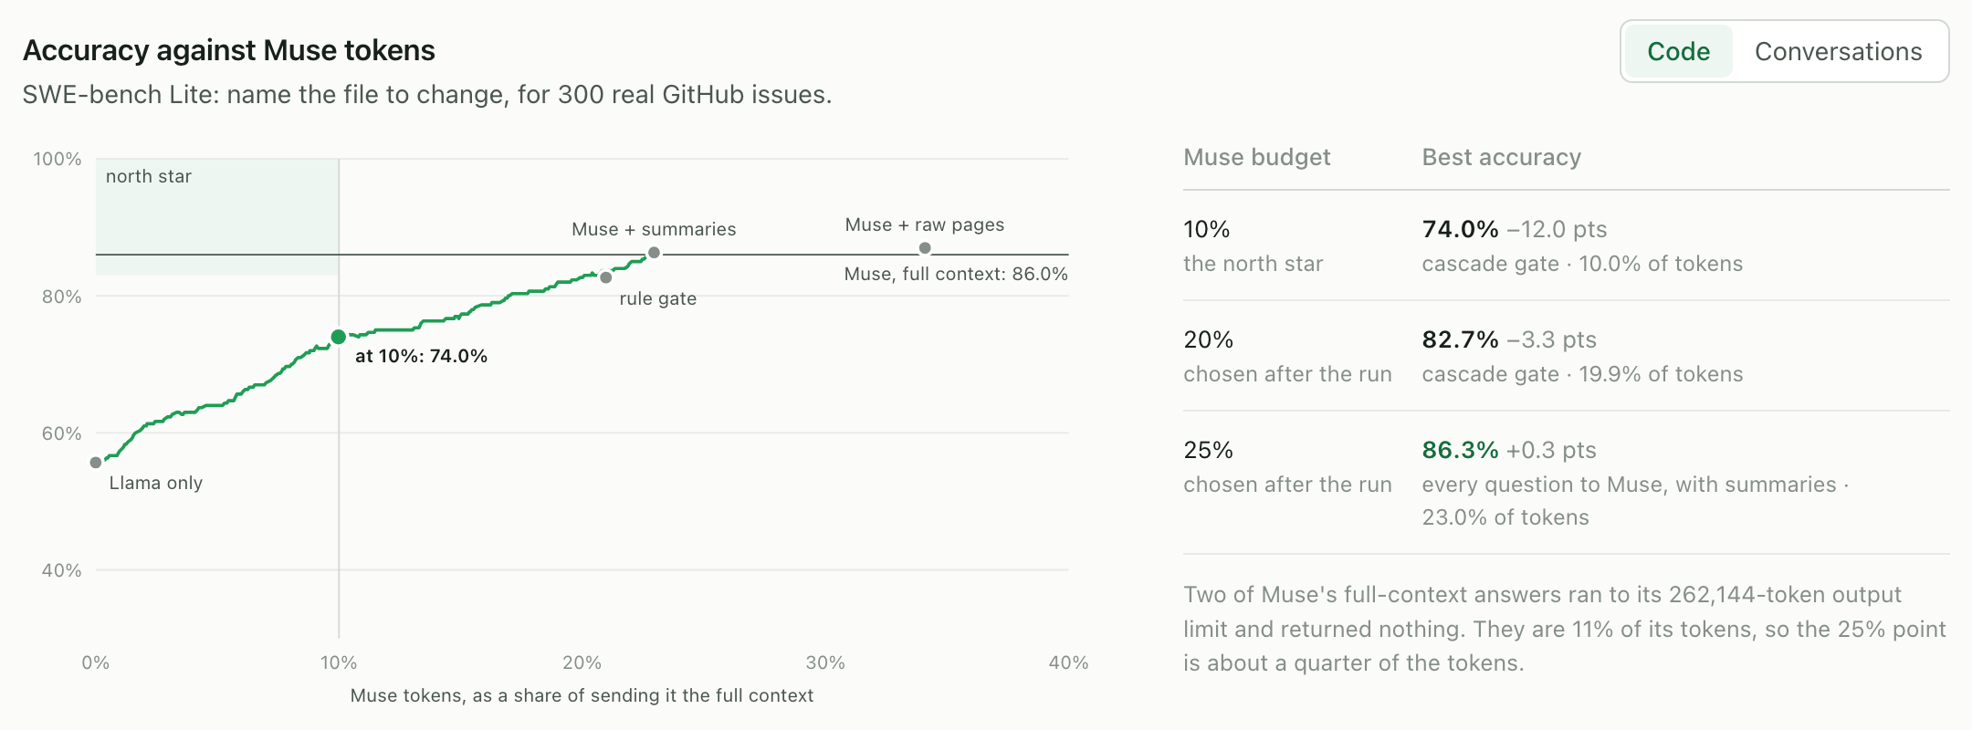
On code: Muse's accuracy for 57% less
All 300 SWE-bench Lite issues on the real models: 86.3% with team memory against 86.0% with the full context.
Notes:
Across 300 real GitHub issues, Muse with the team's memory matches its full-context accuracy, 86.3 against 86 percent, for 57 percent less, GPU included. In fast mode, Llama answers what it's sure of: 68 percent less, 2.3 seconds per answer, at 74 percent.

Slide 5
Llama's own confidence beats an off-the-shelf router
Code accuracy at 10% of Muse's tokens, same 300 issues
0.53
Random escalation
67.5%
how well RouteLLM spots Llama's wrong answers (0.5 is chance)
RouteLLM router
68.3%
0.65
the same for Llama's own confidence, Itara's gate
Itara cascade
74.0%
Bars start at 50%.
Notes:
Why not an off-the-shelf router? RouteLLM decides from the question alone, and it can barely tell when Llama will be wrong. Llama's own confidence can: on a tight budget that's 74 percent against 68.

Slide 6
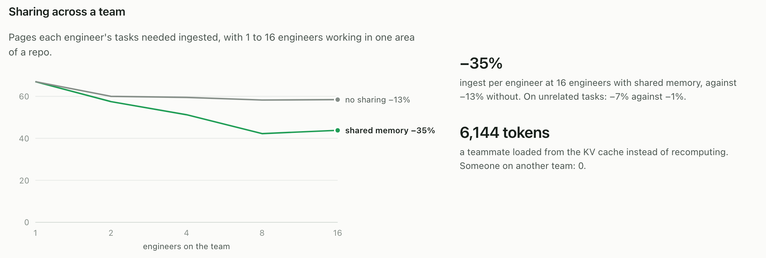
Sharing scales with the team
Notes:
Sharing scales. At 16 engineers, the work per engineer falls 35 percent with shared memory, against 13 percent without. A teammate reused 6,144 cached tokens; someone on another team, none.

Slide 7
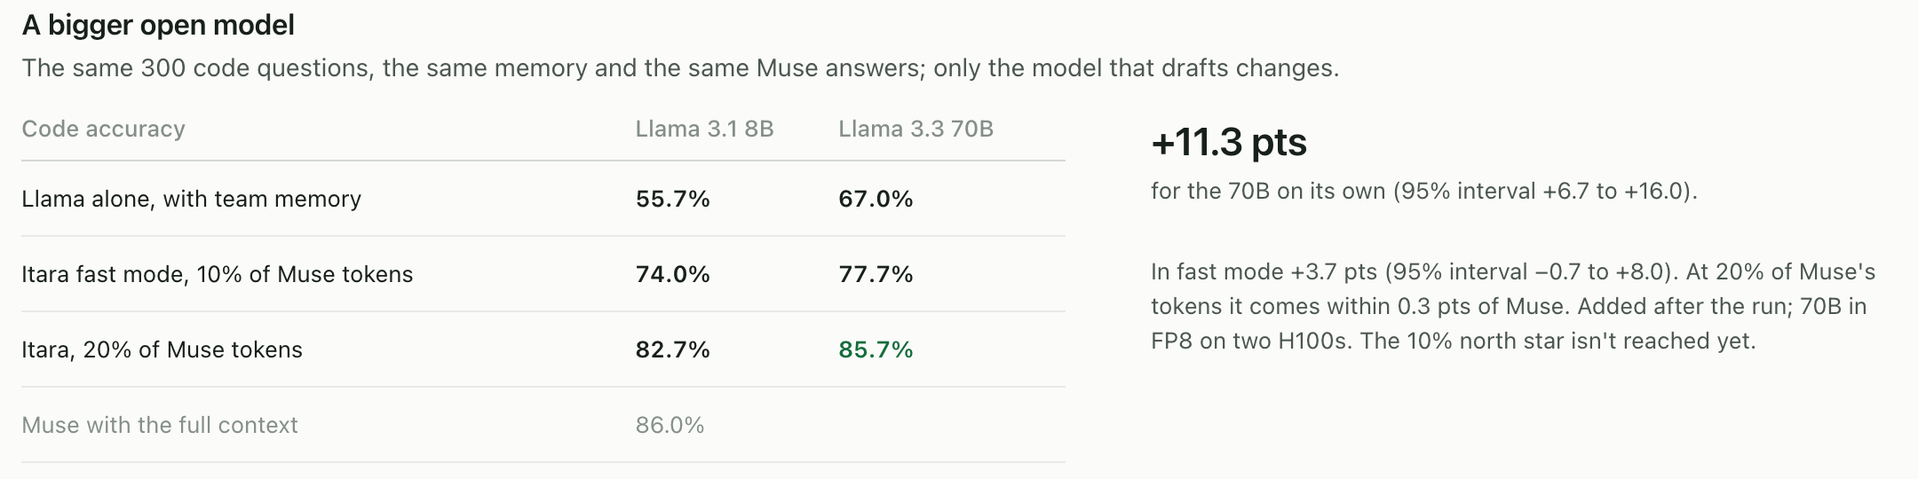
A bigger open model moves us toward the north star
North star, set before the run: Muse's accuracy at 10% of its tokens. Not reached yet. The 70B run was added after.
Notes:
We set a north star before the run: Muse's accuracy at a tenth of its tokens. We're not there yet: 74 percent with the 8 B model. So we then tried Llama 3.3 70 B, with the same memory. On its own it gets 67 percent instead of 56. Fast mode rises to almost 78, and at a fifth of the tokens it comes within 0.3 points of Muse. A perfect judge of its drafts would already hit the north star, so a better judge is next. Long conversations are harder, and retrieval is next there.

Slide 8
Self-host it in four steps
1
git clone https://github.com/chainerprince/itara.git
clone it
2
uv sync
installs the itara command
3
cp .env.example .env
point it at your open and closed models
4
uv run itara up
Postgres, the gateway and the dashboard
Built for the Meta Global AI Developer Hackathon, adapted from the ai-os project, by Prince Mutegetsi with Claude Opus 5.5. PyPI is next.
Notes:
A shared K V cache needs the model's internal state. No closed API exposes it, so this layer has to be open weights: Llama. Itara installs from GitHub today: clone it, run U V sync, then itara up. PyPI is next. Itara. Each piece of your team's knowledge, paid for once.

