Slide 1
Performance Report 10
Connor Haines

Slide 2
Portfolio Description
This is a long-only, buy-and-hold portfolio made up of US Mid Cap stocks. Portfolio optimized Sharpe Ratio by using the output from a Black-Litterman model with views formed through a combination of ARMA GARCH forecasting and discretionary perspectives. Portfolio was formed on 1/12/17 and has held all positions constant since then.

Slide 3
Allocation Strategy
Step 1: Use discretion to choose 20 possible US Mid Cap Stocks. All stocks chosen make up a material portion of IJH, the benchmark portfolio.
Step 2: Forecast returns using ARMA-GARCH forecasting.
Step 3: Use Black-Litterman model with views formed as a mixture of forecasted returns and discretionary views to optimize max sharpe ratio portfolio.
Step 4: Evaluate portfolio performance relative to the benchmark and a historical max sharpe ratio portfolio, paying particular attention to measures of risk.

Slide 4
Market Commentary

Slide 5
Macro Commentary
Housing starts fell sharply this month (1.215m vs 1.262m consensus), as did manufacturing production (-0.4% M/M), leading to further doubt over the strength of the economy during the first quarter.
10-yr treasury yields have fallen sharply over the last week to 2.18%.
Retail sales fell 0.2% in March, while the February number was revised four tenths lower.
CPI fell 0.3% in March, while core CPI fell 0.1%.

Slide 6
Market Commentary
UK Prime Minister May has announced she aims to hold the next UK election on June 8th, well ahead of the next scheduled election in 2020. Analysts say she is hoping for a convincing win to strengthen the conservative’s position in parliament. The House of Commons will vote on the proposition today.
The Dow posted a sharpe 0.6% loss to 20,404 on Tuesday, but stocks were mixed with the Nasdaw up 0.2% to 5,863.
Oil fell by around 4% ($2 a barrel) on Wednesday, it’s most in 6-weeks.
Earnings season kicks off this week, with generally high expectations for a profitable quarter.

Slide 7
Portfolio-level Analysis

Slide 8
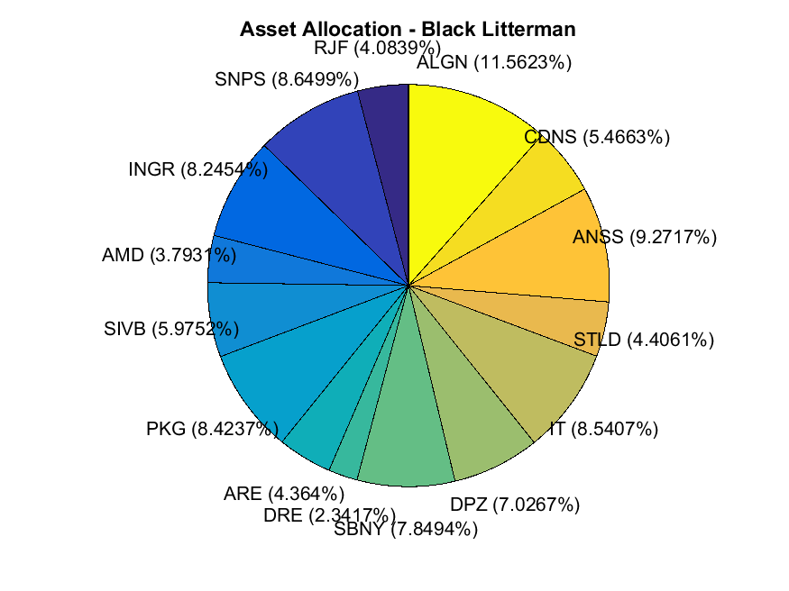
Asset Allocation

Slide 9
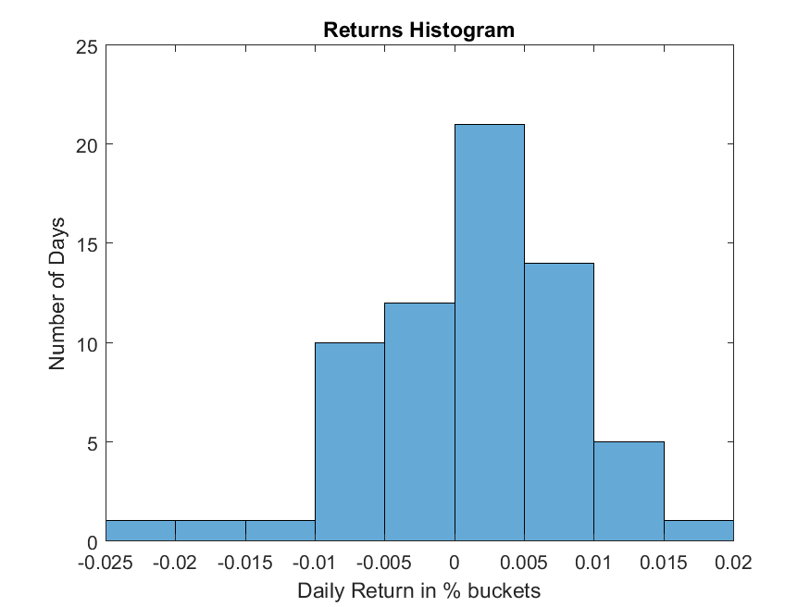
Histogram of Returns

Slide 10
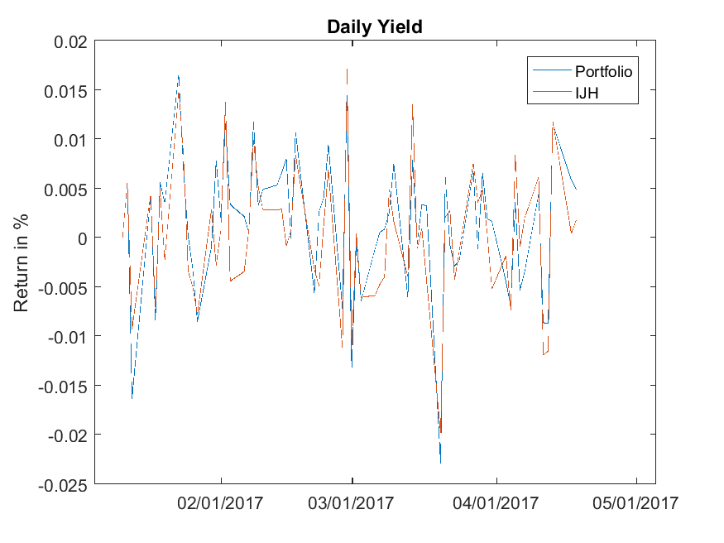
Daily Returns Compared to Benchmark

Slide 11
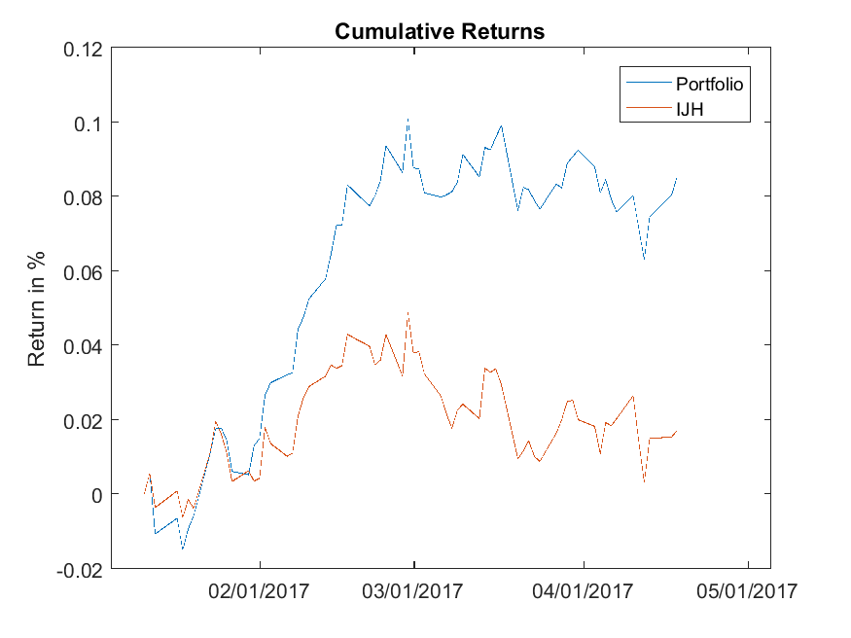
Cumulative Returns Compared to Benchmark

Slide 12
Performance Statistics
 | Portfolio | Benchmark
 | Since Inception | Since Inception
Cumulative Return | 0.085366973750048203 | 0.017203618910542229
Sharpe Ratio | 0.15880032152062556 | 0.013904224583995694
Mean Return | 0.0012934389962128516 | 0.00026066089258397317
Max Port Value | 1106183.0978933352 | 1049353.9124192391
Min Port Value | 985116.18517744844 | 993658.77004067961

Slide 13
Black Litterman Portfolio compared to Backwards Max Sharpe Portfolio

Slide 14
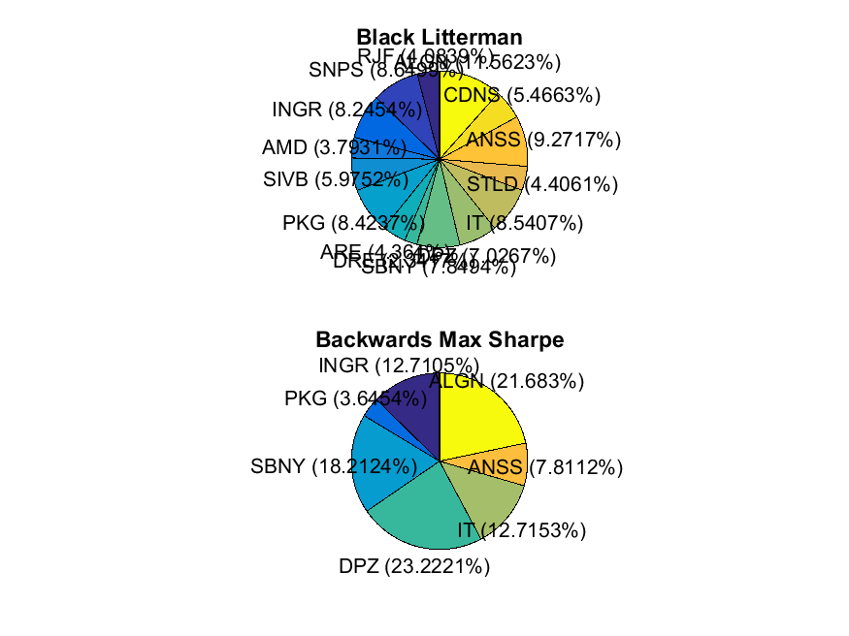
Asset Allocation - Black Litterman vs. Backwards Max Sharpe

Slide 15
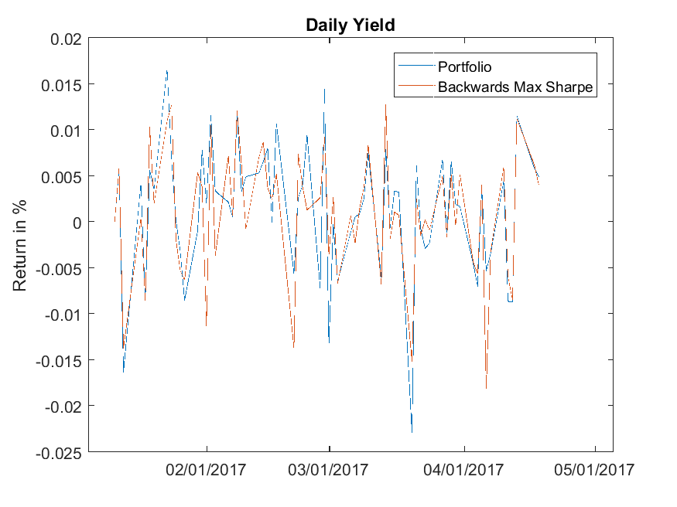
Daily Returns Compared to Backwards Max Sharpe

Slide 16
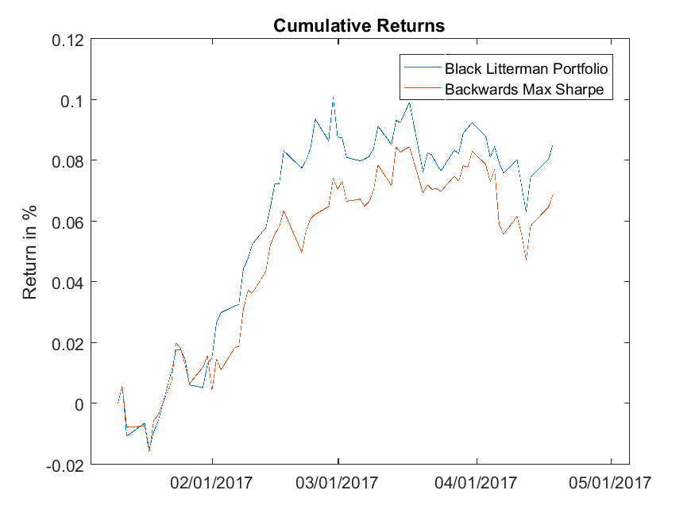
Cumulative Returns Compared to Backwards Max Sharpe

Slide 17
Performance Statistics
 | Portfolio | Backwards Max Sharpe
 | Since Inception | Since Inception
Cumulative Return | 0.085366973750048203 | 0.068778248452003865
Sharpe Ratio | 0.15880032152062556 | 0.12662975183266942
Mean Return | 0.0012934389962128516 | 0.0010420946735152101
Max Port Value | 1106183.0978933352 | 1088198.6329242839
Min Port Value | 985116.18517744844 | 984130.55951738241

Slide 18
Risk Comparisson Across Portfolios

Slide 19
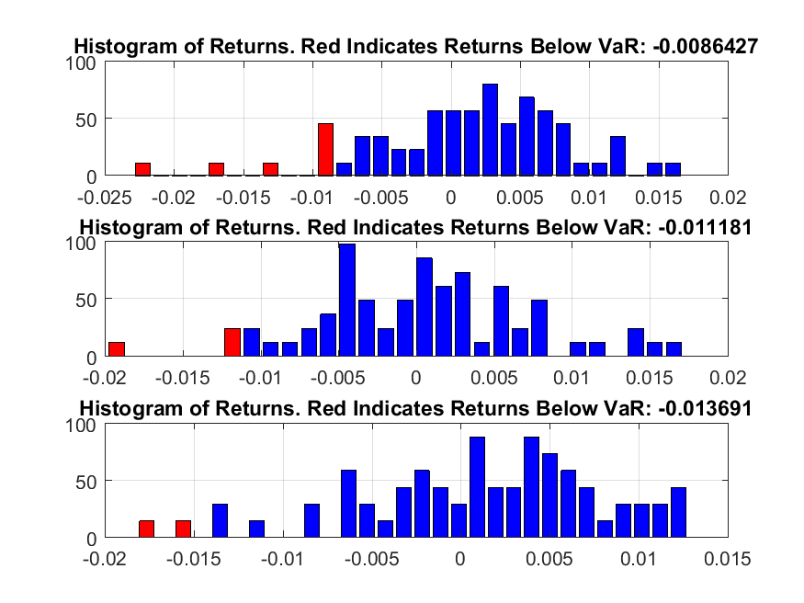
Historical Var - (top to bottom) Black Litterman - Benchmark - Historial Max Sharpe

Slide 20
Risk Statistics
 | Portfolio | Benchmark | Backwards Max Sharpe
 | Since Inception | Since Inception | Since Inception
Standard Deviation | 0.0071661188481755853 | 0.006997135923405973 | 0.0069866015161653104
Skew | -0.70528435148627333 | 0.0080689074294385058 | -0.58969829411417041
Kurtosis | 4.0948012815394819 | 3.3052163940608734 | 3.0692325593995124
Max Drawdown | 0.037159312308629282 | 0.045493415426714465 | 0.036569129567914201
Historical VaR | 0.0086426758992566022 | 0.01118119266055051 | 0.013690845718086209
Gaussian VaR | 0.010493777582374068 | 0.011248603509302782 | 0.010449842170413958

Slide 21
Closing Thoughts
Of the three portfolios, my portfolio performed the best, outperforming the benchmark and historical max sharpe ratio portfolio in terms of cumulative returns and sharpe ratio. Overtime, my portfolio pulled away from the benchmark portfolio and ended up with close to 6% higher returns. However, throughout the investment horizon, my portfolio tracked closely with the historical max sharpe ratio portfolio. I think this makes sense. Both the black litterman model and the historical sharpe ratio portfolio use a variation of finding a historical efficient frontier. BL does this through starting with a market equilibrium distribution of assets, and then using a historical CAPM model (which has an efficient frontier implicit within it) combined with the user inputed views. This returns a BL output that is then inputted into a sharpe ratio optimizer. The real advantage to using a Black Litterman model is that it results in a less concentrated asset distribution than the historical max sharpe ratio portfolio. The asset distributions on slide 14 show this clearly. The risk analysis on the previous slide shows that so far, the risk characteristics of the two portfolios have been similar, however over a longer time horizon and/or if markets become more volatile, the greater diversification in the Black Literrman model could prove useful. Additionally, views inputted into the Black Litterman framework have resulted in a portfolio that has outperformed the historical max sharpe ratio portfolio by ~1.7% since the beginning of the investment horizon.

