Slide 1
How to create a successful Kickstarter campaign?
Best length of time
Ideal pledge goal
Successful type of projects
Ideal month/day/time to launch
Conclusion
From the Perspective of Products
(DSI Interview Task of GA)
Chengpi Wu
2021.10.1

Slide 2
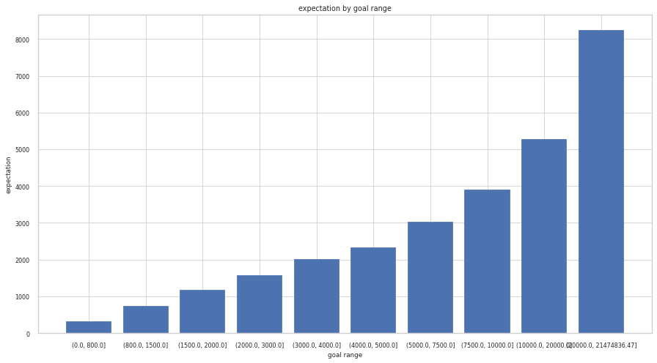
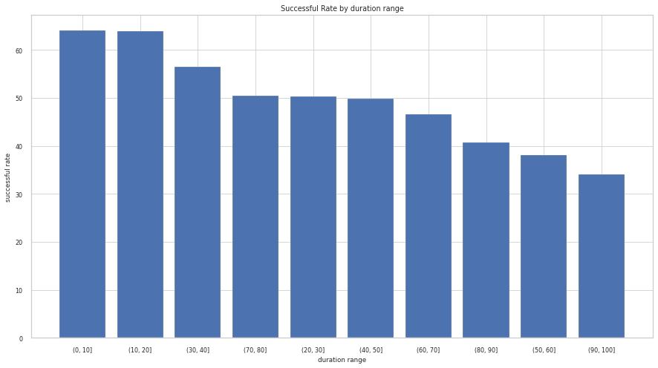
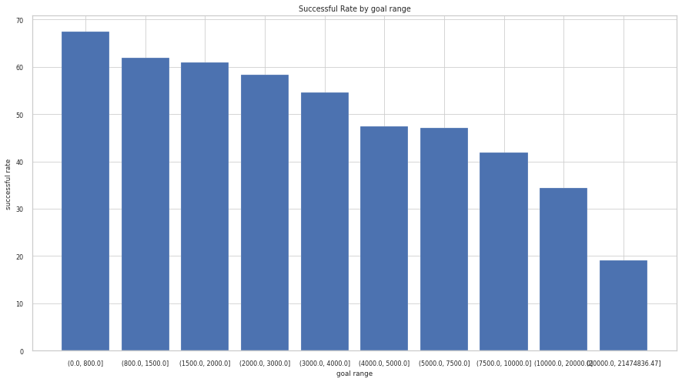
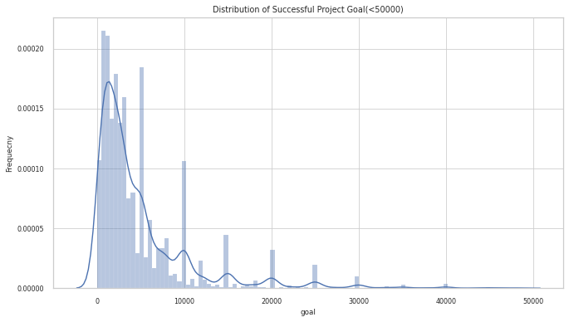
Best length of time to run a campaign, Ideal pledge goal
The shortest duration is the best for success.
The ideal pledge goal depends!
goal_range | success%
(0.0, 800.0] | 67.4
(800.0, 1500.0] | 61.9
(1500.0, 2000.0] | 61.0
(2000.0, 3000.0] | 58.3
(3000.0, 4000.0] | 54.5
(4000.0, 5000.0] | 47.5
(5000.0, 7500.0] | 47.2
(7500.0, 10000.0] | 41.8
(10000.0, 20000.0] | 34.3
(20000.0, 21474836.47] | 19.1
duration_range | success rate%
(0, 10] | 64.1
(10, 20] | 63.9
(30, 40] | 56.5 ---
(80, 90] | 40.7
(50, 60] | 38.0
(90, 100] | 34.1

Slide 3
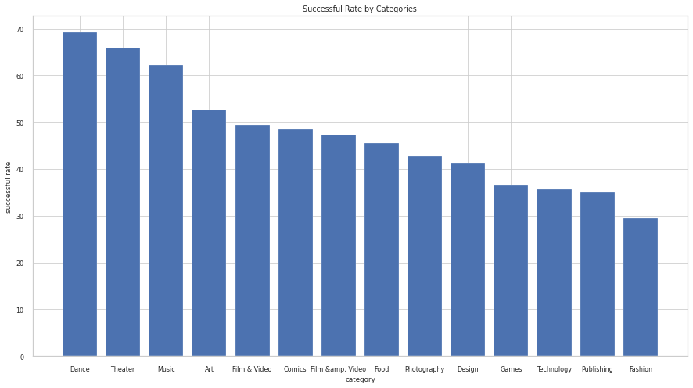
Successful type of projects
category | %
Dance | 69.3
Theater | 65.9
Music | 62.2
Art | 52.8
Film & Video | 49.4
Comics | 48.5
Film &amp; Video | 47.3
Food | 45.5
Dance
Theater
Music
Art
Film & Video

Slide 4
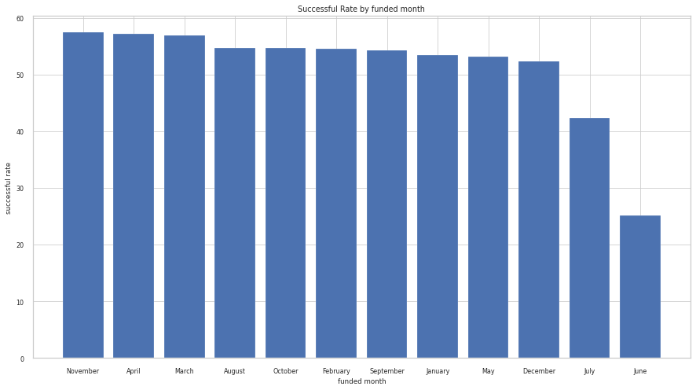
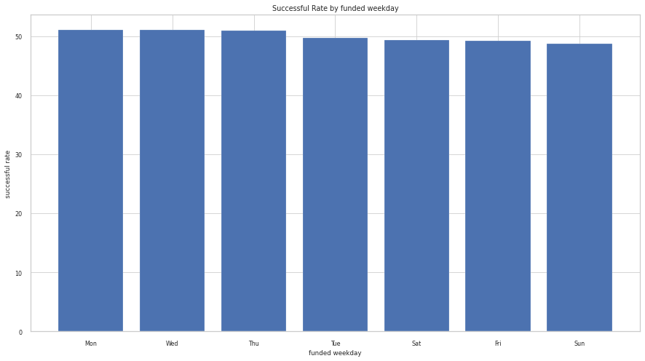
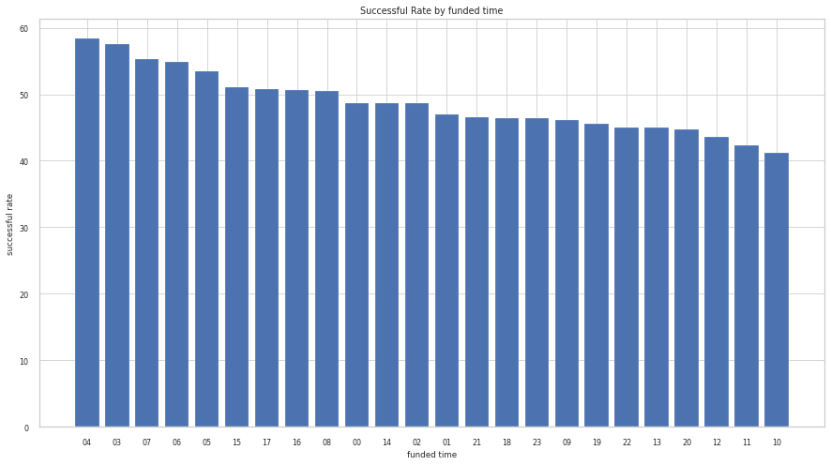
Ideal month/day/time to launch a campaign
Best month is Nov(57.5%)(>April(57.1%)>March(56.9%), best time is in the morning ([4,5](58.4%)> [3,4](57.6%)> [7,8](55.3%) > [6,7](54.9%)), but there are no significant differences between weekdays statistically(Mon(51.09%)>Wed(51.05%)>Thur(50.99%)). Don’t launch a project in June(25.1%) and July(42.4%).

Slide 5
Conclusion
Here are my recommends:
Shorter duration would give more confidence to backers.
The ideal pledge goal depends on many factors.
Connecting the project to entertainment industries such as dance, theater, music or art could attract backers.
Better in the morning. The weekday and month doesn’t matter usually, excepting June/July. Don’t do it.
More:
There are a lot of attributes data could be collected and analyzed. The data given is mainly based on the projects. However, there are three main categories of the data: founders, projects, and backers. For example, the personality type of the project founders are critical for a successful project. We could design a survey to collect the information of the project founders. On the other hand, we need to understand the behavior of the backers. We don’t know how many backers from the given dataset. We could collect the data of viewing behavior such as mostly clicked buttons or inner links, or any other elements. We could also design some surveys for the backers. In conclusion, more interesting data could be added to this project.

