Slide 1

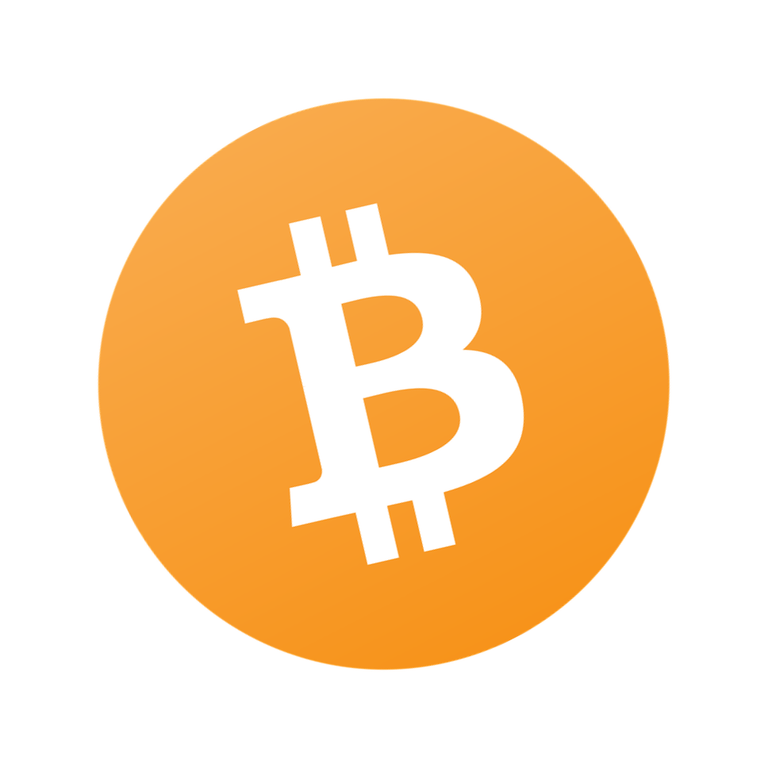
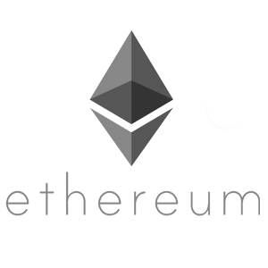
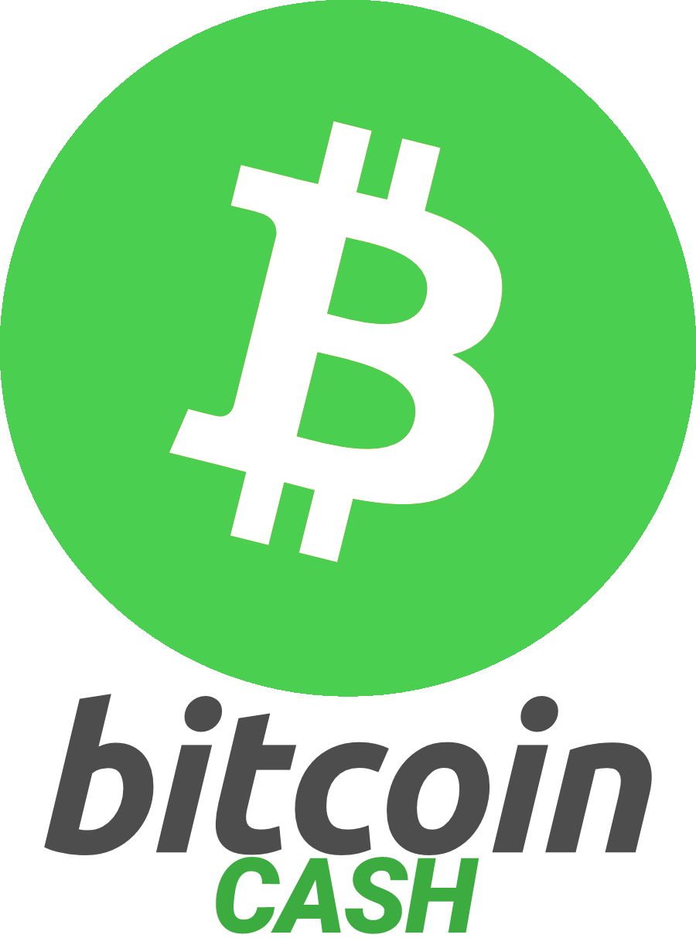

Introduction to Cryptocurrencies for Finance Students

Slide 2
First, a Little About Me
2017 CS Graduate from St. Vincent
Software Engineer at Microsoft (Azure Storage)
Don’t have a formal finance background
Cryptocurrency tech enthusiast!
  Run a hobby website called chaintuts.com
  Interested in cryptocurrency technology and the financial/societal implications
  Don’t believe in crypto speculation/investing

Slide 3
Bitcoin Basics
What is Bitcoin? -
  “The Internet of Money” - Andreas Antonopoulos (Technologist, Security Expert, Bitcoin Evangelist)
  A protocol for creating, managing, and transferring money entirely over computer networks

Slide 4
Important Properties of Bitcoin
Bitcoin is decentralized
  No central authority controls it – no government, corporation, or individual
  Peer to peer network controls issuance, transfers, security
    Think P2P network likes bittorrent, etc.

Slide 5
Important Properties of Bitcoin
Bitcoin is cryptographically secured
  Properties of cryptography secure the issuance and transfer of the currency
  Uses the concepts of digital signatures, proof-of-work, and blockchain databases to do so

Slide 6
Important Properties of Bitcoin
Because of decentralization and cryptographic security,
Bitcoin is Trustless

Slide 7
Technical Components
Blockchain Databases
  Transactions are grouped together and processed every 10 minutes
  Groups are called blocks
  Each block is cryptographically linked to the last block
  Because of linking, further back blocks become nearly impossible to forge

Slide 8
Technical Components
Proof of Work
  Every block, thousands of computers on P2P network race to solve a cryptographic puzzle based on transactions
  This puzzle can only be solved by guessing using CPU power (hence “Proof of work”)
  Proof of work (answer) can be quickly verified by any other party on network
  Winner of race gets reward of new currency

Slide 9
Technical Components
Digital signatures
  Each wallet user has “private keys” that cryptographically prove they own a public address
  Address is public and funds shown on blockchain
  Can’t go backwards from address to private key

Slide 10
The Value of Bitcoin
Why does Bitcoin have Value?
  Unique Properties make it Useful
    People have faith in its utility and future uses
  Because it is useful, people will expend real world resources (electricity and computing power) to maintain the network

Slide 11
Financial Implications
Less need for “trusted” institutions
  End the fed? You could with bitcoin!
    Instead of endless inflation, you have a limited supply, deflationary currency
  No need to trust third parties to process transactions
    Censorship resistant
    More secure tx verification – No more worrying if Visa, Target, etc. get hacked

Slide 12
Financial Implications
Individual control for digital money
  Unlike credit cards, bitcoin behaves like digital cash!
  You hold private keys, you hold the money
  Security model is much harder to breach (network is secure, have to target individuals)

Slide 13
Societal Implications
Banking the Unbanked
  Imagine you’re a migrant worker in the US
  It could cost you 30-40% to wire funds back home across borders
  Bitcoin is borderless and low fee
  Many 3rd world economies have cell phone towers, but not banking infrastructure

Slide 14
Societal Implications
Banking the Unbanked
  Imagine you’re a Palestinian living in the West Bank under military rule
  Confiscation and repression of free exchange are a large risk
  Bitcoin can freely flow in and out
  Bitcoin cannot be easily confiscated! Even if a device is stolen, a 12 word phrase can back up an entire wallet

Slide 15
Final Thoughts
Bitcoin is an entirely different way to do money in the digital age
Decentralization and trustlessness gives power to the people instead of powerful, corrupt institutions
This is just scratching the surface...the use cases are numerous...

Slide 16
Recommended Resources
Andreas Antonopoulos
  Youtube channel
  AA on the Joe Rogan Experience podcast
  Mastering Bitcoin (technical) and The Internet of Money
The Bitcoin Whitepaper (technical, but a solid summary)
Bitcoin.com, bitcoin.org, en.bitcoin.it
  Be wary of bias – there are some divisions in BTC community

Slide 17
Do You Like Free Stuff??
You’re in college, of course you do
  Go to app store of your choice or bitcoin.com
  Download the bitcoin.com wallet
  Set up a Bitcoin Cash wallet (not Bitcoin Core)
  See me as time permits for some free Bitcoin Cash!

Slide 18
Questions?

