Slide 1





Visualizing
Proof-of-Work Algorithms using
MicroProcessors

Slide 2
A Little About Me...
Software Engineer @ Microsoft in Pittsburgh
Run https://chaintuts.com creating Bitcoin & blockchain related tutorials
  On YouTube, Twitter (@chaintuts), Github (chaintuts)
  Articles, Videos, and Code
  Check it out and share!
Interested in how the tech works and its societal & financial impacts

Slide 3



Why Proof-of-Work?
Traditional financial systems required trust in a central authority
Ex: Bob pays Alice via PayPal – PayPal verifies Bob has funds, deposits in Alice’s account

Slide 4
Why Proof-of-Work?
Bitcoin is decentralized and peer-to-peer
But this comes with problems!
  How do we prevent fraudulent transactions like double-spends, etc.?

Slide 5
Blockchain & POW
Everyone running Bitcoin software gets a copy of a distributed ledger called the blockchain
  Like a spreadsheet that shows all transfers – we can infer address balances from this
Every 10 minutes, pending txs batch processed into a new “block”
This batch processing contains a security “challenge” called proof-of-work

Slide 6
Blockchain & POW
Each “block” contains tx data + proof of work nonce (a random number)
This gets run through a one way function called a hash
Block hash has to meet security challenge requirements
Tx/Block
metadata
Block hash
+
Nonce
One way
Hash function

Slide 7
Blockchain & POW
Only way to find nonce that meets guidelines is to guess a bunch of times – no formula or predictable outcome
Once the answer is found, anyone can verify in one step!
Bitcoin nodes share and verify the shared blockchain ledger so that the rules are followed

Slide 8
Blockchain & POW
Network ignores malicious blocks that don’t fit the rules
Attackers would have to out-solve the rest of the Bitcoin network – nearly impossible at scale!
BTC: ~75 quintillion attempts / sec
BCH: ~2 quintillion attempts / sec
ETH: ~170 trillion attempts / sec
LTC: ~400 trillion attempts /sec
BTC: ~75 quintillion attempts / sec
BCH: ~2 quintillion attempts / sec
ETH: ~170 trillion attempts / sec
LTC: ~400 trillion attempts /
Hypothetically attacker: 100 billion attempts / sec?

Slide 9
What is the POW - “Security Challenge”?
Hashes (result of the one way function) are just numbers represented in binary
The challenge is to find a nonce such that the resulting hash is less than the difficulty target
The lower the difficulty, the longer it takes to find an answer!!
  Bitcoin adjusts target so a solution is found and a new block is processed about every 10 minutes

Slide 10
Our POW Simulation
Tx/Block
metadata
Block hash
+
Nonce
One way
Hash function
Random number
8 bit hash
Random data

Slide 11
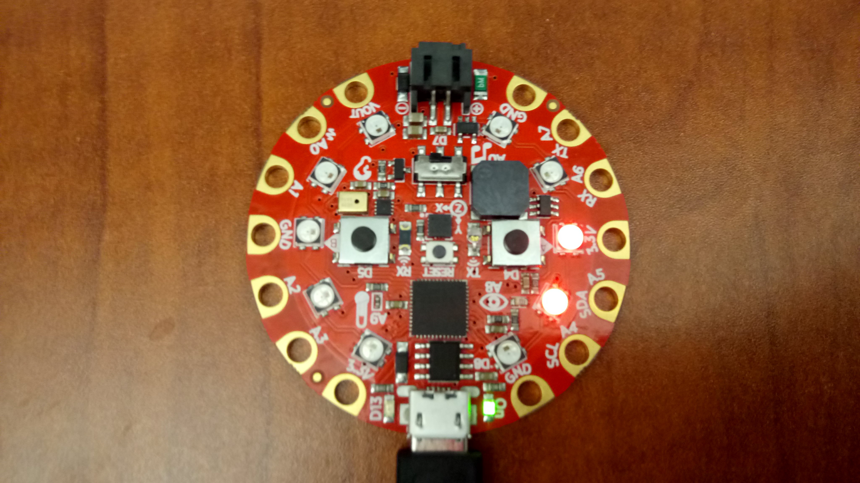
Our POW Simulation
The difficulty target menu – press B to set difficulty from 1 – 7
  Let’s do a sample run at 2
Accessibility: Shake
the board to turn on
“sound mode”

Slide 12
Our POW Simulation
Optional – ensure toggle switch is set toward the “Ear”, Vout, A0
  Enables logging so you can see attempts across runs

Slide 13
Our POW Simulation
Start simulation by pressing A
  LEDs will flash attempts represented in binary!!

Slide 14
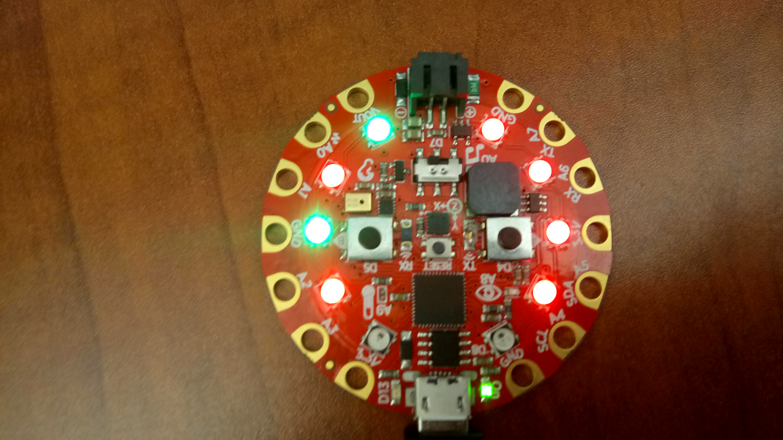
Our POW Simulation
When a solution is found, LEDs will stay lit!
Final “block hash”:
0 0 0 0 1 0 1 0

Slide 15
Our POW Simulation
8 bit numbers:
0 0 1 0 0 0 0 0
128 64 32 16 8 4 2 1
1 0 0 1 1 1 1 1
…
0 0 0 0 1 0 1 0
Target hash is 32 or less
Guess 1 – Hash is 159
Guess n – Hash is 10 Solution is found!!

Slide 16
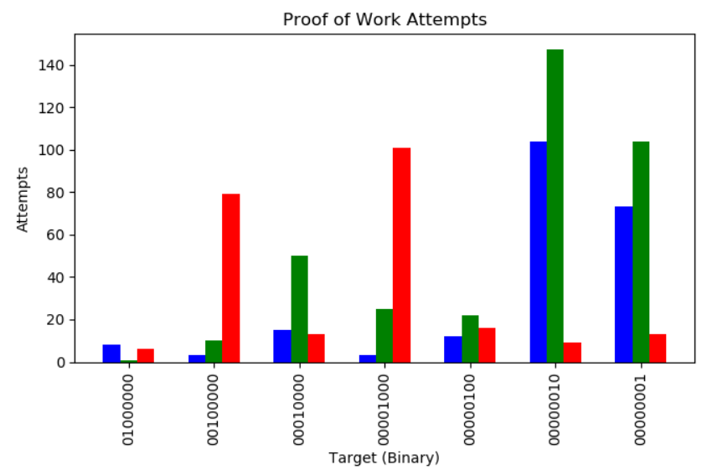
Our POW Simulation
Lower target = lower probability of a guess being a solution (more difficult)

Slide 17
Our POW Simulation
If you’d like – do this visualization yourself after a few runs!
  https://chaintuts.com/graph_pow.py
  Plug in Circuit Playground
  Copy `pow_log.csv` to your machine and run Python script in the same directory

Slide 18
Simulation vs. Real Bitcoin
Size of numbers
  Our simulation is 8 bit (0 – 255)
  Bitcoin uses 256 bit numbers (0 – HUGE)

Slide 19
Simulation vs. Real Bitcoin
Variables – Computing Power, Time, Difficulty
  Our simulation is one dimensional – takes longer as problem gets harder
  In Bitcoin, the more power that runs in parallel (all the mining nodes), the harder the problem is made to keep block time at 10 minutes
  The more power on the network, the harder fraud is!

Slide 20
Questions?

