Slide 1






Cryptocurrency
Security
Fundamentals

Slide 2
A Little About Me...
Software Engineer @ Microsoft in Pittsburgh
Run https://chaintuts.com creating Bitcoin & blockchain related tutorials
  Articles, videos, and code projects
  On YouTube, Twitter, Github
  Support: Patreon, Crypto, Spreadshirt Apparel
Focus is on understanding & teaching core concepts

Slide 3

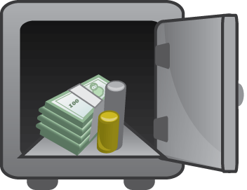
First, A Quick Disclaimer
Security is a complex, evolving topic
There is not a one size fits all solution
Know your threat model, and learn about tools you can use
We’ll discuss some Bitcoin fundamentals and the surrounding security tools

Slide 4


The Core of Crypto Ownership:
Private Keys
0x12351bc143badf2348fe38e8f8b785b...
PRIVATE KEY
Elliptic Curve (secp256k1)
PUBLIC KEY
0x04135981abcd7f7a7d7b7c720….
“Double hash” (SHA-256 and RIPEMD160)
And Base58check encoding
ADDRESS
(PUBLIC KEY HASH)
1MT3uNoFLP82j2aSD5Qtibm2kXJ7RWumAM

Slide 5
The Core of Crypto Ownership:
Private Keys
Private keys are what we need to keep safe the most!
Keys are never shared – only used to “sign” your transactions, proving you own funds
0x12351bc143badf2348fe38e8f8b785b...
Transaction: 0.5 BTC
1MT3uNoFLP82... ->
1BRgCEgKPcz...
ECDSA (secp256k1)
“Here’s cryptographic proof I own these funds”

Slide 6


Private Keys & The #1 Rule...
Not your keys…
NOT YOUR BITCOIN

Slide 7
Private Keys & The #2 Rule...
Not your keys…
NOT YOUR BITCOIN

Slide 8
Types of Wallets
Custodial Wallets
Online Wallets (SPV & Full Node)
Offline Wallets (Hardware & Paper Wallets)

Slide 9
Custodial Wallets
Ex: Coinbase, Binance, other exchanges
Keys are held for you by the wallet provider (you don’t have direct access to them)
Similar to a traditional banking model

Slide 10

Custodial Wallets
Pros:
  Ease of use for beginners (no keys to lose)
  Dedicated security pros managing private keys

Slide 11
Custodial Wallets
Cons:
  Rule #1 – Not your keys, Not your Bitcoin
  Vulnerable to traditional banking failures
    Singular target for thieves
    Insider theft
    Censorship/Freezing your funds

Slide 12
Custodial Wallets
Security Practices
  Use strong 2FA – Authenticator app > SMS
  Use a strong passphrase! - The longer the better, and NO reuse
  Secure your email in the same way
  Use only for purchases or storing small amounts for spending
  In general, storing funds here is not recommended! The funds are not really yours!

Slide 13
Online Wallets
Ex: Mobile wallets (Bitcoin.com, Coinomi, etc.), Full Node PC wallets (Bitcoin ABC, Litecoin Core, etc.)
Keys are generated and stored on an online device
  Usually generated from a seed phrase these days
  Could be randomly generated as well

Slide 14
Online Wallets
Pros:
  Generally still easy to use – more work/understanding than custodial solutions
  Robust feature sets and security options (extra PIN, Encryption, etc.)
  Funds are readily accessible for spending (online)

Slide 15
Online Wallets
Cons:
  Vulnerable to malware and “prying eyes” on the network
    Ex: Electrum attack – users tricked into downloading malicious wallet
    Could observe key generation/steal keys from disk
  Require some knowledge to safely store and backup keys/seed phrases

Slide 16
Online Wallets
Security Practices
  Backup keys/seed phrases upon setup – offline if possible
  Use wallet encryption, access/spending PIN, etc.
  Only use for reasonable amounts that you’ll be spending/using somewhat often
  Suggested route for short/medium term use. Hold your own keys!

Slide 17
Offline Wallets
Ex: Hardware Wallets (Keepkey, Trezor, etc.) and Paper/Metal/etc. Wallets
Keys are generated and stored on a device not connected to a network
  Could be from a seed phrase, or random
  Generated on dedicated hardware, or an offline PC

Slide 18
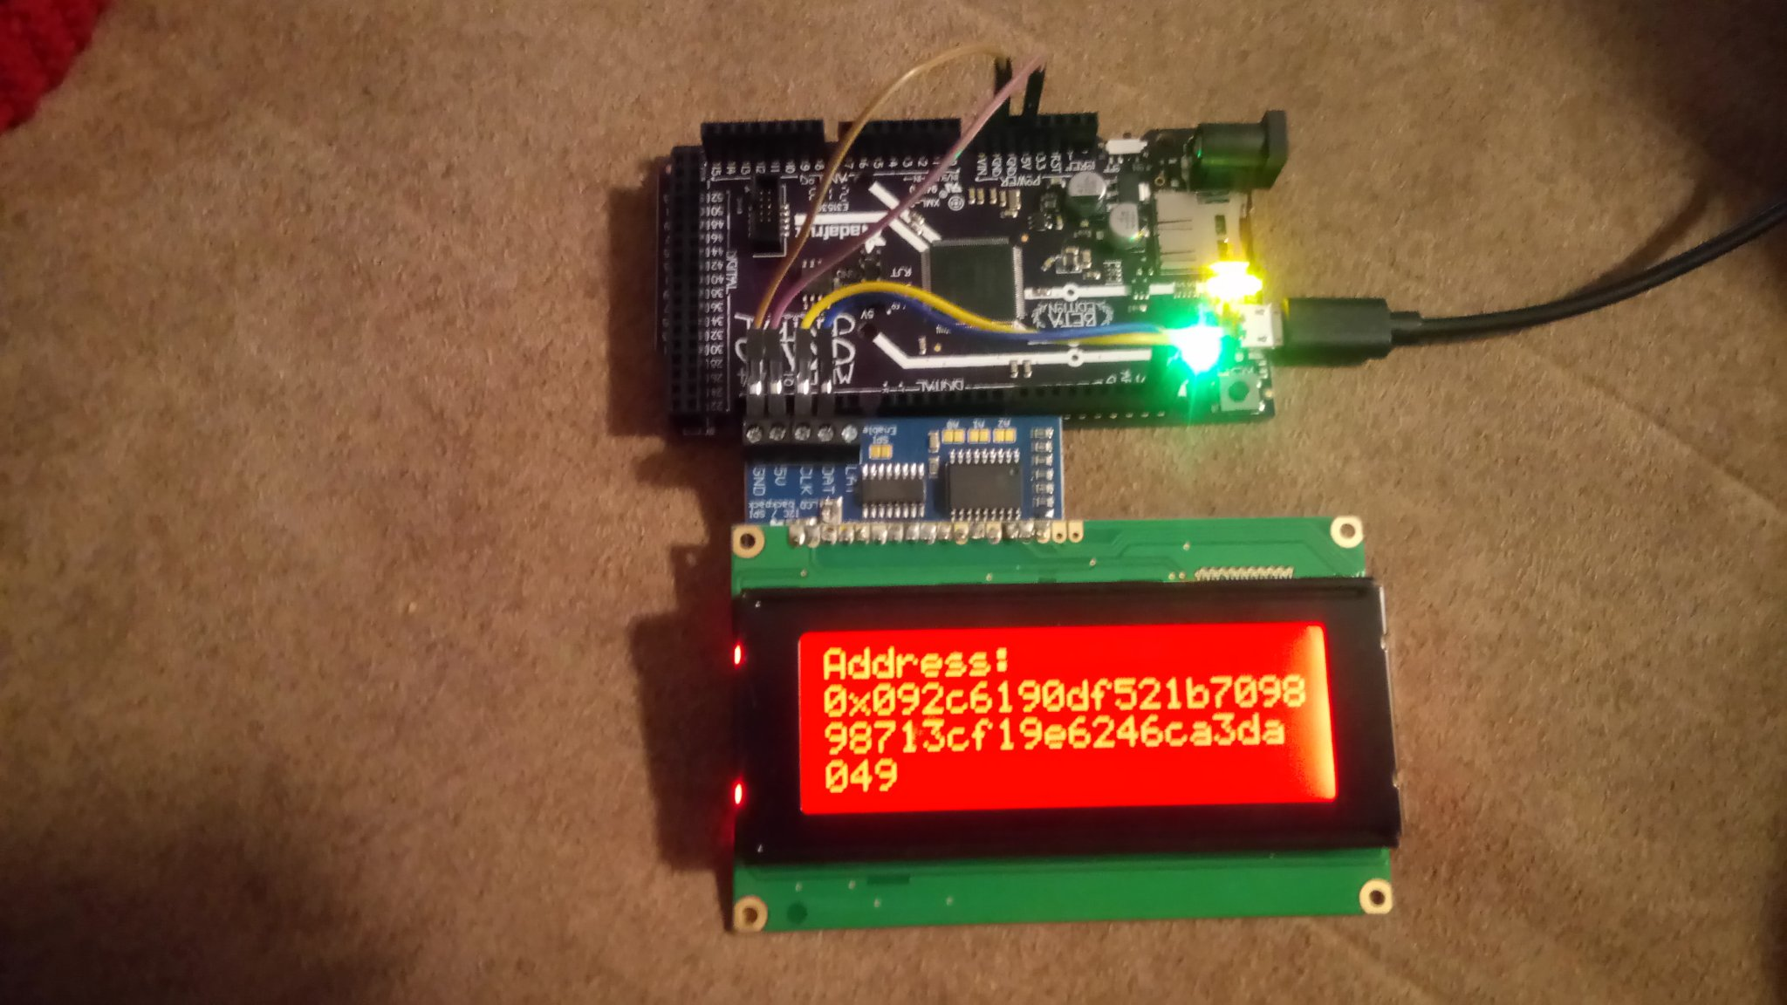
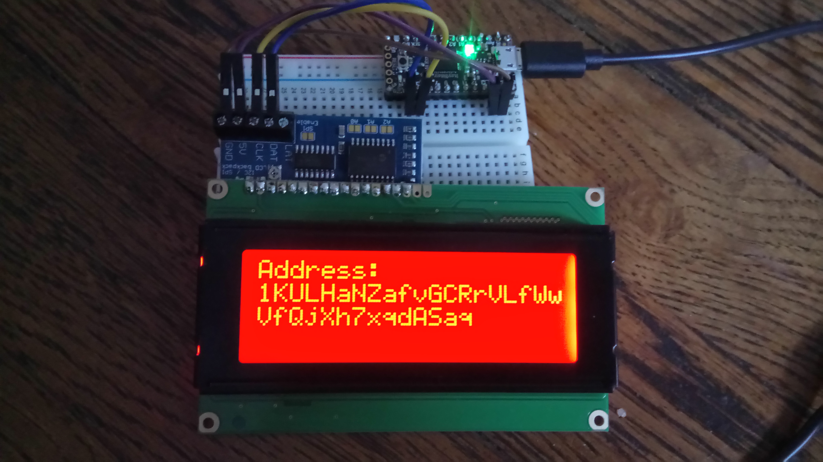
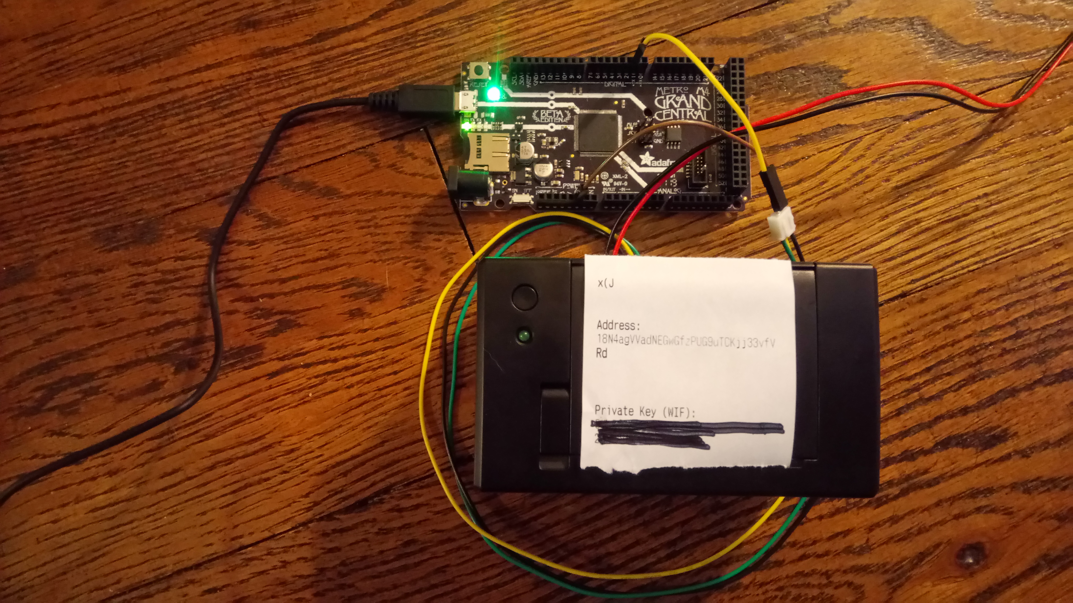
Offline Wallets
If you’re extra nerdy, make your own!
https://github.com/chaintuts/ubitaddr/tree/development

Slide 19
Offline Wallets
Pros:
  Robust security – not vulnerable to network attacks
    Keys have to be physically stolen
    Key generation is difficult to observe
    Can’t create/sign a malicious tx
  Resistant to data loss from computing failures (phone in toilet, HDD failure, loss/theft from daily use)

Slide 20
Offline Wallets
Cons:
  Highest level of technical knowledge needed for safety
  Can be vulnerable to environmental failures (fire, burglary, flooding)
  Need to create copies (seed phrase, keys, etc.) in case of failure
  Requires more work to spend funds later

Slide 21
Offline Wallets
Security Practices
  Create backups – multiple paper/metal/etc. Wallets, or backup seed phrases
  Store in a physically safe location – safety deposit box, home safe, etc.
  Understand risks before you use – UI is not as user friendly
  Recommended for long term storage of savings

Slide 22
What We Didn’t Cover
Privacy – that’s a whole ‘nother animal
  Privacy concerns connecting you with your transactions (how much you have, what you purchase, etc.)
Physical Bitcoin Attacks
  Person-to-person coercion
  See Lopp.net for documented attacks
Bad software implementations
  Cryptography foot guns, etc.

Slide 23
Final Thoughts
Remember, private keys are the core of our security focus
Not your keys, not your Bitcoin!
Before you Bitcoin, know:
  Your level of technical knowledge
  Your threat model and usage (amounts, spend vs. save, etc.)
  Understand core concepts and ask for help if you need it!

Slide 24
Questions?

