Slide 1





The McKenna School Guide to Cryptocurrencies

Slide 2
A Little About Me
Software Engineer @ Microsoft in Pittsburgh
Run https://chaintuts.com creating Bitcoin & blockchain related tutorials
  Articles, videos, and code projects
  On YouTube, Twitter, Github
  Support: Patreon, Crypto, Spreadshirt Apparel
Strong believer in digital sovereignty with digital money!

Slide 3


A Poll...
How many of you have heard of?
  Bitcoin
  Bitcoin Cash
  Litecoin
  Ethereum
How many of you have owned some?
How many of you have bought something with it?

Slide 4
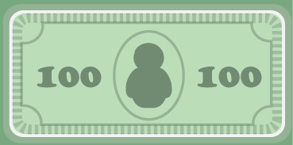
What are Cryptocurrencies?
Cryptocurrencies are a form of Digital Cash
But they’re not like a credit card, or Venmo, or Paypal
They truly behave like digital dollar bills, thanks to several key properties

Slide 5
What Cryptos Offer
A decentralized model – No corporations or governments control Bitcoin Cash, Litecoin, etc.
Censorship resistance – No one can stop your payments to anyone
Global payments – Send money to anyone, anywhere!
Sound money – A limited supply that can’t be changed

Slide 6

Decentralization
Bitcoin & others are built on peer-to-peer software – it’s a protocol not a product
The broader community of users, developers, and miners make decisions on protocol
No corporate, regulatory, or political concerns govern cryptocurrencies
Compare to: Credit cards – built to make CC companies money/shareholder interests

Slide 7
Censorship Resistance
Because Bitcoin is decentralized, it’s also built to be censorship resistant
No one can decide that you’re not allowed to make a transaction for any reason
Compare to: Venmo, Paypal – censor industries like legal cannabis, adult industry, political figures.
Compare to: Credit/Debit – US Gov trying to seize profits from Edward Snowden book

Slide 8

Global Commerce
Because Bitcoin is decentralized and censorship resistant, it’s also global
Send money to anyone, anywhere – support an international cause, send money to family, etc.
No limits on amounts, no high fees, no sanctions lists
Compare to: Western Union – 8% or more fee, won’t serve some areas

Slide 9
Sound Money
Most major cryptos have a limited supply set by the protocol. 21 million Bitcoin Cash, 84 million Litecoin
Some don’t have a cap (Ethereum), but supply is predictable
Compare to: USD – inflating every time the Fed arbitrarily decides to print more

Slide 10
How Are Properties Achieved?
The Blockchain – a distributed database of transactions, cryptographically secured by digital signatures and proof-of-work
Proof-of-Work – Algorithms that require extensive computing to solve
Digital Signatures – cryptography for proving ownership of funds without trust

Slide 11
Blockchain
A public ledger of all transactions (transfers) that have occurred
A new “block” of transactions are batch processed every N minutes
Each block is linked cryptographically to the last one
Tx data
Block hash
Tx data
Prev block hash
Block hash
Tx data
Prev block hash
Block hash

Slide 12

Proof-of-Work
For a new block to be “mined” (added to the chain), miners must compute a very hard problem
Uses a lot of electricity and computing power
Once the problem is solved, anyone can verify the answer instantly (hence: “Proof-of-work”)
Because each block is linked, older blocks become impossible to change (6+ confirmations)

Slide 13


Digital Signatures
0x12351bc143badf2348fe38e8f8b785b...
PRIVATE KEY
Elliptic Curve (secp256k1)
PUBLIC KEY
0x04135981abcd7f7a7d7b7c720….
“Double hash” (SHA-256 and RIPEMD160)
And Base58check encoding
ADDRESS
(PUBLIC KEY HASH)
1MT3uNoFLP82j2aSD5Qtibm2kXJ7RWumAM

Slide 14
Confused? Don’t Panic
You don’t have to be a tech nerd to understand these properties…
A little bit of knowledge goes a long way to understanding why this is important
:)

Slide 15



Why Should Finance Pros Care?
Improved interoperability between institutions
  ACH takes days to clear
  Cryptocurrencies take minutes
  This could vastly improve efficiency of transfers/clearing
  More efficient transfer is more efficient business

Slide 16
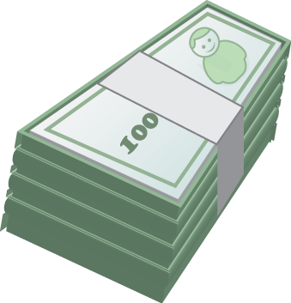
Why Should Finance Pros Care?
A sound money future
  Imagine your currency holdings in cash (not investments) growing in value over time
  No more needing to just keep up with inflation (2-3%)
  Increased predictability in currency markets

Slide 17


Why Should Finance Pros Care?
Dramatically more secure payments
  Billions per year are spent on fraud prevention and losses associated with ID theft
  Every time you use a credit card, you’re revealing private information you trust the merchant with
  With cryptocurrencies, the protocol is inherently more secure thanks to public key cryptography

Slide 18
Lastly – Should I Invest?
My opinion – No! Cryptocurrencies are highly speculative to treat as a “set and forget” investment
    HOWEVER!
“Invest in Education” - Andreas Antonopoulos
You should get some crypto and USE IT!
  Learn how it works
  Understand its valuable properties
  Be a part of this bright future of money!

Slide 19
The Fun Part – Free Money!
Go to app store of your choice
Download the bitcoin.com wallet or Coinomi wallet
Set up a Bitcoin Cash (Not Bitcoin BTC) Wallet
See me as time permits for some free BCH

Slide 20
Questions?

