Slide 1






The Basics of Wallets & Wallet Security

Slide 2
A Little About Me...
Software Engineer @ Microsoft in Pittsburgh
Run https://chaintuts.com creating Bitcoin & blockchain related tutorials
  Articles, videos, and code projects
  On YouTube, Twitter, Github
  Support: Patreon, Crypto, Spreadshirt Apparel
Focus is on understanding & teaching core concepts

Slide 3

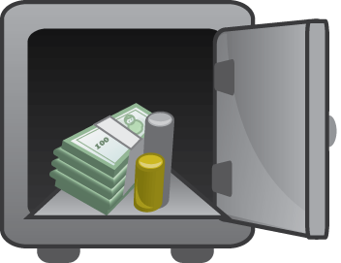
First, A Quick Disclaimer
Security is a complex, evolving topic
There is not a one size fits all solution
Know your threat model, and learn about tools you can use
We’ll discuss some Bitcoin fundamentals and the surrounding security tools

Slide 4
What Exactly is a Wallet?
Really a collection of private keys
Private keys used to be randomly generated, but now come from a seed phrase
Crypto-secure seed encoded as words for easy backup

Slide 5


What Exactly is a Wallet?
0x12351bc143badf2348fe38e8f8b785b...
PRIVATE KEY
Elliptic Curve (secp256k1)
PUBLIC KEY
0x04135981abcd7f7a7d7b7c720….
“Double hash” (SHA-256 and RIPEMD160)
And Base58check encoding
ADDRESS
(PUBLIC KEY HASH)
1MT3uNoFLP82j2aSD5Qtibm2kXJ7RWumAM

Slide 6
What Exactly is a Wallet?
0x2352bca23aafd389… encoded as word1, word2
SEED PHRASE
Privkey child
Privkey child
PRIVATE KEYS
Privkey
grandchild
Privkey
grandchild
Privkey
grandchild
Privkey
grandchild

Slide 7
What Exactly is a Wallet?
The process of deriving keys from a seed phrase is deterministic
Same seed phrase, same keys, same addresses when restoring a wallet!
With one caveat...

Slide 8
What Exactly is a Wallet?
Different wallets use different derivation paths
Ex: m/44’/0’/0’/0/0
  M/44’ is constant
  0’ is Bitcoin
  0’ is the first account
  0 means external, 1 for change addrs
  0 is the first address

Slide 9
What Exactly is a Wallet?
What about addresses, transactions, balances, etc.???
All of that is stored on the public blockchain, NOT in the wallet!
Wallet software simply fetches this data as needed, or stores the full chain

Slide 10


Private Keys & The #1 Rule...
Not your keys…
NOT YOUR BITCOIN

Slide 11
Private Keys & The #2 Rule...
Not your keys…
NOT YOUR BITCOIN

Slide 12
Types of Wallets
Custodial Wallets
Online Wallets (SPV & Full Node)
Offline Wallets (Hardware & Paper Wallets)

Slide 13
Custodial Wallets
Ex: Coinbase, Binance, etc.
Hold private keys for you, doesn’t give a seed phrase
Pros: Ease of use, ease of security
  Great if you’re new or less tech savvy
Cons: Not your keys, not your coins!
  Ultimately like a traditional bank model that can fail (Mt. Gox)

Slide 14
Online Wallets
Ex: Coinomi, Bitcoin.com, Bitcoin Core
Wallet is on an online device
You control private keys (seed phrase)
Pros: Still easy to use, everyday transactions, control you own coins
Cons: Online is more vulnerable to attacks, you can make mistakes

Slide 15
Offline Wallets
Ex: KeepKey, Ledger, Paper wallets
You control private keys, stored with no internet connection
Pros: Highest level of security, long term storage
Cons: Most complicated
  Paper/metal wallets are easy to screw up
  Hardware wallets less so – preferred method

Slide 16
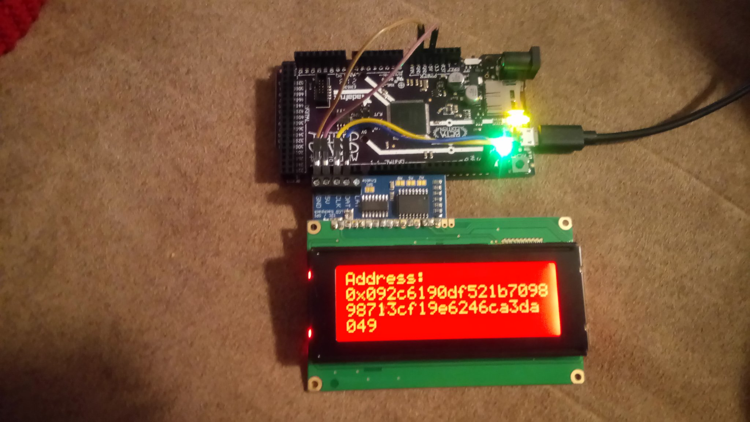
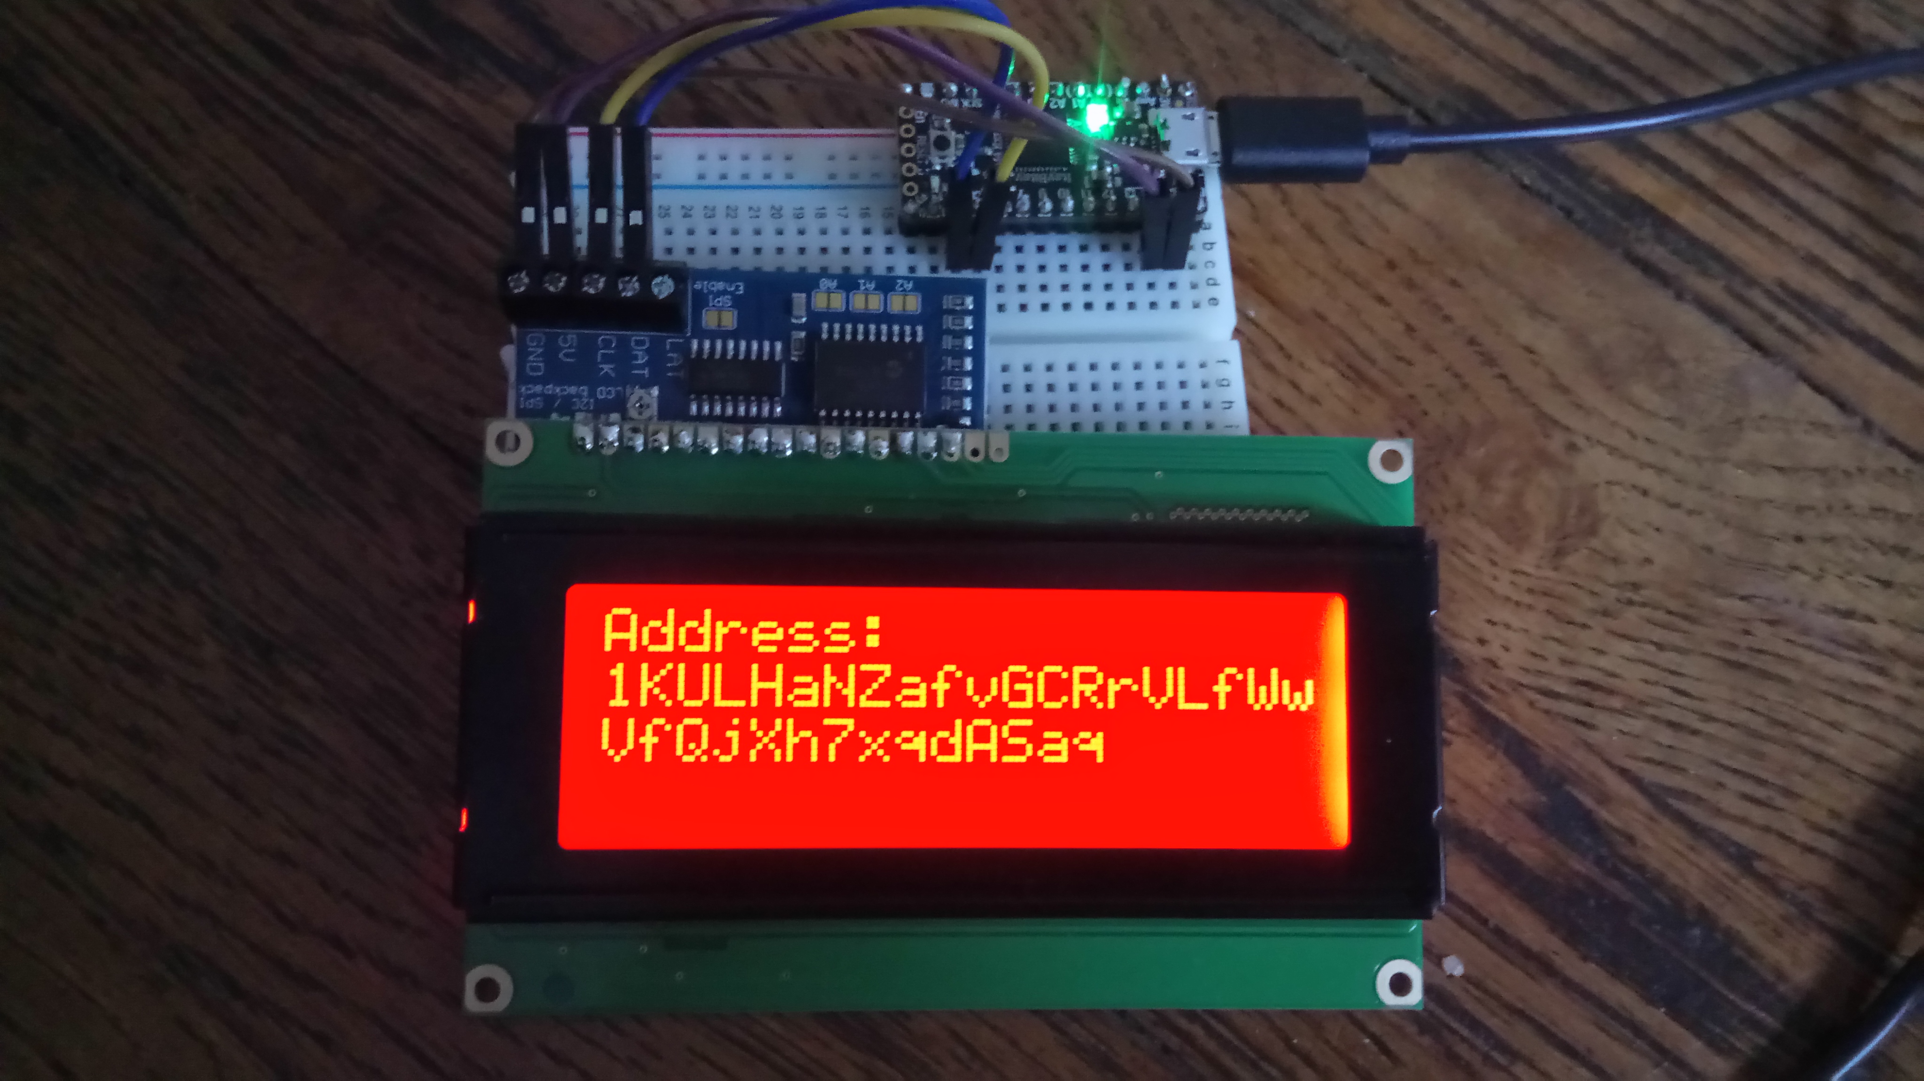
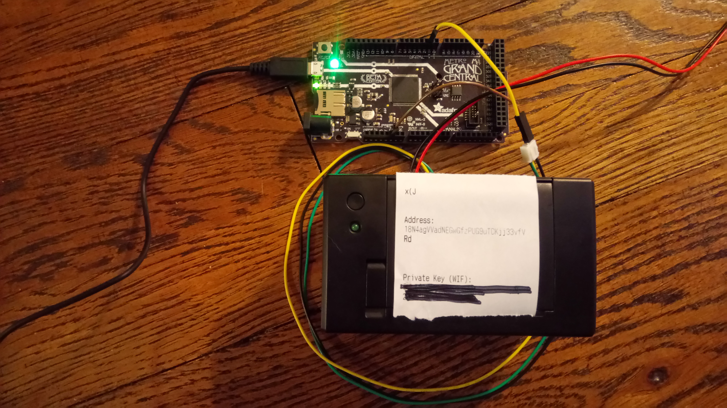
Offline Wallets
If you’re extra nerdy, make your own!
https://github.com/chaintuts/ubitaddr/tree/development

Slide 17
Potential Threats
Exchange goes under or steals your coins
  Mt. Gox, Quadriga CX
SIM swap attacks used to gain access
DNS hijacking/malware swaps address
Social engineering
Physical attacks (the ol’ wrench attack)

Slide 18
So What Should I Use?
Factors to consider: level of tech savvy, use cases, amounts
  Custodial: Great for small amounts, purchase/sell, non-tech savvy
  Online: For day to day purchases, small to medium amounts, reasonably savvy
  Offline: Large amounts, long term savings, more tech savvy individuals (hardware wallets help bridge the gap)

Slide 19
Final Thoughts
Remember, private keys are the core of our security focus
Not your keys, not your Bitcoin!
Before you Bitcoin, know:
  Your level of technical knowledge
  Your threat model and usage (amounts, spend vs. save, etc.)
  Understand core concepts and ask for help if you need it!

Slide 20
Questions?

