Slide 1






Building a Microcontroller
Bitcoin Address
Generator

Slide 2
A Little About Me...
Software Engineer @ Microsoft in Pittsburgh
Run https://chaintuts.com creating cryptocurrency & blockchain related tutorials
  Articles, videos, and code projects
  On YouTube, Twitter, Github
  Support: Patreon, Crypto, Spreadshirt Apparel
Focus is on understanding & teaching core concepts

Slide 3

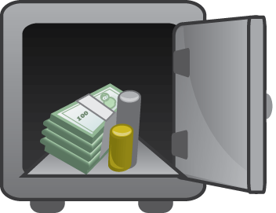
First, A Quick Disclaimer
I’m not a cryptography/security expert, but I am a software engineer
Security is a Complex, evolving topic
This is a proof-of-concept for building open hardware, open source cryptocurrency tools

Slide 4


The Core of Crypto Ownership:
Private Keys
0x12351bc143badf2348fe38e8f8b785b...
PRIVATE KEY
Elliptic Curve (secp256k1)
PUBLIC KEY
0x04135981abcd7f7a7d7b7c720….
“Double hash” (SHA-256 and RIPEMD160)
And Base58check encoding
ADDRESS
(PUBLIC KEY HASH)
1MT3uNoFLP82j2aSD5Qtibm2kXJ7RWumAM

Slide 5
The Core of Crypto Ownership:
Private Keys
Private keys prove ownership of funds using digital signatures
Anyone with the keys can spend the funds
It’s absolutely critical that keys are both:
  Securely generated
  Securely stored

Slide 6
Offline Wallets
Ex: Hardware Wallets (Keepkey, Trezor, etc.) and Paper/Metal/etc. Wallets
Keys are generated and stored on a device not connected to a network
  Could be from a seed phrase, or random
  Generated on dedicated hardware, or an offline PC

Slide 7
Offline Wallets
Typical solutions are commercial devices, with open source firmware
  Trezor, Ledger, KeepKey
  I asked, why can’t I build one of these myself on cheap hardware??
  Thus, uBitAddr was born!

Slide 8
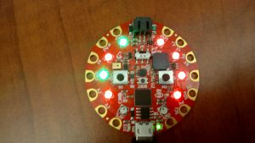
The Idea
It would be super cool to generate real, offline keys with my own code
I had some basic microcontroller experience from another project (visualizing proof-of-work)
Let’s build something with readily available, “easy” to code products
Proof-of-work simulator
On the Circuit Playground

Slide 9
The Challenges
Need a platform with enough memory to store, run code
  First experiments shows the M0 platform was insufficient
Cryptographic primitives – need:
  SHA-256, RIPEMD160, Keccak (for ETH) hashes
  Secp256k1 ECDSA algorithm
MUST have cryptographically secure RNG

Slide 10
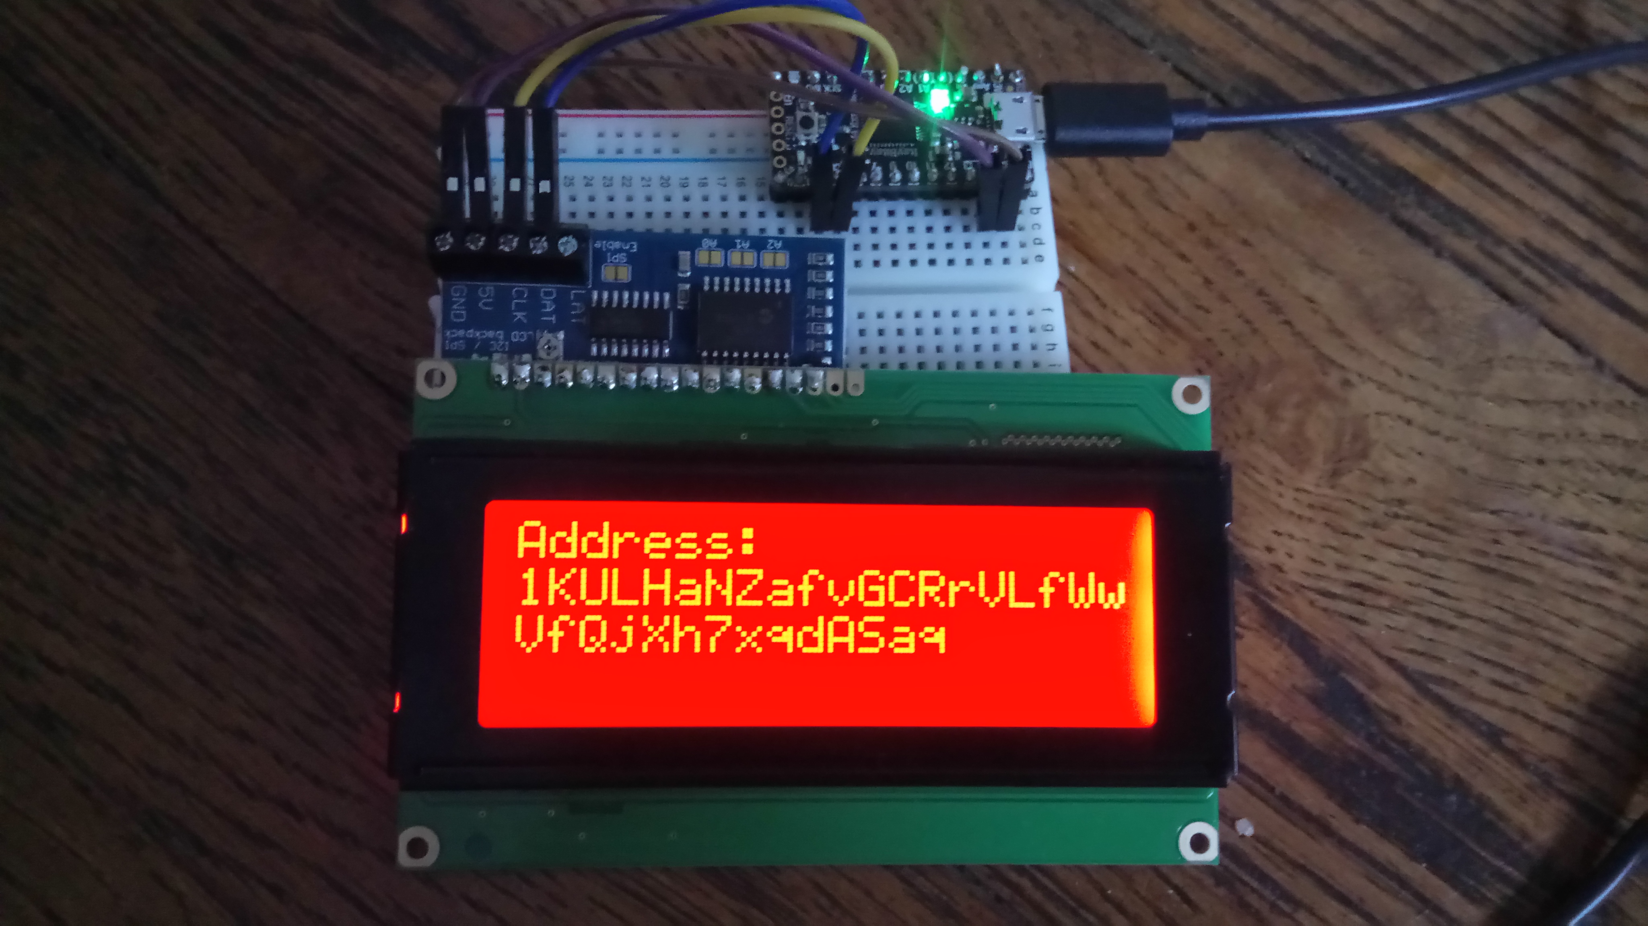
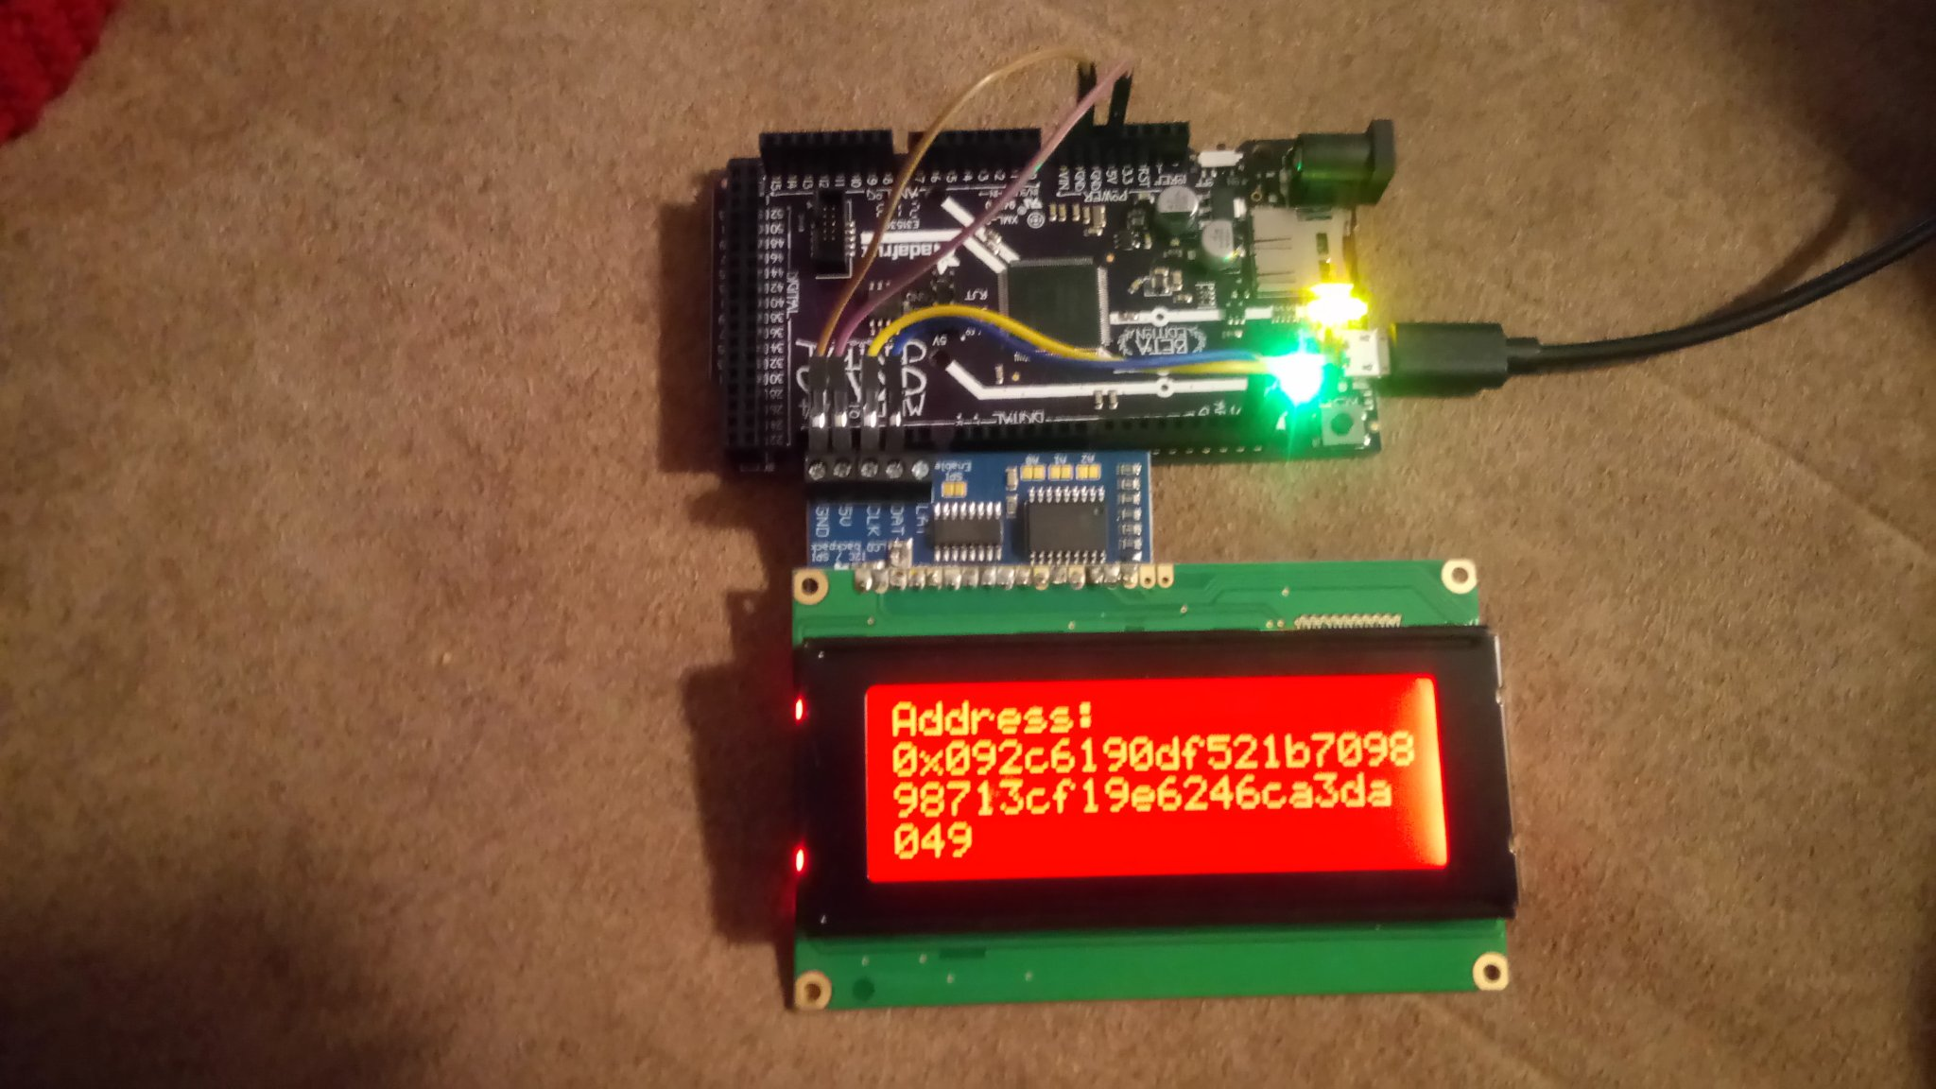
Answering the Challenges
Memory, power
  Decided on the Adafruit M4 platforms
  Grand Central, ItsyBitsy tested
  Runs on Atmel SAMD51, 256KB+ flash and 192KB+ RAM
ItsyBitsy M4
Grand Central M4

Slide 11
Answering The Challenges
How to get Crypto Primitives? - Use the Open Source!
  Standalone Python libs are hard to find and run on micro platform
  Trezor firmware is open source, standalone C code
  Ported Trezor code (more on that later)

Slide 12
Answering The Challenges
Need for true random number generation
  Platform choice fixed this for us!
  M4 microcontrollers used all have built in true random number generation built in
  Other option could have been to read data from an accelerometer or used other suitable environmental noise

Slide 13
Putting It Together
The stack:
  Custom CircuitPython module, C
  Application, CircuitPython
  Device: M4 processor with I2C Character LCD screen (mostly used) or a receipt printer
  Supported currencies: BTC, BCH, ETH, LTC, DGB

Slide 14
Putting It Together
Custom CircuitPython Module
  Followed “Extending CircuitPython” by Dave Astels
  Where the crypto happens (thanks to Trezor)
  Gets CRNG seed passed in from Python layer
  Hashes seed into private key, generates pubkey, returns encoded keypair
    Chain-appropriate address encoding
    WIF or HEX privkey

Slide 15
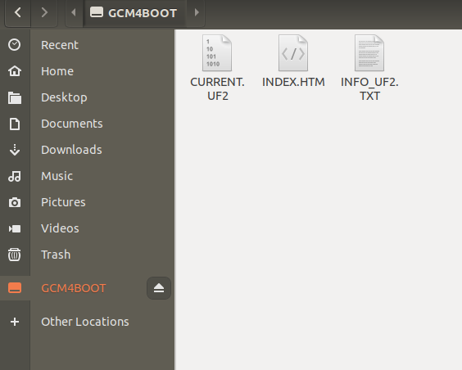
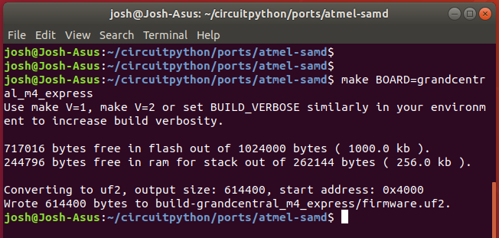
Putting It Together
Custom CircuitPython Module
  Have to build firmware and load on the device (UF2 format)

Slide 16
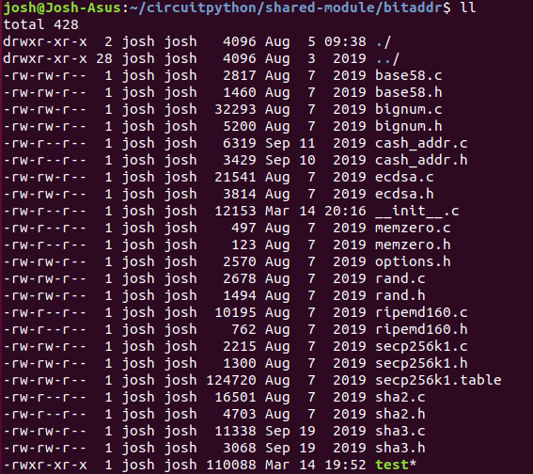

Putting It Together
Custom CircuitPython Module
  Trezor crypto-primitives and encoding functions are pretty standalone
  Made simple CLI testing possible

Slide 17
Putting It Together
CircuitPython layer
  Generates entropy (Python os.urandom, which uses the built in CSRNG)
  Calls custom module code to get privkey, address
  Displays on LCD screen or prints to receipt printer, etc. using Adafruit libraries

Slide 18
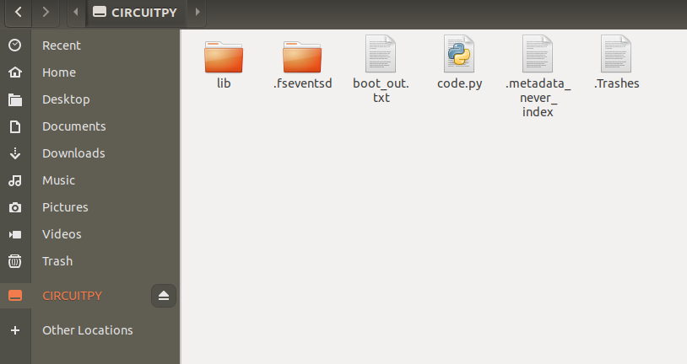
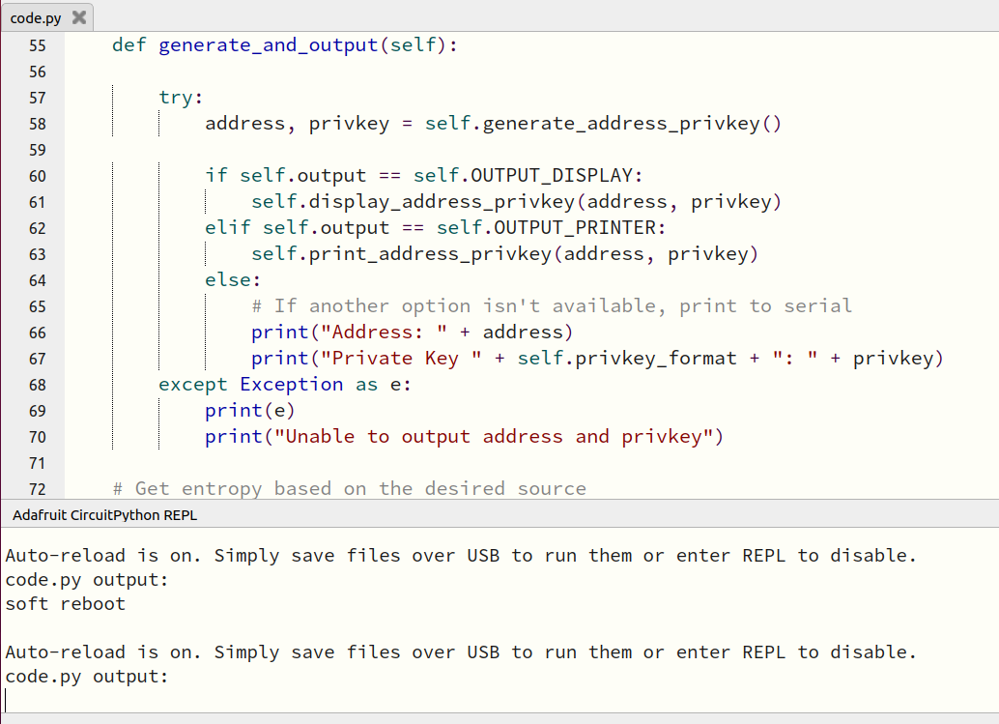
Putting It Together
CircuitPython layer
  Load code into CIRCUITPY drive
  Usage is then simple – each reset generates and shows a new keypair!

Slide 19
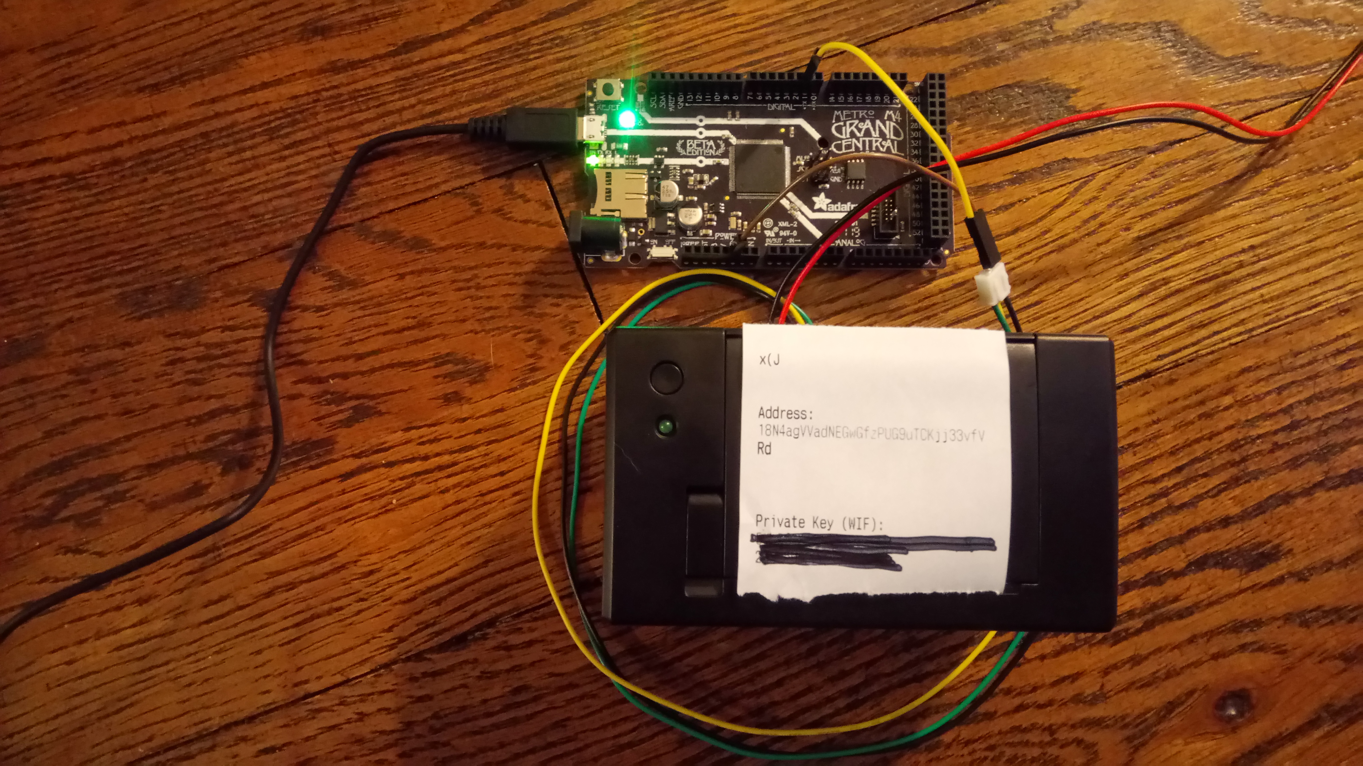
uBitAddr
https://github.com/chaintuts/ubitaddr/tree/development

Slide 20
Potential Pitfalls
Cryptography Foot-Guns
  Again, I’m not an expert here
  There’s always hidden dangers with implementations
    Used trusted primitives
    Kept things simple
    Tested, tested, tested manually against known-working implementations

Slide 21
Potential Pitfalls
Single keypairs are out-of-favor/legacy
  MUST make sure to copy correctly, double check before sending funds
  Encoding is not human friendly
  Data easily corrupted (water damage, bad handwriting, character distinctions)
  As is, this code only shows keypair ONCE

Slide 22
Potential Future Improvements
Biggest: Upgrade to BIP39/BIP44 compatible seed phrases instead of single keypairs
  Give user a seed phrase for safe backup
  Generate new addresses as needed
  Even if we use it for one address from tree (similar to old impl), backup is easier and safer
UI/UX improvements
  Warnings, store keypairs?, etc.

Slide 23
Potential Future Improvements
Upgrade to CircuitPython5 – latest builds
  Downside: build process was tricky
Device powerful enough for pure-Python implementation?
  Easier development, less complexity
  Downside: Python crypto-security pitfalls?
Unit testing to catch basic & edge cases with generation
Open to ideas – always trying to improve!

Slide 24
Questions?

