Slide 1






Understanding Offline Wallets...and Building One!

Slide 2

Wallet Usage?
How many of you have used:
  A hardware wallet?
  An old-school paper wallet or raw keypair?

Slide 3
A Little About Me...
Software Engineer @ Microsoft in Pittsburgh
Run https://chaintuts.com creating cryptocurrency & blockchain related tutorials
  Articles, videos, and code projects
  On YouTube, Twitter, Github
  Support: Patreon, Crypto, Spreadshirt Apparel
Focus is on understanding & teaching core concepts

Slide 4

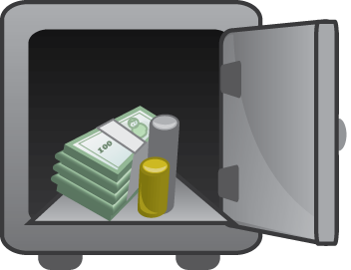
First, A Quick Disclaimer
I’m not a cryptography/security expert, but I am a software engineer
Security is a Complex, evolving topic
This is a proof-of-concept for building open hardware, open source cryptocurrency tools

Slide 5


How Addresses are Generated
0x12351bc143badf2348fe38e8f8b785b...
PRIVATE KEY
Elliptic Curve (secp256k1)
PUBLIC KEY
0x04135981abcd7f7a7d7b7c720….
“Double hash” (SHA-256 and RIPEMD160)
And Base58check encoding
ADDRESS
(PUBLIC KEY HASH)
1MT3uNoFLP82j2aSD5Qtibm2kXJ7RWumAM

Slide 6
What Wallets Do
Generate and Secure private keys & addresses
Scan the blockchain for relevant transactions
  Full node – downloads the whole chain and validates all blocks & transactions (signatures, other protocol rules)
  SPV wallet – downloads address-relevant data from full nodes and validates some info
  Some wallets use a 3rd party API to get data

Slide 7

What Wallets Do
Sign and broadcast new transactions
  For Bitcoin and other UTXO chains – composes a transaction with spendable “outputs” as new “inputs” to the transaction
  Sends out transaction to network for validation

Slide 8
The Importance of Private Keys
Ultimately, the private keys are the most important bits of data that wallets generate & store
  Not your keys, not your coins – anyone with the keys can spend funds from another wallet
  All other data like addresses, balances, transactions are public blockchain data
  Critical that keys are both:
    Securely generated
    Securely stored

Slide 9
Types of Wallets
Custodial Wallets – such as Exchanges
Online Wallets – Bitcoin.com, Coinomi, Bitcoin Core full node, etc.
Offline Wallets

Slide 10
Offline Wallets
Most common, modern wallets are purpose built hardware wallets
  KeepKey, Trezor, Ledger, etc.
  Both generate keys and sign transactions
Simplest form: an encoded keypair
  Paper wallets
  Keypairs engraved in metal, etc.

Slide 11
Why Offline Wallets?
Robust security – not vulnerable to network attacks
  Keys have to be physically stolen
  Key generation is difficult to observe
  Can’t create/sign a malicious tx
Resistant to data loss from computing failures (phone in toilet, HDD failure, loss/theft from daily use)

Slide 12
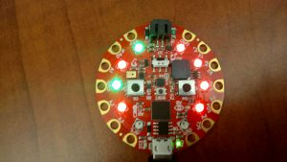
The Idea
It would be super cool to generate real, offline keys with my own code
I had some basic microcontroller experience from another project (visualizing proof-of-work)
Let’s build something with readily available, “easy” to code products
Proof-of-work simulator
On the Circuit Playground

Slide 13
The Challenges
Need a platform with enough memory to store, run code
  First experiments shows the M0 platform was insufficient
Cryptographic primitives – need:
  Hashing algorithms such as SHA-256
  ECDSA - secp256k1
MUST have cryptographically secure RNG

Slide 14
The Challenges
MUST have cryptographically secure RNG
  Many “random” occurences in code are not truly random
    Games, etc. use “pseudorandom” algorithms
    Usable, but predictable
  For cryptography, we MUST use a system that generates true randomness
    Using environmental noise, etc.

Slide 15
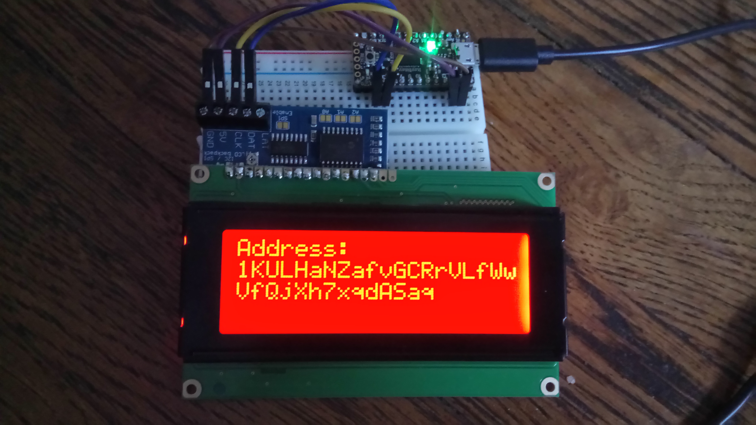
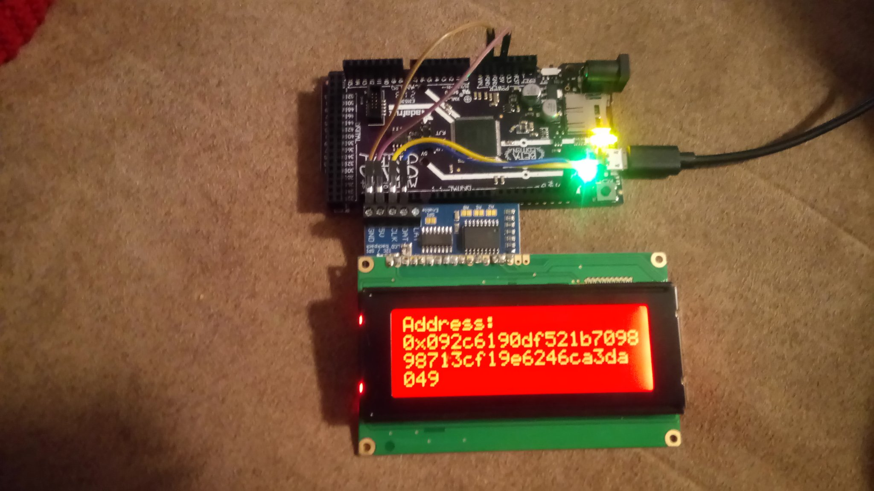
Answering the Challenges
Memory, power
  Decided on the Adafruit M4 platforms
  Grand Central, ItsyBitsy tested
ItsyBitsy M4
Grand Central M4

Slide 16
Answering The Challenges
How to get Crypto Primitives? - Use the Open Source!
  Standalone Python libs are hard to find and run on micro platform
  Trezor firmware is open source, standalone C code
  Ported Trezor code (more on that later)

Slide 17
Answering The Challenges
Need for true random number generation
  Platform choice fixed this for us!
  M4 microcontrollers used all have built in true random number generation built in
  Other option could have been to read data from an accelerometer or used other suitable environmental noise

Slide 18
Putting It Together
The stack:
  Custom CircuitPython module, C
  Application, CircuitPython
  Device: M4 processor with I2C Character LCD screen (mostly used) or a receipt printer
  Supported currencies: BTC, BCH, ETH, LTC, DGB

Slide 19
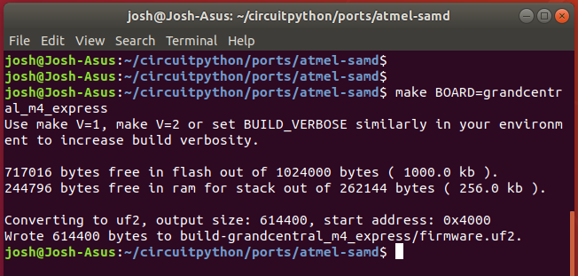

Putting It Together
Custom CircuitPython Module
  Gets CRNG seed passed in from Python layer
  Hashes seed into private key, generates pubkey, returns encoded keypair
    Chain-appropriate address encoding
    WIF or HEX privkey

Slide 20
Putting It Together
CircuitPython layer
  Generates entropy (Python os.urandom, which uses the built in CSRNG)
  Calls custom module code to get privkey, address
  Displays on LCD screen or prints to receipt printer, etc. using Adafruit libraries

Slide 21
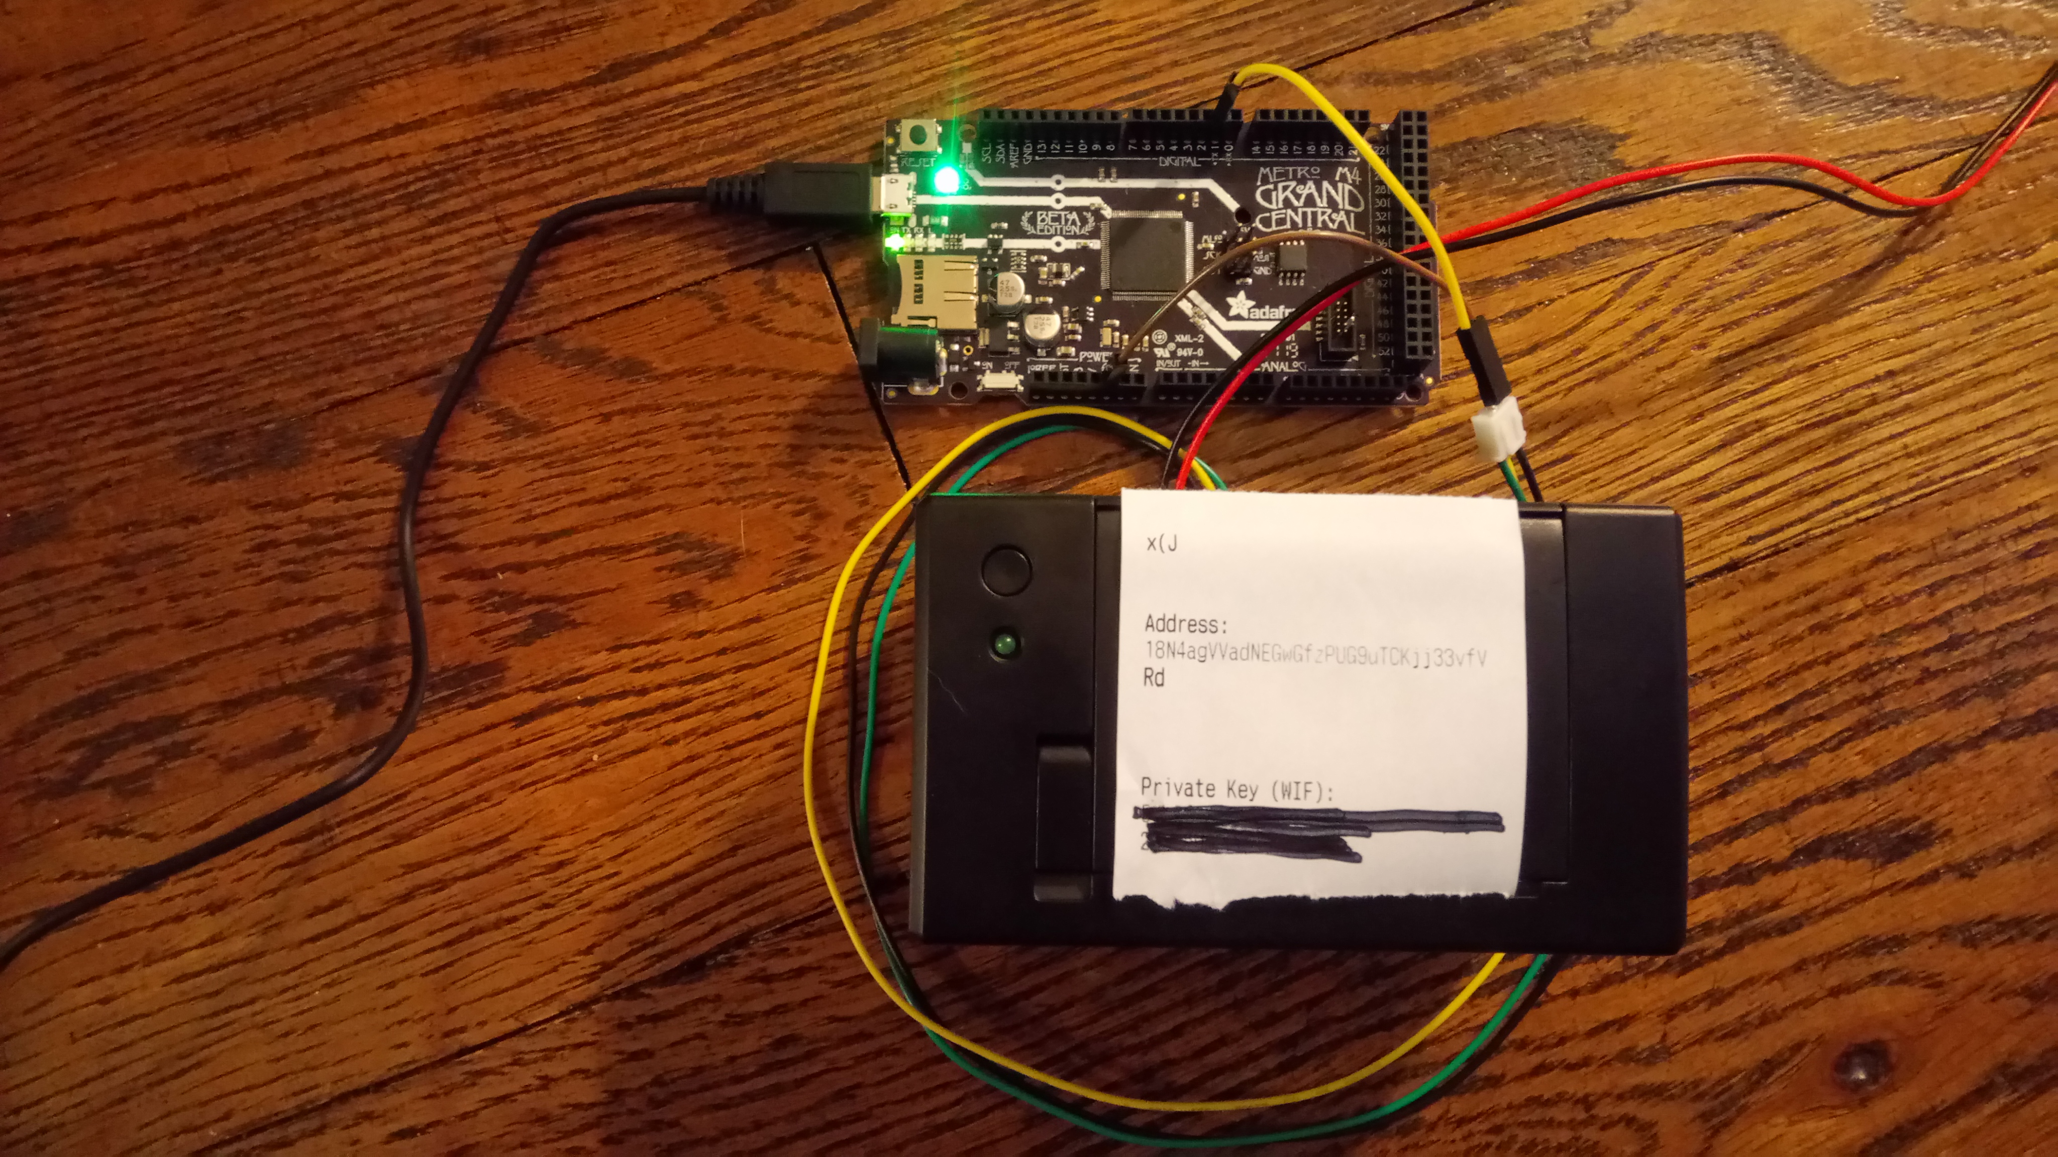
uBitAddr
https://github.com/chaintuts/ubitaddr/tree/development

Slide 22
Potential Pitfalls
Single keypairs are out-of-favor/legacy
  MUST make sure to copy correctly, double check before sending funds
  Encoding is not human friendly
  Data easily corrupted (water damage, bad handwriting, character distinctions)
  Change can cause issues

Slide 23
Potential Pitfalls
UI/UX
  Code only shows keypair once (generates a new one on restart)
  Doesn’t provide any security recommendations
Cryptography foot-guns
  Used trusted implementations and manually tested to mitigate this

Slide 24
Potential Future Improvements
Biggest: Upgrade to BIP39/BIP44 compatible seed phrases instead of single keypairs
  Give user a seed phrase for safe backup
  Generate new addresses as needed
  Even if we use it for one address from tree (similar to old impl), backup is easier and safer
UI/UX improvements
  Warnings & security reqs, store keypairs?, etc.

Slide 25
Potential Future Improvements
From a code perspective:
  Update module/firmware code for CP5
  Move to pure Python implementation?
  Unit testing to catch regressions and edge cases
Open to ideas – always trying to improve!

Slide 26

The Importance of Offline Wallets
As Andreas A. says – Not your keys, not your coins!!
Keys must be safely generated and stored offline for online storage
Can this be done with open hardware & open source – this experiment says yes!!

Slide 27
Questions?

