Slide 1
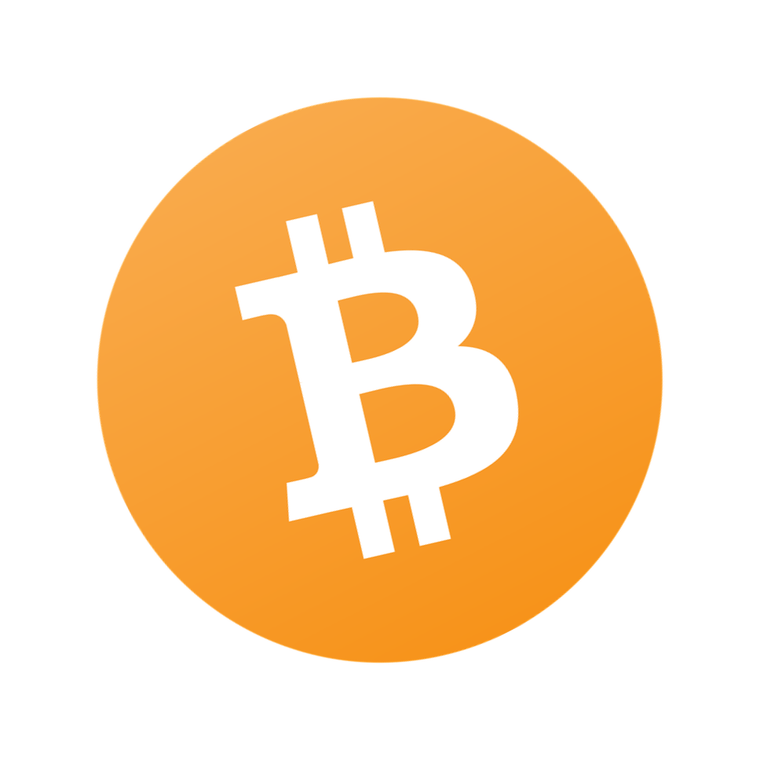


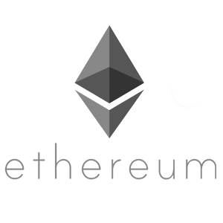


Building a Beginner Smart Contract

Slide 2
A Little About Me...
Software Engineer @ Microsoft in Pittsburgh
Run https://chaintuts.com creating cryptocurrency & blockchain related tutorials
  Articles, videos, and code projects
  On YouTube, Twitter, Github
  Support: Patreon, Crypto, Spreadshirt Apparel
Focus is on understanding & teaching core concepts

Slide 3

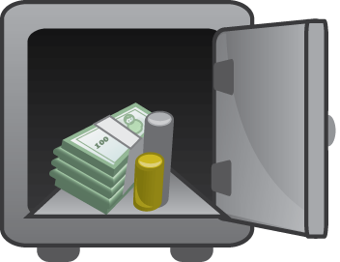
First, A Quick Disclaimer
I’m not an expert in smart contract dev…not even intermediate
I am a professional software engineer!
Want to give my perspective on building a beginner smart contract…as a beginner!

Slide 4
Programming 101
Devices don’t do anything on their own…
We have to “program” them with explicit instructions
Laptop, phone, even your car
  Instructions interpreted by a CPU…make it do something
  Calculations, display, accept inputs, etc.
Do I have to learn machine code for every device??
  No, because of *abstractions*

Slide 5
Abstractions
We’ve built layers between machine code and the “high level” languages we use
Don’t have to know x86 assembly to code on a laptop
Can learn C, C++, Python, Java, etc. which are all “translated” to the machine you’re on

Slide 6
Types of Languages
Compiled
Interpreted
Intermediate (bytecode)

Slide 7
Types of Languages
Compiled
  Ex: C, C++
  Instructions are read by a “compiler” -> translated directly into machine code for the *target platform*
  Have to re-compile for each target platform/OS
    Ex: Linux, ARM (Raspberry Pi)
    Ex: Windows, x86-64

Slide 8
Types of Languages
Interpreted
  Ex: Python, JavaScript
  Instructions are read and then executed line-by-line
    Interpreter translates instructions to machine/system calls on the fly
  No need for compilation, just need interpreter available on that system!
    Ex: Python on Windows, Linux, CircuitPython devices
    Ex: JavaScript in your web browser

Slide 9
Types of Languages
Intermediate Languages
  Ex: Java, C#.NET, *Solidity*
  Instructions are compiled into an intermediate language called “bytecode”
  The language virtual machine then interprets/recompiles instructions to the target machine – various strategies for this
  Ex:
    Java compiled on a Windows, executing on an Android Phone
    C#.NET compiled on Windows, running on an XBOX360

Slide 10

Programmable Blockchains
What does this have to do with Blockchains?
  Many blockchains are programmable!
  Bitcoin and Bitcoin Cash use an interpreted language called Script for transactions
    Allows for legacy, multisig, segwit (BTC), SLP tokens (BCH), etc.
  Ethereum is even more programmable…

Slide 11
The Ethereum Virtual Machine
Ethereum features an intermediate language for running smart contracts (Ethereum Bytecode)
We can write contract code using different languages (Solidity, Vyper) and compile to bytecode for execution
There are some key differences between coding in say…Java…and using the EVM

Slide 12
PC vs. Ethereum
Cost:
  Execution on a PC is CHEAP!
  Every operation on Ethereum costs “gas”, a unit for measuring compute resources used by executing the contract
  Don’t use Ethereum for compute-heavy, performant code. Go rent an Azure VM for that

Slide 13
PC vs. Ethereum
Turing-completeness
  Abstract concept, but think of the ability to use loops, etc. in code
  Bitcoin Script is non-turing complete – cannot loop forever
  Ethereum IS turing complete…so not a difference but noteworthy
  Prevent locking up networking resources with gas limit – can’t loop infinitely

Slide 14
PC vs. Ethereum
Determinism
  PC program may execute differently every time on a PC
    Ex: Computer game with some random elements
  Smart contract will always execute the same on any network node!
    Must be this way to have a decentralized network
    Any node/miner can execute the contract transaction and verify the end result

Slide 15

Building a Smart Contract
The idea: Implement a basic dice roll contract
Call a contract function, get back a return value 1-6
Just need a basic contract for this – no state, etc.
Use it for something fun…picking backyard bike park features for practice ☺

Slide 16
The Code
pragma solidity ^0.6.6;
contract BikeParkDice
{
// The only function for this contract
// It uses some seed data and a hash to return a "random" number from 1-6
function rollDice() public view returns(uint256 final_roll)
{

Slide 17
The Code
// Get the sending address, block difficulty, and block timestamp
// to give us a good enough "seed" for our pseudo-random number
bytes32 seed = keccak256(abi.encodePacked(msg.sender));
bytes32 seed_2 = keccak256(abi.encodePacked(block.difficulty));
bytes32 seed_3 = keccak256(abi.encodePacked(block.timestamp));

Slide 18
The Code
// Hash the seed data. This keccak hash is deterministic (necessary for Ethereum contracts!)
// and is preimage resistant, which is helpful for our pseudo-random generation
bytes32 hash = keccak256(abi.encodePacked(seed, seed_2, seed_3));
// Cast the hash bytes to an integer value
uint256 hash_num = uint256(hash);

Slide 19
The Code
// Return a number from 1-6 by using the modulo (remainder) function
final_roll = (hash_num % 6) + 1;
return final_roll;
}
}

Slide 20
Development and Testing
Used Remix IDE at https://remix.Ethereum.org
Built in Solidity Compiler and JavaScript VM for testing!
  Didn’t need to deploy contract to real testnet or mainnet to experiment with it.
  Could easily call function and test return value
    View function – called on a local node using API such as web3.js – no state change
    Functions that change state must be called via transaction and “watched” for return

Slide 21
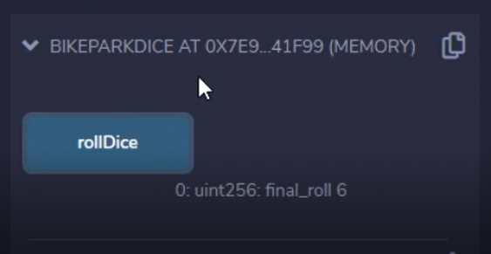
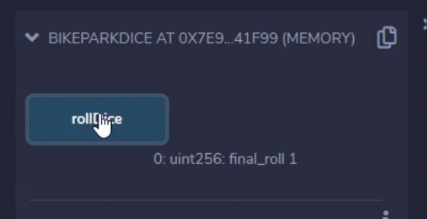
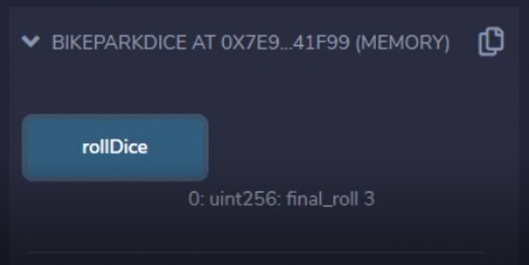
Development and Testing

Slide 22
Real Deployment
Beyond just testing – How would I deploy?
Compile Solidity contract down to bytecode
Create transaction with bytecode as data and send to 0x0…0 (the “zero address”)
Wait for contract to be mined
Contract will live at a contract address, used to send new transactions with calls in them

Slide 23
Ethereum Contracts
Use a virtual machine/intermediate language compiled from HLL like Solidity
Are Turing complete, but require gas
Are deterministic (needed for decentralization)
Use where decentralization is key!
  Representing real-world assets (Non-fungible tokens), creating new currencies (tokens), legal applications, decentralized finance, etc.

Slide 24
Questions?

