Slide 1







Talking to Your Users
About Cryptocurrency Security

Slide 2
A Little About Me...
Software Engineer @ Microsoft in Pittsburgh
Tech Educator @ chaintuts
Love to build free and open source technical education!
  Interested in cryptocurrencies, blockchains, digital security topics

Slide 3

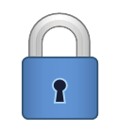
The Core of Crypto Ownership:
Private Keys
We call a cryptocurrency private key store a wallet
It’s absolutely critical that wallets (private keys) are both:
  Securely generated
  Securely stored
There are different classes of wallets, all with differing threats

Slide 4

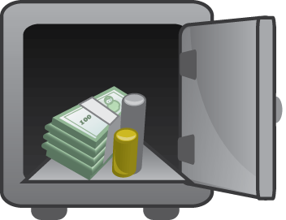
Wallet Security Overview
Much of this may not be news to technical & security pros
We as the builders have a duty to educate our users on security
Want to give you new ways to think about security education for cryptocurrencies

Slide 5

Discussing Security
Classes wallets, and broad security overview
Common cryptocurrency threats
Security bullet-points for your users

Slide 6

Wallet Class Security Overview
Most secure
(non-custodial)
Least secure
(non-custodial)
Security varies
(custodial)
Offline wallets
Online mobile wallets
Online desktop wallets
Online web wallets
Exchanges (special case)

Slide 7
Wallet Class Security Overview
Broadly speaking:
  Offline is better than online
  Specialized hardware is better than general purpose
  Self-custody is better than an exchange -
    IF the user is prepared for it (special case)
  The amount will dictate the level of security needed

Slide 8
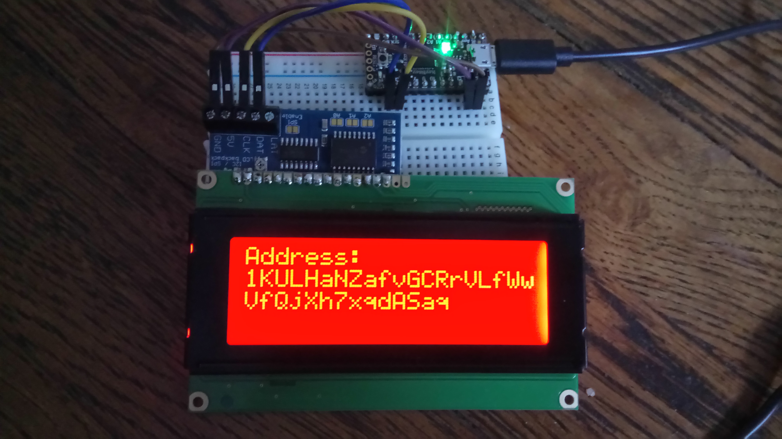
Hardware/Offline Wallets
Users should be highly encouraged to use hardware wallets
All key generation and storage is done offline on specialized hardware
Greatly lowers the attack surface for key theft!
  Can’t watch keygen,
  signatures (key leakage)
  Can’t phone home with
  stolen keys
  Can’t run gen-purpose malware
My demo DIY hardware wallet
uBitAddr

Slide 9

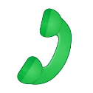
Online Wallets
For online use, encourage mobile applications over desktop, web wallets
Mobile has more locked-down OS
  Less susceptible to malware, but not foolproof
  Most users go through app stores, which have some safeguards in place

Slide 10

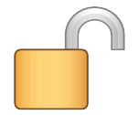
Online Wallets
Desktop and web wallets present the highest attack surface – discourage
  Malware threats
  Key leakage/theft
  Phishing attacks
  Bad passwords, password reuse

Slide 11

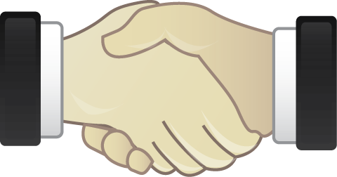
Exchanges
Exchanges are a special case, because:
  You are trusting a “Bitcoin bank” instead of holding keys yourself
  Security is only as good as:
    Their security (which is a big target)
    Your password, 2FA hygiene

Slide 12
Let’s Talk Threats #1
Malware threats (desktop, web, mobile)
  Address jacking (demo: AddrJack)
  Fake wallet software (ex: fake Electrum updates)
  Key theft
  malware

Slide 13

Let’s Talk Threats #2
Bad passwords and 2FA hygiene (web, exchanges)
  People love to reuse passwords...this is particularly dangerous for web wallets and exchange accounts
  Most people don’t use long, higher entropy passphrases (length over complexity!!)
  SMS based 2FA is vulnerable to SIM-swap attacks
  Users may skip 2FA altogether

Slide 14

Let’s Talk Threats #3
Phishing & Social Engineering (Everything)
  The absolute hardest to protect your users from…
  “Fake investment (forex, mining, etc.)” scams
  “Fake giveaway scams”
  Ledger data breach related scams – extortion, fake software updates, etc.
  Most thefts I have seen happen
  through social engineering,
  not technical exploits!

Slide 15


Bullet Points for Your Users
Encourage hardware wallets for high-value accounts
Encourage mobile wallets for spending money
Encourage/require strong passphrases (length over complexity) for wallets, exchanges
Encourage/require strong app or hardware based 2 factor authentication
Train your users on social engineering!

Slide 16
Bullet Points for Your Users
Security landscape is ever evolving
This is not a comprehensive list – be open to new info and feedback
With great power (being your own bank) comes great responsibility
Overall:
  Train your users to think about security first!
  Develop software with security-first mindset!

Slide 17
Questions?

