Slide 1






Let’s Get Random –
Entropy and Cryptocurrencies

Slide 2
A Little About Me...
Software Engineer @ Microsoft in Pittsburgh
Tech Educator @ chaintuts
Love to build free and open source technical education!
  Interested in cryptocurrencies, computer science, security topics

Slide 3
Why Talk About Entropy?
Entropy (randomness) is critical to applied cryptography/cryptocurrencies
Broken randomness breaks cryptographic systems
It’s interesting!

Slide 4

Entropy (In CS)
Different (but similar) to entropy in physics – the degree of disorder in a system
Randomness collected by a computer system for use in things like key generation, nonces, etc.
There’s different “levels” of randomness for our purposes

Slide 5

Types of Entropy
True random sources
Non-cryptographic pseudorandom numbers
Cryptographically-secure pseudorandom numbers

Slide 6
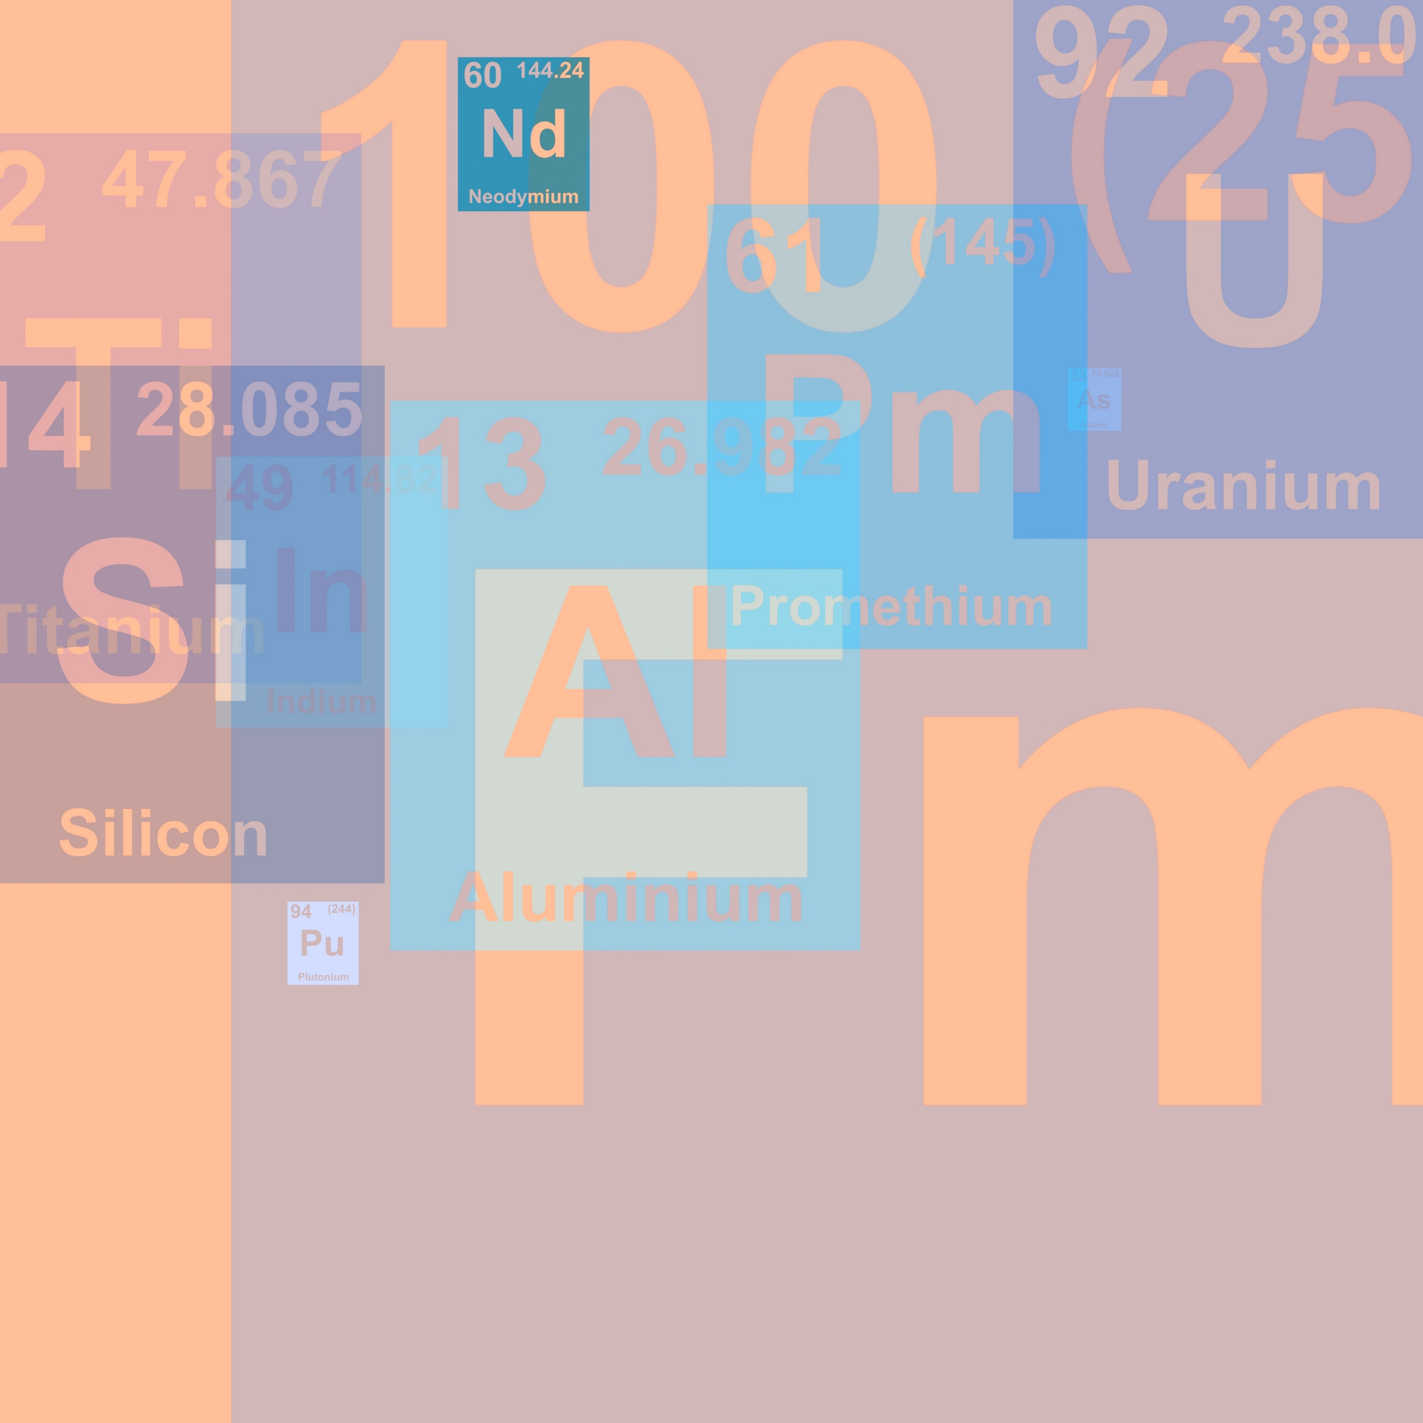
True Random Sources
There are a few sources of true randomness in the universe
One of them is radioactive decay
This entropy is possible to record, but impractical
We can’t easily carry around radioactive isotopes, nor expect the systems not to break

Slide 7
Pseudorandomness
Instead of relying on physical TRNGs, let’s use computer algorithms instead
Problem: computers are very predictable
There’s different algorithms for getting random bits
Two types: PRNG, CS-PRNG

Slide 8
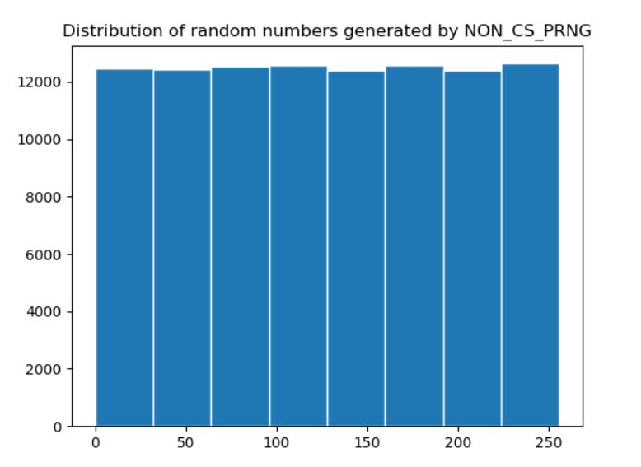
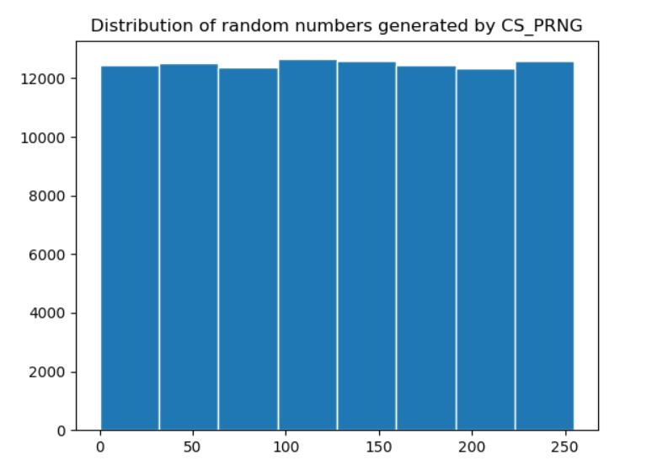
PRNG vs. CS-PRNG
Non-CS PRNG – Mersenne Twister
vs.
CS-PRNG – OS source via Python os.urandom()
Histogram showing the distribution of random numbers generated… what’s the actual difference?

Slide 9
PRNG vs. CS-PRNG
It’s not just about uniform distribution.
It’s about predictability of new random bits
Given 624 numbers, you can predict next numbers from Mersenne Twister
Cannot predict output of CS-PRNG function given previous bits

Slide 10
PRNG vs. CS-PRNG
Why do we care?
It’s critically important for many cryptographic uses of RNGs that the numbers be unpredictable
Ex: key generation for a crypto exchange
Imagine an attacker gets hold of 650 keys in a leak, and then can predict new keys!

Slide 11
CS-PRNGs
Seed -> Feed
Use relatively unpredictable environmental sources
  Mouse movement, key press timings, accelerometer, temperature, etc.
  Can even be manually generated, like dice rolls
Feed those sources to a cryptographic function
  SHA hashing algorithm, AES block cipher in CTR mode
  Production algorithm: Fortuna
Get unpredictable random bits out the other end

Slide 12
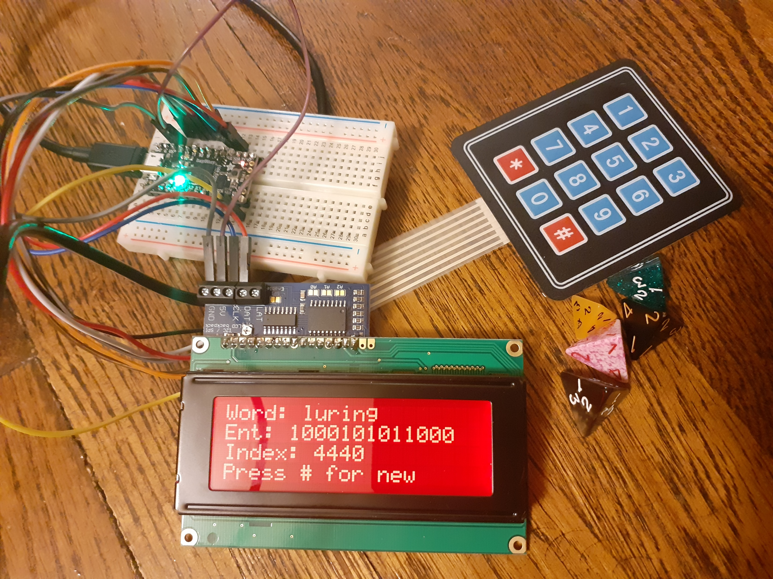
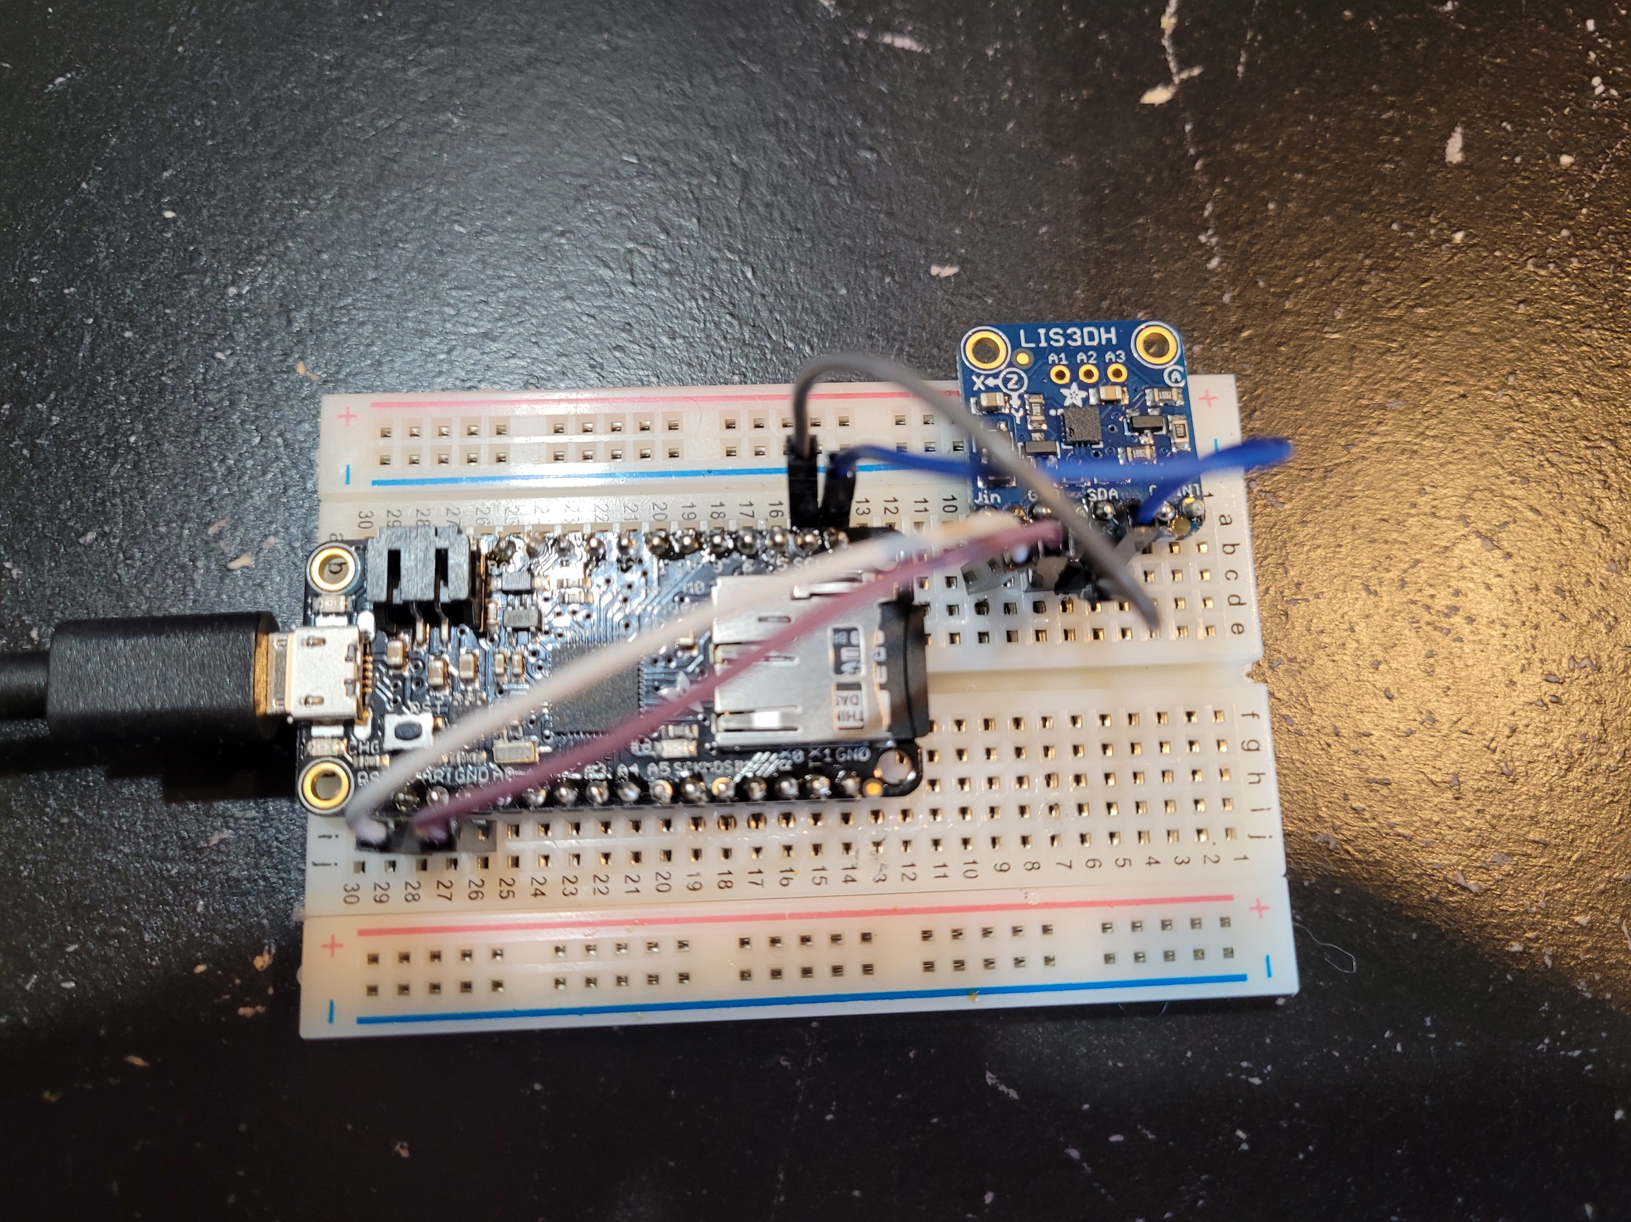
Demos:
https://github.com/chaintuts
Entropal: Diceware password generator showing bits of entropy
EntropyCollector: Generates passwords from accelerometer entropy

Slide 13
Uses of Cryptographic Randomness in Cryptocurrencies
Key generation
Signatures
Proof-of-Work
Proof-of-Stake
and what happens when these
things break…

Slide 14
Key Generation
Private keys are the core of cryptocurrency ownership – your keys, your coins. Not your keys, not your coins!
Key must be random – keys themselves are 256 bits, but often start from 128 bit seed which is key stretched
256 bit keys give so many possibilities, collisions are near impossible if the keys are random
  2^256 is around 10^64, on the order of the number of atoms in the observable universe

Slide 15
Key Generation - Breakage
What happens if keys aren’t random enough?
Pretty much worst-case scenario for crypto – the coins are stolen and moved to an attacker wallet.
Practical example: Brainwallets
  SHA-256 hash of a user-generated passphrase like “"Interior Crocodile Alligator” -> used as 256 bit private key
  Ryan Castellucci did a DEFCON topic and they released a tool called brainflayer
  They note that brainwallets are often drained in minutes to hours, even with seemingly strong passphrases
  Humans are bad at entropy

Slide 16
Signatures/Nonces
Signature algorithms such as secp256k1 (elliptic curve used in Ethereum and Bitcoin) require a nonce when signing messages (like transactions)
Nonce must be one time use
Nonce reuse can easily reveal private key
Ex: https://github.com/chaintuts - NotOKReuse
Sloppy wallet programming can lead to theft

Slide 17
Some Less Obvious Uses…
Proof-of-Work and Proof-of-Stake!
We have to make it difficult for an attacker to change the state of the blockchain, and to sustain an attack
In other words, we need the block “winner” to be chosen at random
But, we also want to reward those that invest more in mining/staking with a higher probability of being selected

Slide 18
Proof-of-Work
PoW uses the pseudo-random property of cryptographic hash functions like SHA-256
Require a block with a certain number of leading zero bits (ex: 4, real difficulty much higher)
  block + 0 -> 1aef0...
  block + 1 -> ed032...
  block + 2 -> 123ac8... . .....
  block + 4000 -> 0000a2
Difficulty: the more 0 bits, more guesses on average it takes to find a block
The mechanism is simple: more hashpower, higher chance of being the first to guess correctly

Slide 19
Proof-of-Stake
PoS again uses the pseudo-random property of hashes like SHA with a commit-reveal scheme for RNGs on the blockchain
Validator generates a random number from its CS source, hashes, commits to blockchain
Later, the number is revealed. The number can be hashed by other nodes to verify it’s the same hash that was committed
Numbers XORed for a random validator selection
It’s impractical for nodes to game the system in their favor, since they can’t easily change number after the commit (by finding a hash collision)

Slide 20

Let’s Get Random
There’s different types of RNGs – and the ones we need are cryptographically secure sources
  Use proven systems – like your OS’s random source
  Ex: Python os.urandom() NOT the random module
Random numbers are critical for obvious things like key generation/nonces
But they’re also critical for things like PoW and PoS algorithms that secure these networks
Getting random wrong has serious consequences, like coin theft

Slide 21
Questions?

