Slide 1






Subtle and not so Subtle Ways to Lose Your Cryptocurrency

Slide 2
A Little About Me...
Software Engineer @ Microsoft in Pittsburgh
Tech Educator @ chaintuts
Love to build free and open source technical education!
  Interested in cryptocurrencies, blockchains, digital security topics
  Tired of meeting folks after they lost money – I want to help people before that happens

Slide 3


Cryptocurrency – Powerful But Vulnerable….
Cryptocurrencies are powerful tools with irreversible transactions and PKI
Thieves and scammers take advantage of this
What you’ll get:
  Common attack vectors & mitigation techniques
  Take this back to your products, users, etc.!

Slide 4


Cryptocurrency – Powerful But Vulnerable….
Social Engineering
Malware
User Error
Bad Security Hygiene Practices
Wallet Implementation Problems
… all ways real users get rekt. Let’s talk about fixing that!

Slide 5
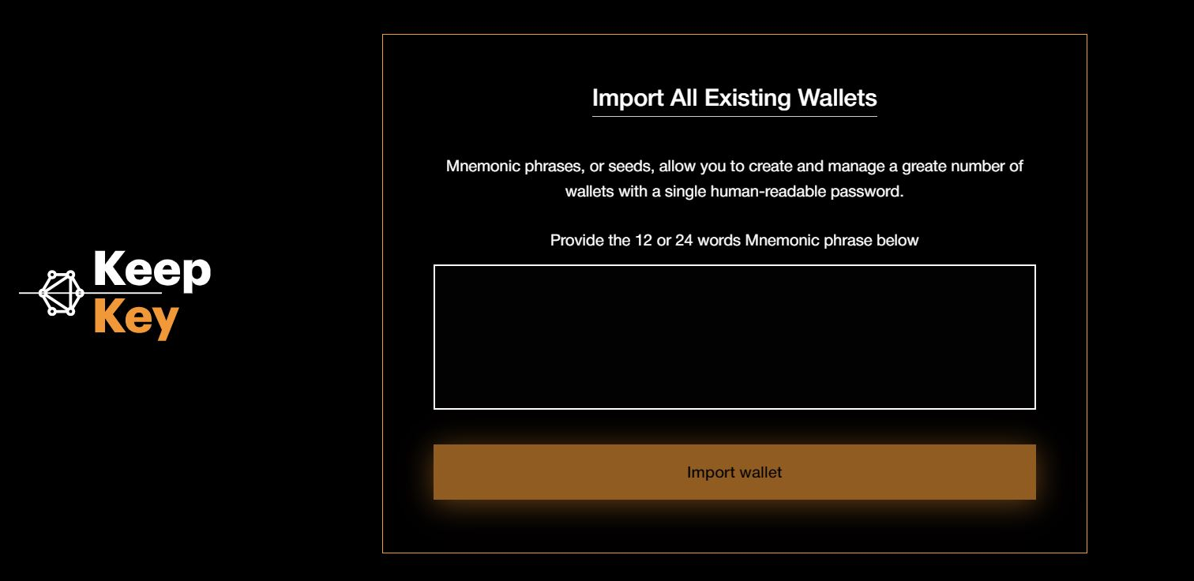
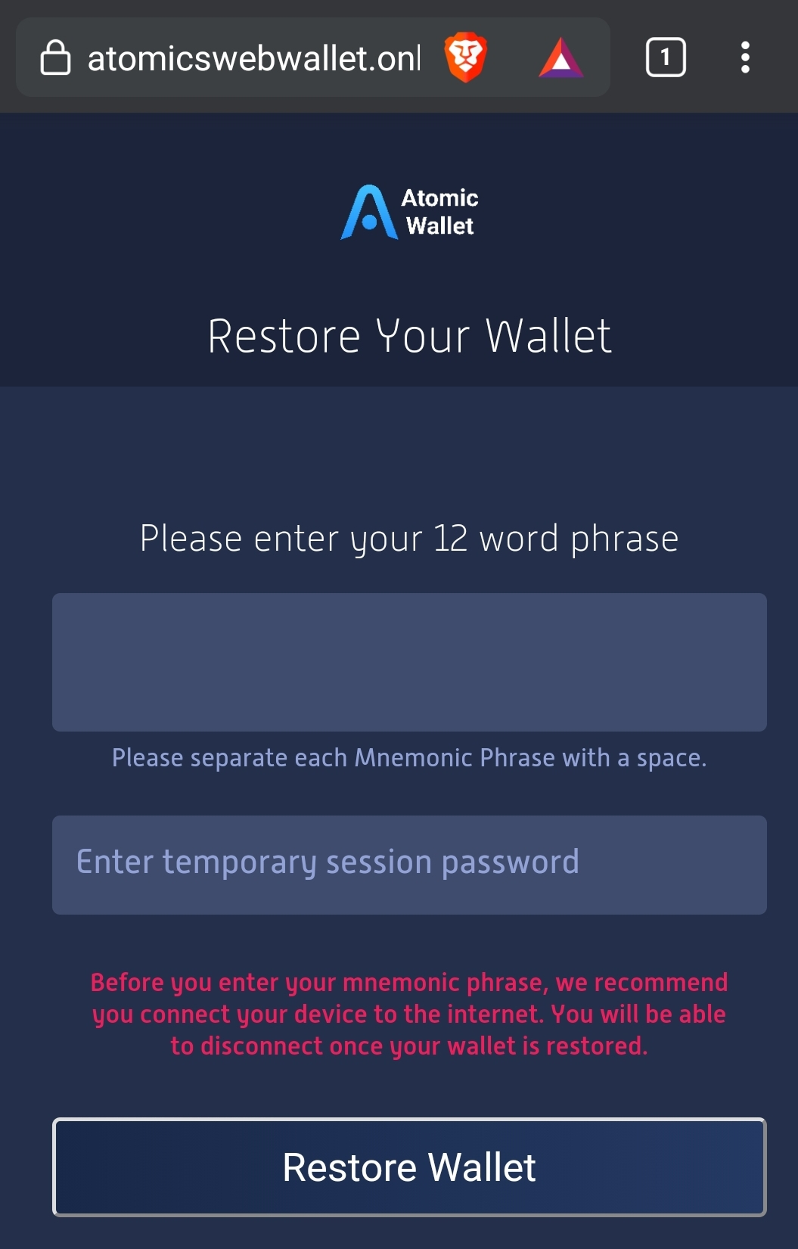
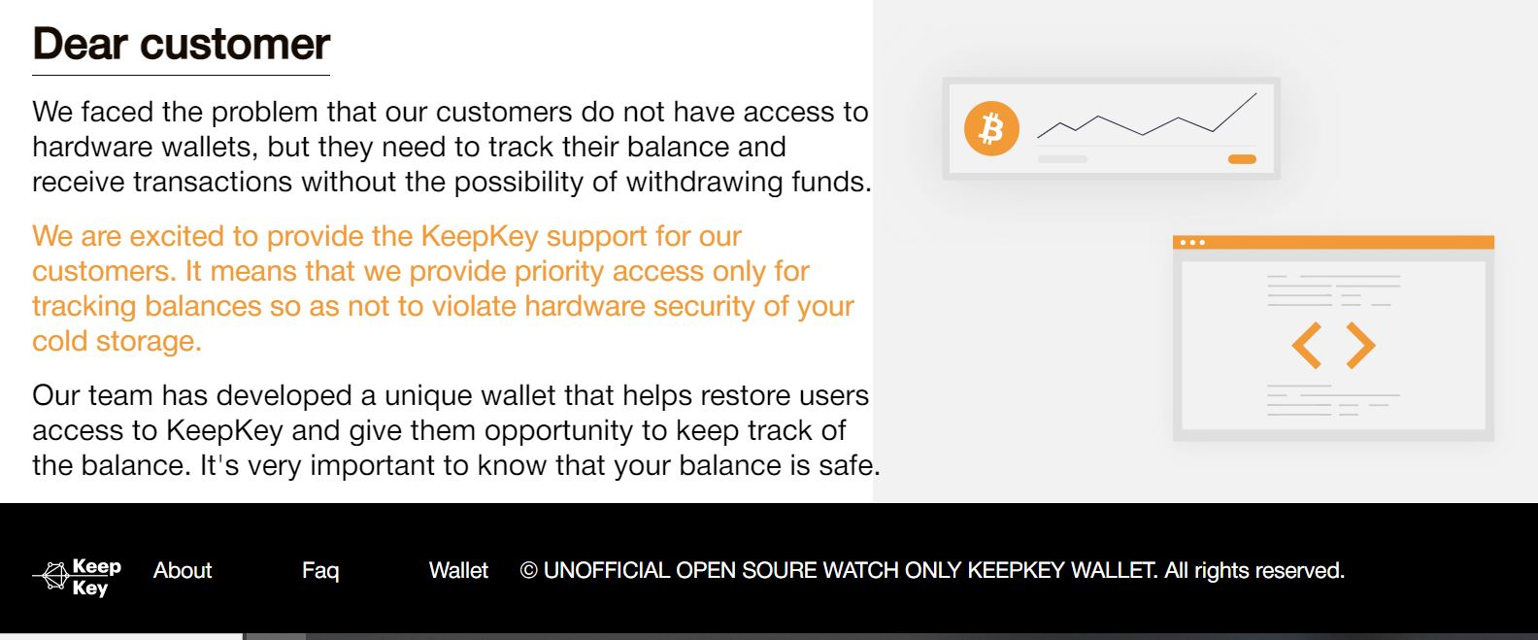
Social Engineering #1 – Fake “Support”

Slide 6
Social Engineering #1 – Fake “Support”
Example #1 - Crypto company "support" phishing - ex: fake KeepKey wallet tools
Attack: trick the user into giving up account access (via 2FA codes/password reset) or seed phrase (direct access to keys)
Countermeasures: Know that no legitimate support will ask for 2FA codes, seed phrases
  We need warnings on our stuff; reminders for end users

Slide 7
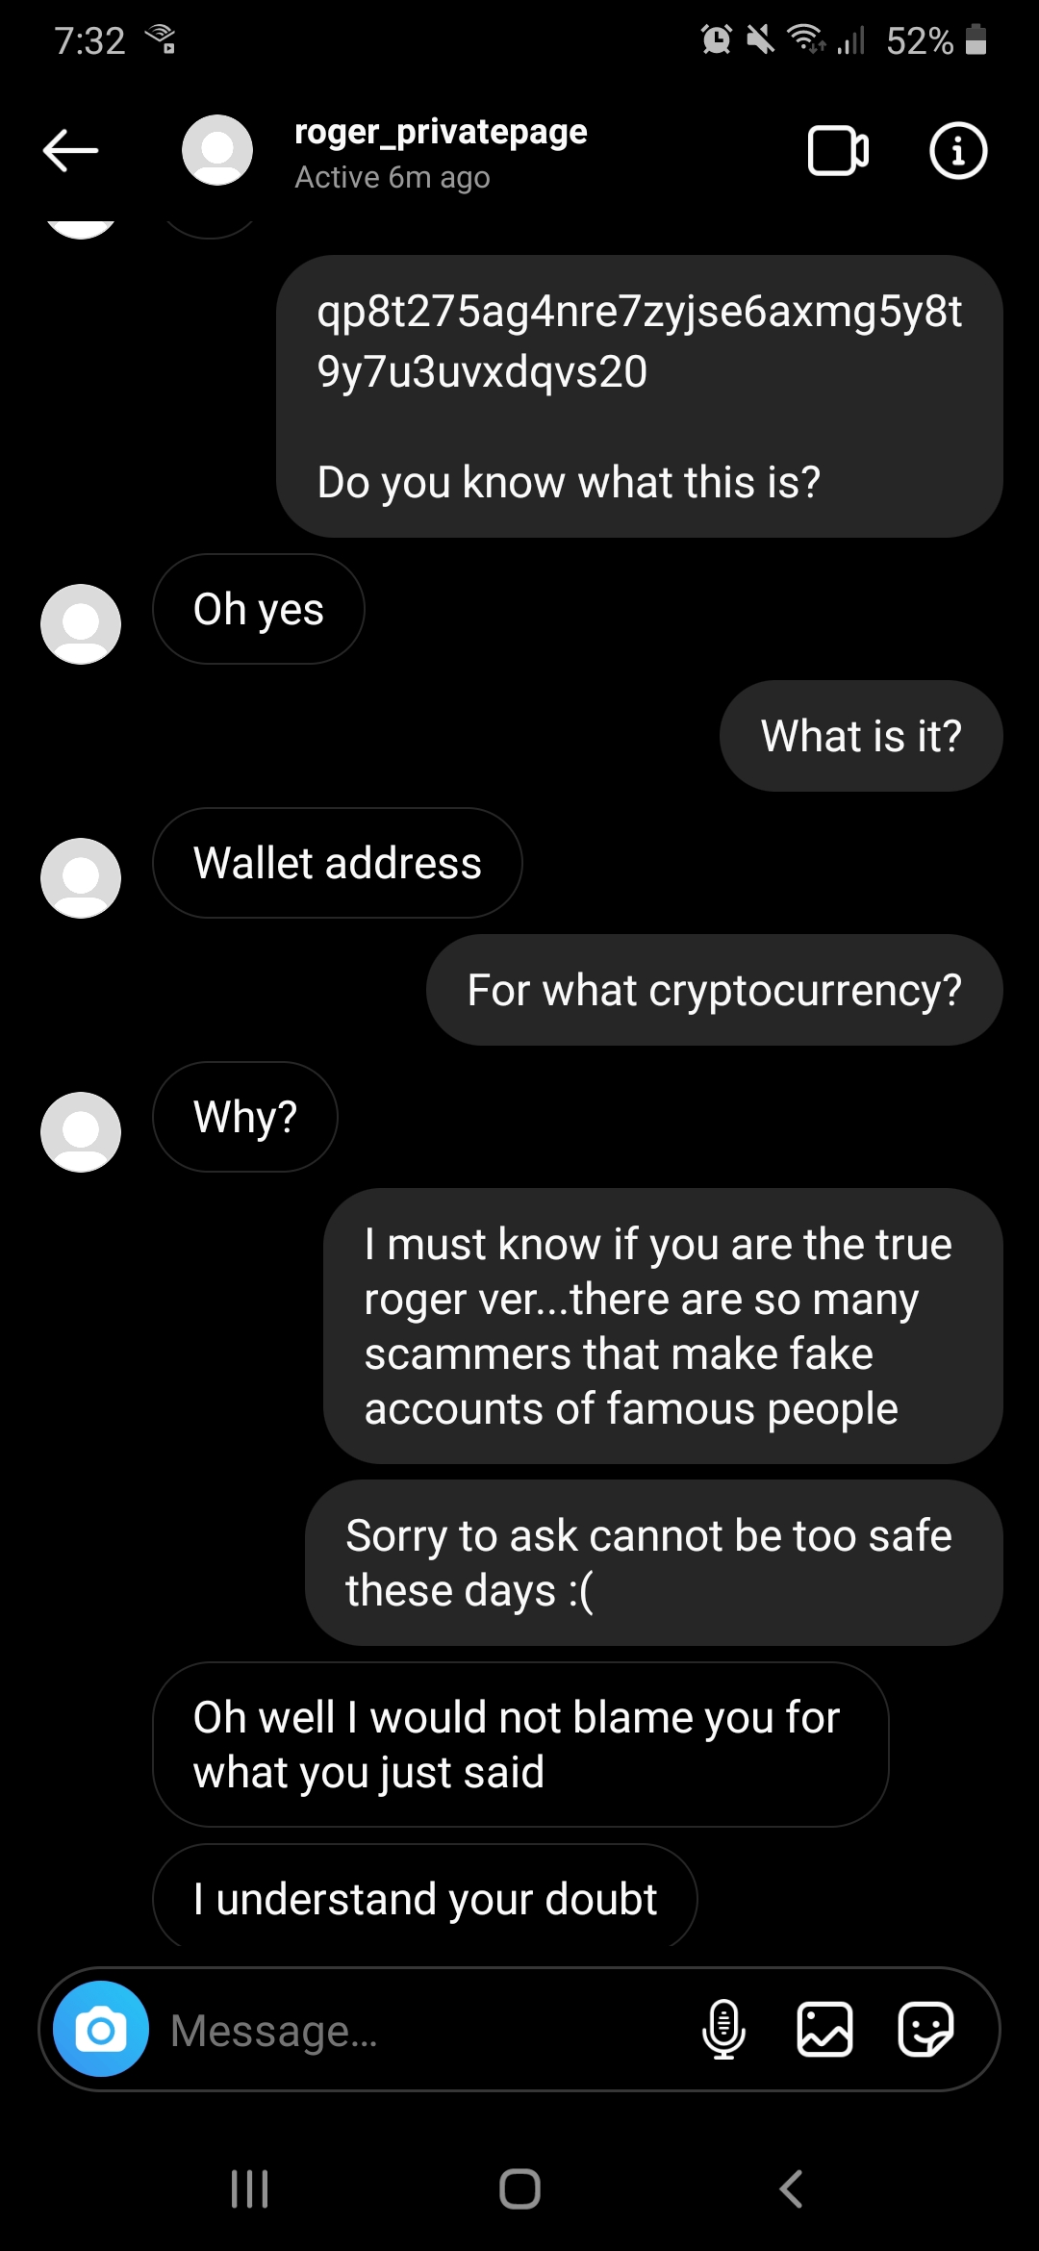
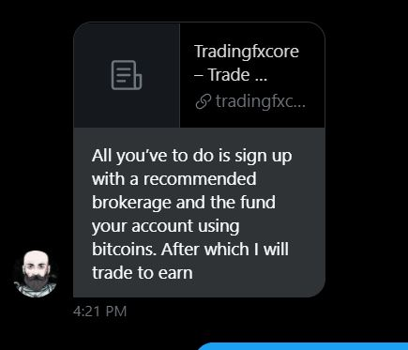
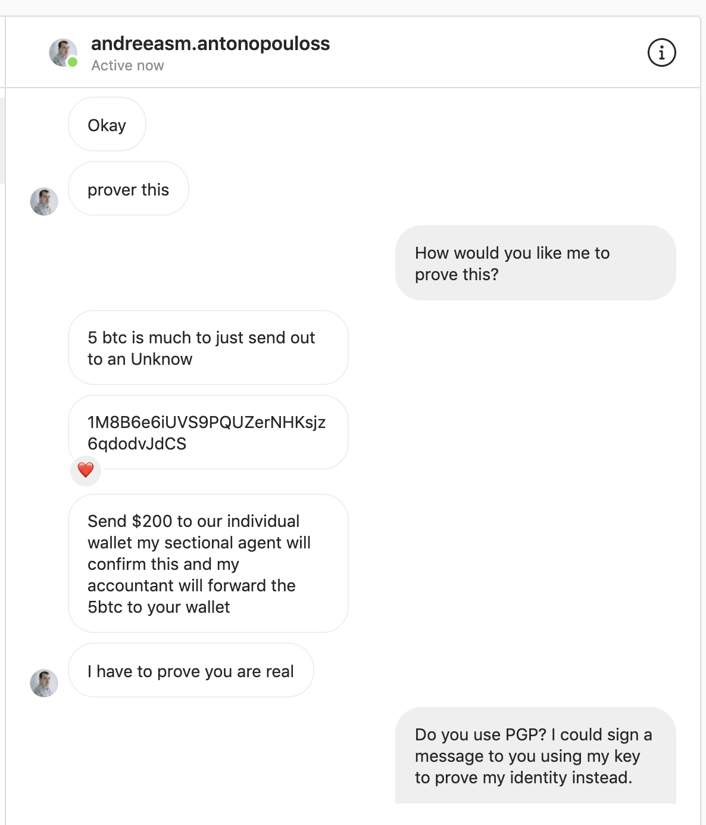
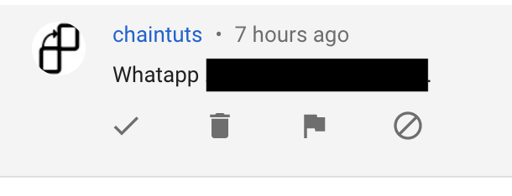
Social Engineering #2 – Impersonation

Slide 8
Social Engineering #2 – Impersonation
Example #2 – Impersonation ex: fake Andreas, Roger, chaintuts, etc.
Attack: an account impersonating a crypto celebrity tricks you into sending Bitcoin to a fake, but convincing "Bitcoin investment" website
Countermeasures: awareness of the irreversibility of crypto transactions, what these scams look like, impersonation tactics
  Ex: Andreas’ Twitter bio says “BEWARE of giveaway scams” - a simple message goes a long way

Slide 9
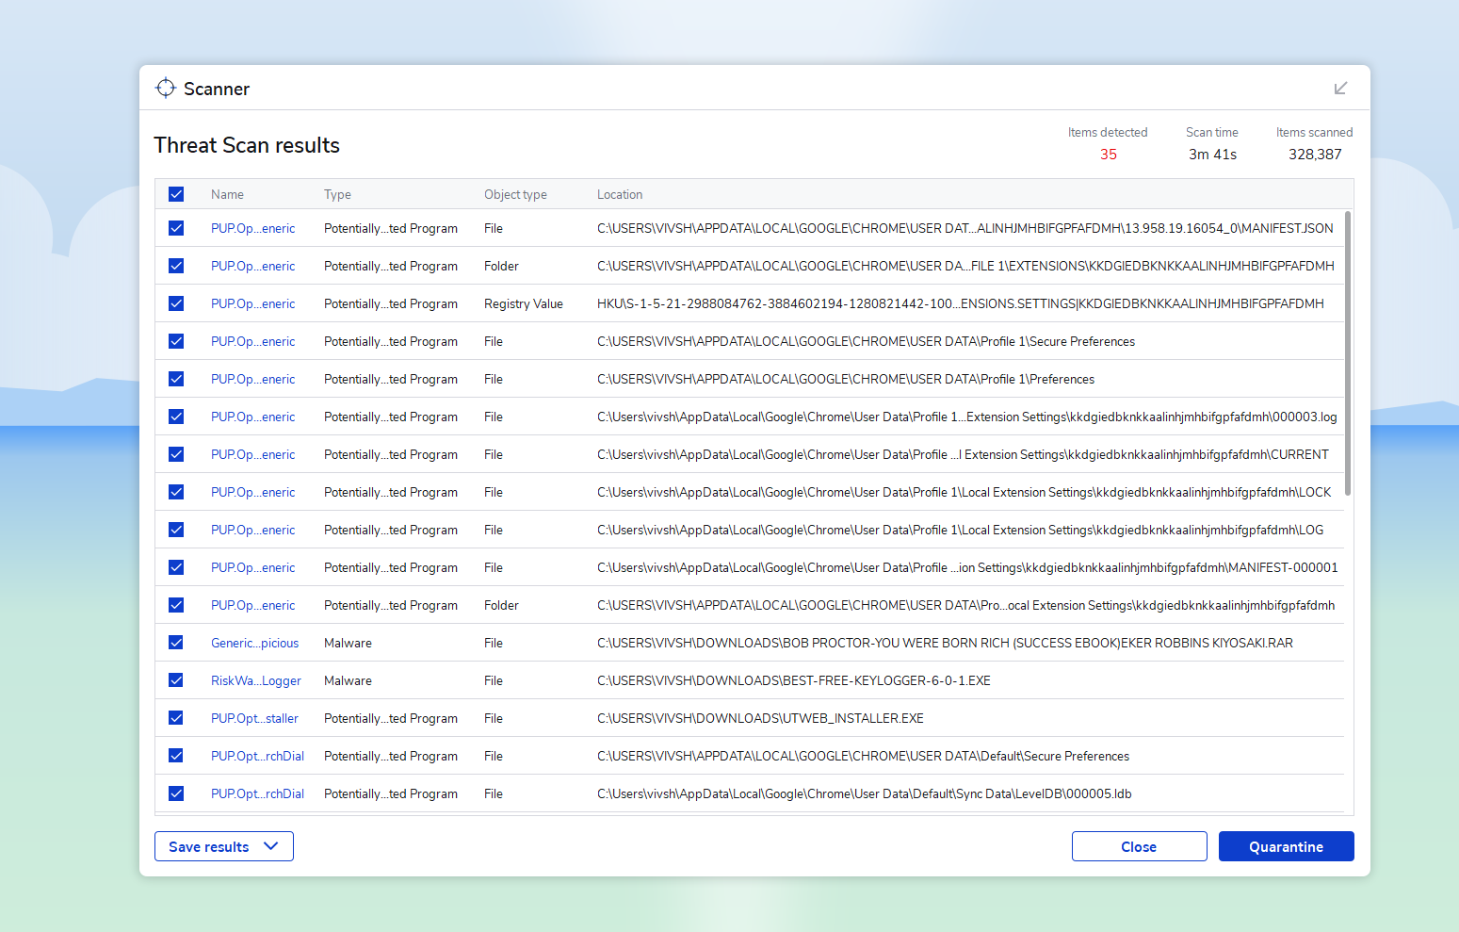
Malware – Clipboard Swaps

Slide 10
Malware – Clipboard Swaps
Example – my homebrew “AddrJack”
  Https://github.com/chaintuts/addrjack
  https://youtu.be/suOpeSUlwN8 - Quick demo
  It takes all of 30 minutes to make a basic one, and real ones are more sophisticated!
Attack: malware on a user's computer senses a crypto address in the clipboard, swaps it to an attackers. The user pastes the malicious address and sends coins to the attackers
Countermeasures: Always double, triple checking that addresses match the intended recipient’s

Slide 11
User Error #1 – “Cross Chain” Swaps

Slide 12
User Error #1 - “Cross Chain” Swaps
Attack: Not an attack, but a user error.
  The user mistakenly sends Bitcoin Cash to a Bitcoin address, or mixes one Ethereum token for another.
  For exchanges, this results in permanent loss of funds. For non-custodial wallets, recovery through manual intervention is sometimes possible.
    I have done successful manual recoveries, but they are 1 in 100
Countermeasures: Always double, triple checking the address belongs to the intended Cryptocurrency
  EVERY WALLET UI/UX should have this warning. None that I know of actually do.

Slide 13
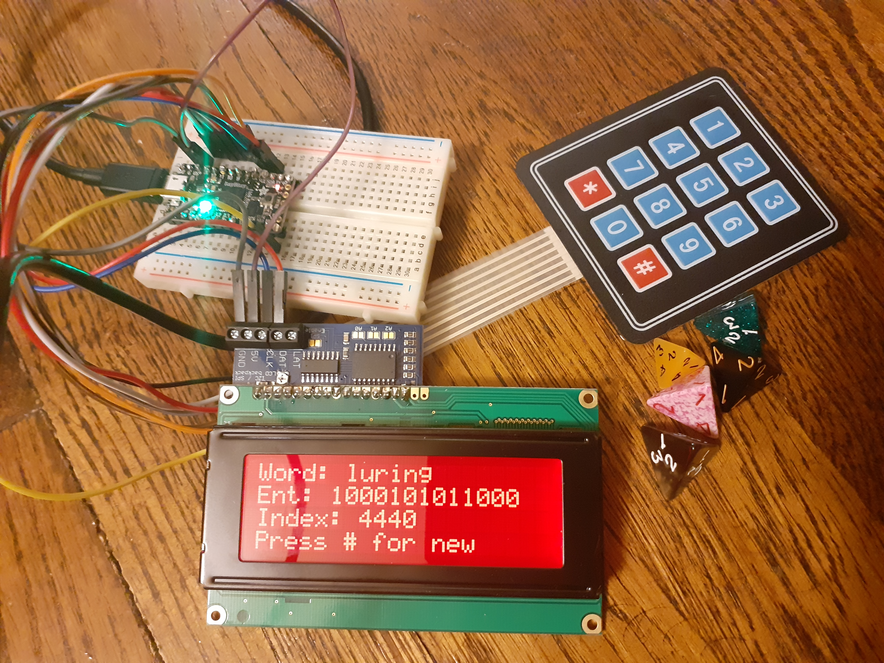
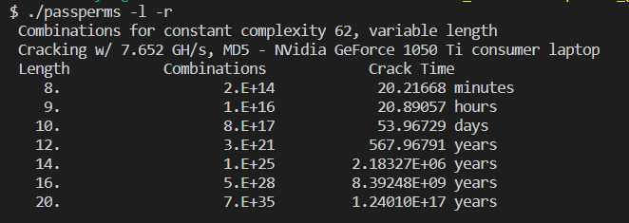
Security Hygiene #1 - Passwords
PassPerms – a basic password cracking time demo that shows why length > complexity in general
https://github.com/chaintuts/passperms
Entropal – a hardware diceware demo
https://github.com/chaintuts/entropal

Slide 14
Security Hygiene #1 - Passwords
Attack:
  The user reuses an insecure password between other accounts and an exchanage (ex: Coinbase) or web wallet (ex: blockchain.com).
  A breach exposes the password and the attacker compromises the user's exchange/wallet accounts
Countermeasures: Proper password hygiene - no password reuse, long passphrases/randomly generated passphrases, the use of secure password managers
  If you own a crypto-related website, insist on whatever the industry standard is for user passwords
  Don’t allow your users to mess this up

Slide 15
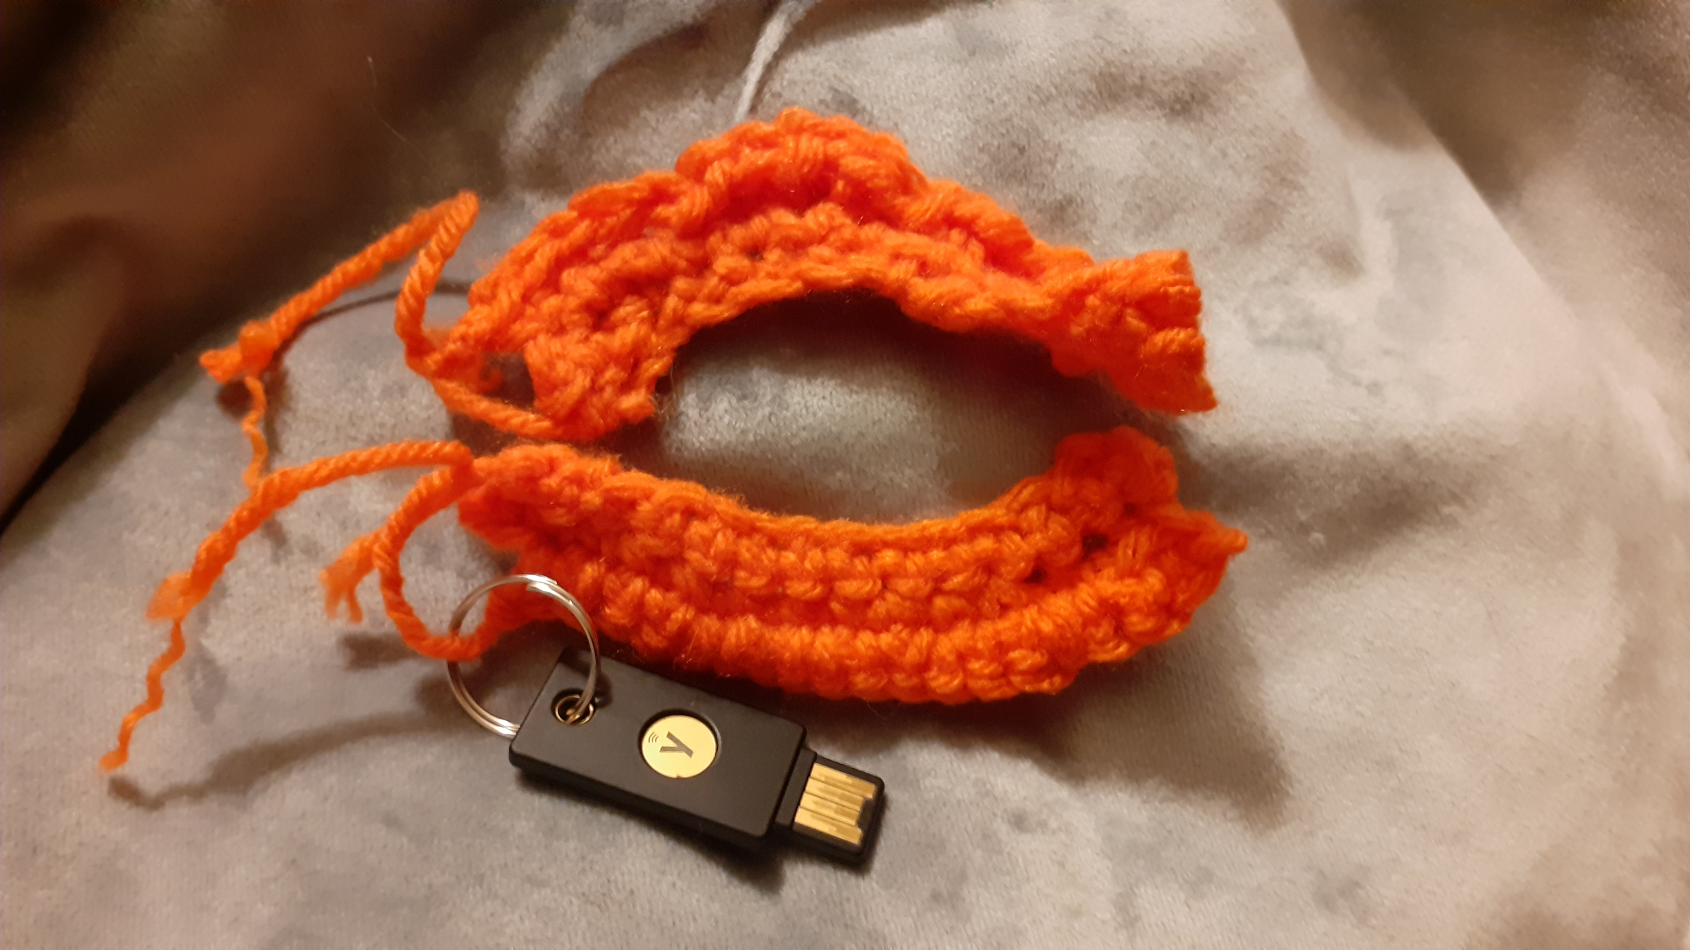
Security Hygiene #2 - 2FA
SIM swaps – an all-too-common plague in the crypto space
Attack:
  The attacker knows the user has SMS-based 2FA on an exchange and an exposed phone number.
  The attacker socially engineers the phone company into porting the number to their device.
  The attacker initiates a password reset to compromise the user's account.
Countermeasures: Only using App-based/TOTP (okay) or security key (best) based 2 factor authentication
  If you own a crypto related website, do not use SMS 2FA. Just don’t.
  And be the coolest by enabling U2F/FIDO security keys!

Slide 16
Poor Wallet Implementations
Wallet implementation/installation issues - ex: Electrum phishing attack, ECDSA nonce reuse, brainwallets
Attack: varies, the attacker uses some poor implementation detail to compromise a wallet software or wallet keys, gaining direct access to user funds
Countermeasures:
  signature/hash verification of software
  use of well-audited and reputable wallet software
  never using brainwallets/paper wallets

Slide 17
Final Thoughts
A lot of this probably isn’t news to you – and that’s the point
These are common ways real people lose money, every day
MOST attacks are mitigated by common-sense, relatively non-technical countermeasures
It’s our job as industry professionals to educate our users, implement sound user experiences, build secure software, and develop best practices - This industry is so new, everyone watching this can be a part of building better security – go do it!

Slide 18
Questions?
Twitter @chaintuts
chaintuts.com – Contact Form
DEFCON discord @joshmcintyre#2481
I would love to hear from you – Seriously, get in touch with those questions and feedback!
This content is licensed under CC-BY 4.0 – reuse is encouraged!

