Slide 1
Muddemal
Digital Seized Asset Management System Handbook

Slide 2
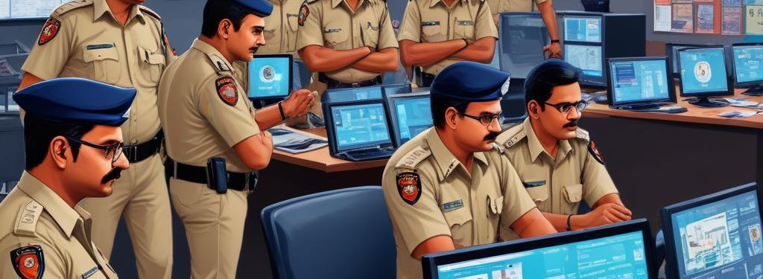
Introduction
This presentation outlines the Muddemal system designed for efficient management of seized assets by Maharashtra Police.

Slide 3
01
Introduction

Slide 4

Project Overview
Muddemal is a cutting-edge desktop application that simplifies and modernizes the management of seized assets in Maharashtra Police stations. It harnesses advanced digital technologies to enhance accuracy, increase transparency, and significantly improve efficiency in asset tracking. The system reduces administrative burdens, streamlines judicial processes, and fosters accountability. Developed by Chainworks Digital Private Limited, known for successful government projects, Muddemal is tailored for law enforcement through collaboration with police departments, ensuring reliability and practical applicability.

Slide 5

Project Scope
The scope of Muddemal encompasses comprehensive management of seized assets, featuring automated data entry through OCR, AI-driven asset classification, secure record-keeping leveraging blockchain technology, real-time asset tracking with QR codes, and digital handling of evidence such as photographs, videos, and documents. The application also supports a multilingual interface, making it accessible in English, Hindi, and Marathi.

Slide 6

Intended Audience
The intended audience for Muddemal includes police officers and station administrators who will utilize the application for managing seized assets. Additionally, the system is relevant for the Maharashtra state police departments and judicial and legal officers who need access to asset tracking and digital evidence. The design and functionality of Muddemal prioritize user experience, ensuring that all stakeholders can effectively engage with the system.

Slide 7
02
Architecture

Slide 8
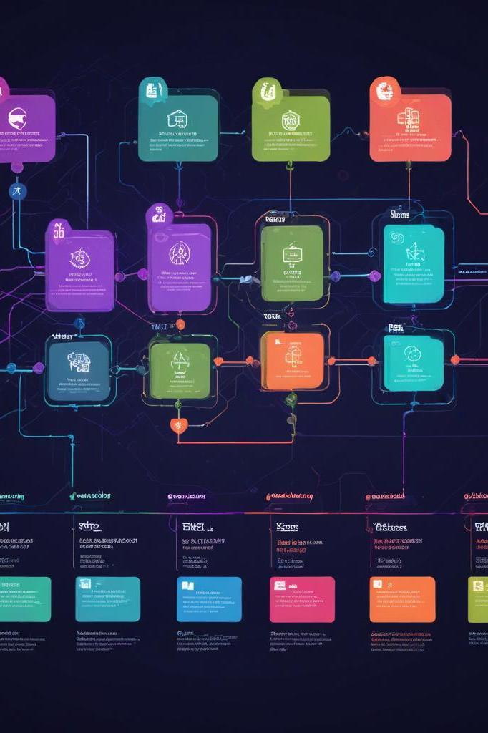
Modules/Components
The Muddemal system is structured around several key modules designed to facilitate various aspects of seized asset management. The Data Entry Module enables automated uploading of FIRs through Optical Character Recognition (OCR), while the Blockchain Module ensures secure and immutable data storage. The AI Module employs intelligent classification of assets, the Tracking Module facilitates real-time asset tracking using QR codes, and the Digital Evidence Module manages multimedia file uploads. Lastly, the Multilingual Interface supports the application in English, Hindi, and Marathi, enhancing accessibility.

Slide 9

Data Flow
The data flow within Muddemal is streamlined to ensure efficiency and accuracy. Initially, FIR documents are scanned or uploaded, after which the OCR module extracts necessary data for processing. The verified data is securely stored on the blockchain to ensure integrity and prevent tampering. Items are then classified by the AI module for optimal management. QR codes are generated for each asset, enabling precise tracking. Additionally, all digital evidence is uploaded and securely stored, allowing for real-time access and monitoring by authorized personnel.

Slide 10

Technology Stack
Muddemal is built on a robust technology stack that facilitates its various functionalities. The frontend is developed using React, providing a dynamic and responsive user interface. Node.js powers the backend, ensuring a solid framework for server-side logic. The database is managed using SQL, with Prisma ORM for efficient data handling. The application is designed using the Electron framework for desktop deployment, while blockchain functionalities are supported through the Ethereum platform using Solidity Smart Contracts. Integration with Python enables the use of Tesseract OCR for data extraction.

Slide 11

Conclusions
In conclusion, Muddemal represents a significant advancement in the management of seized assets within Maharashtra's police stations. By leveraging cutting-edge technology such as blockchain, AI, and comprehensive data management practices, the system promotes efficiency, transparency, and accountability. The collaborative development approach ensures that it meets the specific needs of law enforcement, making it a vital tool in enhancing operational effectiveness.

Slide 12
Thank you!
Do you have any questions?
+91 620 421 838

