Slide 1
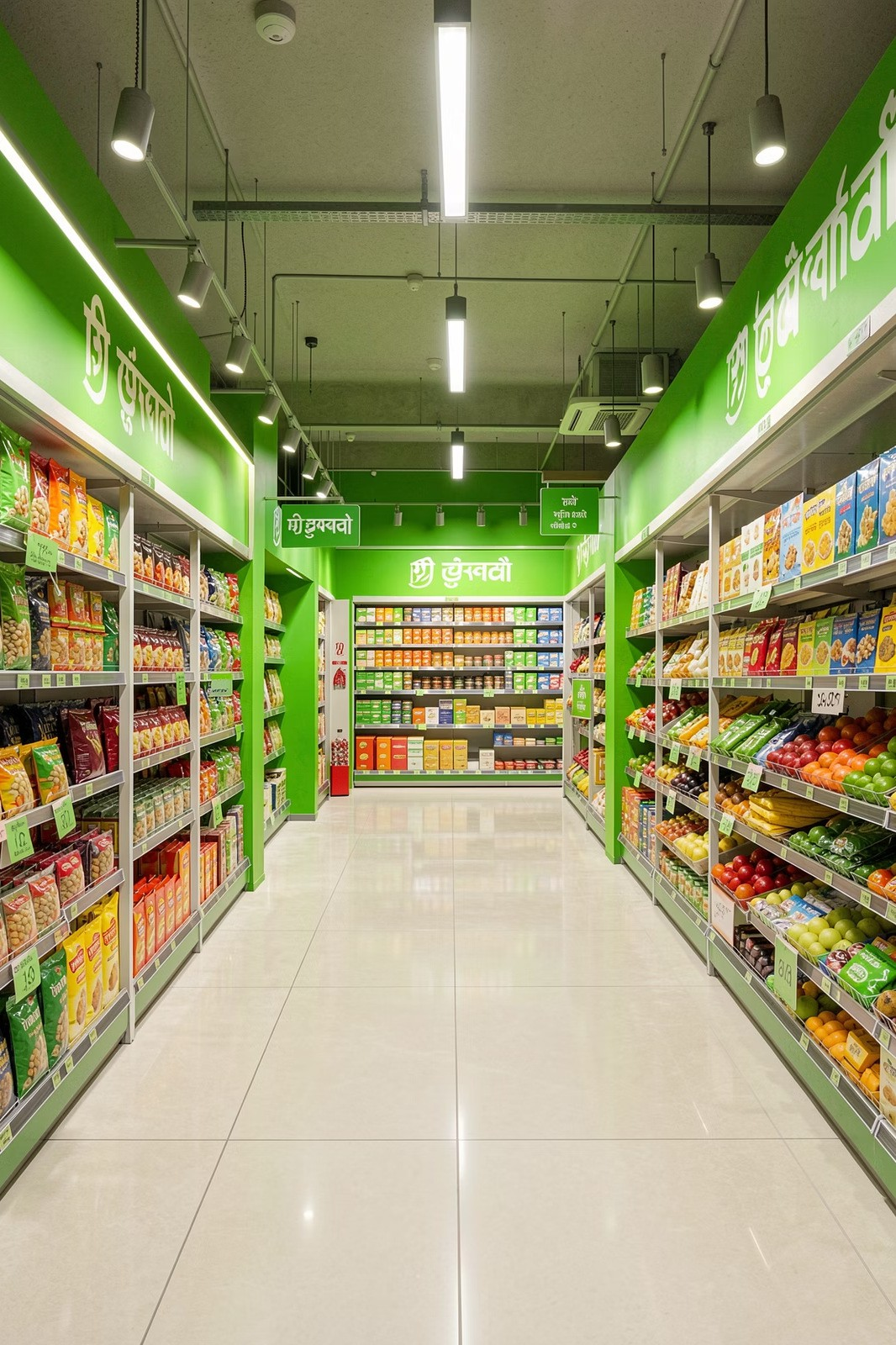
DMART SALES ANALYTICS
Sprint 2: Revenue Metrics Calculation

Slide 2

What We're Building in Sprint 2
SPRINT OBJECTIVE
After completing data cleaning in Sprint 1, we now build business-critical KPIs using Excel formulas. The goal is a clean, calculation-ready dataset that feeds directly into future dashboard reporting for senior management.
Input
Cleaned order & product data from Sprint 1
Process
Excel formulas — Revenue, Profit, Margin, Discount
Output
KPI summary ready for dashboard reporting

Slide 3
7 Business Requirements (BRD)
BUSINESS REQUIREMENTS DOCUMENT
Each requirement maps to a specific calculation or reporting output for senior management's KPI summary.
1 2
3
Revenue per Order
Sales Price × Quantity
Profit Earned
Revenue − Cost
Discount Amount
Original − Discounted Price
4
5
6
Profit Margin %
Profit ÷ Revenue
Total Sales Summary
Aggregate all orders
Top Categories
Category-wise performance
7
KPI Dashboard Prep
Final summary output

Slide 4

Revenue & Profit Calculations
CORE FORMULAS
BR-f: Revenue per Order
Multiplies the unit sales price by quantity sold to derive total revenue for each order line.
= [Sales Price] * [Quantity]
BR-2: Profit Earned
Subtracts the total cost of goods from revenue to reveal actual profit per order.
= [Revenue] - [Cost]
Revenue Formula
Sales Price × Quantity
Profit Formula
Revenue − Cost
Always reference the cleaned data columns from Sprint 1. Avoid hardcoding values.

Slide 5
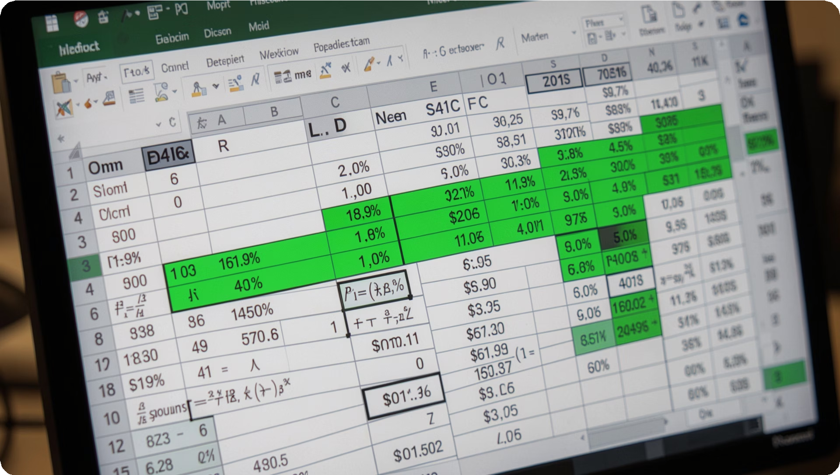
Discount & Profit Margin
CORE FORMULAS
BR-3: Discount Amount
Captures the total discount given per order line — the difference between list price and actual selling price.
= [Original Price] - [Discounted Price]
BR-h: Profit Margin %
Expresses profit as a percentage of revenue. Format the cell as Percentage (%) in Excel.
= [Profit] / [Revenue]
A margin below 10% may flag low-performing SKUs for review.

Slide 6

Summarising & Validating Data
AGGREGATION & LOOKUP
SUM / SUMIF
Aggregate total revenue, profit, or quantity across all orders or filtered by a condition.
Pivot Tables
Quickly summarise sales by category, region, or date for the KPI dashboard summary.
VLOOKUP / XLOOKUP
Validate product IDs and fetch category or cost data from reference tables.
=XLOOKUP
=VLOOKUP
=SUM(E2:E1000)
=SUMIF(Category,"Electronics",Reve nue)
Insert → PivotTable Rows: Category Values: SUM(Revenue)

Slide 7

Total Sales Summary & Category Performance
BR-5 & BR-6
BR-5: Total Sales Summary
Use SUM() across all order rows to compute grand totals for Revenue, Profit, and Quantity Sold — the headline figures for management.
BR-6: Top Performing Categories
Use a Pivot Table grouped by Category with SUM(Revenue) to rank categories. Grocery and Electronics typically lead at DMart.
Sort Pivot Table by Revenue (Descending) to instantly surface top performers.

Slide 8
BR-7
Preparing the KPI Summary for Dashboard
Consolidate all calculated metrics into a single KPI Summary Sheet — the foundation for future Power BI or Excel dashboard sprints.
₹
Total Revenue
💰
Total Profit
%
Avg. Margin %
₹39.26M
₹6.87M
17.51%
Gross sales across all regions
Net profit after all deductions
Average profit margin per order
🛒
Total Orders
📦
Qty Sold
15,345
76,831
Total transactions processed
Total units sold across categories

Slide 9
Formula Cheat Sheet
QUICK REFERENCE
Keep this reference handy while working through Sprint 2 tasks.
KPI | Formula | Example
Revenue | Sales Price × Quantity | =C2*D2
Profit | Revenue − Cost | =E2-F2
Discount | Original − Discounted Price | =G2-H2
Margin % | Profit ÷ Revenue | =I2/E2
Total Revenue | SUM of Revenue column | =SUM(E2:E1000)
Category Total | SUMIF by Category | =SUMIF(B:B,"Grocery",E:E)
Product Lookup | XLOOKUP / VLOOKUP | =XLOOKUP(A2,Prod!A:A,Prod!C:C)

Slide 10

What to Submit to Rajesh
SPRINT 2 DELIVERABLES
0!
Updated Excel Workbook
All formulas applied — Revenue, Profit, Discount, Margin % columns populated for every order row.
02
KPI Summary Sheet
A dedicated tab with total Revenue, Profit, Margin %, Discount Impact, and Quantity Sold.
03
Category Performance View
Pivot Table or summary showing revenue breakdown by product category — sorted by top performer.
0h
Validation Check
Use XLOOKUP/VLOOKUP to confirm product IDs and categories match the master reference table.

