Slide 1

Sprint 7 – EX7: Regional Sales Analysis
Business Intelligence Reporting using Microsoft Excel
DMART · BUSINESS INTELLIGENCE TEAM

Slide 2


Business Problem & Objective
The Challenge
Large regional datasets with no consolidated view Difficult cross-region performance comparisons Limited visibility into revenue contribution
Need for management-ready visual reports
Our Objective
Transform raw regional sales data into clear, visual insights 4 enabling DMart leadership to make faster, smarter, data-driven decisions across all four regions.
Raw Data
Analysis
Insights
Dashboard

Slide 3
Dataset Overview & KPIs
Four regions — North, South, West, and East — analyzed across revenue, profit, orders, and units sold.
₹39.26M
Total Sales
Combined revenue across all regions
₹6.87M
Total Profit
Net profit from all regional operations
15,385
Total Orders
Transactions processed across regions
76,531
Units Sold
Individual product units delivered

Slide 4
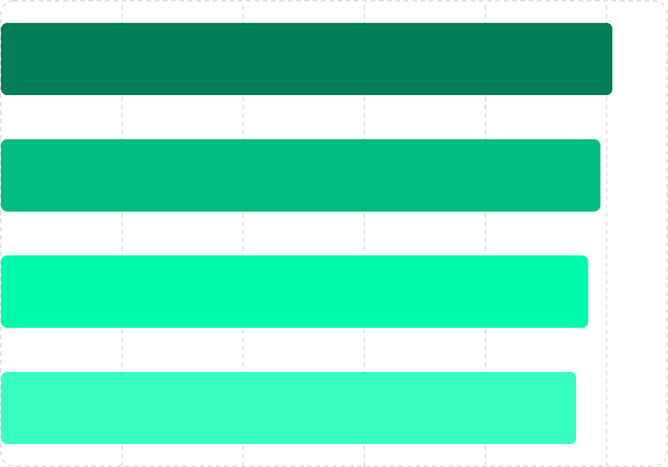

Region-wise Revenue Analysis
EXCEL TOOL: SUMIF / PIVOT TABLE
Region
Key Insight
North Region leads with ₹10.1M — the highest revenue contributor among all four regions. The gap between North and East is just ₹0.6M indicating a well-distributed revenue base with minimal regional disparity.
North
South
West
North contributes 25.7% of total revenue — the strongest single-region share.
East
0
2
—
6
Revenue (₹M)
8
10

Slide 5

Revenue Contribution by Region
FORMULA: REGION REVENUE ÷ TOTAL REVENUE × 100
Balanced Revenue Distribution
All four regions contribute nearly equal shares to total revenue — each representing approximately 24–26% of the ₹39.26M total. This balanced distribution reduces dependency on any single market and supports stable diversified growth.
North · 25.75%
South · 25.25%
West · 24.75%
East · 24.25%
North
25.7%
South
25.2%
West
24.7%
East
24.2%

Slide 6
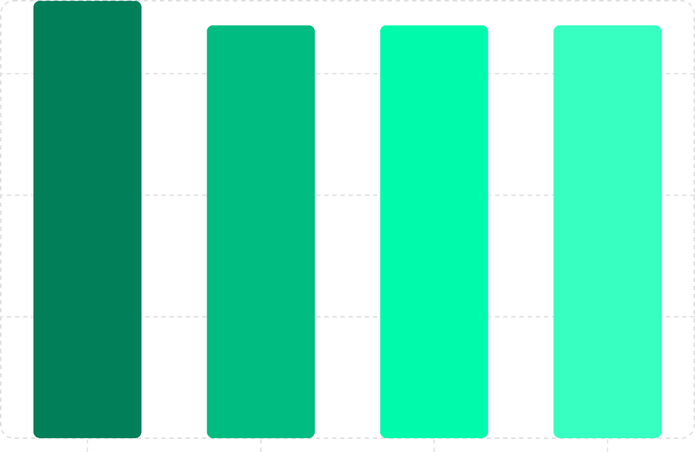

Region-wise Profit Analysis
EXCEL TOOL: SUMIF
Profit (₹M)
Key Insight
North Region generates the highest profit at ₹1.8M marginally ahead of the other three regions. All regions contribute almost equally to the total profit of ₹6.87M — reflecting consistent operational efficiency across the business.
1.5
1
0.5
Overall profit margin stands at 17.5% — a healthy indicator of cost management across all regions.
0
North
South
West
East
Region

Slide 7
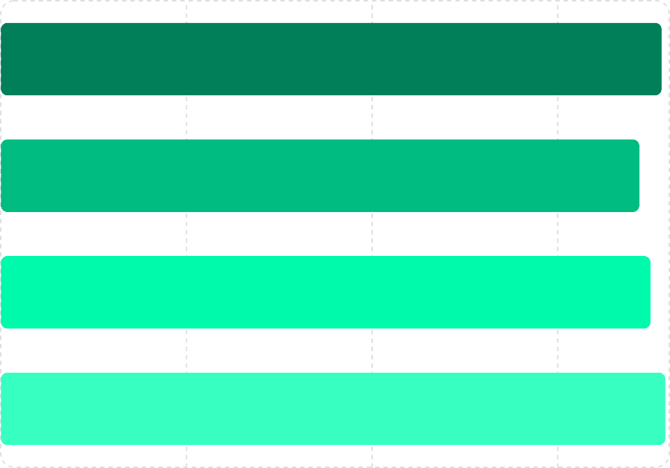
Profit Margin Comparison
FORMULA: (PROFIT ÷ REVENUE) × 100
Region
Average Margin: 17.5
Consistent Efficiency Across Regions
All four regions maintain profit margins tightly clustered between 17.2% and 17.9% — a variance of less than 1 percentage point. This uniformity signals strong, standardized operational practices company-wide.
North
South
West
East
0
5
10
Profit Margin (%)
15
Best Margin
East Region at 17.9%
Company Average
17.5% overall

Slide 8
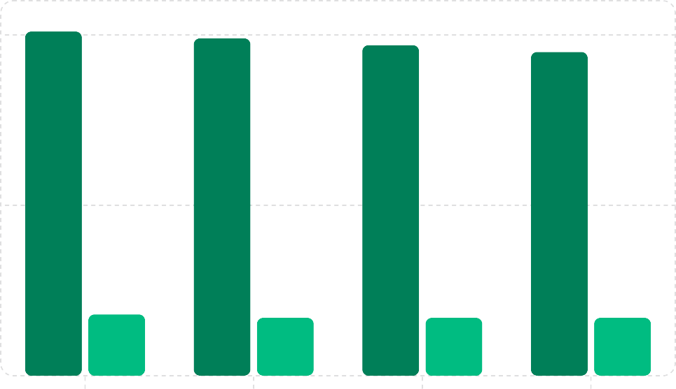
Regional Performance Summary
EXCEL TOOL: PIVOT TABLE + CHARTS
Revenue (₹M)
Profit (₹M)
Unified Regional View
North leads in both revenue (₹10.1M) and profit (₹1.8M), while all regions remain closely aligned. The minimal performance gap across regions reflects balanced market penetration and operational consistency.
10
5
North: ₹10.1M revenue · ₹1.8M profit — the top-performing region overall.
0
North
South
West
East
Region

Slide 9

Business Insights & Recommendations
North Region
Highest revenue and profit — consider increased investment and resource allocation to accelerate growth.
South, West & East Regions
Consistent performers with stable margins — focus on targeted campaigns to close the gap with North.
Strategic Outlook
Balanced regional contribution reduces risk — leverage this stability to pursue aggressive expansion goals.

Slide 10

Thank You
Data-Driven
Decisions Start Here
This analysis demonstrates how Excel-based Business Intelligence transforms raw regional sales data into strategic insights — empowering DMart leadership to drive growth with confidence.
Tools Used
Excel Formulas · Pivot Tables · Charts · Dashboards
Key Deliverables
KPI Summary · Revenue Analysis · Profit Comparison · Executive Dashboard

