Slide 1
PTG UI Generator

Slide 2
Introduction to PTG UI CLI
This is a command line tool which is used to generate UI application using modern frameworks like Angular, React, Vue. Generated application includes all best practices needed for enterprise applications.
The CLI is a powerful tool for creating, modifying, and maintaining any software project, and is particularly useful for customizing our UI projects. We can use this CLI, for example, to generate commonly-used UI patterns or specific components, using predefined templates or layouts. We can use this CLI to enforce architectural rules and conventions, making our projects consistent and inter-operative.

Slide 3
Features & Benefits
Common Codebase.
Multiple UI framework support.
Supports multiple CSS frameworks.
Supports internationalization.
State Management.
Routing.
Best coding practices.
Save Application Architect efforts Significantly from Days to Minutes .
Pre-installed VS code extensions.

Slide 4
Sample project Generation
User should be part of UI competency azure active directory.
To Generate project we have to setup Artifactory as primary step using following command.
The above command will globally install vsts-npm-auth package required to setup Artifactory.
For the next step the .npmrc file needs to be updated which is located at:
npm i -g vsts-npm-auth
C:\User\YourUserName

Slide 5
In case if .npmrc is not available on some system then those users have to create this file.
Below entry needs to be added in .npmrc.
To store credential in .npmrc, open command prompt and type the below command
After running this command it will ask for azure credentials that the user will have to provide.
registry=https://registry.npmjs.org/ @ptg-ui:registry=https://pkgs.dev.azure.com/YASHTech-UIUX/YASH-UIUX-Library/_packaging/UI-packages/npm/registry/
`vsts-npm-auth -config .npmrc`

Slide 6
The last step is package Installation. To install package following two steps are required.
Step 1: Install CLI Globally using below command.
npm i -g @ptg-ui
Step 2: Execute below command in the directory where the projects needs to be created.
ptg-cli

Slide 7
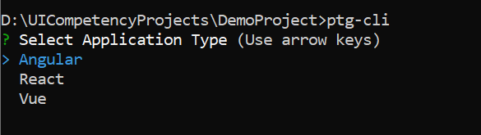
After running ptg-cli command following 3 applications are available that can be selected by user
For Now we will be generating Angular Application hence we selected Angular as application type from here.

Slide 8
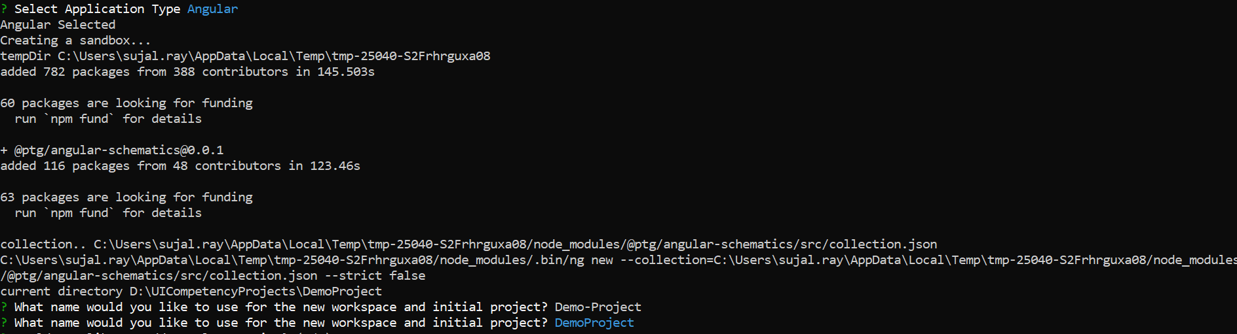
Sandbox creation gets started after selecting application type. This activity takes some time as many dependencies are added here.
Once sandbox gets created it ask for project name.

Slide 9
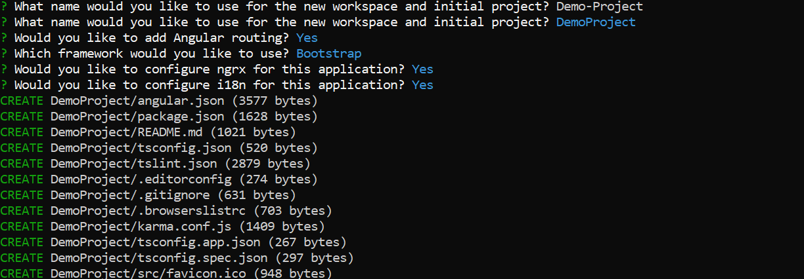
Similarly, it will ask for following set of generator questions.

Slide 10
Default set of routing is created as well as code gets generated based on user selection for bootstrap or material.
State management setup using ngrx is also provided.
Internationalization support is also there which can used for various language setup.

Slide 11
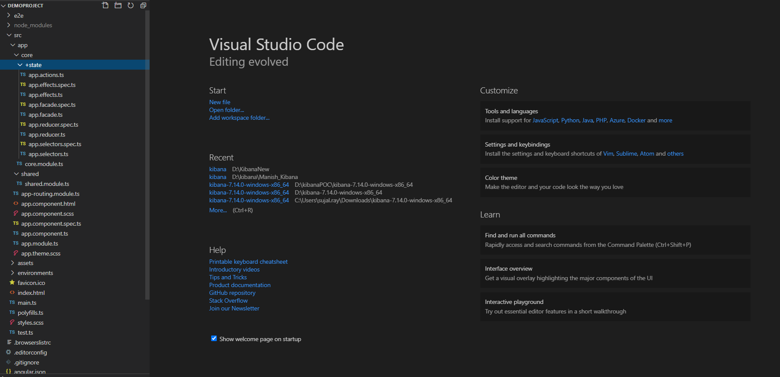
Following folder structure gets generated.

Slide 12
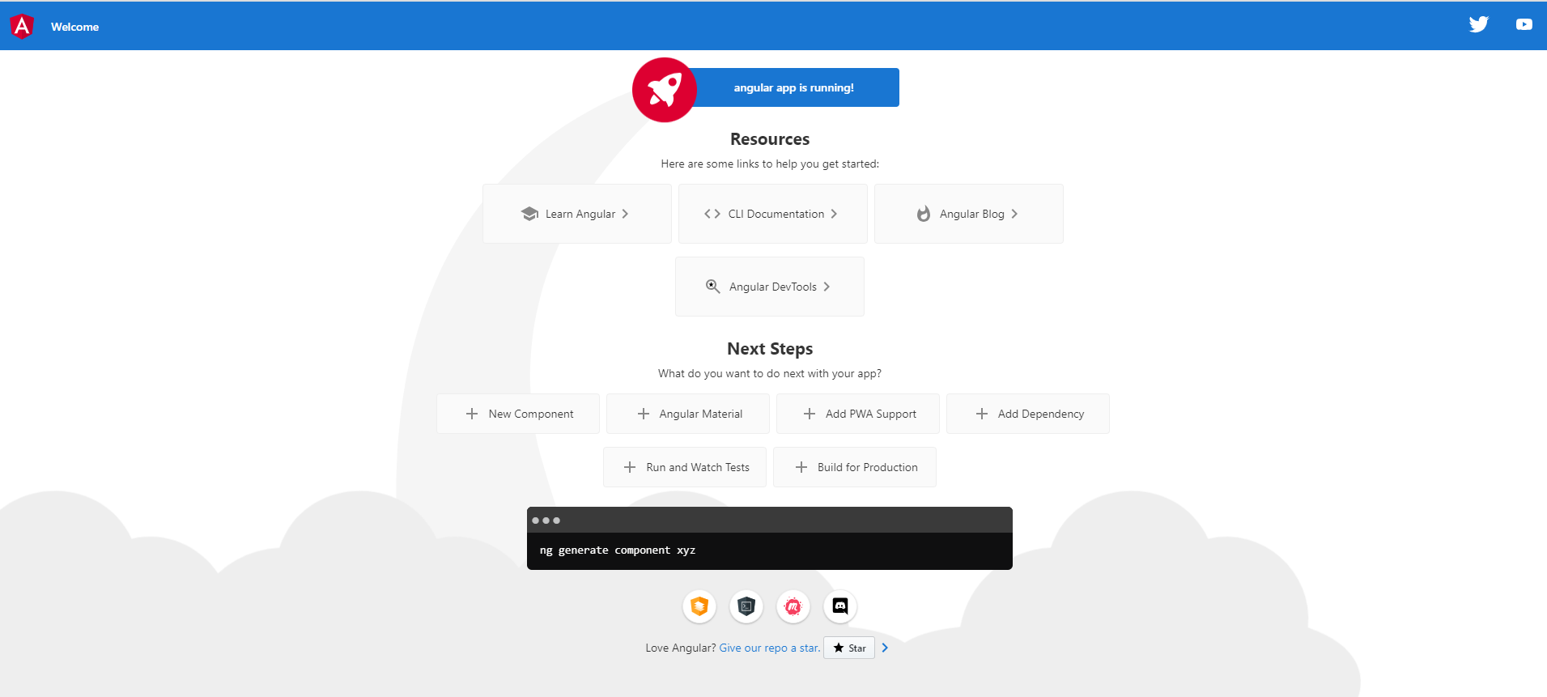
Application can be run using ng serve command

Slide 13
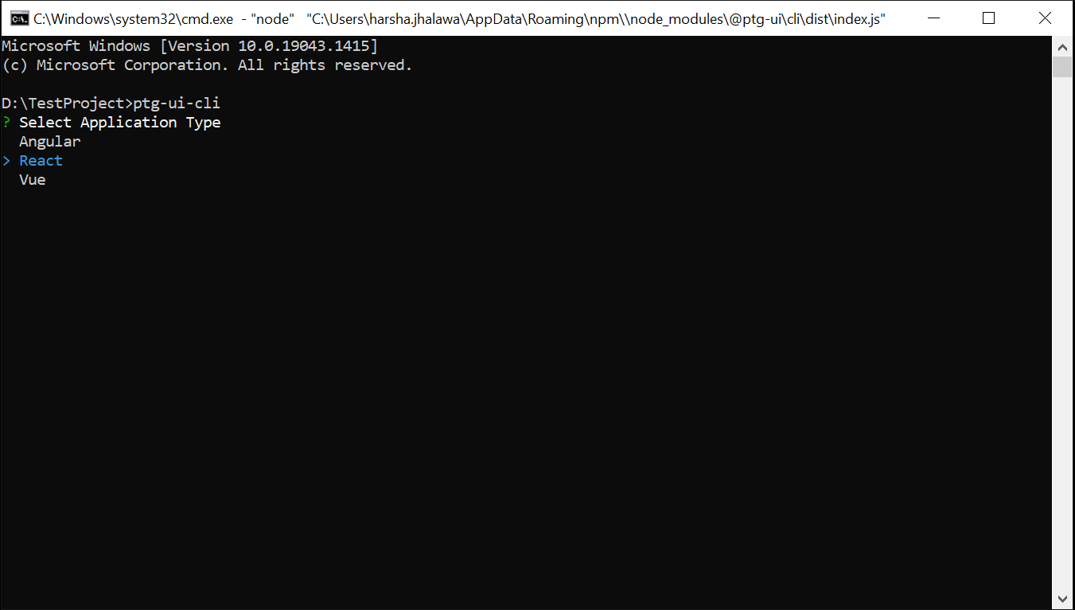
Select React as application type

Slide 14
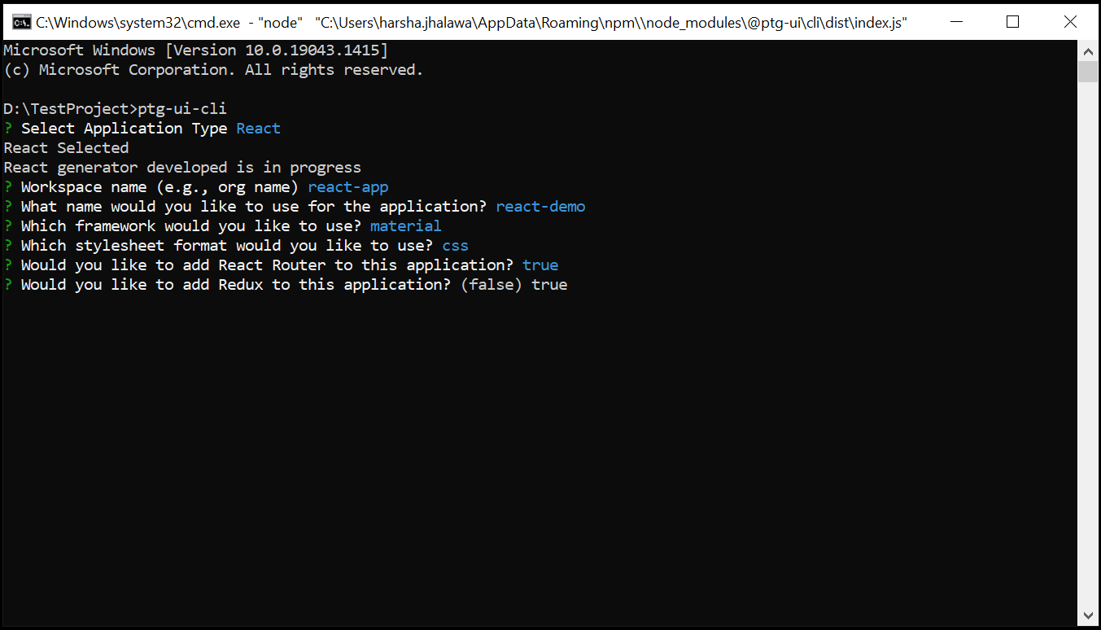
Once we select react as our application type, it will ask for your preference for creating the project.

Slide 15
React project will be created with best practice folder structure.
Css framework will be added to the code based on user selection from bootstrap or material ui.
Routing and redux functionality will be added depending up on the selection.

Slide 16
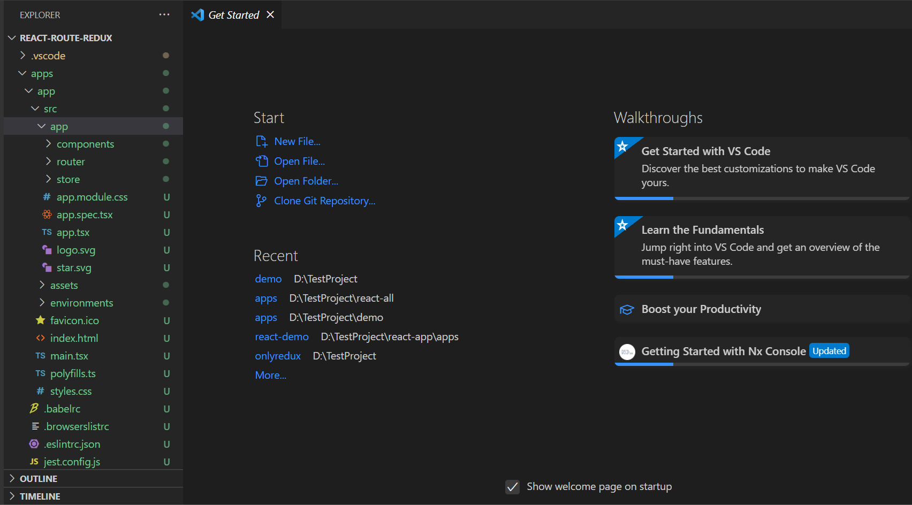
Following folder structure gets generated. Application can be run using npm start command

Slide 17
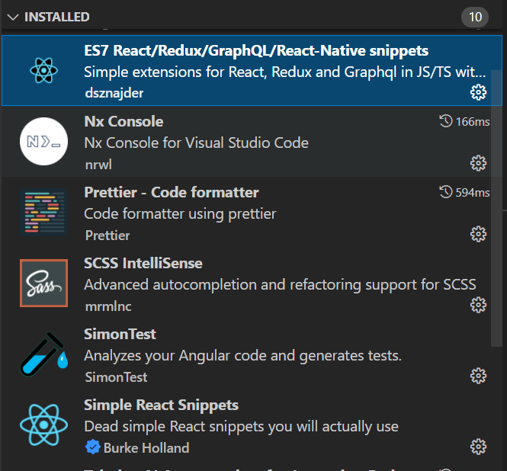
VS code extensions are also added in the project.

Slide 18
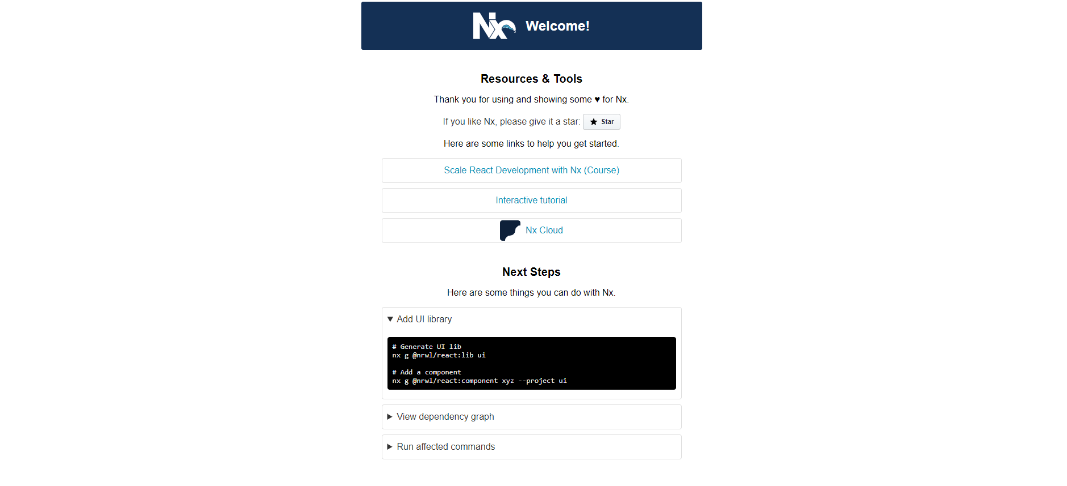
Application can be run using npn start command

Slide 19
Thank you!

