Slide 1
DATA STRUCTURE
Subject code:- 3330704
Prof. Karmur kishan T.

Slide 2

UNIT-3 STAck & Queue 14-marks
TOPICS TO BE COVERED... … … ( MIMP )
3.1 Linear and Non-Linear Data Structures
3.2 Stack : Array representation of Stack, PUSH POP Operations on Stack, Implementation of Stack, Application of Stack, Infix, Prefix and Postfix Forms of Expressions, Recursive Functions (factorial, greatest common divisor, Fibonacci series)
3.3 Queue: Array representation of Queue, Operations on Queue, Implementation of Queue, Limitation of Single Queue
3.4 Concepts of Circular Queue
3.5 Application of queue
3.6 Difference circular queue and simple queue

Slide 3
3.1 linear and non-linear data structure
Linear Data Structure:
In the linear data structure processing of data items is possible in linear fashion.
Data are processed one by one sequentially.
Examples of the linear data structure are:
(A) Array (B) Stack (C) Queue (D) Linked List

Slide 4
Continue… …
Non Linear data structure:
In the Non linier data structure processing of data items is not possible in linier fashion.
Examples of the non linier data structure are:
(A)Tree (B) Graph

Slide 5
3.2 STack
A stack is a linear OR non-primitive list in which insertion and deletion operations are performed at only one end of the list.
A stack is Last in First out (LIFO) Structure.
A stack is a linear data structure in which elements are added and remove from one end, called top of stack.
For example of stack is, consider a stack of plates on the counter in cafeteria, during the time of dinner, customer take plates from top of the stack and waiter puts the washed plates on the top of the stack.
So new plates are put on the top and old one yet bottom.

Slide 6
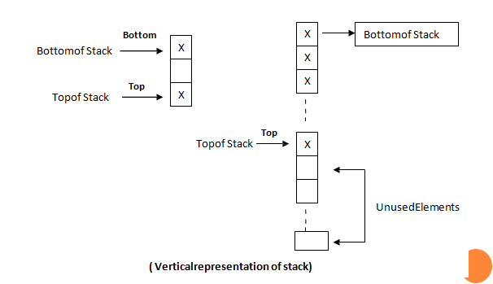
Continue… …
ARRAY REPRESENTATION OF STACK
1.Verticaly Representation of stack

Slide 7
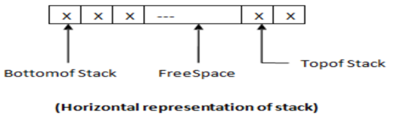
Continue… …
The operation in a stack is representation by using vector consisting of number of elements.
A pointer top keeps of the top elements ,when stack is empty to phas a value 0.
Every time a new element is added at top,top is incremented by one.
When an element is deleted from a top,top is decremented by one.
2.Horizontal Representation of stack

Slide 8
Continue… …
IMPLEMENTATION OF STACK
A stack is a list and list can be implemented by two ways:
1 Pointer(linked List/ Dynamic Implementation)
2 Array(Static Implementation)

Slide 9
Continue… …
OPERATIONS ON STACK
1. Push Operation:
The operations that add an element to the top of the stack is called PUSH operation. It is used to insert an element into the stack.
2. Pop Operation:
The operation that delete top element from the top of stack is called POP. it is used to delete an element from stack

Slide 10
Continue… …
PUSH POP OPERATIONS ON STACK
1. PUSH Operation
In push operation, we can add elements to the top of the stack, so before push operation, user must check the stack, it should not be a full.
If stack is already full and when we try to add the elements then error occurs. It is called “Stack Over Flow” error.
Algorithm: PUSH(S, TOP, VAL)
This algorithm insert an element X to the top of the stack.
The Stack is represented by vector S which contains N elements.

Slide 11
Continue… …
TOP is a pointer which points to the top element of the Stack.
Step-1: [Check for stack overflow]
If (TOP >= N) then
Write (‘Stack Overflow’)
Return
Step-2: [Increment TOP]
TOP=TOP+1
Step-3: [Insert Element]
S [TOP] = VAL

Slide 12
Continue… …
Step-4: [Finished]
Return
2. POP Operation
In POP operation, we can delete or remove an elements from top of the stack, so before pop operation, user must check the stack, stack should not be a empty.
If the stack is empty, and we try to pop an element, then error occur. It is called “Stack under Flow” error.

Slide 13
Continue… …
Algorithm: POP(S, TOP)
This algorithm removes an element from the Top of the Stack.
The Stack is represented by vector S which contains N elements.
TOP is a pointer which points to the top element of the Stack.
Step-1: [Check for the Underflow on the Stack]
If TOP = 0 then
Write (‘STACK UNDERFLOW’)
Exit

Slide 14
Continue… …
Step-2:[Decrement Pointer]
TOP=TOP-1
STEP-3:[Return former top element of the stack]
Return(S [TOP + 1])

Slide 15
Infix, prefix and postfix forms of expressions.
There are basically three types of polish notation:
Infix (B) Prefix (C) Postfix
When the operator(+) exists between two operands(A & B) then it is known as Infix notation.(e.g. A+B)
When the operator(+) are written before their operands(A & B) then it is known as Prefix notation(Polish notation). (e.g. +AB)
When the operator(+) are written after their operands(A & B) then it is known as Postfix notation(Reverse polish notation). (e.g. AB+).

Slide 16
Continue… …
Stack is widely used to convert infix notation into prefix or postfix notation.
Rules for converting infix notation to prefix/ postfix
The operations with heights precedence are converted first and then after a portion of the expression have been converted to postfix.
It is to be treated as single operand.
Take only two operands at a time to convert in a postfix from like A+Bà AB+
Always, convert the parenthesis first

Slide 17
Continue… …
Convert postfix exponentiation second if there are more than one exponentiation in sequence then take order from right to left.
Convert in to postfix as multiplication and division operator, left to right.
Convert in postfix as addition and subtraction left to right.

Slide 18
Continue… …
Convert infix into Prefix expression
1. (A + B) * C 2. (A+B)*(C+D) 3. (A-B)+C*A+B 4. (B*C/D)(D/C+E)
=(+AB)*C =(+AB)*(+CD) = - AB+C*A+B =(*BC/D)(D/C+E)
=*(+AB)C =*(+AB)(+CD) =-AB+*CA+B =(/*BCD)/(D/C+E)
= *+ABC = *+AB+CD =+-AB*CA+B =(/*BCD)/(/DC+E)
=++-AB*CAB =(/*BCD)/(+/DCE)
=//*BCD+/DCE

Slide 19
Convert infix into Postfix expression.
1. A*B/C+D 2. C*B*A/D 3. A*B/(C+D-E) 4. A*B+C*D+E*F
= [AB*]/C+D = [CB*]*A/D =A*B/([CD+]-E) =[AB*]+C*D+E*F
= [AB*C/] +D = [CB*A*]/D =A*B/[CD+E-] =[AB*]+[CD*]+E*F
=AB*C/D+ =CB*A*D/ =[AB*]/[CD+E-] =[AB*]+[CD*]+[EF*]
=AB*CD+E-/ =[AB*CD*+]+[EF*]
=AB*CD*+EF*+

Slide 20
CONTINUE… …
APPLICATION OF STACK
There are three main application of stack:
(1) Recursion:
Recursion means function call itself.
It is the technique of defining a process in terms of itself.
Stack is widely used in recursion because of its Last in First out Property.
In terms of C language the function calling itself is known as recursion.

Slide 21
CONTINUE… …
(2) Evaluate polish notation:
The process of writing the operators of an expression either before their operands or after operands are called the polish notation.
There are basically three types of polish notation:
(A) Infix (B) Prefix (C) Postfix
(3) Stack Machine:
Stack Machines are also used to evaluate polish notations.

Slide 22
Continue… …
Two example of the stack machine are PDP-11 and B5000.
These machines are well suited for stacking local variables and parameter that arise in the function call.
Stack machines provides faster execution of polish notation.
RECURSIVE FUNCTIONS (FACTORIAL, GREATEST COMMON DIVISOR, FIBONACCI SERIES)
Recursion means a function call itself.

Slide 23
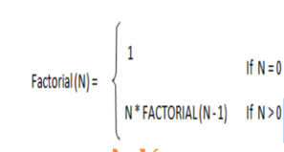
Continue… …
Example: The factorial function can be recursively defined as,
Here, FACTORIAL(N) is defined in terms of FACTORIAL(N-1) which is again defined in terms of FACTORIAL(N-2) and this process continue until FACTORIAL(0) is reached.

Slide 24
Continue… …
The value of FACTORIAL(0) is defined as 1.
To Generate the Fibonacci number using recursion:
A fibonacci series is,
0 1 1 2 3 5 8……………….N
If we consider F0 = 0 and F1 = 1 then F2 = F0 + F1 = 0 + 1 = 1, similar F3 = F2 + F1 = 1 + 1 = 2, and F4 = F3 + F2 = 2 + 1 = 3 and so on.

Slide 25
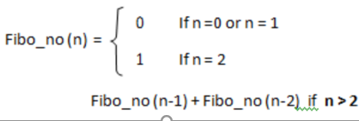
Continue… …
It is clear that each succeeding(next) term is the sum of two preceding(previous) terms, doing this procedure until i becomes less then the value of n.

Slide 26
Continue… …
To implement Greatest Common Divisor(GCD) function in a recursive form using following steps:
If m <= n and n % m = 0 then gcd(n, m) = m(Termination step).
If n < m then gcd(n, m) = gcd(m, n) ( Recursive definition of gcd).
If n >= m then gcd(n, m) = gcd(m, n % m) (Recursive definition of gcd).

Slide 27
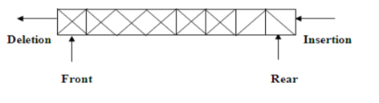
3.3 Queue
A queue is a linear list in which insertion is performed at one end called rear end and deletion is performed at another end of the list called front end.
The information in such a list is proceeds in the same order as it was received.
Since insertion is performed at one end and deletion is performed at another end the element which is inserted first is first to delete.
So it is also known as FIRST IN FIRST OUT (FIFO) or FIRST COME FIRST SERVE (FCFS) data structure.

Slide 28
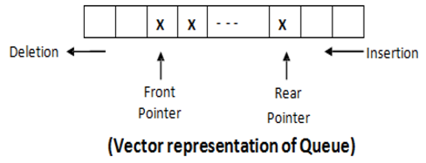
Continue… …
ARRAY REPRESENTATION OF QUEUE
A queue has two pointer, from pointer and rear pointer which are pointing to front and rear element of the queue.

Slide 29
Continue… …
IMPLEMENTATION OF QUEUE
A Queue is a list and list can be implemented by two ways:
Pointer(linked List/ Dynamic Implementation)
Array(Static Implementation)
OPERATIONS ON QUEUE
1. QINSERT (Q, Front, Rear, N, Val)
This function insert an element into the queue

Slide 30
Continue… …
The Queue is represented by vector Q which contains N elements.
Front is a pointer which points to the front end
Rear is a pointer which points to the rear end
Y is the element to be inserted.
ALGORITHM:QINSERT
STEP-1: [Check Overflow error?]
If Rear≥N then
Write (‘Queue Overflow’)
Exit

Slide 31
Continue… …
Step-2: [Increment rear pointer]
RearßRear+1
Step-3: [Insert element]
Q[Rear]ß Val
Step-4:[Is front pointer properly set?]
If Front=0 then
Frontß1
Return
Step-5: [Finished] Exit

Slide 32
Continue… …
2. Algorithm to delete an element from the queue
QDELETE (Q, Front, Rear)
The Queue is represented by vector Q which contains N elements.
Front is a pointer which points to the front end
Rear is a pointer which points to the rear end
Step-1: [Underflow?]
If Front = 0 then
Write (‘Queue Underflow’)
Exit

Slide 33
Continue… …
Step-2:[Delete element]
XßQ [F]
Step-3:[Queue empty?]
If Front =Rear
Then FrontßRearß0
Else FrontßFront+1

Slide 34
Continue… …
Step-4:[Return element]
Return (X)
Step-5: [Finished]
Exit

Slide 35


Continue… …
LIMITATION OF SINGLE QUEUE
Disadvantage of simple queue is that even if we have a free memory space in a queue we cannot use that free memory space to insert element.
For example consider following operations:

Slide 36
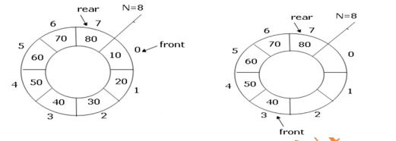
Continue… …
As shown in figure we insert three elements 5, 10, 15 in simple queue. After that we delete 5 and 10 as shown in figure.
Now even we have a free memory space we cannot use that memory space. So simple queue results in wastage of memory space. This problem can be solved by using circular queue.
For example consider the following operations:

Slide 37
Continue… …
As shown in 1st figure, we insert eight elements 10, 20,30,40,50,60,70,80 in simple queue.
After that we delete 10, 20 and 30 as shown in 2nd figure.
Now we have a free memory space in circular queue and we can use that memory space by incrementing rear pointer by 1(rear=0).

Slide 38
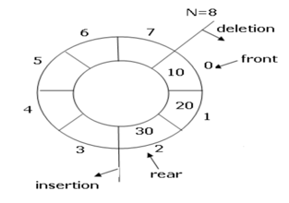
3.4 concept of circular queue
A circular queue is a queue in which elements are arranged such that the first element in the queue follows the last element in the queue.
The arrangement of circular queue is shown in figure below:

Slide 39
Continue… …
Here in the circular queue the first element q[0] follows the last element q[n-1].
Disadvantage of simple queue
It is that even if we have a free memory space in a queue we cannot use that free memory space to insert element.

Slide 40
3.5 Application of queue
A queue is the natural data structure for a system to serve its incoming requests. Most of the process scheduling or disk scheduling algorithms in operating systems use queues.
Computer hardware like a processor or a network card also maintain buffers in the form of queues for incoming resource requests.
A stack-like data structure causes starvation of the first requests, and is not applicable in such cases.
A mailbox or port to save messages to communicate between two users or processes in a system is essentially a queue-like structure.
Queue is widely used in Simulation.

Slide 41
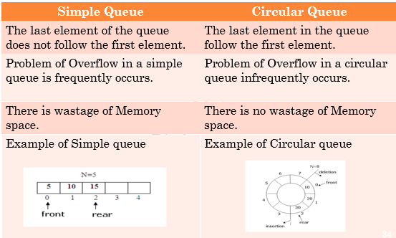
3.6 difference between Simple queue and circular queue

Slide 42
Difference between LIFO(Stack) & fifo(queue)
LIFO | FIFO
1. In LIFO the insertion and deletion operation are performed at one end. | 1. In FIFO the insertion and deletion operation are performed at Different end.
2. In LIFO the element which inserted last is first to delete. | 2. In FIFO the element which inserted first is first to delete.
3. LIFO require only one pointer called TOP. | 3. FIFO requires two pointers called FROUNT and REAR.
4. Example: piles of trays in cafeteria. | 4. Example: Students at registration counter.
5.In LIFO there is no wastage of memory space. | 5. In FIFO even we have free memory space sometimes we cannot use that space to store elements.

Slide 43
Thank you

