Slide 1



GAPP: THE COORDINATION-EXECUTION GAP SOLUTION
Solving structural inefficiencies in organizational commitments and systemic reliability.

Slide 2

PROBLEM STATEMENT
The Commitment–Execution Gap
Modern coordination systems suffer from a structural gap between expressed commitment and actual execution.
Leading to systemic failures:
INEFFICIENCIES
RESOURCE MISALLOCATION
FINANCIAL LOSS
SYSTEMIC RELIABILITY

Slide 3
DETAILED PROBLEM STATEMENT
The Core Failure: Commitment–Execution Gap (CEG)
A phenomenon where digital optimization of "sign-ups" has decoupled the act of declaration from the burden of execution, creating an environment saturated with "cheap signals."
The modern coordination landscape is currently undermined by a structural failure termed the Commitment–Execution Gap (CEG), a phenomenon where the digital optimization of "sign-ups" has decoupled the act of declaration from the burden of execution. While platforms have made signaling intent nearly frictionless and cost-free, the real-world effort required for follow-through remains unchanged, leading to an environment saturated with "cheap signals"—low-fidelity commitments that users treat as non-binding placeholders. This asymmetry is not merely a behavioral quirk but a systemic design flaw that prioritizes low-barrier entry over accountability, resulting in severe resource misallocation, financial sunk costs, and operational chaos for organizers. As non-execution becomes statistically normalized, it creates a "trust tax" that forces defensive over-booking and depletes social capital. Because existing frameworks remain "execution-blind," failing to incorporate social visibility or meaningful stakes, the gap between what is promised and what is performed continues to expand, leaving coordination-dependent systems increasingly fragile, inefficient, and untrustworthy.
Existing frameworks remain "execution-blind," failing to incorporate social visibility or meaningful stakes.

Slide 4
PRIMARY RESEARCH
1. Organizer Perspectives
Focus: Systemic Impact and Coping Mechanisms
Key Quantitative Findings:
Reliability Variance: Follow-through as low as 0% in some digital tasks.
Overbooking Hedge: Deliberate over-inviting to ensure capacity.
Trust Erosion: Systems rated 3/5 on trust (the "broken" status quo).
2. Participant Perspectives
Focus: Frictionless Commitment and Psychological Distance
Top Drivers of the Gap:
Lack of Penalties: No financial or social cost for skipping.
The "Easy" Trap: Low friction correlates with high non-execution.
Temporal Decay: Motivation expires before the execution date.
3. Consequences & Fixes
Major Impacts:
Operational Chaos & Emotional/Morale Drain.
Financial Loss: Direct sunk costs (food, space, logistics).
The Roadmap:
Scalable Coordination-Enhancement Framework via aligned incentives.
4. Conclusion & Mandate
The Data Mandate:
Move toward Accountability Architecture: Social visibility (Public Lists) and minor economic stakes.
Market Validation:
High appetite for the solution; confirmed Product-Market Fit with vast "Early Access" requests.

Slide 5
SECONDARY RESEARCH
1. The Behavioral Framework
Why Intent ≠ Action
Hyperbolic Discounting: Immediate rewards (dopamine hit) valued over future costs.
Cognitive Effort Aversion: "Frictionless" sign-ups aren't "logged" as high-priority.
Planned Behavior: Triggers override rational intent in high-distraction environments.
2. Economic Benchmarks
The Cost of "No-Shows"
Healthcare: Costs U.S. system $150B annually; no-show rates of 15-30% mirror GAPP data.
The "Trust Tax": Predictive "Overbooking Economy" (10-15%) punishes reliable participants.
3. The "Friction" Strategy
Rethinking UI/UX
"One Sec" Case: Intentional friction improves follow-through on long-term goals.
Accountability: Social visibility to peers (Strava model) increases execution by 2x.
4. Mechanisms of Success
Proven Interventions
Micro-Stakes: $5 refundable deposits leverage "Loss Aversion."
Implementation Intentions: Specifying 'how' increases follow-through by 40%.
Reputation Scoring: Reliability ranking (Uber/Airbnb) creates long-term stakes.

Slide 6

POSTER SHOWCASE

Slide 7




POSTER METHODOLOGY
Phase 1
Primary Research of the problem.
Phase 2
Secondary Research of the problem.
Phase 3
Finalization of research findings.
Phase 4
Synthesis of data into visual model.

Slide 8






DESIGN PHILOSOPHY - CORE
Immutable Commitment
Friction-Wise
Closed Loop
Adding intentional 'good friction' to filter out low-intent participants.
Every commitment must end in a verification of execution or a recorded failure.
Commitment should be an explicit, recorded action, not a passive byproduct of a chat.

Slide 9




DESIGN PHILOSOPHY - EXECUTION
Reciprocity
Active Nudging
Incentivizing execution through mutual benefit and reputation staking.
Context-aware notifications that track progress toward commitment deadlines.

Slide 10






TOOLS OF RESEARCH
Empathy Map
Mind Map
User Journey
Decoding user frustrations during coordination failures.
Exploring the root causes of the execution gap.
Mapping the 'Drop-off' points from intent to action.

Slide 11


USER PERSONA
A Student Organizer
PAIN POINT
Spends 5 hours a week chasing people who "promised" to show up but didn't.
GOAL
Reliable participation data to manage event logistics and resource allocation without manual follow-up.

Slide 12
SWOT ANALYSIS
STRENGTHS
Free end-to-end — no transaction fees
India-first: WhatsApp & SMS integrations
Student-first UI — mobile-first, dark mode
Two-role architecture (student + organizer)
Lightweight SPA — <1s load times
WEAKNESSES
Early stage — no existing user base
Dependent on college admin buy-in
Limited brand awareness vs established apps
Team capacity for ongoing maintenance
No offline functionality yet
OPPORTUNITIES
64% students uninvolved — huge TAM
Colleges digitizing post-pandemic
WhatsApp Business API for notifications
Expand to 500+ colleges Tier 1-3
Sponsorship from clubs / placement cells
THREATS
CU Intranet updates could add features
Low student adoption if onboarding is hard
WhatsApp groups too entrenched culturally
Competing student startup platforms
Data privacy regulations (DPDP Act 2023)

Slide 13
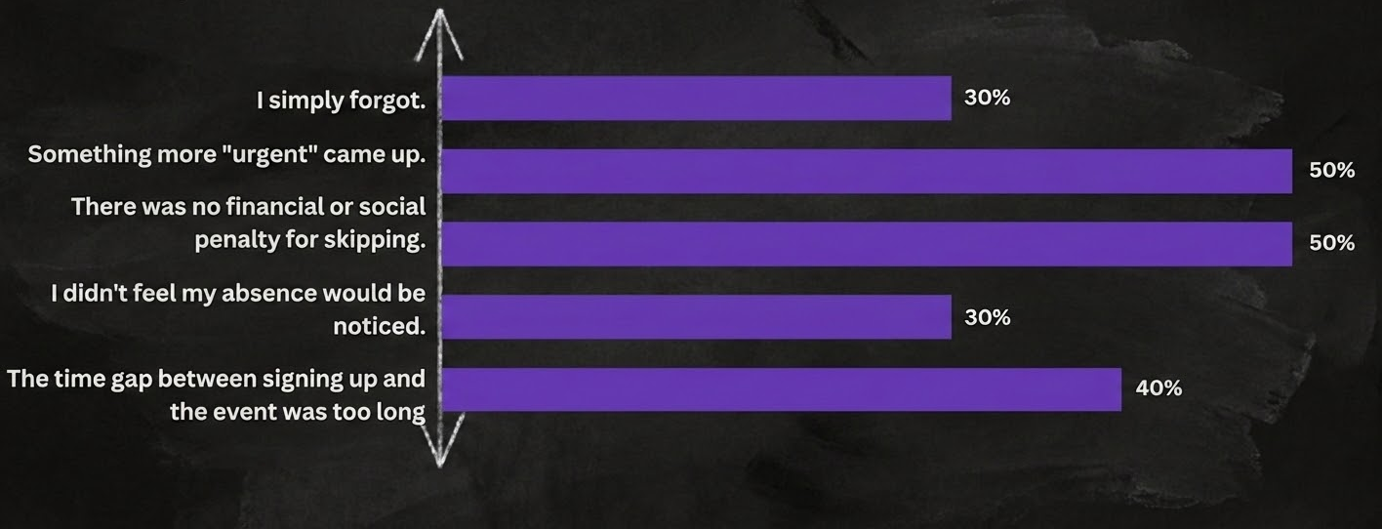
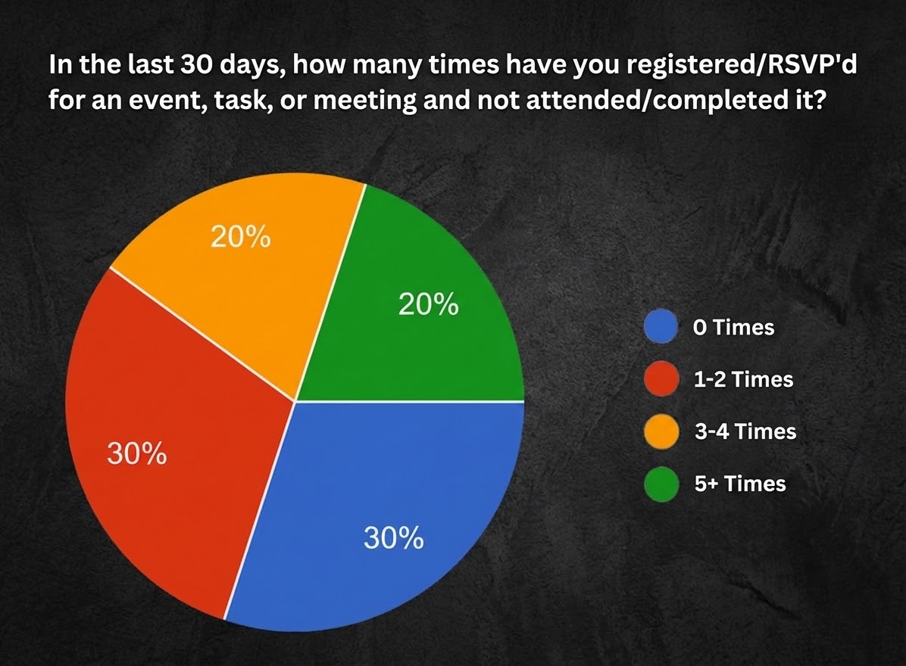
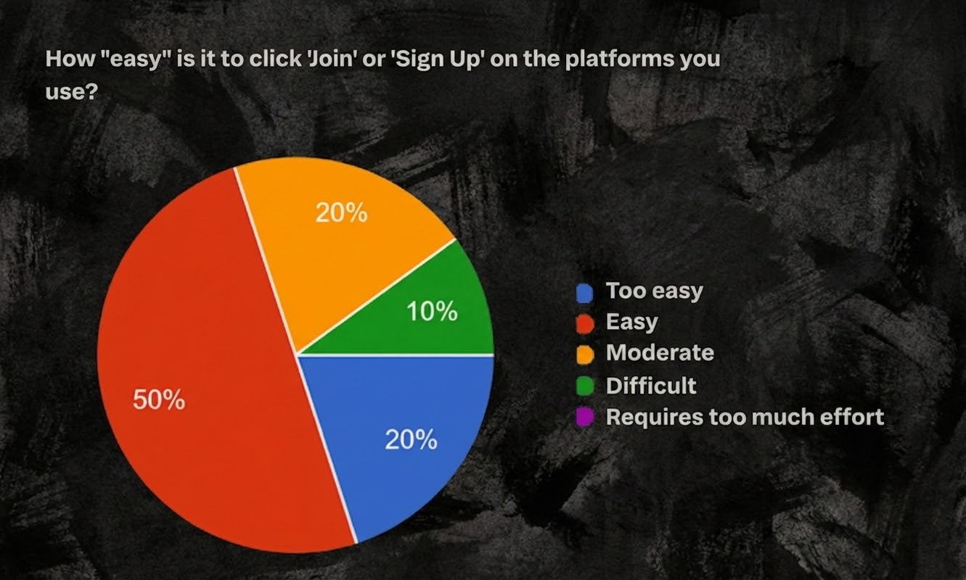
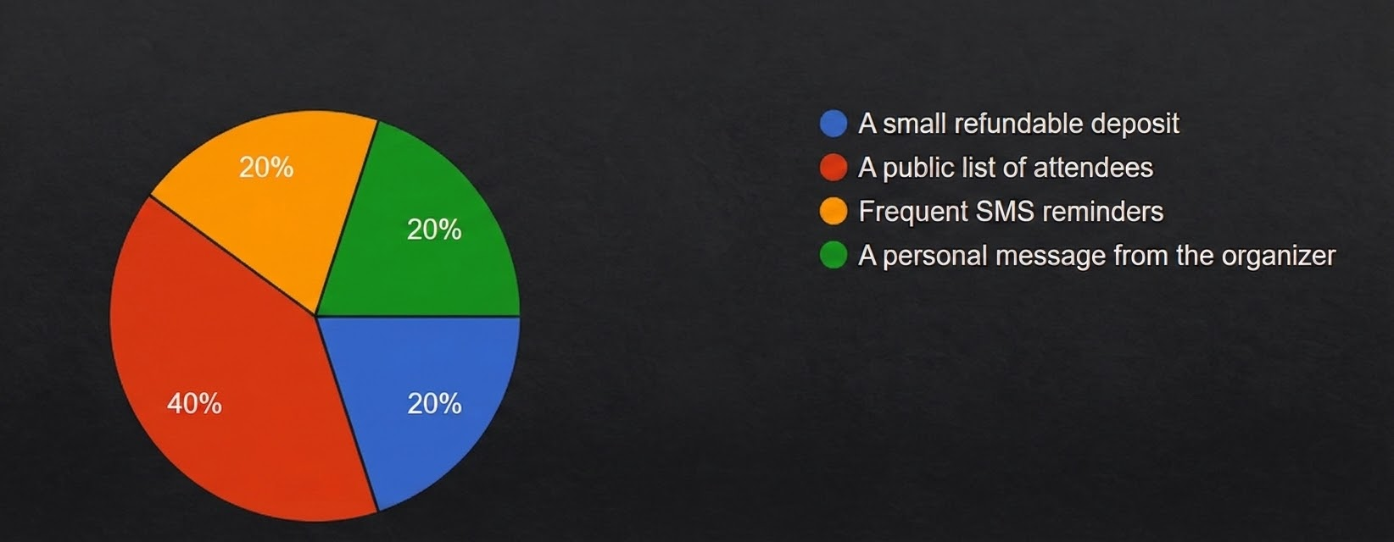
USER SURVEYS (Applicants)
How many events have you missed after RSVP in the last 30 days?
Reason for Non-Execution
Ease of clicking 'Join' or 'Sign Up' on platforms?
The “Fix”

Slide 14
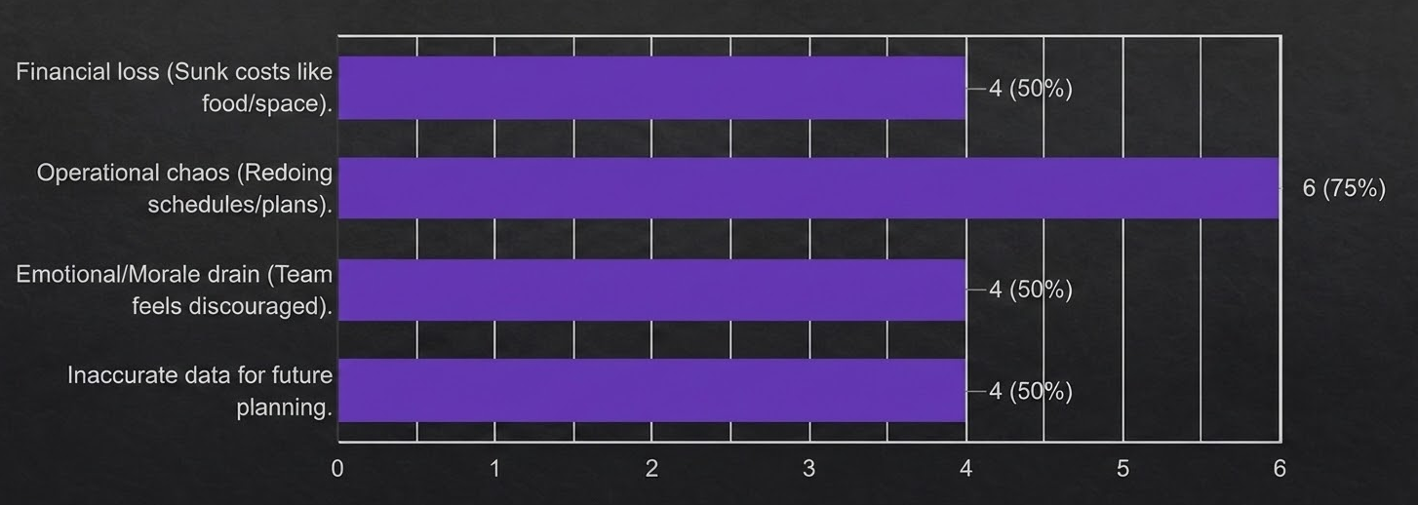
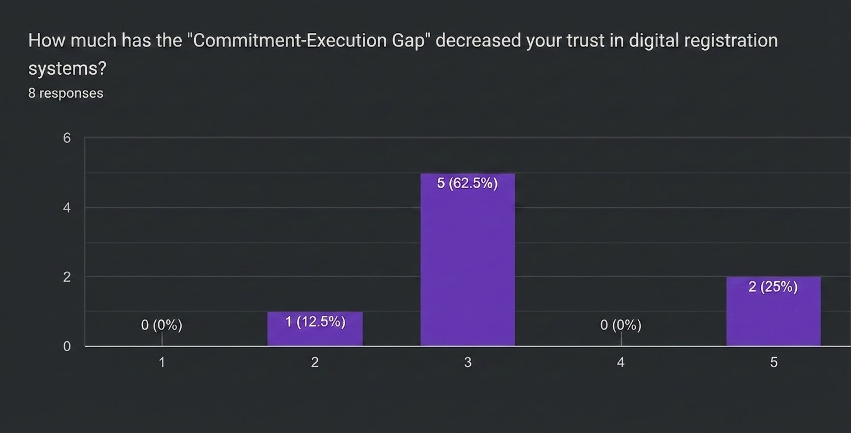
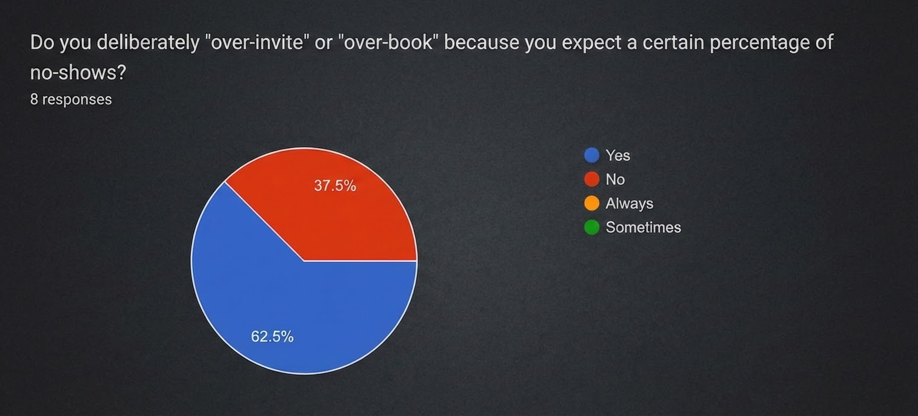
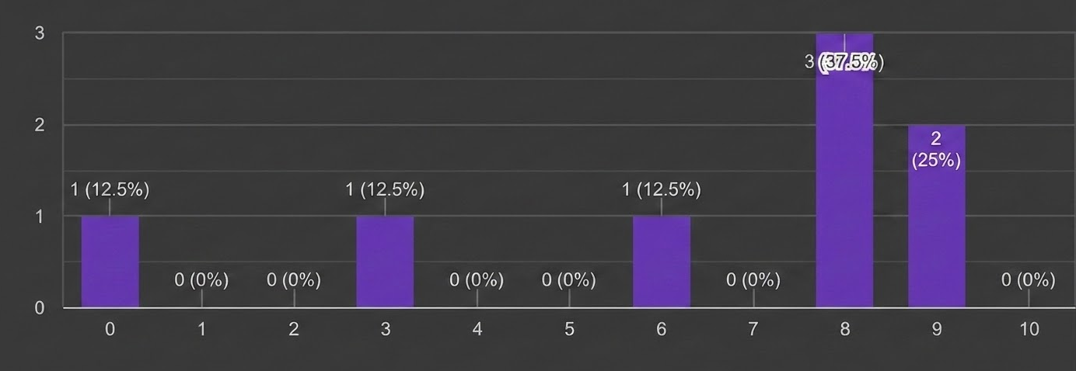
USER SURVEYS (Organisers)
Broken Commitment Consequences
Trust Decrease in Digital Systems
Deliberate Over-booking Habits
Follow-through Rates (Out of 10)

Slide 15
CONCLUSIONS OF USER STUDY
The Core Cause
Users do not fail because they are malicious or lazy. They fail because the modern digital ecosystem provides zero stakes.
The Reminder Gap
Standard reminders are ignored without social or financial weight to back them up.
Organizer Penalty
Organizers are punished for being inclusive (over-booking) and thorough in their pre-planning.
The Solution Needed
A system is needed that effectively turns commitment into execution.

Slide 16
CONCLUSIONS OF PROBLEM STUDY
Accountability Crisis
Ineffective Tracking
Manual Burden
The Commitment-Execution Gap is fundamentally an accountability crisis.
Traditional "To-Do" lists are insufficient because they track what to do, but provide no penalty or reward for doing it.
Manual intervention is currently required to fix these failures.

Slide 17



RESEARCH INSIGHTS
Financial Stakes
Social Currency
Commitment Framing
Financial stakes work effectively to ensure commitment, but they can deter casual users from joining.
Reputation serves as a powerful social currency, driving accountability through communal standing.
Forcing users to type "Implementation Intentions" (the how/when) reduces ghosting rates by 50%.

Slide 18




MARKET STUDY
General Event Platforms
Examples: Eventbrite, Whova, Insider.in, BookMyShow, Paytm Insider
Paid, corporate-focused
Poor campus UX
No student verification
India Campus Platforms
Examples: Unstop, Knowafest, StuMagz, Dare2Compete, CollEvent
Competition-only or listing-only
No full event lifecycle management
Service-Based Platforms
Examples: TeamOrange, Hire4Event, Gradnet, Just Attend, Pathfly
Expensive, admin-heavy
Not student facing or self-service
International Campus Tools
Examples: CampusGroups, Simplicity Engage, Presence.io, Eventify
$5K+/year, US-centric
Complex setup, not India-ready

Slide 19
COMPETITOR MATRIX
Platform
Fee?
Campus Focus
RSVP Mgmt
Mobile-First
India Context
Our Edge
Eventbrite
Paid
Corporate
Yes
Partial
No
Free - student first
Unstop
Free
Competitions
No
Partial
Yes
All event types - RSVP
CU Intranet
Free
Yes
Manual
Desktop
Yes
Unified dashboard - auto remind
CampusGroups
$5K+/yr
Yes
Yes
Yes
No
Zero cost + WhatsApp native
Insider.in
10% fees
Commercial
Basic
Yes
Yes
No fees - college verified
gapp
FREE
College-first
AUTO
Mobile PWA
WhatsApp-SMS
END-TO-END SOLUTION

Slide 20
CONCLUSIONS OF MARKET STUDY
Process Used
Market Trends
Key Insight
Feature comparison
UI analysis
Friction-testing
Tools are currently polarized:
Too Soft: Standard To-do lists
Too Punishing: Beeminder style
There is a "missing middle" market for an app that utilizes:
Reputational Stakes
(A public score system)

Slide 21
DIFFERENTIATION FACTOR
The Secret Sauce
“
How are we different? We treat a person's "word" as quantifiable currency.
Implementation Intentions (Behavioral Science)
Gapp Leaderboard (Social Mechanic)
Accountability without financial risk
"GAPP doesn't just send a message; it secures a commitment."

Slide 22

BRANDING STRATEGY
Safety and Action
Our brand identity uses Safety Orange to signify both the urgency of coordination and the caution of commitment.
The Deep Charcoal background provides a professional, focused atmosphere for execution.

Slide 23



NAMING LOGIC
The GAP
Identifies the space between saying and doing.
The APP
The digital vehicle to bridge that structural void.
GAPP
A name that sounds like 'Bridge' in its functional intent.

Slide 24
LOGO BREAKDOWN
Minimalist Geometry
The GAPP logo uses a split geometric form representing two separate entities (Intent and Action) being unified through a bridge.
The Safety Orange highlight specifically marks the 'Verification' point of the bridge.

Slide 25
VISUAL IDENTITY
Aa
Safety Orange
Primary Accent: High Visibility. Used for calls to action and critical highlights.
Deep Charcoal
Background: Depth & Focus. Provides a professional, modern canvas for content.
Space Grotesk
Headers: Modern & Bold. A clean geometric sans-serif for strong brand presence.

Slide 26
PROTOTYPING
Experience the solution live at:
https://gapp-tracker.netlify.app/
Click the link above to explore

Slide 27
FUTURE POTENTIAL
01
02
03
Phase 1
Campus Deployment
Initial rollout focused on academic environments and student-led testing.
Phase 2
SME Operation Coordination
Expanding to small and medium enterprises for operational alignment.
Phase 3
Global Commitment Network
Establishment of a large-scale, international ecosystem of partners.

