Slide 1

Dr. D. Y. Patil Institute of Technology
Sant Tukaram Nagar, Pimpri, Pune-18
Department of Computer Engineering
Seminar Title:-The Path Towards Resource Elasticity for 5G Network Architecture
Name:-Chaitanya Ashok Chobhe
Roll No:-TCOC34
Guide :-mrs.Archana mam

Slide 2
CONTENTS
Sr.no Title
Introduction
Literature Servey
Architecture
CONCLUSIONS

Slide 3
Introduction
The 5th generation (5G) of cellular systems will change the access to technology for users, vertical markets and industries.
In this paper, they focus on an architectural concept for 5G network architecture that we believe will be key given the above well-established innovations. We refer to this concept as resource elasticity.
The reminder of this paper, dedicated to describe in depth the concept of resource elasticity, is organized as presents a definition of elasticity, along with the main associated requirements and key performance indicators (KPIs).

Slide 4
1. 5G empowering vertical industries
Literature Servey
This document has been endorsed by the 5G Infrastructure Association, the European Factories of the Future Research Association, ERTICO - ITS Europe, the Networked and Electronic Media Initiative, the European Utilities Telecom Council and Continua , Feb. 2016
the 5G capabilities will provide ubiquitous access to a wide range of applications and services with increased resilience, continuity, and much higher resource effi ciency, while protecting security and privacy
5G will provide enormous improvements in capacity and boost user data rates.

Slide 5
2. Elasticity in cloud computing: a survey
Literature Servey
Emanuel Ferreira Coutinho · Flavio Rubens de Carvalho Sousa ´ · Paulo Antonio Leal Rego · Danielo Gonc¸alves Gomes · Jose Neuman de Souza , Aug. 2015.
Elasticity helps to improve the use of resources, essential in a cloud computing environment, since it avoids the waste of resources, reducing costs.
providers should use resources efficiently and monitor the resources in small units of time.

Slide 6
3. Documentation of Requirements and KPIs and Definition of Suitable Evaluation Criteria
Literature Servey
Lars Christoph Schmelz, Christian Mannweiler , Albert Banchs , Sept. 2017.
For resource elasticity, a scenario is assumed where an NF is running over a set of resources to produce a set of outputs. Furthermore, it is assumed that for each novel function under consideration there is an inelastic counterpart, i.e., the “classical” version that provides the required functionality.
Requirements regarding network slicing in 5G systems, including creation, removing, or modification of network slices are listed In the following:
The 5G system should allow the realisation of Network Slice Instances (NSIs) across several infrastructure domains which may be owned by different parties (multi-domain operation
The 5G system shall allow the operator to create, modify and delete an NSI.
The 5G system shall enable the network operator to define a minimum available capacity as well as a maximum capacity for an NSI.
The 5G system shall enable the network operator to define a priority order between different NSIs in case multiple NSIs compete for resources on the same network.

Slide 7
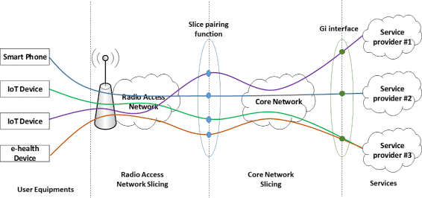
Mobile Network Architecture Evolution toward 5G Peter Rost, Albert Banchs, Ignacio Berberana, Markus Breitbach, Mark Doll, Heinz Droste, Christian Mannweiler, Miguel A. Puente, Konstantinos Samdanis, and Bessem Sayadi , May 2016.
Literature Servey
5G Network slicing

Slide 8
Network slicing
Literature Servey
Network slicing is centered on the concept of deploying multiple dedicated logical mobile networks with varying levels of mutual isolation on top of the same infrastructure.
A network slice is a collection of mobile network functions (or groups of functions) and a specific set of radio access technologies (RATs) (or specific RAT configurations) necessary to operate an endto-end logical mobile network.
network slicing is an evolution of network sharing, which has been a key business model for mobile network operators to reduce deployment and operational costs.

Slide 9
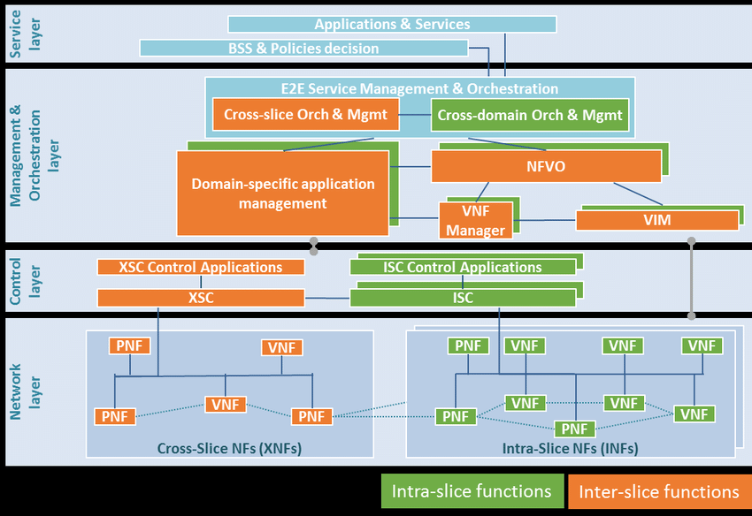
Architecture
5G baseline architecture for 5G-MoNArch

Slide 10
5G baseline architecture for 5G-MoNArch
the preliminary high-level functional view of the 5G-MoNArch architecture is designed in a modular manner and depicts four layers .
For each of these layers, it defines the architectural elements that deliver the system’s functionality. It includes the key functional elements, their responsibilities, the interfaces exposed, and the interactions between them.
The high-level functional view of the system architecture is depicted in Figure . It shows the separation into four layers as well as the differentiation into intra-network-slice and inter-network-slice functions

Slide 11
Service Layer
The Service Layer, at the top of this structure, comprises business-level decision functions, applications, and services, operated by a tenant or other external entities.
The Service Layer comprises Business Support Systems and business-level Policy and Decision functions as well as applications and services operated by a tenant or other external entities.
These functions of the Service Plane interact with the Management & Orchestration Plane via the Service Management function, see below.

Slide 12
Management & Orchestration (MANO) Layer
The Management & Orchestration (MANO) Layer extends the ETSI NFV management and orchestration architecture towards multi-tenant and multi-service networks.
It include the Virtual Infrastructure Manager (VIM), the VNF Manager (VNFM) and the NFV Orchestrator.
The E2E service Management & Orchestration includes Service Management function and Orchestration functions.
The orchestration function includes both Cross-slice orchestration and management (Orch & Mgmt) function and Crossdomain Orch & Mgmt function.
The Cross-slice Orch & Mgmt function is responsible for inter-slice management .
Cross-domain Orch & Mgmt function is taking care of the coordination/negotiation between different management domains for a single slice.

Slide 13
Control Layer
The Control Layer accommodates the two main controllers:-
(1) the Cross-slice Controller (XSC) for the control of Cross-slice Network Function (XNFs) that are shared by multiple network slices (depicted in orange)
(2) Intra-slice Controller (ISC) for Intra-slice Network Function (INFs) that are dedicated to individual network slice (depicted in green).
They translate decisions of the northbound control applications into commands towards southbound Virtualised NFs (VNFs) and Physical NFs (PNFs) in both User and Control Planes

Slide 14
Network Layer
the Network Layer comprises the VNFs and PNFs needed to carry and process the user data traffic.
Such VNFs and PNFs can be either the control plane network functions or user plane network functions

Slide 15
CONCLUSIONS
In the quest to dramatically increase the flexibility of networks, in this paper they have introduced the concept of resource elasticity for 5G network architecture.
In addition to providing a definition, set of requirements and KPIs, they proposed the exploitation of elasticity along three different dimensions: computational elasticity, orchestration-driven elasticity, and slice-aware elasticity
Finally, they provided a brief overview of the elasticity implications for the main architectural components of a 5G system

Slide 16
Thank you

