Slide 1
Secure Chat – An end to end secure chat application
Chaitanya Vooradi
Himani Kondra

Slide 2
Introduction
Secure chat is a instant messaging application
Asset to be protected is the message sent by user
Designers and the users are stakeholders
Adversary can be any active or passive adversary

Slide 3
Goals and Assumptions
Goals
Passwords shouldn’t be saved plain text
Every message should be encrypted by user through a randomly generated key
Integrity check of messages is done
Assumptions
BouncyCastle Libraries and Java Crypto Libraries are cryptographically secure
Certificate issued is trusted

Slide 4
Server Side
Hosted on AWS
JDBC connector for connecting to MYSQL Databases
JAVA backend
LetsEncrypt

Slide 5
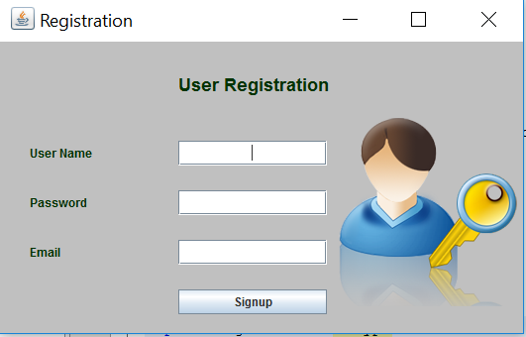
Client Side
Desktop Application
Registration
Email Validation is done
Passwords are secured with bcrypt

Slide 6
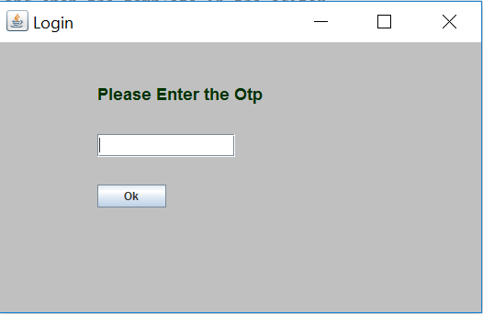
Client Side
Email Validation is done by sending a OTP to the email given while registering.

Slide 7
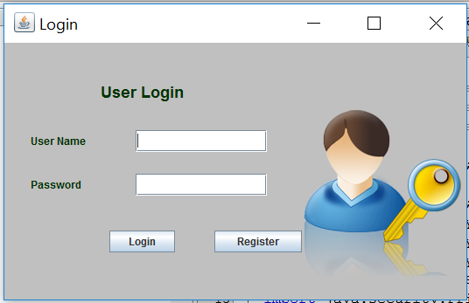
Client Side
Login
Registered users can login by entering the username and password
The password entered is encrypted using bcrypt to compare with stored password on server.

Slide 8
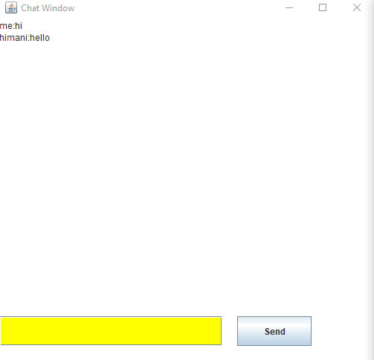
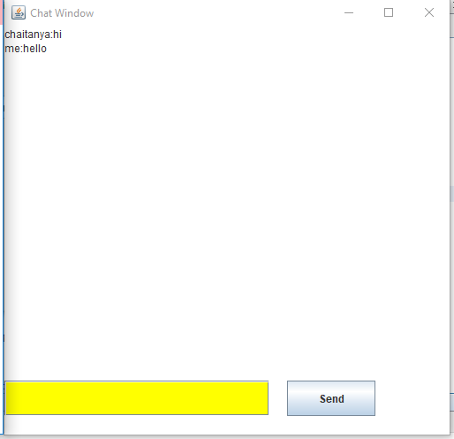
Client side
Communication Window

Slide 9
Algorithm
AES 256 in CBC mode is used to encrypt and decrypt the message
The keys used for encryption and decryption are generated randomly and are secured using RSA.
The integrity check is done using SHA256 – HMAC

Slide 10
Demo
https://www.youtube.com/watch?v=_CvQYz89hYU&feature=youtu.be

Slide 11
Thank You

