Slide 1

Optimized Storage Management system
Monitoring and storage of food grains
BY : CLOWNS

Slide 2

Problem:
A food delivery service has to deal with a lot of perishable raw materials which makes it difficult to maintain , so the important factor which plays a major role is predicting the demand i.e accurately forecasting weekly and daily demand .
Prediction of demand plays a major role because too much inventory in warehouse may lead to risk of wastage and too less may lead to out-of-stock situation . Which may tend customers to opt for an alternative solution
So to check the supply of raw materials and preventing the raw material spoilage in warehouses we came up with a solution .

Slide 3

Solution:
Solution
We build a machine learning model to predict the demand of goods for over next period of time . We build mobile/web application to interact with ml model .
A significant add-on in our monstograin model which helps in maintaining raw materials is monitoring and storage facility of raw materials
Here the major factors like CO2 , temperature and humidity which plays the major role in the grain spoilage are considered and continous monitoring of these parameters in the warehouse is done using an iot device .
The live data is shown to the user in the mobile/web application and and also alerts when these parameters reach an abnormal range .

Slide 4
Why us ?
Quick Installations
Our systems are designed from the ground up to be easy to interact with due to an attractive UI.
Cross Platform Support: You can access the MONSTOGRAIN dashboard from your laptop, phone or tablets and start Controlling your machines
Real Time Analysis of the data is done.
The data produced by our systems is often highly sensitive, and can directly relate to production levels, environmental conditions or occupancy. So, All the requests which are made to the server are encrypted requests.
End to End System (No prior experience needed to configure and hardware maintenance)

Slide 5
HOW CO2 SENSING WORKS ?
According to many thesis shows that CO2 sensing can be effectively used to monitor stored grain quality and detect early the onset of grain spoilage .
Insects and moulds are aerobic organisms that respire and release carbon dioxide into the interstitial air of a stored grain mass.
Past research indicates that a stable grain mass has a CO2 concentration of 400-600 ppm.
Higher levels indicate biological activity abnormality .
CO2 sensors can detect grain spoilage due to insects and moulds usually about three to five weeks earlier than detection by traditional methods such as visual, odour, or temperature detection.

Slide 6
EVALUATING CO2 VALUES :
Past research data and experience gained by early adopters of the technology clearly show that safe grain storage was observed at CO2 concentrations of up to 600 ppm.
Higher concentrations indicate biological activity due to mould growth and/or insect development inside the grain stored in warehouses .
Concentrations of 600 to 1,500 ppm indicate onset of mould growth most often triggered due to storage of grain above the safe storage moisture content .
Concentrations of 1,500 to 4,000 ppm and beyond clearly indicate severe mould infection or stored-product insect infestation.

Slide 7
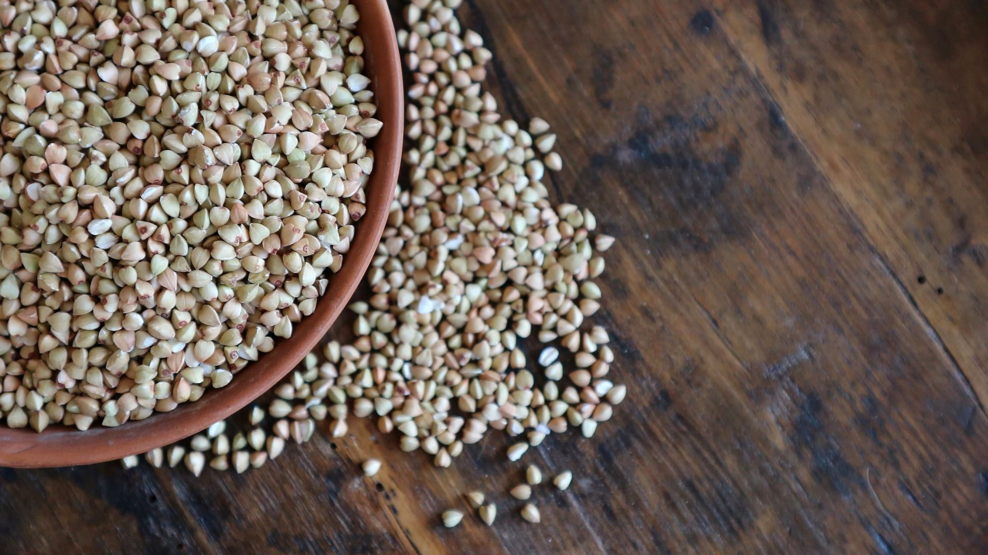
Moisture :
If grain moisture content is too high, even the best aeration equipment and monitoring management will not keep the grain from spoiling.
All stored product insect pests, micro-organisms, including moulds, require moisture to survive and multiply.
If the moisture content in a product going into store is too low, insects and micro-organisms will be unable to grow provided that the moisture in the store is also kept low.

Slide 8
How It Works ?
STEP 1 : Sensors in monstograin would track the temperature , co2 and humidity conditions using iot.
STEP 2: Data is uploaded to Firebase real time Database.
STEP 3: Real time DATA is sent to the web app / native aid app .
STEP 4: From the past all data we will predict the future data and precautions to be taken using Machine Learning
STEP 5: ALERT!! Alert message is sent to mails when the conditions are abnormal , and it would effect the grains .

Slide 9
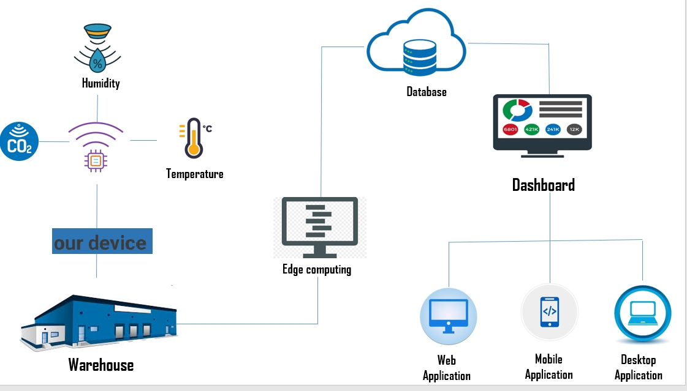
Workflow:

Slide 10
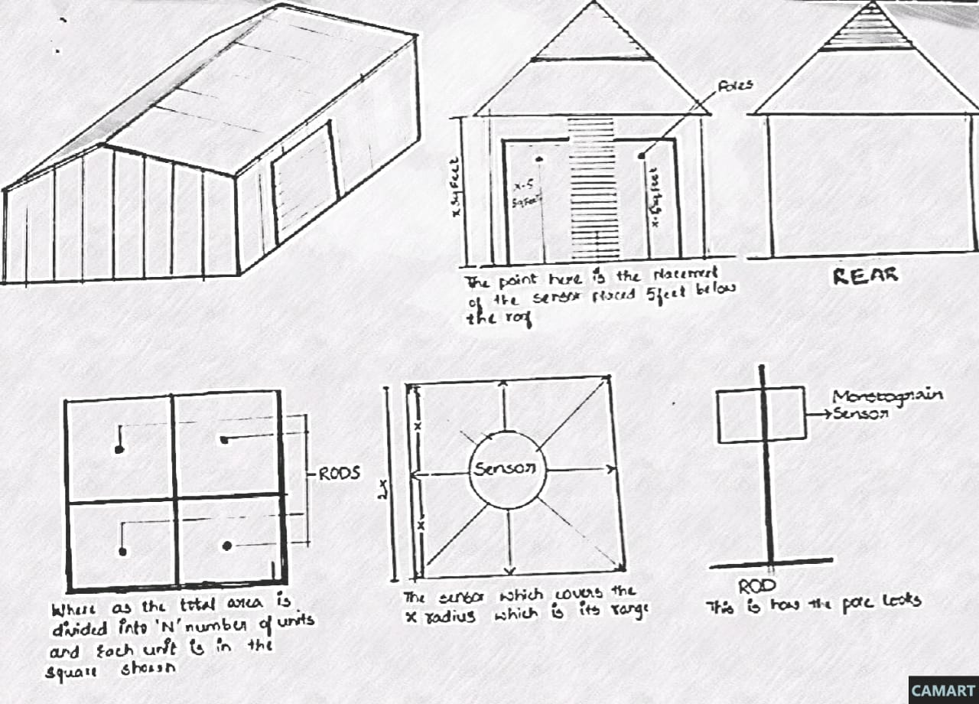
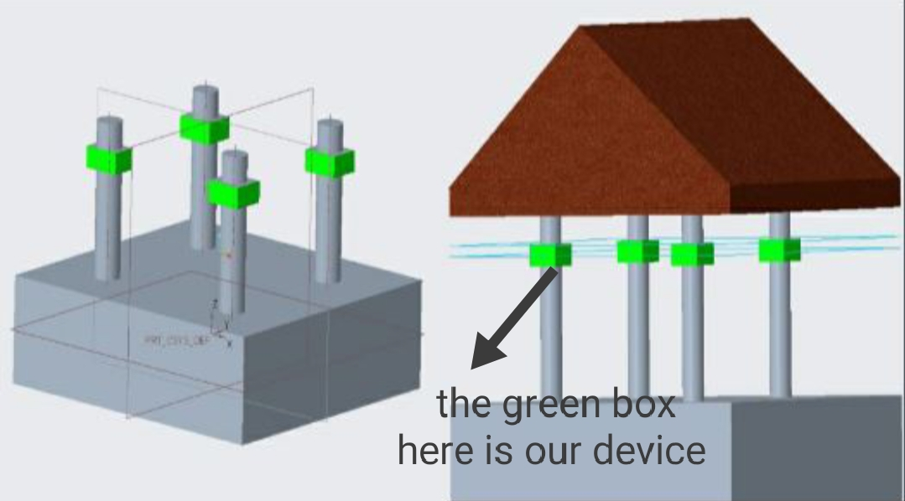
FINALISED DESIGN CONCEPT

Slide 11
No of sensors per cubic volume calculation according to the design concept:
We considered the size of warehouse in terms of volume .
Consider the size of warehouse to be 20,000 sq. ft.
# Area of warehouse =20,000 sq. ft
Volume of a cuboid = (length × breadth × height) cubic units.
# Volume of warehouse .
Volume of warehouse with height 25 ft = 20,000*25 =5,00,000 cubic feet.
# The range of the sensors which we use is
Volume of sphere = (4*3.14*(Radius)³)/3
Volume of sensor who has a range of 15 ft= (4*3.14*15*15*15)/3
=14,142 cubic ft
To find out the no. of sensors we divided the volume of warehouse with the volume each sensor covers
# No. of sensors =Volume of warehouse/Volume covered by the sensor.
No. of sensors = 5,00,000 cubic ft/14,142 cubic ft
~36 sensors

Slide 12
Setup cost for a small sized warehouse (15,000 sq. ft - 20,000 sq. ft)
Material | Quantity | Cost per unit | Total cost
Raspberry pi model 3 | 6-7 | 2750/- | 16,500/-
DHt22 | 50 | 200/- | 10,000/-
NDIR CO2 Sensor MH-Z14A | 30 | 1600/- | 48,000/-
Thermoplastic rods | 50 | 700/kg | 35,000/-
Installation |  | 20,000/- | 20,000/-
Edge computing | 1 | 30,000/- | 30,000/-
TOTAL COST : | 1,59,500/-

Slide 13
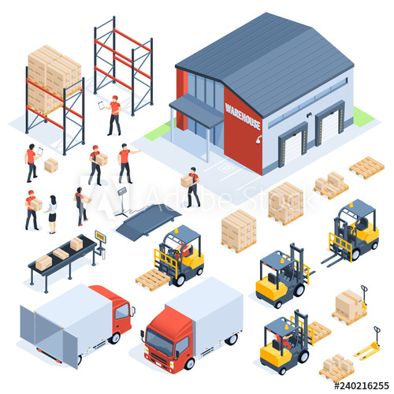
Variation of cost as per the size of warehouse
Size of warehouse | Total installation cost
10,000 sq. ft - 20,000 sq. ft | 1,59,500/-
20,000 sq. ft - 30,000 sq. ft | 2,16,000/-
30,000 sq. ft - 50,000 sq. ft | 2,75,450/-
50,000 sq. ft - 65,000 sq. ft | 3,22,350/-

Slide 14




COMPETITION
•There are many competitors like Grain automation , Grain Technik, Rostfrei steels , Telesnese .
•These are the monitoring systems which have their minimal presence and are costly to be installed.
•They manipulate with the infrastructure of the warehouse, as they also ask to install silos.
•Grain Technik has a mobile device which moves around the warehouse but only monitors the area surrounding it.

Slide 15
BUSINESS COMPETITIVE ANALYSIS
 | Demand Prediction | Grain Technik | Grainautomation | Telesense
TARGET WAREHOUSES | Grain warehouses | Grain warehouses | Silos Storage | Silo/Bins storage
Continuous monitoring | Throughout the warehouse | Only the area where their device is placed | Only if silos are present | They build silos and then monitor
Temperature/Humidity as parameter | Yes | Yes | Yes | Yes
Carbon dioxide as parameter | Yes | No | No | No
Edge computing | Yes | No | No | No
Device type | Sensors spread across the warehouse | Movable device which monitors the only given area | They place sensors inside the silos. | They place sensors inside the silos.
Cost for setting up in a small warehouse (10,000-20,000 Sq. ft) | 1,59,500 /- | 2,50,000/- for single device | 7,75,000/- | 5,65,500/-

Slide 16
Finance:
Initially we will charge the customer with the 40% of the installation cost and rest can be paid in terms of installments.
We provide first 6 months of free service and monitoring then later we will charge 4000 rupees .

Slide 17




MARKET STRATEGY
Spreading awareness of our Services/Product with the help of Google SEO(Search Engine Optimization) and advertisements in Farming journals etc. for greater exposure.
Tie ups with target warehouses chains like Food cooperation of India (FCI) .
Initial costumers get additional 6 months of free maintenance .
We hosts events where the warehouses are isolated.

Slide 18
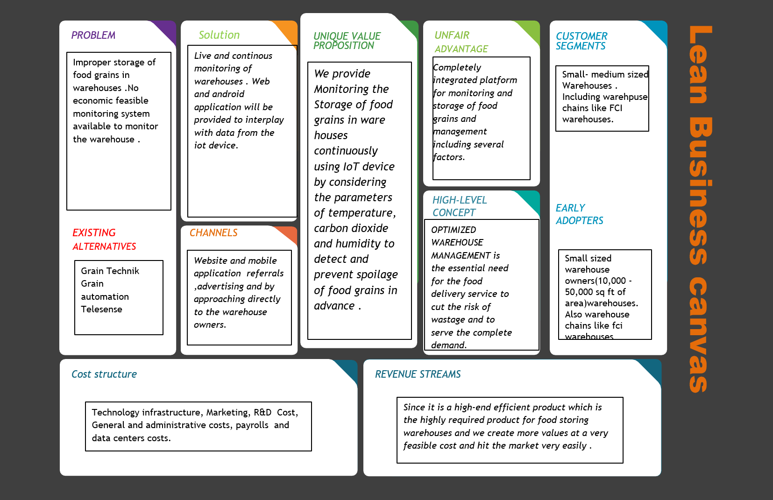

Slide 19
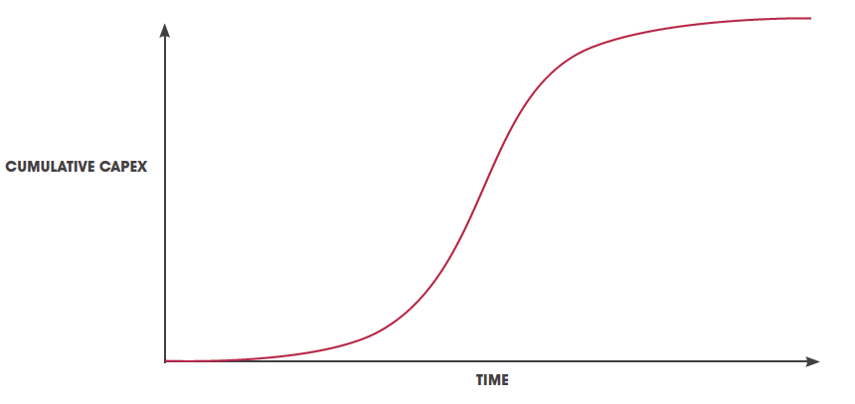
Expected Growth

Slide 20
MILESTONES :
Feb 2021
SALE OF 100 PRODUCTS
July. 2021
MONSTOGRAM V2 WITH MANY MORE CONDITION CHECKS
October 2021
TRY TO CAPITALIZE IN MARKET
Jan 2022
IMPLEMENT PREDICTIVE ANALYSIS OF THE COLLECTED DATA FOR FURTHER INTERVENTIONS

Slide 21
REFERENCE : https://www.world-grain.com/articles/10238-monitoring-co2-in-stored-grain
THANK YOU

