Slide 1
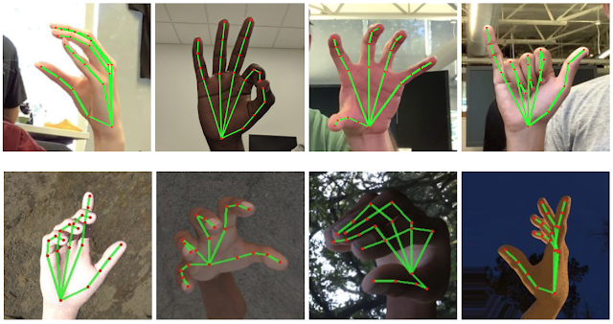
Hand Landmark Model
This model was trained using 30,000 real world images ,and high-quality synthetic hand model over various backgrounds and map it to the 21 3D coordinates as shown in the figure:

Slide 2
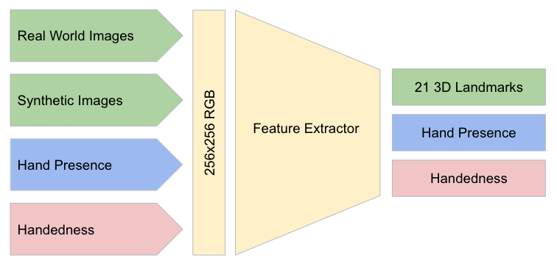
Hand Landmark Model

Slide 3
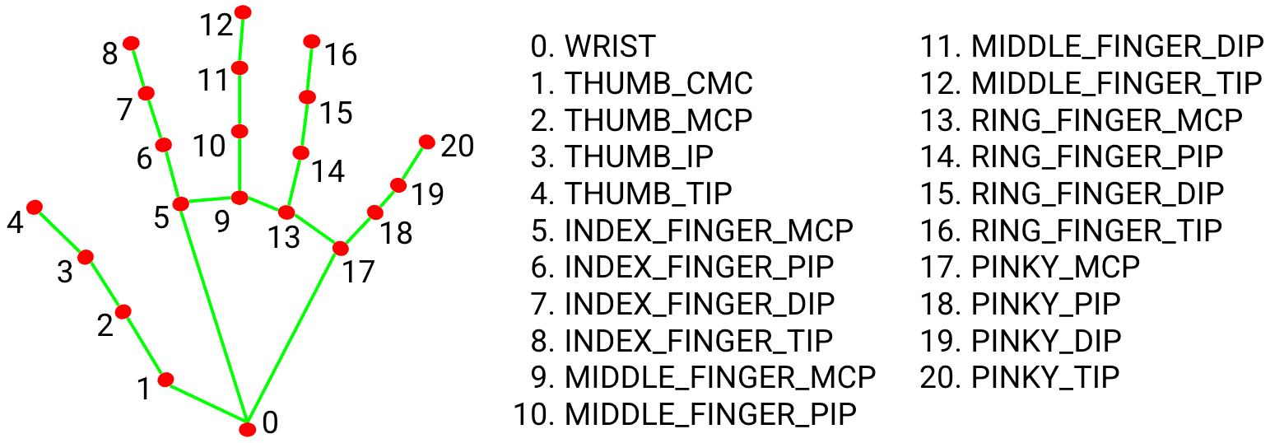
Hand Landmark Model

Slide 4
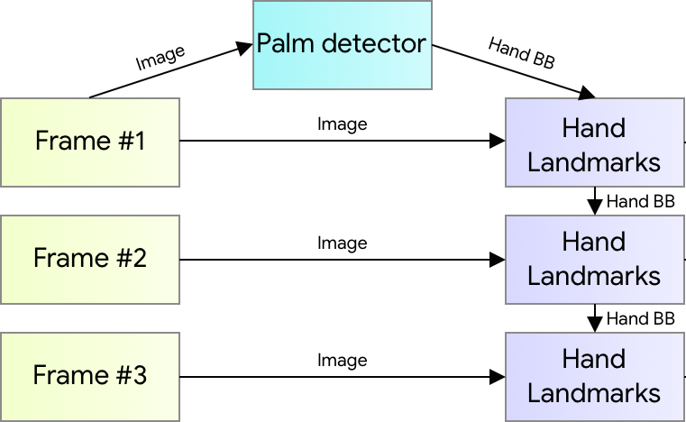
Flow Diagram of Hand Pose Model

Slide 5
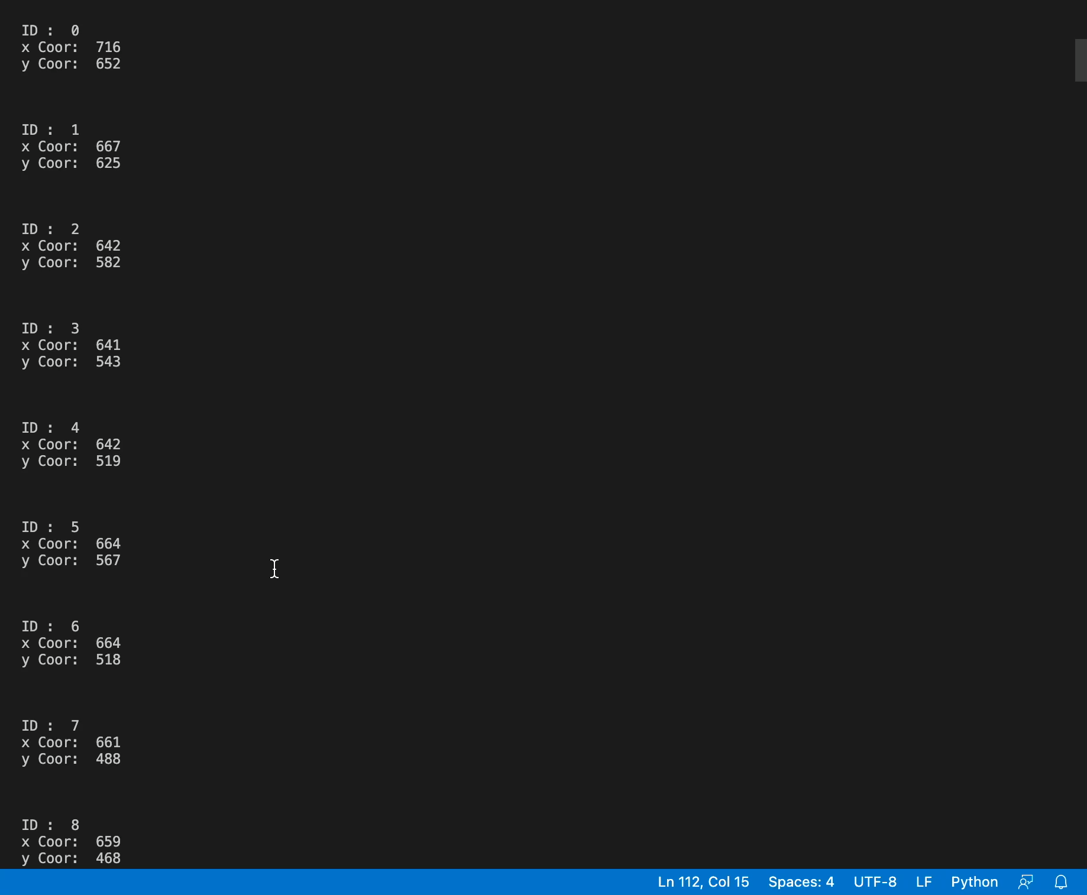
Output of Hand Pose Model

