Slide 1


INTRODUCTION TO DATASCIENCE
HEALTHCARE MANAGEMENT

Slide 2


GOAL
To reduce the total health cost incured on person by analysing the data.

Slide 3
DETERMINANTS OF HEALTHCARE EXPENSES
LOCATION
AGE
BMI
SMOKER

Slide 4

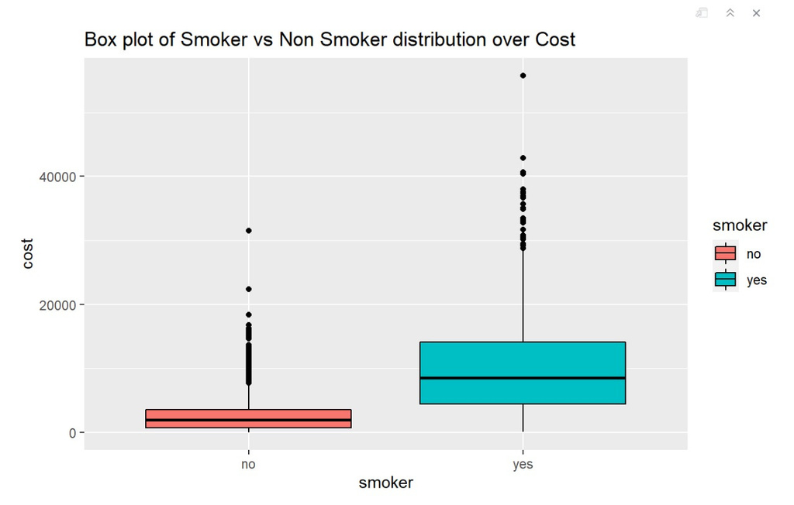
HEALTHCARE COST IS MORE LIKELY TO INCREASE WITH SMOKING HABITS.
TAKEAWAY: Average expenses of the smoker are greater than 10k; Hence, smoking is one of the attributes related to expenses.

Slide 5

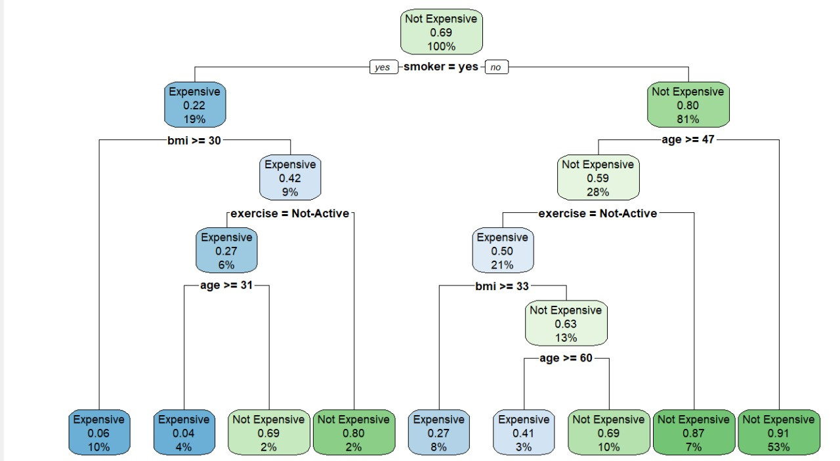
HEALTHCARE EXPENSES BASED ON BMI AND SMOKING HABITS

Slide 6
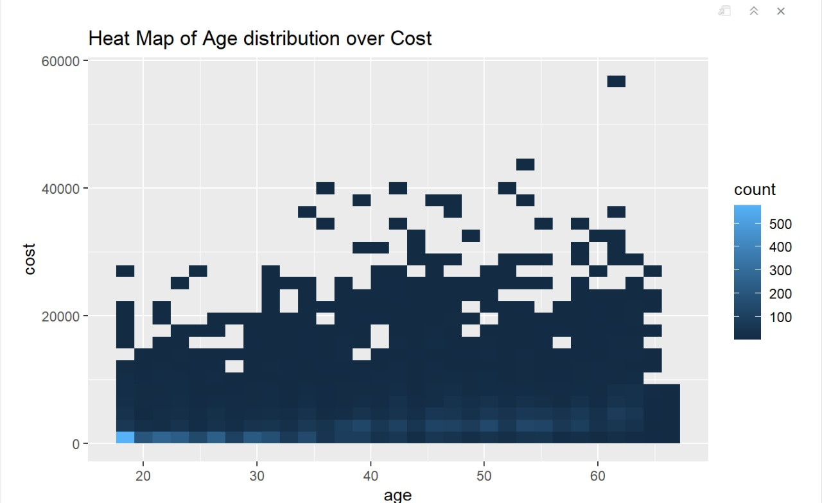
AGE IS RELEVANT TO HEALTHCARE EXPENSES.
TAKEAWAY :
Age and cost have positive co-relation, as age increases healthcare expenses increase.

Slide 7
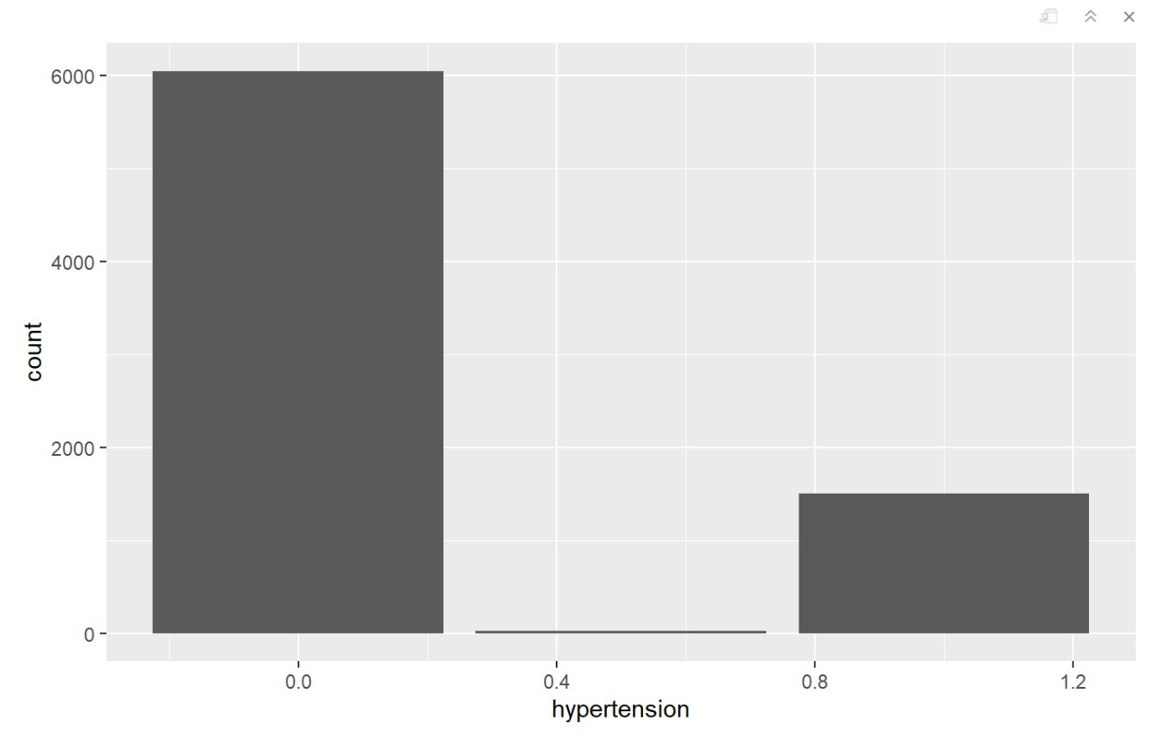
HYPERTENSION VS FREQUENCY

Slide 8
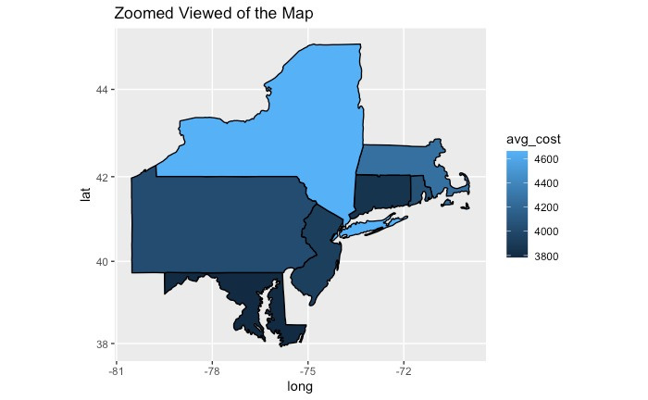
MEAN COST BASED ON LOCATION
5,000
4,000
3,000
2,000
1,000
0
CONNECTICUT
RHODE ISLAND
PENNSYLVANIA
NEW JERSEY
NEW YORK
NEW YORKERS' mean Healthcare Expenses is costlier compared to other states

Slide 9
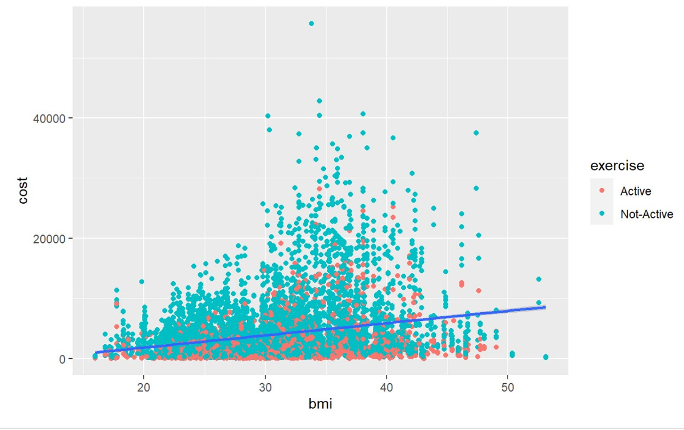
CORRELATION OF COST AND BMI
TAKEAWAY :
For people who have an active lifestyle, their cost of healthcare is way less than people with inactive lifestyle.

Slide 10
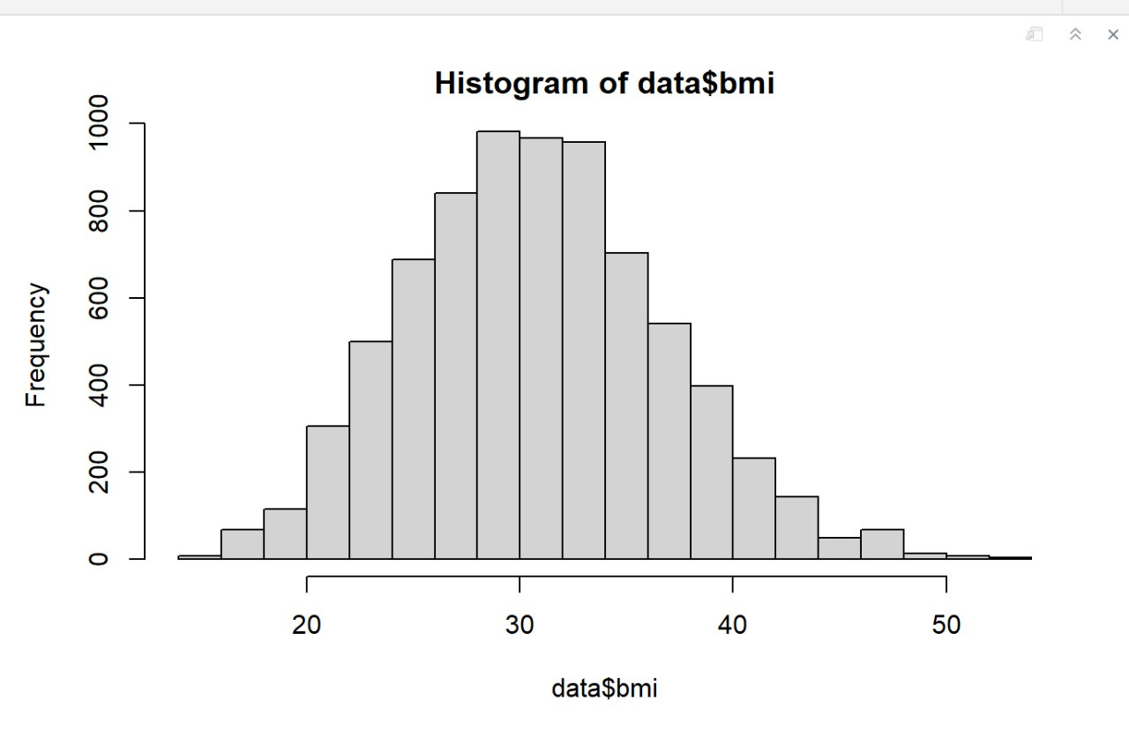
BMI VS FREQUENCY

Slide 11

RECOMMENDATIONS
Healthcare programs for obese people
De-addiction program for smokers
Family insurance plan for people with 1-4 Children.
Suggest People with 0.5 hypertension take precautionary medical care

Slide 12


Accuracy
84.3
OUR RECOMMENDATIONS ARE BASED ON
Sensitivity
63.01

Slide 13

THANK YOU

