Slide 1
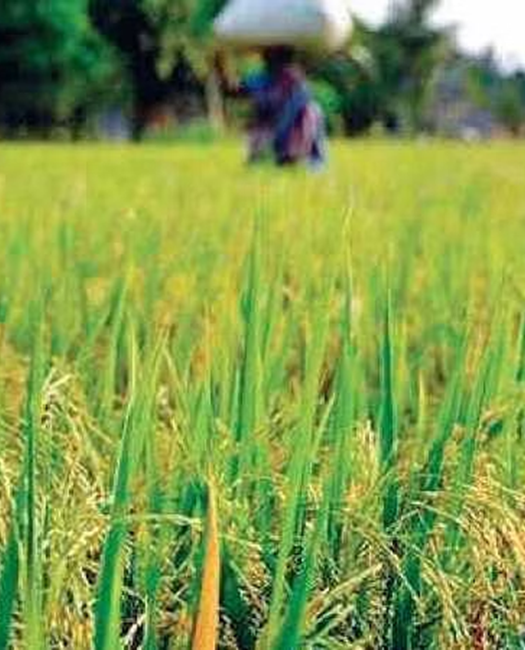
Crop recommendations using Historical rainfall data
Supervised by- Prof. Dr. Martin Crane
Presented by-
Chaitanya Ashish Khot (22262858),
Yash Manoj Modi (22260873)

Slide 2
Index
Introduction
Literature Review
Dataset
Data Preprocessing and exploration
Feature Engineering
Methodology
User Interface
Results and Discussion
Conclusion and Future Work

Slide 3
Introduction
Research Question:
Can historical rainfall data be effectively leveraged to provide accurate crop recommendations and optimal soil conditions for farmers, thereby enhancing agricultural productivity and sustainability?
What inspired us for this project?
Agriculture's vital role in the Indian economy and livelihoods.
Unpredictable rainfall impacts Indian crop yields.
Making customized recommendations for regional diversity.
Empower farmers with technology for smart farming choices.

Slide 4
Literature review
No. | Authors | Year | Research Focus | Methodology | Key Findings
1 | D. K. Dwivedi and P. K. Shrivastava | 2022 | Rainfall Probability Distribution and Forecasting Monthly Rainfall | ARIMA Model | Analyzed rainfall probability distribution and forecasted monthly rainfall using ARIMA model for Navsari.
2 | R. Kavitha, M. Kavitha, and R. Srinivasan | 2022 | Crop Recommendation in Precision Agriculture | Logistic Regression, Support Vector Machine, Random Forest Classifier, K-Nearest Neighbour | Studied crop recommendation in precision agriculture employing supervised learning algorithms for enhanced agricultural practices.
3 | U. Ashwini, K. Kalaivani, K. Ulagapriya, and A. Saritha | 2021 | Tamilnadu Monsoon Rainfall Prediction | Time Series Analysis using Seasonal ARIMA | Seasonal ARIMA model used for prediction of Tamilnadu monsoon rainfall with presented key findings.
4 | A. Sharma, M. Bhargava, A. V. Khanna | 2021 | AI-Farm: A Crop Recommendation System | Decision Trees, Support Vector Machine, Random Forest, K-Nearest Neighbour | Developing a crop recommendation system using AI techniques to assist farmers in crop selection
5 | Sukarna, E. Y. P. Ananda, and M. S. Wahyuni | 2021 | Rainfall Forecasting Model Using ARIMA and Kalman Filter | ARIMA, Kalman Filter | Developed a rainfall forecasting model combining ARIMA and Kalman Filter for Makassar, Indonesia.

Slide 5
Unveiling the Data
A total of three datasets have been employed in this research: the rainfall dataset, the crop dataset, and a custom dataset specific to sub-divisions.
The primary dataset employed for rainfall prediction was the rainfall dataset. Additionally, crop recommendations were formulated with the assistance of two supplementary datasets.
1. Rainfall Dataset:
Provided by the Government of India.
Spans over a century with sub-division-wise monthly rainfall records.
Presents an extensive historical perspective on India's sub-divisional precipitation trends.
Comprises 4188 rows and 19 columns, ensuring rich and detailed information

Slide 6
Unveiling the Data
Feature | Data Type
N (Nitrogen) | int64
P (Phosphorus) | int64
K (Potassium) | int64
temperature | float64
humidity | float64
ph | float64
rainfall | float64
label | object
2. Crop Dataset:
Accessible on the Kaggle platform.
Provide guidance on 22 suitable crop choices using diverse soil characteristics.
Contains 2200 rows and 8 features, facilitating detailed analysis and informed crop selection along with their growth conditions.
Fig. Features in the crop dataset

Slide 7
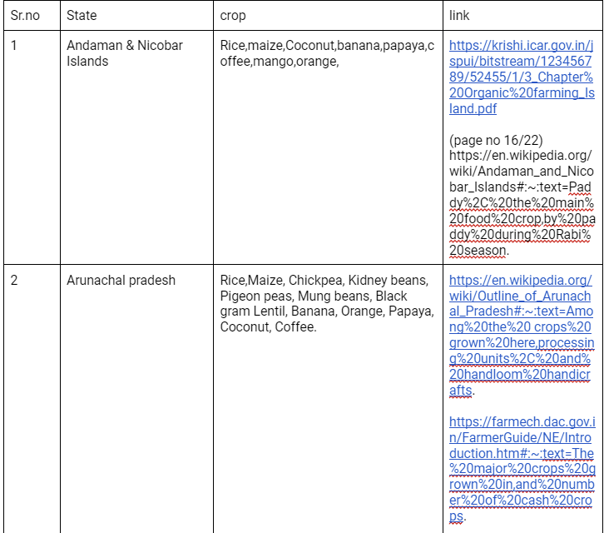
Unveiling the Data
3. Sub-division-wise crop Dataset:
Developed to establish connectivity between the rainfall and crop datasets.
Encompasses crop varieties cultivated within all mentioned sub-divisions in the rainfall dataset.
All the values in this dataset are backed up by authorized and verified open data sources.
It contains 494 rows and 3 features
Fig. References table snippet

Slide 8
Data cleaning
Handling Null Values:
Explored rows and columns with nulls to identify patterns.
Noticed most nulls were pre-1970, possibly due to data preservation techniques.
Filled and compared nulls using 0, mean, forward fill, and interpolation methods.
Chose forward fill (ffill) for minimal impact on data.
Data Enrichment:
Utilized complete monthly data to fill na values in seasonal and annual columns.
Investigated rainfall distribution, highlighting June to September as the peak period (around 87% of total rainfall in the year).
Notes:
Could not use upsampling techniques like smote as we were

Slide 9
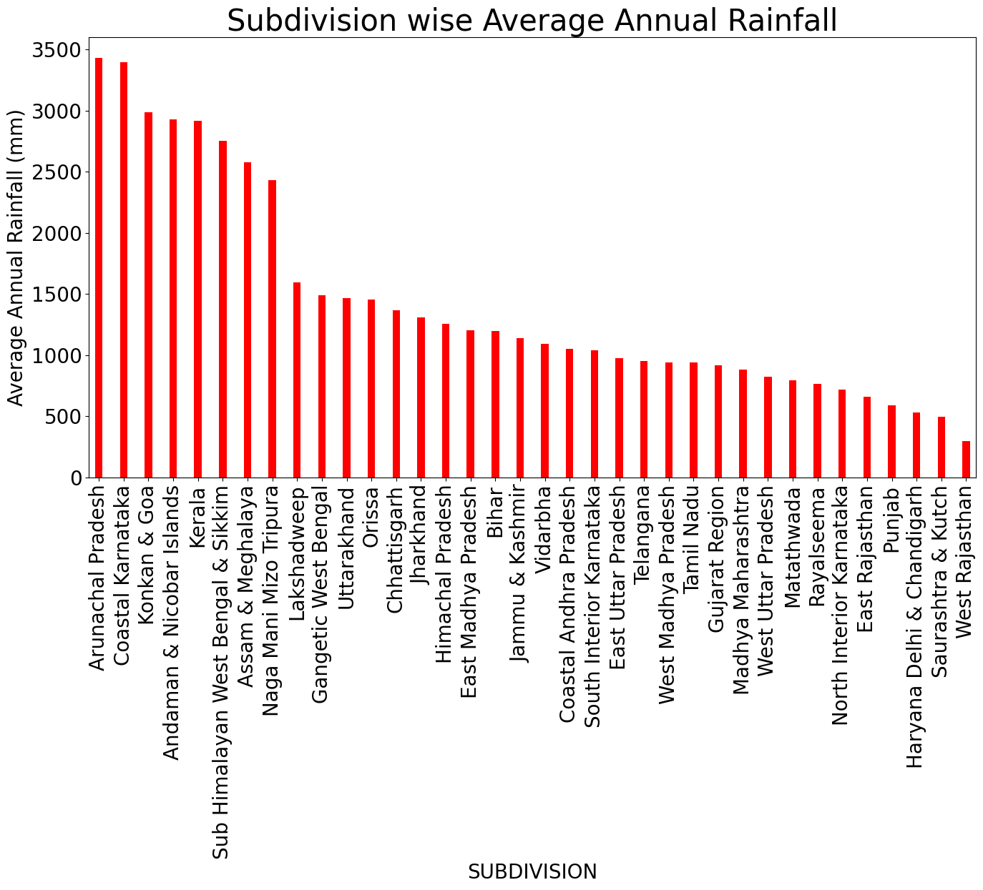
Data cleaning
The presented graph illustrates the mean annual precipitation across all subdivisions from 1901 to 2017.
The data unveils that Arunachal Pradesh exhibits the highest average annual rainfall, whereas West Rajasthan records the lowest, among the depicted subdivisions.
Fig. Sub-division wise average annual rainfall

Slide 10
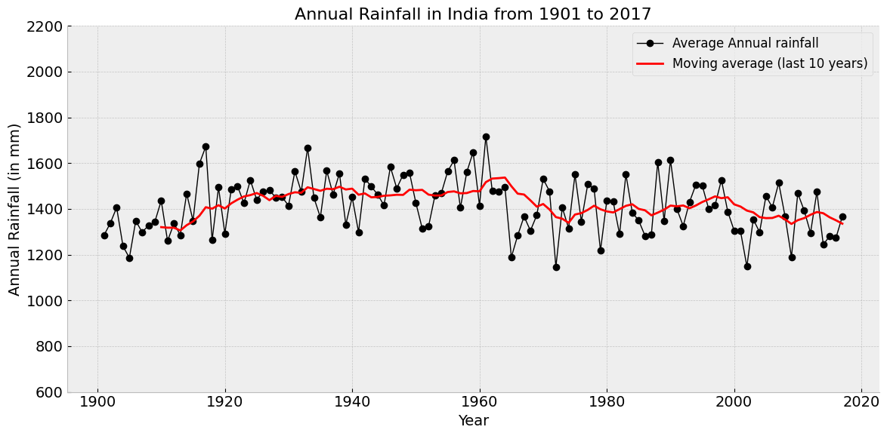
Data exploration
Historical Insights:
Discovered minimum (1972) and maximum (1961) rainfall years.
Connected 1961's high rainfall to notable events like the Panshet Flood and the green revolution triggered by the 1965-66 drought years.
Fig. Annual rainfall in India (1901-2017)

Slide 11
Data exploration
Monsoon Season Analysis:
Visualized month-wise rainfall for subdivisions, confirming concentrated monsoon season rainfall.
Compared pre-monsoon and monsoon plots to understand seasonal trends.
Created moving averages (4-pt and 8-pt) for peak rainfall months, highlighting stable patterns with recent slight decreases.
Climate Trends:
Observed post-1960s minor dip in Indian rainfall.
Linked global warming to shortened monsoon season.
Analyzed subdivision-wise seasonal rainfall, showcasing regional disparities.

Slide 12
Feature Engineering
Data Segmentation: Partitioned data frame into monthly, seasonal, and annual rainfall subsets for clarity.
Harvesting Seasons Defined: Introduced Kharif (Jun-Sep), Rabi (Oct-Mar), and Zaid (Mar-Jun) with average and total rainfall for crop planning.
Test Data Creation: Generated a 2017 rainfall data frame for evaluating forecasts.
Data Preservation: Exported preprocessed data frames for future reference.
PCA for Feature Importance: Employed PCA to determine monthly data's significant individual impact on predictions, which was equivalent to its seasonal aggregation.

Slide 13
Implementing previous work
Explored past methodologies including Multiple Linear Regression, Random Forest Regression, K Neighbors Regression, Support Vector Regression, and Decision Tree Regression and evaluated them using RMSE.
MLR exhibited the most promising outcomes, while SVM displayed less favourable results.
Identified Challenge: Recognized that previous models were utilizing existing features to predict test data values, rather than forecasting for forthcoming years.
Transition to Time Series Models: Responded by adopting time series forecasting models to fulfil the prediction requirements effectively.
Model Selection: Opted for ARIMA and LSTM for time series forecasting.
Chose ARIMA over SARIMA due to the absence of evident seasonality in the data.
Refined Focus: Directed efforts towards precise future value prediction to enhance the practical utility of the models.

Slide 14
Implementing forecasting models
Initial Challenge: Attempted monthly data forecasting, faced inconsistency due to complex multi-month predictions across subdivisions.
Parameter Search: Employed ACF and PACF plots for ARIMA parameter identification. Testing AIC/BIC and regularization degraded results.
Sequential Forecasting Limitation: Using the previous month’s forecast for the next month led to inaccuracies.
Strategic Shift: Transitioned to seasonal forecasts, simplifying models.
Seasonal Focus: Utilized Kharif, Rabi, and Zaid seasons for ARIMA and LSTM forecasting.
Refinement Steps: Employed cross-validation, and experimented with different ARIMA and LSTM parameters to improve accuracy.

Slide 15
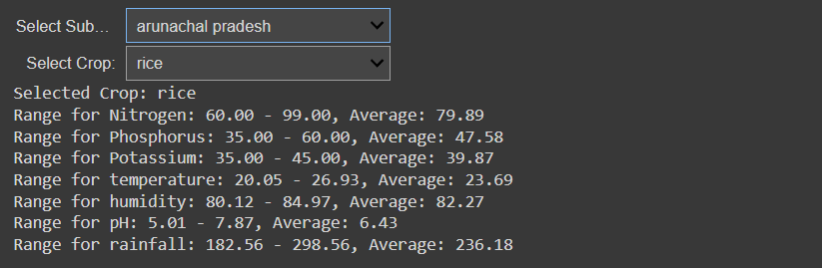
Integration for Crop Recommendation
User Interaction: Incorporated user-friendly dropdown for subdivision selection in Python.
Customized Crop List: Displays crops grown in the user's subdivision during the Kharif season.
Crop Selection Details: Upon choosing a crop, present its soil requirements, and rainfall range.
Front-end UI available to the user

Slide 16
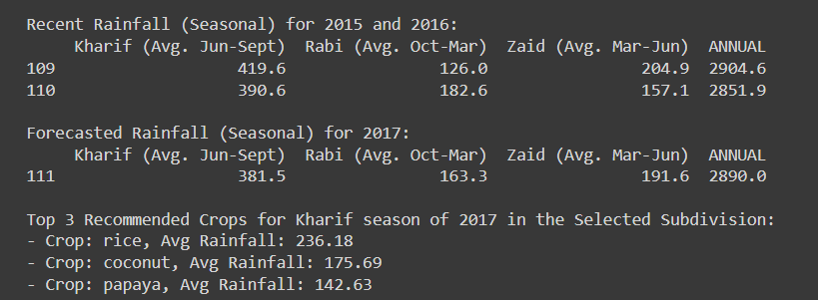
Integration for Crop Recommendation
Seasonal Insights: Provides recent Kharif, Rabi, and Zaid seasonal rainfall data for two years.
Forecasted Rainfall: Displays forecasted rainfall for the upcoming year.
Precise Comparison: Compares forecasted Kharif rainfall with historical records.
Tailored Recommendations: Based on the comparison, suggest 3 optimal crops for cultivation, ordered by relevance.
Front-end UI available to the user

Slide 17
Results and Discussion
Model | MAPE (%) | MAE | RMSE
ARIMA | 35.11 | 20.12 | 20.12
ARIMA (Tuned) | 26.08 | 53.33 | 53.33
LSTM | 50.23 | 25.72 | 25.72
LSTM (Tuned) | 33.35 | 19.07 | 19.07
Overall, optimization efforts led to improved performance across both models, as evidenced by lowered MAPE, MAE, and RMSE values. Such enhancements are crucial for achieving accurate and reliable forecasts for our crop recommendation system.

Slide 18
Conclusion
Utilized machine learning and data analysis to predict rainfall and propose sustainable crop choices.
Integrated historical rainfall and soil attributes, identifying key factors impacting crop yield.
Enhanced crop forecasting with ARIMA and LSTM models, achieving 33.35% MAPE and 19.07 MAE/RMSE after tuning.
Offered farmers a valuable tool for informed decisions, optimizing methods and bolstering agricultural productivity for long-term sustainability.

Slide 19
Future Work
Seasonal Extension: Expand from Kharif to encompass all agricultural seasons for comprehensive analysis.
User-Friendly Interface: Elevate user experience by implementing HTML/CSS front-end for a dynamic website.
Enhanced Dynamism: Incorporate future years' rainfall data for more accurate forecasting.
Advanced Forecasting Algorithms: Integrate diverse time series algorithms, including Prophet or Neural Prophet to refine predictions.
Economic Considerations: Incorporate crop prices to optimize recommendations for economic viability.

Slide 20
Thank you!

Slide 21
Questions?

