Slide 1
RCA & Problem Management AI Agent
Modern incident analysis with Gemini LLM, similarity matching, and rich operational output.

Slide 2
Overview
A unified agent for incident analysis, risk guidance, and repeat-issue triage. The dashboard delivers an incident number, RCA summary, recommended actions, and context from similar past incidents.
Works with a Node.js frontend proxy and Python backend. Gemini LLM drives the analysis, while similarity matching identifies repeat failures and accelerates resolution.

Slide 3
Tools & Stack
• Frontend: HTML, CSS, vanilla JavaScript
• Node.js: Express proxy, CORS, axios
• Python: Flask API, Gemini integration, incident similarity
• Data: CSV incident history and prompt templates
• LLM: Google Gemini via generative AI SDK
• Deployment: local service ports 3000 and 5000
• UX: responsive dashboard with status and error handling
• Output: JSON API for RCA, recommendations, and matches

Slide 4
LLM & Analysis Details
The Python back end sends a prompt to Google Gemini for structured RCA. Response parsing extracts summary, root causes, recommended actions, confidence and risk levels. This enables the UI to present executive-ready incident insights and operational guidance.

Slide 5
Architecture
1. Frontend: Collects incident details and presents results.
2. Node Proxy: Routes requests from browser to Python API.
3. Python API: Runs similarity matching and Gemini analysis.
4. Output: Returns structured JSON to frontend.

Slide 6
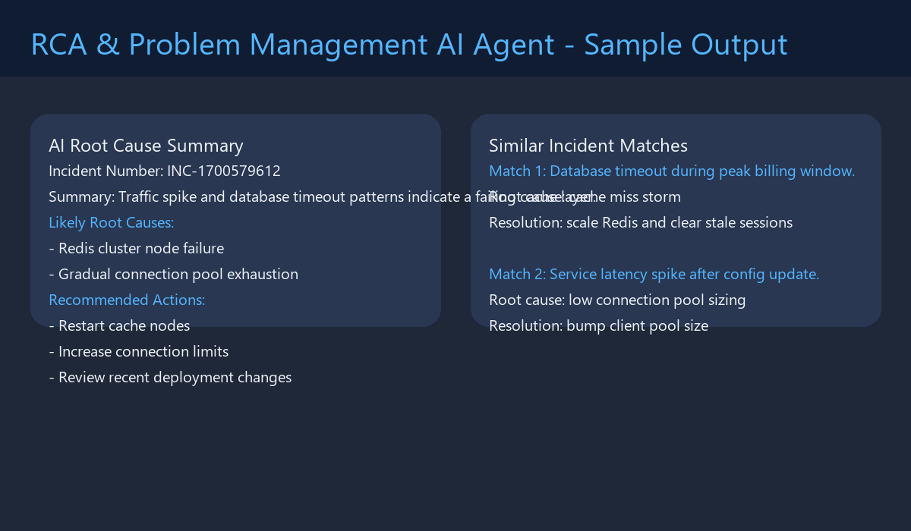
Sample Output

Slide 7
Important Details
• Local service ports: 3000 (frontend) and 5000 (Python API) • Set GEMINI_API_KEY environment variable • Use clear incident descriptions for best RCA results • Similarity matching uses CSV historical incident data
• Output includes incident number, summary, root causes, recommendations, and risk metrics • Node proxy handles JSON requests and CORS • Frontend uses status badges and error messages for feedback • The deck is designed for technical and stakeholder review

