Slide 1

Presented By
Chaitanya Sai Manne
Karthik Reddy Vundela
Sri Chaitanya Patluri
Sai Venkatesh Gatiganti

Slide 2
Introduction
What is Patent ?
  A property right granted by the Government of the United States of America to an inventor ‘to exclude others from making, using, offering for sale, or selling the invention throughout the United States or importing the invention into the United States’ for a limited time in exchange for public disclosure of the invention when the patent is granted
Patent Analysis
  To understand the patents particularly what are the steps involved in invention and how they are related to each other is complex and time-consuming. To ease the work, expedient tools help us to understand patents which increases the quality and lower the cost.

Slide 3
TOPAS Workbench
It’s a prototype which integrates technologies for Entity recognition, lexical Chain identification, patent segmentation, claim e description alignment, invention composition derivation and patent summarization.
Each of the TOPAS technologies is realized as a separate module.
Most of them can be used independently from each other. Only alignment and composition detection presuppose a prior segmentation.
An open source software named as GATE is used for document representation and algorithm integration.
TOPAS processes patents in all three European patent languages: English, French and German.

Slide 4
TOPAS Workbench Architecture

Slide 5
TOPAS Workbench - GATE
A patent chosen for closer inspection is stored, after being preprocessed in GATE format. The modules are developed in JAPE or integrated into GATE by wrapping mechanism.
The module is processed in proprietary format, so GATE-format is transformed and the output is transferred back into GATE-format.
The use of GATE ensures the flexibility.

Slide 6
TOPAS Workbench - Preprocessor
The preprocessor module sends a series of processing tools like parts-of-speech, lemmatizer, parse, NLP, GATE’s tokenizer etc.
They choose MATE tool, as it can handle very long sentences of up to 900 words and also they is a possibility to retrain them in order to adapt to their own domain.

Slide 7
Entity Recognition
A sequence of words is considered an entity term if
    It is a noun phrase
    It belongs to the domain of interest
deals with two types of recognitions
    Predefined
    Generic
Predefined term types: patent citations, physical measurements, technical quality entities, substances, processes
Generic entities: product names, brand names, machine components, etc.

Slide 8
Predefined Term Type Recognition
Patent citations and physical measurements are recognized using regular expressions
F₁–score of 1 indicates that regex based patent citation recognition works well
Due to ambiguity in physical measurement F₁–score is limited to 0.58
The other types are recognized by matching the tokens of a given document with entries in gazetteer lists giving an accuracy of 0.95-0.99

Slide 9
Generic Entity Recognition
Firstly, preprocessed patents are filtered to collect term candidates
Then a statistical model is used to distinguish terms that represent technical entities from those that do not
The model determines the probability of a candidate to be technical based on a variety of features
E.g. frequency,position,overlap
The model is trained with data that is generated by an automatic procedure with high reliability

Slide 10
Lexical Chain Identification
Defines a sequence of terms related by a sematic relation
Based on Stanford Deterministic Coreference Resolution System(StCR) which consists of candidate detection, coreference resolution and post- processing
Some changes were made to customize StCR for domain of patents which include an improvised pipeline.
The source code was refactored to suit other languages as well.
A pdf-interface was used for inspection of lexical chains by experts.

Slide 11
Invention Composition Extraction
segment each claim into text spans that describe a component of an invention
Classify the obtained spans based on linguistic cues
Identify corresponding components within the spans using a domain- specific grammar &results of entity recognition
Mark parts of an invention in the description section thus aiding the composition with description as well.

Slide 12
Segmentation
Segmentation of description of a patent is done at three different levels of abstraction.
1st Level – Broad Section-wise Partition
2nd Level – Thematic Zoning of Individual Section
3rd Level – Topic-oriented division.
1st Level Segmentation:
Here, the patent is divided in to five mandatory and two optional segments.
Mandatory Segments:
1. Technical Field.
2. Background Art.
3. Summary of the Invention.
4. Description of the Drawings.
5. Preferred Embodiments.
Optional Segments: Industrial Applicability. Examples.

Slide 13
The Segmentation is done according to the above list by using the headlines which indicate the start of a respective segment.
If a headline is not present, then two strategies can be followed, first is 1st on Heuristics and 2nd on Conditional Random Fields (CRFs).
Heuristic Based Approach:
(i) End of Technical Field/Start of Background Art (This is done by Text Mining Method
developed by Tseng et al.)
(ii) The End of Background Art/Start of Summary (This is done by observing if an objective of the
invention is mentioned in the summary of invention)
(iii) Start and End of Description of Drawings (This is done by observing explicit references to
drawings and size of the descriptions of drawings)
CRF Based Approach: This approach takes in training stage as input a sequence of paragraphs of the description, represented by a small number of features and labeled with the title of the Level 1 segment it belongs to, to learn the correlation between features and segment titles. In the classification stage then, this correlation is applied to deduce segment titles from the detected features.
So, by above approaches, a confidence value is computed whether there is an explicit headline and if the both strategies coincide.

Slide 14
2nd Level Segmentation
This level covers headline and topic transition segment recognition.
As headlines are not explicitly marked in given data, a paragraph shorter than 100 characters and does not end with a sentence delimiter(.,!,:,?) is considered as a headline.
These candidates are then classified as:
(i) one of the level 1 segments.
(ii) “Embodiment” headline (if a headline marks the beginning of an embodiment description)
(iii) “figure” headline (if a headline marks the beginning of a figure description)
(iv) “other” headline (if a headline marks the beginning of a topic specific to the invention as, e.g.,
“Structure of the carburetor 11”, which marks the beginning of the presentation of the
structure of the carburetor 11);
(v) “no_headline”, if a candidate is not a headline.

Slide 15
For Classification, Support Vector Machine (SVM) classifier is used.
Topic transition segments, whose identity has not been recognized, are sentences that indicate the description of the content of a new topic. For example, “Next, the operation principle of the battery charger in the first embodiment will be described”.
The Detection of headlines and topic transition segments facilitates the derivation of a partial table of contents by listing all the headlines and transition segments in the sequence in which they appear in the patent description and linking them to textual part which comes right after it. This table lets the user access any particular segment in the description section quickly and helps in document navigation.

Slide 16
3rd Level Segmentation
This level addresses the detection of patent chunks that cover other types of regular useful information including advantages of invention, objectives of invention, about the achievement of the objectives.
These segments are recognized partially by regular expressions and partially by SVM classification.
The Average F1-Score is 0.75.
Claim segments are composed of statements (in the logical sense) on an individual element of the invention. They are recognized using a rule-based mechanism.

Slide 17
Claim – description alignment
It is the task of aligning segments in the claims with sentential and sub-sentential description segments that are directly related to each other on that latter provide additional information on the former or rephrase the former.
This is done for the purpose of two things.
(i) To facilitate interactive patent analysis by highlighting parts in the description that explain and
or elaborate on a claim or a part of the claim.
(ii) To provide features for abstractive summarization.
The Alignment is done at different levels namely, paragraph, sentential and sub-sentential segment.
This is done by representing segments in claims and description section as vectors where each position in a vector corresponds to the tf-idf value of a term.
A cosine similarity is computed between each segment in the claims and each segment in the description. If the similarity is greater than user defined threshold, then the segments are considered aligned.

Slide 18

The similarity computation is done according to the following process.
For each claim segment SC,
a. compute element similarity between primary element of SC and the linguistic structures of all
sentential or sub-sentential segments SD of the description that have the same syntactic structure
and thus would qualify as element of the invention, according to a given element similarity
measure es.
b. compute the lexical overlap between SC and SD, according to a given lexical overlap measure ls.
c. combine the element and lexical similarities between SC and SD.
d. Choose the SD with the maximal similarity according to Step c as the description segment to be
aligned with SC.

Slide 19
Patent summarization
TOPAS combines two know techniques for summarization.
Extractive summarization
Abstractive summarization
Extractive summarization:
Surface oriented and applies relevance metrics based on distribution.
Selects entire sentence for summarization.
Abstractive summarization:
Selects summary relevant content from the sentence and assembles them using linguistic aggregation into summary .
Requires robust semantic analysis.

Slide 20
Summarization(contd)
TOPAS assigns weights to selected segments of the patent.
Training on human annotated data is done for assigning weights.
Score for the qualitative evaluation done by TOPAS Industrial consortium is given as 3.38(average) and for linguistic quality it is 3.8.
Quality of concrete summarization depends on quality of outputs of all previous modules.
Types of features that are considered for giving weights and selecting segments are
Mention-based features.
Segment relevance features
Classical extractive summarization features.

Slide 21
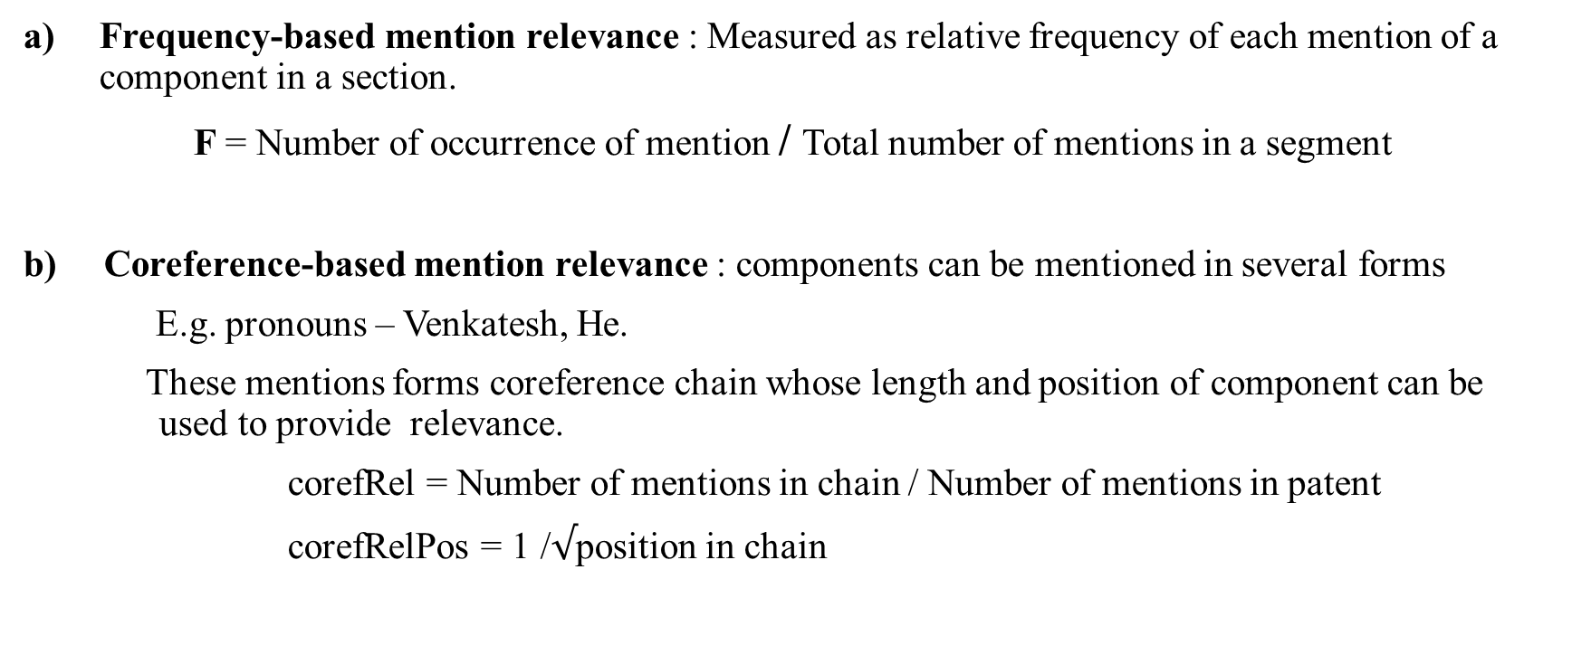
Mention-based features
Frequency-based mention relevance : Measured as relative frequency of each mention of a component in a section.
F = Number of occurrence of mention / Total number of mentions in a segment
b) Coreference-based mention relevance : components can be mentioned in several forms
E.g. pronouns – Venkatesh, He.
These mentions forms coreference chain whose length and position of component can be used to provide relevance.
corefRel = Number of mentions in chain / Number of mentions in patent
corefRelPos = 1 /$√$position in chain

Slide 22
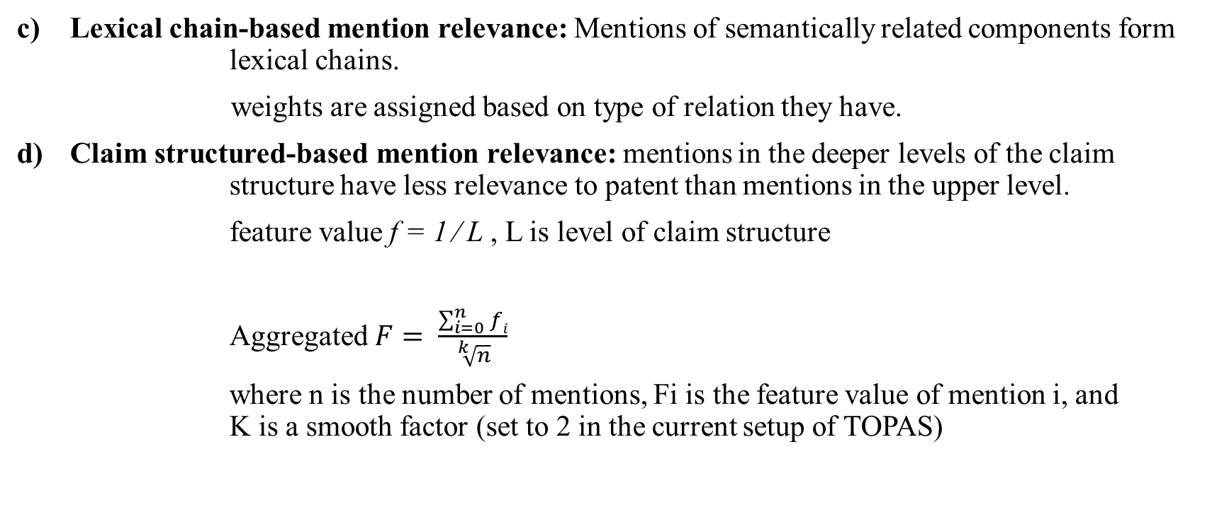
Mention-based features(contd)
Lexical chain-based mention relevance: Mentions of semantically related components form lexical chains.
weights are assigned based on type of relation they have.
Claim structured-based mention relevance: mentions in the deeper levels of the claim structure have less relevance to patent than mentions in the upper level.
feature value f = 1 ∕ L , L is level of claim structure
Aggregated $F= \frac{\sum_{i=0}^{n}{fi}}{\sqrt[k]{n}}$
where n is the number of mentions, Fi is the feature value of mention i, and K is a smooth factor (set to 2 in the current setup of TOPAS)

Slide 23
Segment Relevant features
Claim alignment similarity features : captures the strength of the association of a segment with claim
Length feature: Prevents long from getting heavy weights.
feature is inversely proportional to number of mentions.
Semantic features: Feature values are based on type of segment.
Invention feature: if segment is principle of invention then feature is 1,otherwise 0.

Slide 24
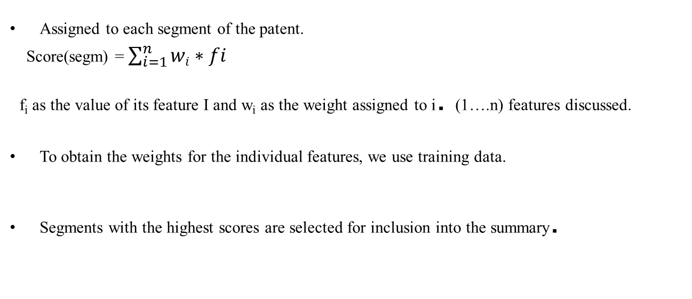
Summarization Metric
Assigned to each segment of the patent.
Score(segm) = $\sum_{i=1}^{n}{wi∗fi}$
f_{i} as the value of its feature I and w_{i} as the weight assigned to i. (1….n) features discussed.
To obtain the weights for the individual features, we use training data.
Segments with the highest scores are selected for inclusion into the summary.

Slide 25
Compiling Summaries
Aggregation of selected segments into summary using rule based paraphrasing and filtering grammars.
This is done in MATE flat form , an open source grammar development environment.
E.g. The device contains a signal processing unit
The device is located next to the shading unit
»The device contains a signal processing unit . It is located next to the shading unit.
This aggregated segments are passed to MATE natural language generator ,which gives fluent summary of the patent

Slide 26
Future work
TOPAS technologies have been tested only on specific patent collection only in its entire lifetime, needs to be tested on broad range of patents.
Suboptimal performance of the preprocessing tasks needs to be improvised.
Maturation of the all TOPAS technologies has to be done as it is still prototype.

Slide 27
Thank you

