Slide 1
Share It
Simple Software to Transfer Files
Group Members:-
1.Alpesh Kaushal -(17CS30003)
2.Chaitanya Bhutada -(17CS10011)

Slide 2
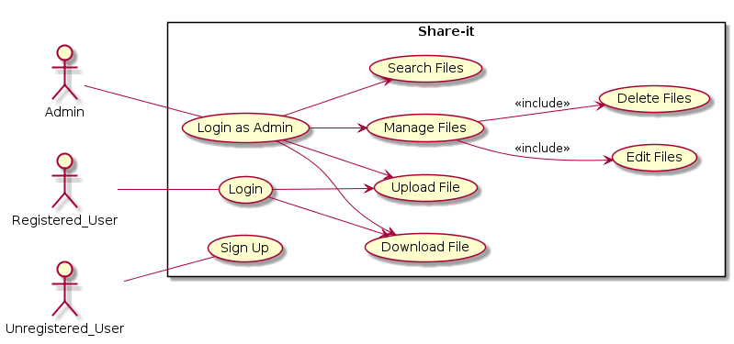
Use Case Diagram

Slide 3
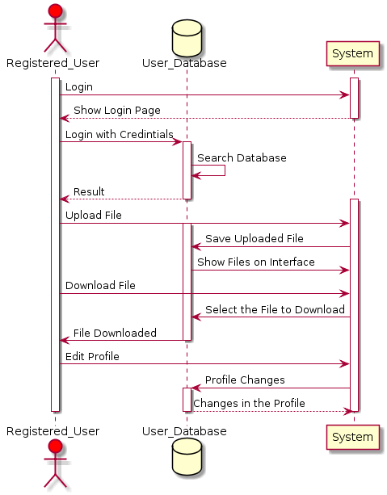
Sequence Diagram

Slide 4
Environment Used
1] Java TCP Protocols
(Source:-https://www.tutorialspoint.com/java/java_networking.htm)
2] Java Swing
(Source:-https://www.javatpoint.com/java-swing)
3] Jconnector
(Source:-https://www.javatpoint.com/example-to-connect-to-the-mysql-database)

Slide 5
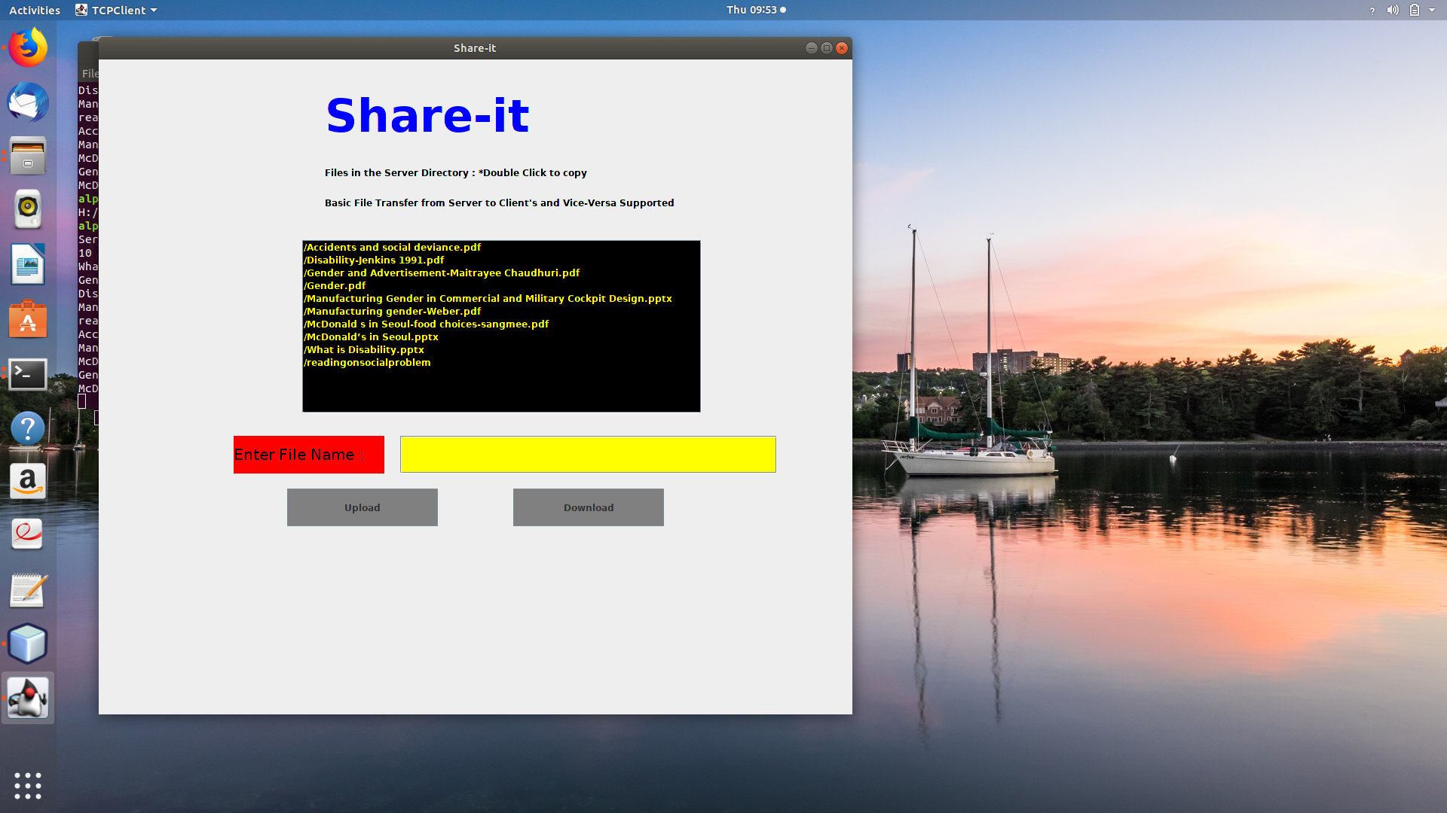
Screenshot’s

Slide 6
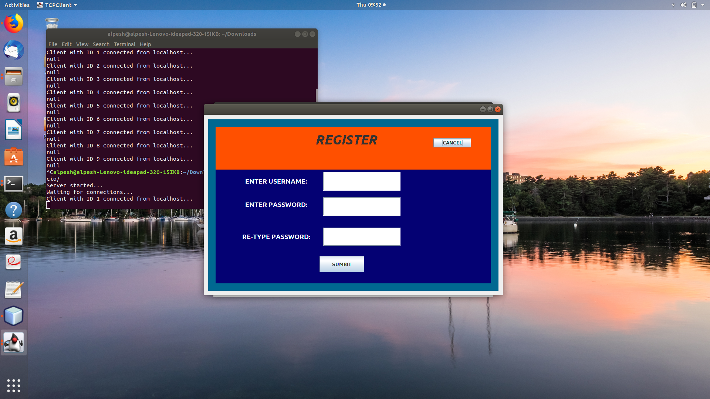
Screenshot’s

Slide 7
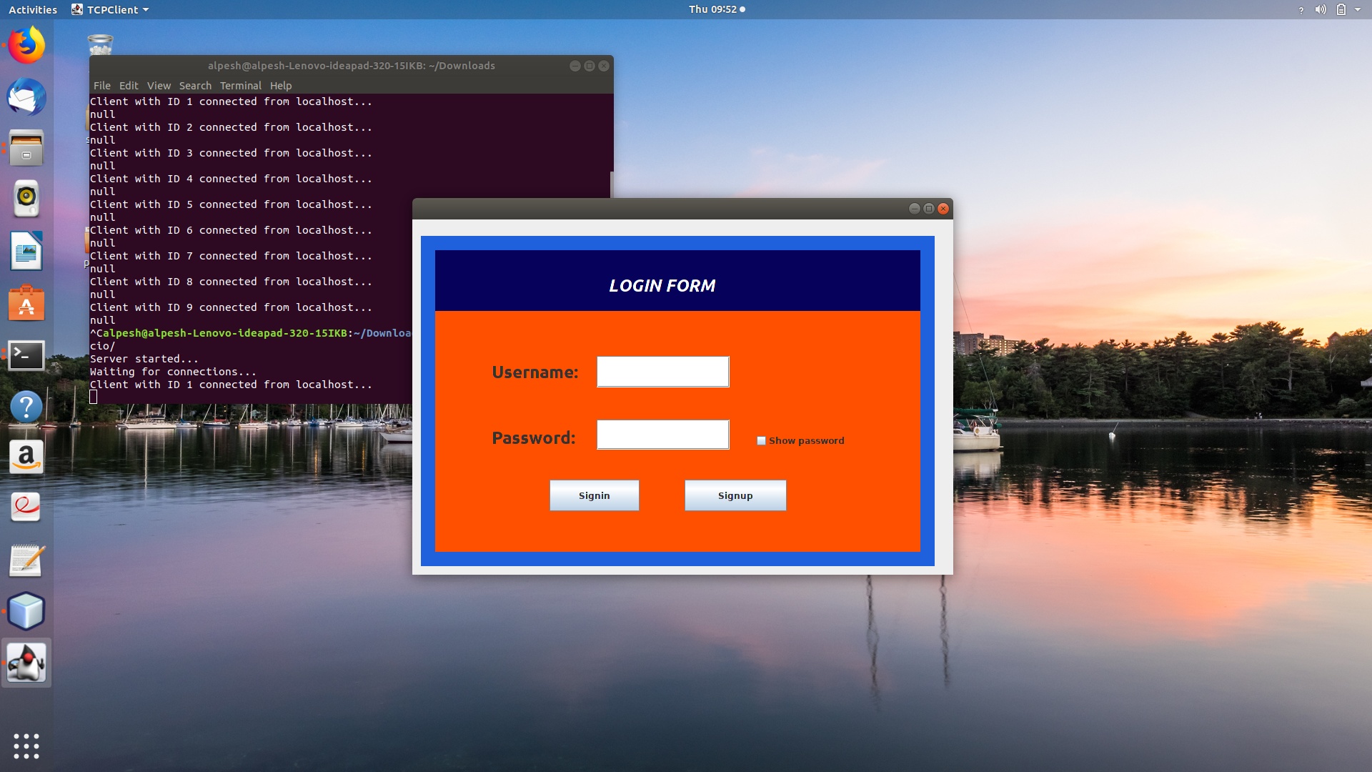
Screenshot’s

Slide 8
Work Done
1] Login , Sign up Page for Client Side of the Software
2] Basic Upload and Download File’s through the network

Slide 9
Challenge’s
The major challenge was to code the Software in Java which was a new Programming Language for us.
Learn about TCP and jconnector and Swing

