Slide 1
Load Balancing System

Slide 2
ABSTRACT
This project is about the algorithm for distributing Session Initiation Protocol (SIP) requests to a cluster of SIP servers. Our load balancer improves both throughput and response time versus a single node while exposing a single interface to external clients. We present the design, implementation, and evaluation of our system using a cluster of Intel x86 machines running Windows.
The algorithm we used here is Transaction Least-Work-Left (TLWL)

Slide 3
EXISTING SYSTEM
While individual servers may be able to support hundreds or even thousands of users, large-scale ISPs need to support customers in the millions.
A central component to providing any large-scale service is the ability to scale that service with increasing load and customer demands.
A frequent mechanism to scale a service is to use some form of a load-balancing dispatcher that distributes requests across a cluster of servers.
However, almost all research in this space has been in the context of either the Web or file service.

Slide 4
PROPOSED SYSTEM
We introduce new algorithm that outperform existing ones.
Our work is relevant not just to SIP, but also for other systems where it is advantageous for the load balancer to maintain sessions in which requests corresponding to the same session are sent by the load balancer to the same server.

Slide 5
MODULES
Load Balancer
SIP Cluster Servers
Load Balancer :load balancer improvesboth throughput and response time versus a single node while exposing.
SIP Cluster Servers :Session Initiation Protocol (SIP) requests to a cluster of SIP servers.

Slide 6
SYSTEM REQUIREMENT SPECIFICATIONS:
Hardware Requirements:
Operating System : Windows
Technology : JAVA 1.6, Swings
Hardware Specification
Processor : Minimum Pentium IV
RAM : 512 MB
Hard Disk : 80GB

Slide 7
USE CASE DIAGRAM

Slide 8
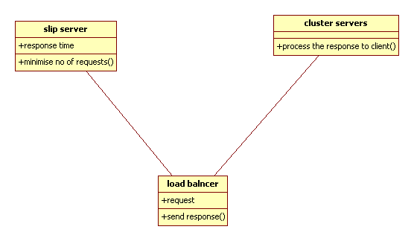
CLASS DIAGRAM

Slide 9
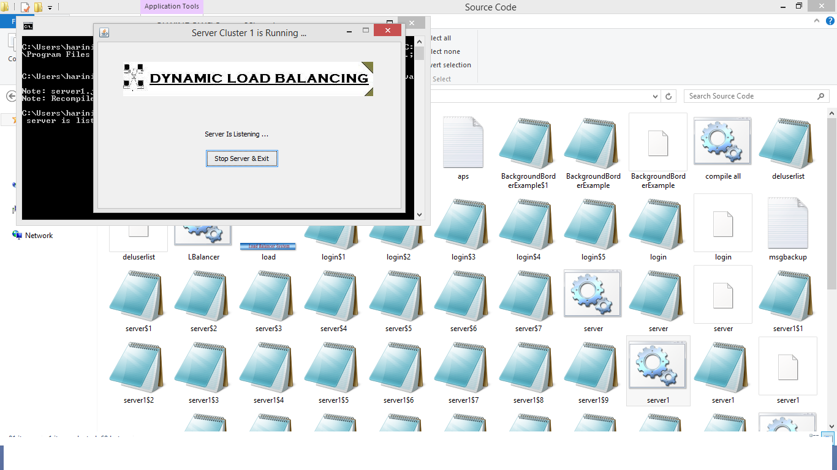

Slide 10
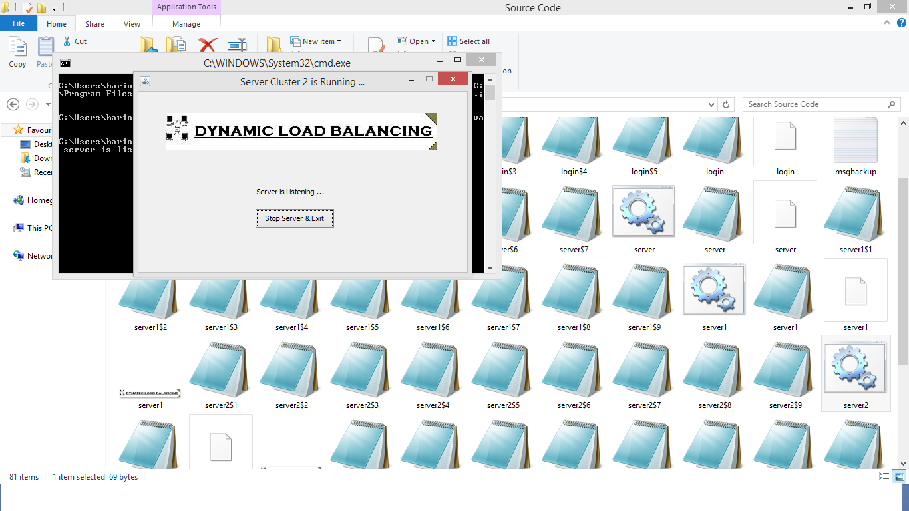

Slide 11
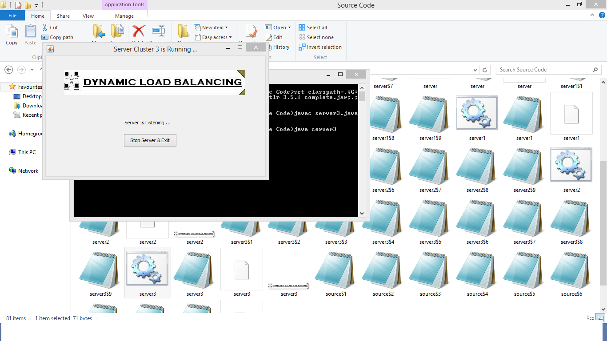

Slide 12
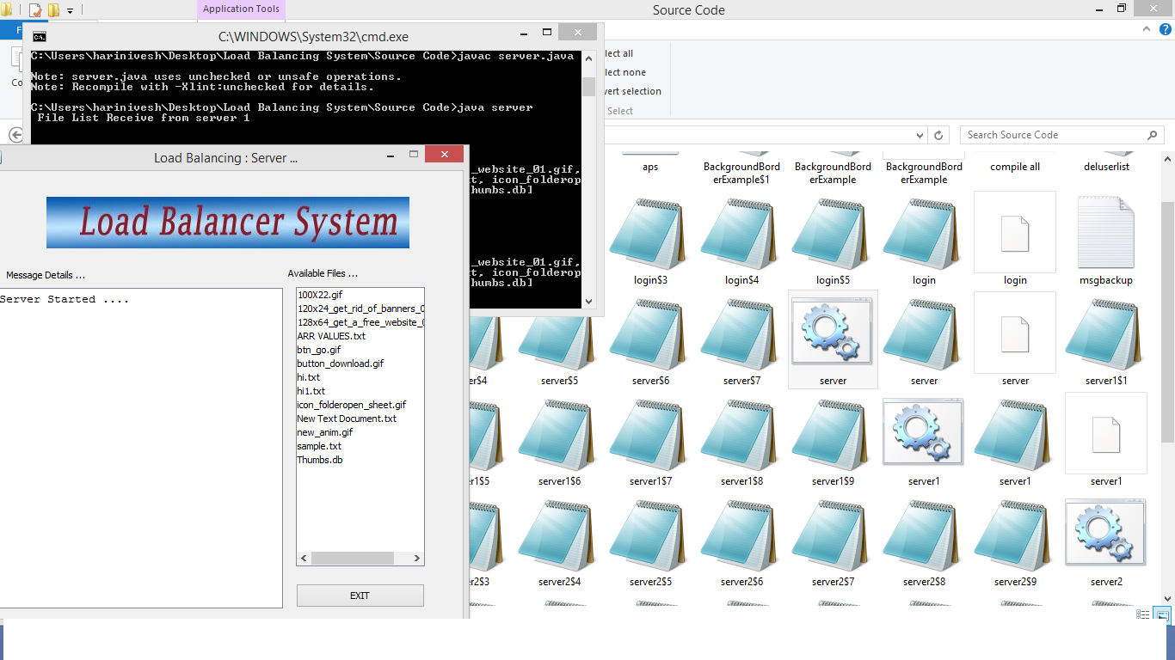

Slide 13
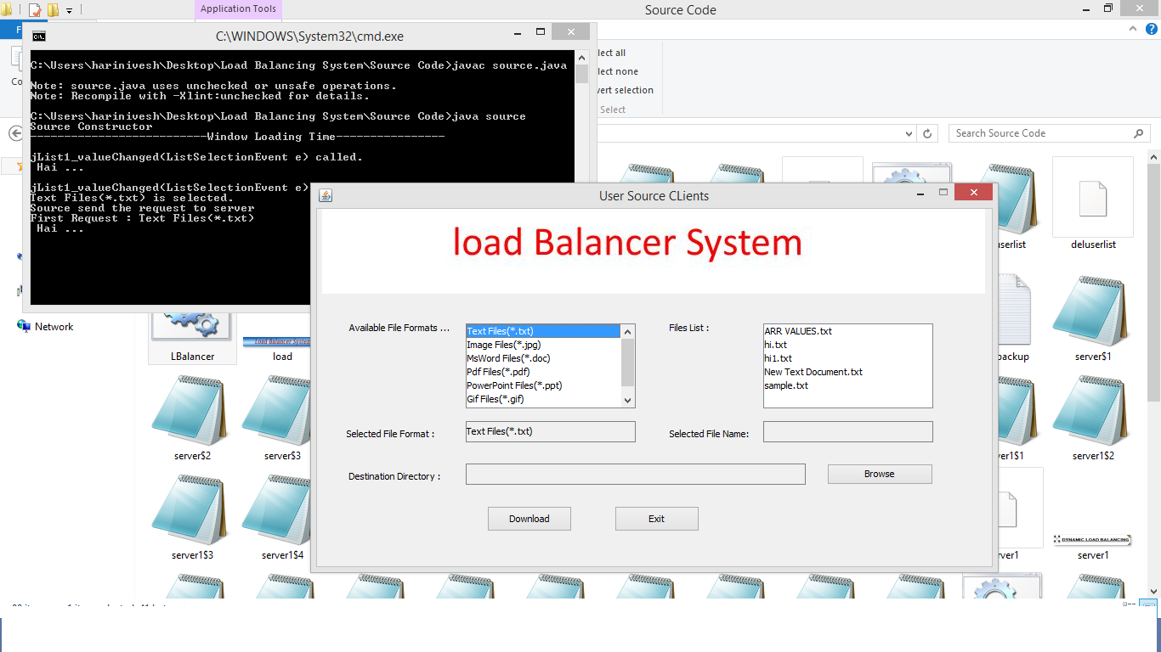

Slide 14
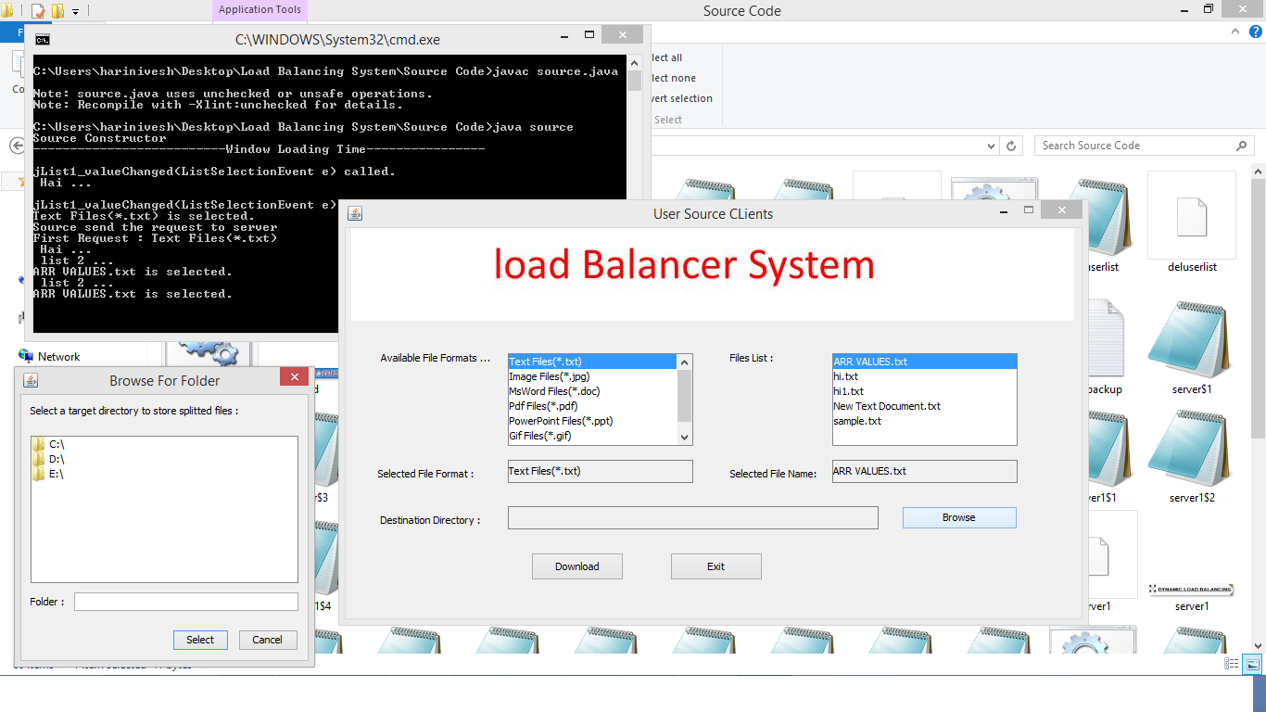

Slide 15
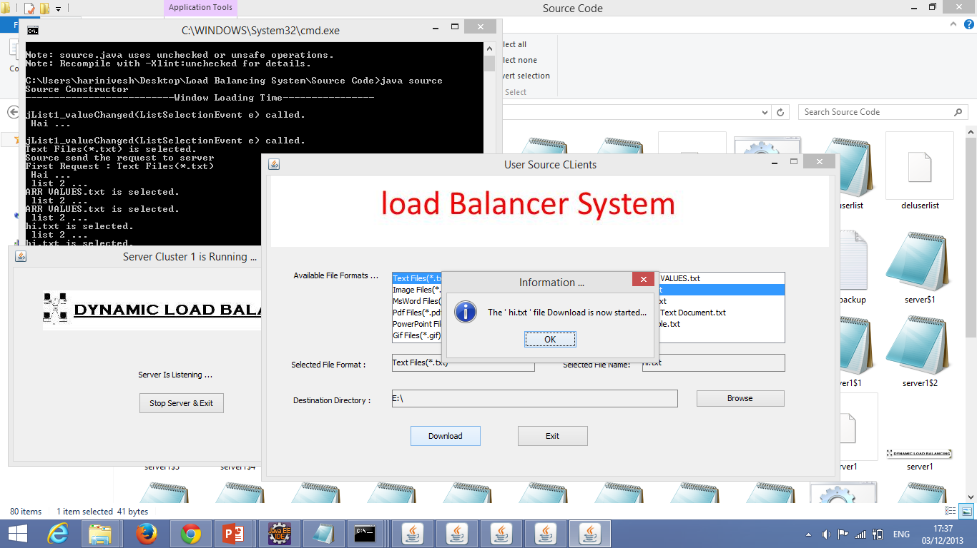

Slide 16
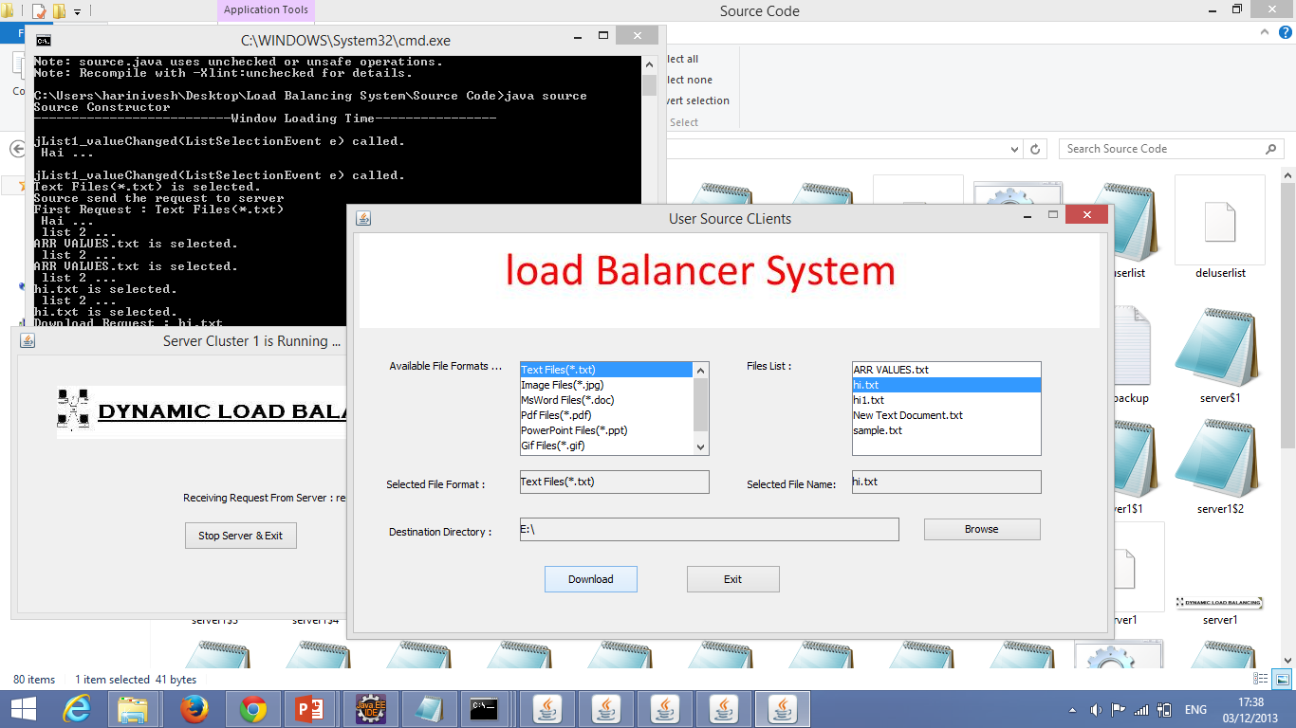

Slide 17
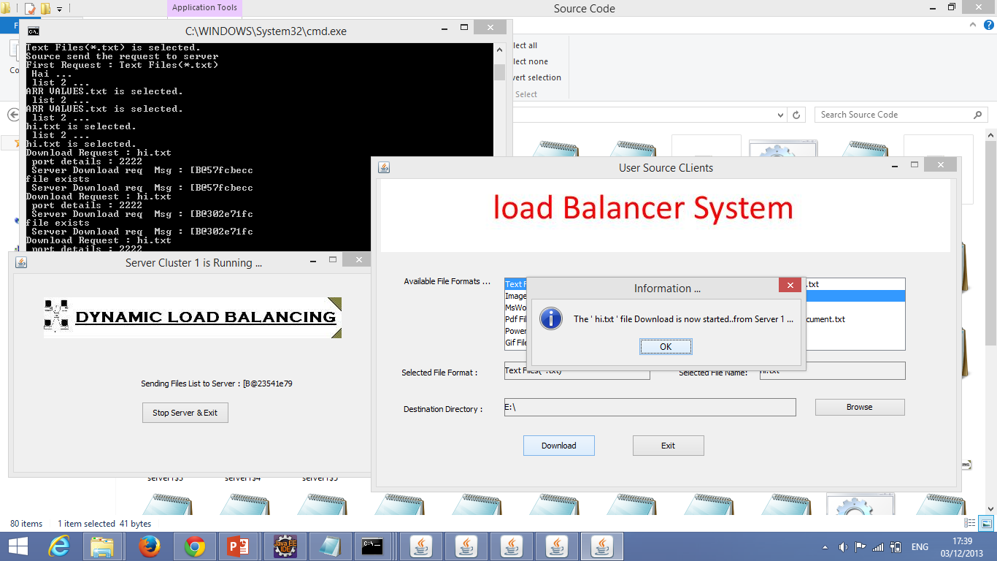

Slide 18
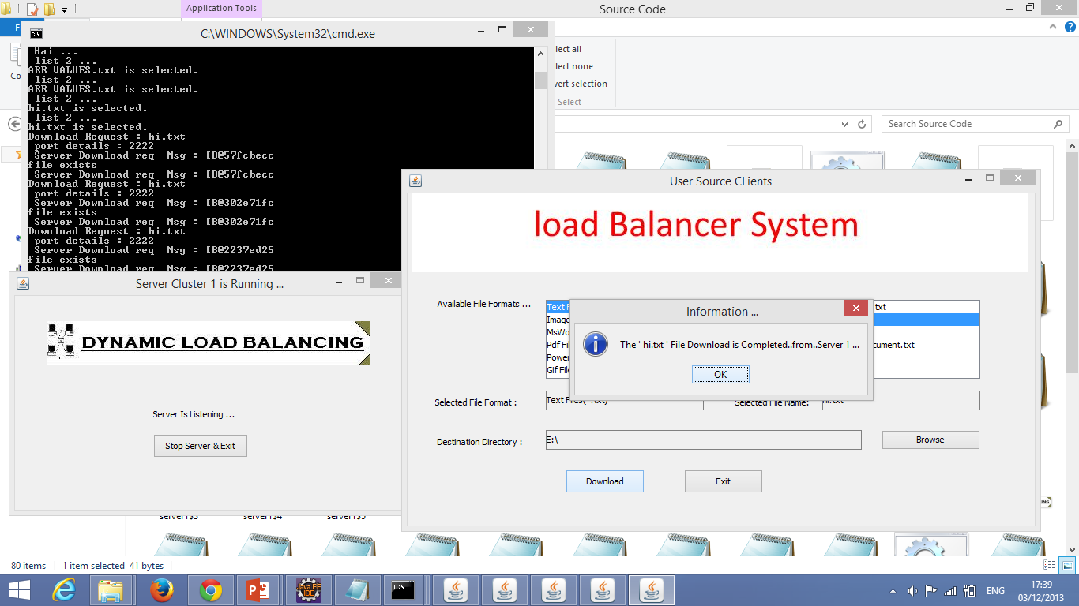

Slide 19
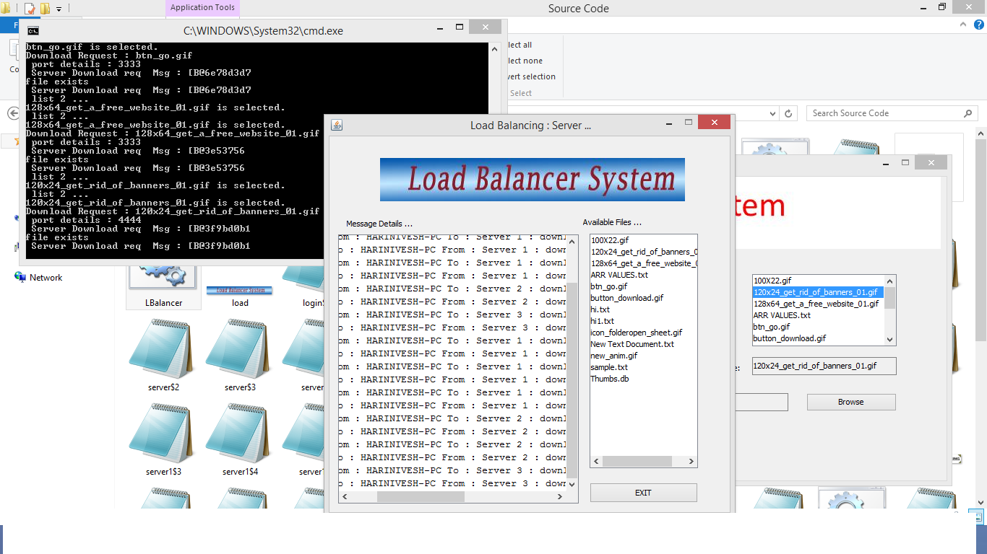

Slide 20
Reference :
Hongbo Jiang; Iyengar, A.; Nahum, E.; Segmuller, W.; Tantawi, A.N.; Wright, C.P.,
"Design, Implementation, and Performance of a Load Balancer for SIP Server Clusters,
" Networking, IEEE/ACM Transactions on , vol.20, no.4, pp.1190,1202, Aug. 2012 doi: 10.1109/TNET.2012.2183612

Slide 21
Call-Join-Shortest-Queue:
Call-Join-Shortest-Queue (CJSQ) tracks the number of
calls allocated to each back-end server and
routes new SIP calls to the node with the least number
of active calls.

Slide 22
Transaction-Join-Shortest-Queue:
Transaction-Join-Shortest-Queue (TJSQ) routes a new
call to the server that has the fewest active transactions,
rather than the fewest calls. This algorithm improves on
CJSQ by recognizing that calls in SIP are composed
of the two transactions, INVITE and BYE, and that
by tracking their completion separately, finer-grained
estimates of server load can be maintained. This leads
to better load balancing, particularly since calls have
variable length and thus do not have a unit cost.

Slide 23
Transaction-Least-Work-Left:
Transaction-Least-Work-Left (TLWL) routes a new call
to the server that has the least work, where work (i.e.,
load) is based on relative estimates of transaction costs.
TLWL takes advantage of the observation that INVITE
transactions are more expensive than BYE transactions.

Slide 24
CONCLUSION
This project introduces three novel approaches to load balancing in server clusters.
We present the design, implementation of a load balancer for cluster-based servers.
Our load balancer performs session-aware request assignment to ensure that SIP transactions are routed to the proper back-end node that contains the appropriate session state.
We presented three novel algorithms: (Call-Join-Shortest-Queue)CJSQ, TJSQ, and TLWL. The TLWL algorithms result in the best performance, both in terms of response time and throughput, followed by TJSQ.
TJSQ has the advantage that no knowledge is needed of relative overheads of different transaction types.
All the CJSQ, TJSQ TLWL specified in the IEEE paper which is used as reference

Slide 25
Queries?

