Slide 1
CodeCraft : Unleashing Langchain & LLMs
Resume Analyser
Chaitanya N(PES2UG22CS138)
Dishanth K(PES2UG22CS186)

Slide 2
Problem Statement
To effectively addresses the challenge of enhancing employability by providing personalized resume analysis and skill recommendations, offering valuable insights to job seekers and empowering them to align their skill sets with industry demands, ultimately improving their job search success.

Slide 3
Proposed Methodology
Data Processing:
Utilize PDF parsing techniques to extract text content from uploaded resumes.
Employ basic text processing methods to tokenize, clean, and preprocess the resume text.

Slide 4
Proposed Methodology
2. Resume Analysis:
Apply keyword extraction to identify relevant skills and qualifications mentioned in the resume.
Use basic pattern matching or rule-based methods to categorize resume sections such as education, work experience, and skills.

Slide 5
Proposed Methodology
3. Skill Recommendation:
Implement a simple rule-based system to recommend additional skills based on the identified keywords and job role.
Prioritize skills commonly associated with the user's field of interest or industry.

Slide 6
Proposed Methodology
4.Course Recommendations:
Curate a small list of online courses or learning resources relevant to the recommended skills.
Present course recommendations based on predefined mappings between skills and courses.

Slide 7
Proposed Methodology
5. User Interface Design:
Develop a straightforward web interface using Streamlit for resume upload and result display.
Design intuitive widgets for users to interact with, such as buttons for skill recommendation and course suggestions.

Slide 8
Pipeline

Slide 9
Phase 1: Data Processing
Libraries Used:
streamlit: For building the web application interface.
pyresparser: For parsing the resume and extracting information.
pdfminer3: For parsing PDF files to extract text content.
Steps:
User uploads a PDF resume using the Streamlit file uploader widget.
The uploaded PDF file is processed using PDF parsing techniques from the pdfminer3 library to extract text content.

Slide 10
Phase 2: Resume Analysis
Libraries Used:
None used explicitly but involves string processing and pattern matching.
Steps:
The extracted text content from the resume is analyzed to identify key information such as name, email, contact details, and skills.
Basic string processing techniques are employed to categorize resume sections such as education, work experience, and skills.

Slide 11
Phase 3: Skill Recommendation
Libraries Used:
streamlit_tags: For displaying and interacting with tags in the Streamlit interface.
Steps:
Based on the extracted skills from the resume, predefined lists of keywords related to different job roles or industries (e.g., data science, web development) are used to identify the user's field of interest.
Skill recommendations are provided based on the identified field of interest, using predefined lists of recommended skills for each job role or industry.
The streamlit_tags library is used to display the recommended skills as interactive tags in the Streamlit interface.

Slide 12
Phase 4: Course Recommendations
Libraries Used:
gradientai: For accessing AI models via the Gradient platform.
Steps:
User input (query) is collected to specify the skill for which course recommendations are requested.
An API call is made to the Gradient platform using the gradientai library to access AI models for generating course recommendations based on the specified skill and is fine tuned using some samples.
The generated course recommendations are displayed in the Streamlit interface.

Slide 13
Phase 5: Resume Score Calculation
Libraries Used:
None explicitly used, but involves basic arithmetic operations.
Steps:
Each relevant section identified in the resume adds points to the overall score, reflecting the completeness and quality of the resume.
A simple scoring system,based on a predefined set of criteria, assigns scores to different resume components.
The total score is calculated by summing up the scores assigned to each resume section.
The calculated resume score is displayed to the user in the Streamlit interface, providing feedback on the effectiveness of their resume presentation.

Slide 14
Output and results
Users can upload their resumes and receive detailed analysis results, including extracted information such as skills, education, and work experience.
Personalized skill recommendations help users identify additional skills to enhance their resumes and improve their job search prospects.
Course recommendations offer users opportunities for skill development and career advancement based on their identified skills.
The user-friendly interface enhances the overall user experience, providing a seamless and interactive platform for resume analysis and career guidance.
The inclusion of resume scoring provides users with actionable feedback on their resume quality, enabling them to make improvements and increase their chances of success in the job market.

Slide 15
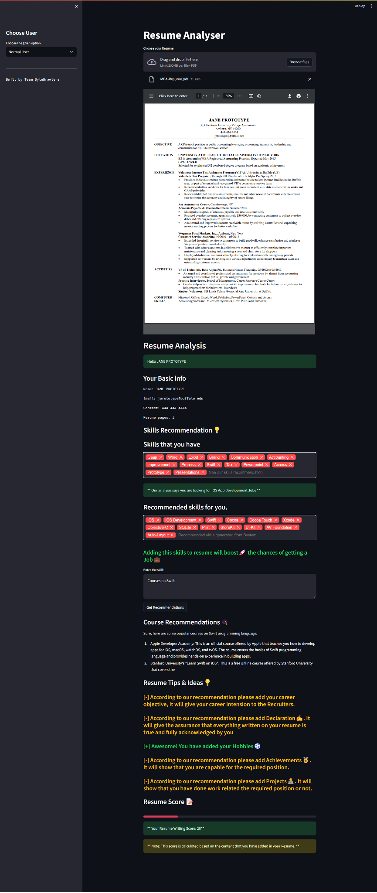

Slide 16
Why you choose this particular
topic?
1. Relevance: Resume enhancement is crucial for job seekers.
2. Empowerment: Personalized feedback empowers users in their job search.
3. Innovation: Leveraging tech improves resume analysis and recommendations.
4. Impact: Enhancing resumes boosts career prospects effectively.
5. Accessibility: User-friendly web app ensures broad access to assistance.

Slide 17
Business Model
Basic Model:
Offer a basic version of the Resume Analyzer for free, allowing users to upload a limited number of resumes and receive basic analysis and recommendations.
Premium Subscription:
Introduce premium subscription plans with enhanced features and benefits for users who require more advanced analysis and personalized recommendations.

Slide 18
Business Model
Corporate Plans:
Offer tailored plans for businesses and organizations looking to provide career development and skill enhancement resources for their HR employees.
Corporate plans may include bulk discounts, centralized administration features, and customizable branding options.
Advertising Revenue:
Generate revenue through targeted advertising within the platform, leveraging user data and analytics to provide relevant advertising opportunities to advertisers.

Slide 19
Conclusion & Future scope
The Resume Analyzer project provides personalized career guidance and skill enhancement in the competitive job market.
Leveraging innovative technology and user-friendly design, the web application empowers users to optimize resumes, receive tailored skill recommendations, and access relevant courses.
It demonstrates potential to positively impact users' employability and career prospects by aiding in navigating the complexities of the job search process.
Successful implementation showcases opportunities for future development and expansion, with potential to enhance functionality and broaden reach.
Overall, the Resume Analyzer project serves as a valuable tool for job seekers, offering comprehensive support and guidance throughout their career development journey.

Slide 20


