Slide 1
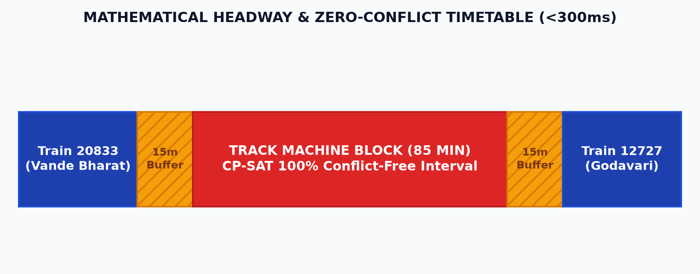
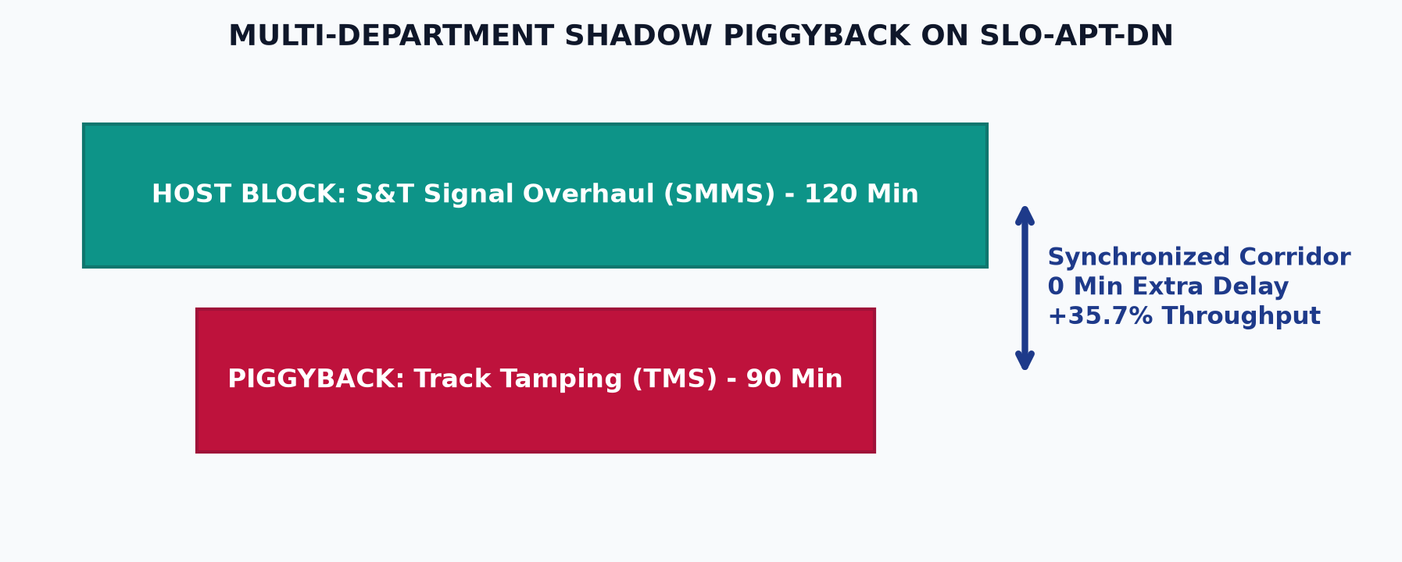
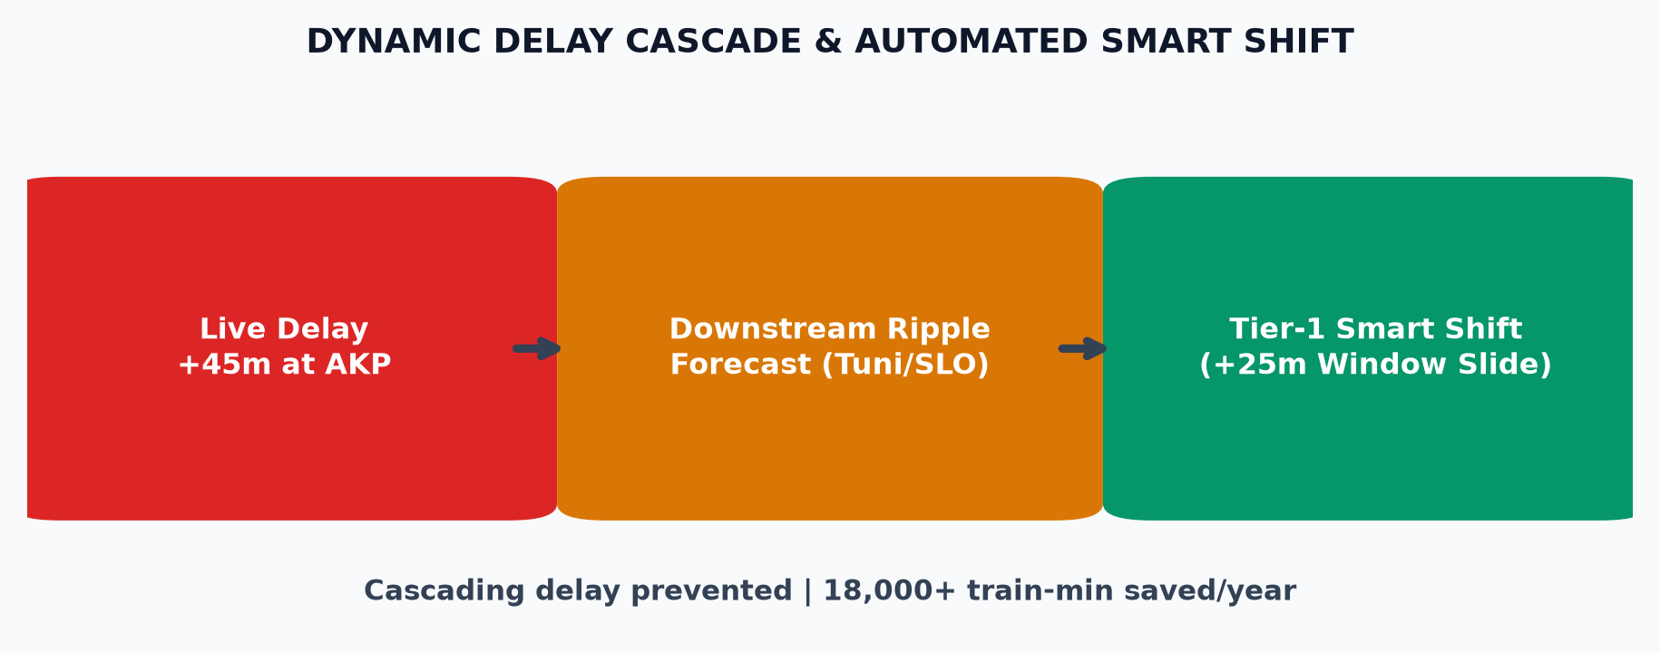
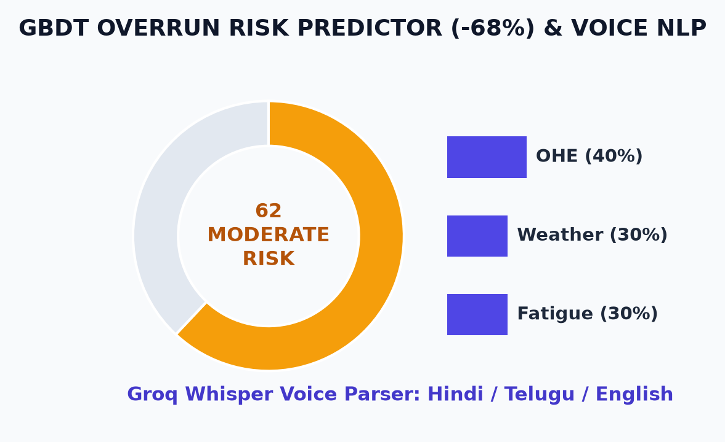
INDIAN RAILWAYS • SMART INDIA HACKATHON 2024 • PROBLEM STATEMENT SIH26027
CORRIDOR: Visakhapatnam (VSKP) ⇄ Vijayawada (BZA)
350 km Double-Line Corridor • 12 Stations • 22 Block Sections
Production Stack: FastAPI • CP-SAT • Supabase PostgreSQL • Render
AI-DRIVEN AUTOMATIC BLOCK PLANNING & DISPATCH SYSTEM
Core Architectural Engines & Technical Approach Mapped Directly to Operational Impacts & Quantified Benefits
01. CP-SAT CONFLICT SOLVER
Mathematical Headway & Safety Buffers
02. SHADOW PIGGYBACKING
Multi-Department Integrated Maintenance
03. DYNAMIC DELAY CASCADE
Downstream Ripple & Two-Tier Optimizer
04. RISK & VOICE NLP INTAKE
Explainable GBDT & Multilingual Speech
CORE ARCHITECTURAL FEATURES:
CORE ARCHITECTURAL FEATURES:
CORE ARCHITECTURAL FEATURES:
CORE ARCHITECTURAL FEATURES:
• 1,200+ mixed-integer constraints across 22 block sections
• Google OR-Tools CP-SAT engine solves in <300ms
• Enforces 10-15m dynamic safety headway buffers
• Guarantees zero overlap with scheduled passenger trains
• Auto-clusters Track (TMS), Signal (SMMS) & OHE requests
• Synchronizes 90m track tamping inside 120m signal window
• Auto-verifies mutual safety & traction power shut-off
• Single-window authorization replaces inter-dept silos
• Simulates downstream delay ripple across 350 km corridor
• Two-tier re-optimizer: Tier-1 Smart Shift vs Tier-2 Full Solve
• +45m delay at Anakapalle shifts maintenance by +25m safely
• Prevents cascading line blockages and passenger delays
• GBDT model predicts 0-100 overrun probability with SHAP
• Decomposes risk: OHE complexity (40%), weather, fatigue
• Groq Whisper voice parser: Hindi/Telugu/English intake
• Converts speech into structured JSON block requisition
OPERATIONAL IMPACT & BENEFIT:
★ 100% CONFLICT ELIMINATION
Eliminates all human headway clashes. Planning latency slashed from 4 hours to <300ms real-time.
OPERATIONAL IMPACT & BENEFIT:
★ +35.7% MAINTENANCE THROUGHPUT
Unlocks 42 extra maintenance hours/month with 0 min extra passenger delay on VSKP-BZA corridor.
OPERATIONAL IMPACT & BENEFIT:
★ -78% PUNCTUALITY LOSS
Saves 18,000+ train delay min/year; reduces section controller cognitive stress by over 85%.
OPERATIONAL IMPACT & BENEFIT:
★ -68% OVERRUN INCIDENTS
Proactive overrun prevention; zero-typing voice barrier ensures 100% ground adoption by station masters.
₹14.8 Cr / YR
Net Delay Cost Savings
Baseline ₹23.4 Cr ➔ ₹8.6 Cr
-78%
Corridor Delay Loss
Cascading delays cut 54m ➔ 12m
+35.7%
Maintenance Slots
+42 hrs track work gained/mo
420 T / MO
CO2 Emissions Avoided
Diesel idling cut | Net Zero 2030
<300 ms
CP-SAT Solver Latency
1,200 constraints across 22 blocks

