Slide 1
ABSTARCT:
Wireless
And
Mobile Communication....
SUBMITTED BY:K.Bhavana durga
P.Jayasri

Slide 2
CONTENTS
INTRODUCTION
WIRELESS TRANSMISSION:
Signals
Frequencies
Antenna
Modulation
Basic Functions in Mobile Systems
Location management
Handover
Roaming
4G SERVICES
Economic implications
CONCLUSION

Slide 3
Introduction:
The field of wireless and mobile communication has a remarkable history that spans over a century of technology innovations from Marconi's first transatlantic transmission in 1899 to the worldwide adoption of cellular mobile services by over four billion people today.
Wireless has become one of the most pervasive core technology enablers for a diverse variety of computing and communications applications ranging from third-generation/fourth-generation (3G/4G) cellular devices, broadband access, indoor WiFi networks, vehicle-to-vehicle (V2V) systems to embedded sensor and radio-frequency identification (RFID) applications.
This has led to an accelerating pace of research and development in the wireless area with the promise of significant new breakthroughs over the next decade and beyond.
This paper provides a perspective of some of the research frontiers of wireless and mobile communications, identifying early stage key technologies of strategic importance and the new applications that they will enable.
The paper also introduces a number of emerging wireless/mobile networking concepts including multihoming, ad hoc and multihop mesh, delay-tolerant routing, and mobile content caching, providing a discussion of the protocol capabilities needed to support each of these usage scenarios.

Slide 4
Frequencies for mobile communication
VHF-/UHF-ranges for mobile radio
simple, small antennas
good propagation characteristics (limited reflections, small path loss, penetration of walls)
typically used for radio & TV (terrestrial+satellite) broadcast, wireless telecommunication (cordless/mobile phone)
SHF and higher for directed radio links, satellite communication
small antenna, strong focus
larger bandwidth available
no penetration of walls
Mobile systems and wireless LANs use frequencies in UHF to SHF spectrum
some systems planned up to EHF
limitations due to absorption by water and oxygen molecules (resonance frequencies) weather depen

Slide 5
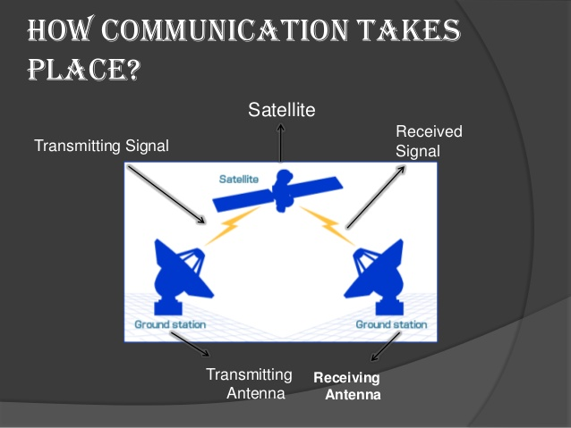
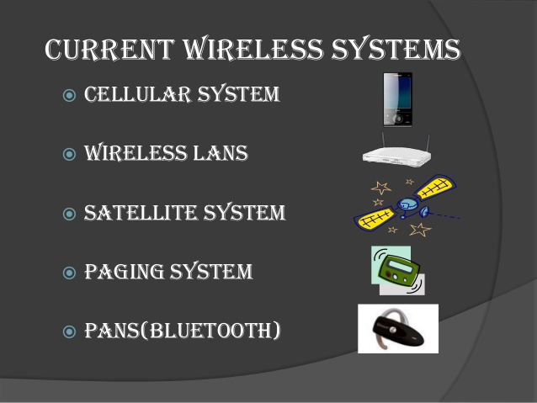

Slide 6
Mobile Communication Systems –
What does it require?
Provide telecommunition services
voice (conversation, messaging)
data (fax, SMS/MMS, internet)
video (conversation, streaming, broadcast)
anywhere -coverage
Any Time-connectivity, reachability
wireless - without cord/wire
Mobile - in motion, on the move (terrestrial)
secure - integrity, identity, privacy, non-repudiation
Reliable -guaranteed quality of service

Slide 7
WHY 4G????
If 3G is not quite established yet, why are we talking about 4G? The answer is that if research and planning into 4G is not carried out now, it will not be possible to keep up with consumer demand. While 3G will attempt to satisfy demand in the current and short-term future, the market will outgrow 3G in a matter of years. The importance of planning ahead to 4G is also highlighted by the fact that 3G systems are not cross compatible or unified on a worldwide scale and may not live up to all the hype.With mobile communications, the evolutionary pattern seems to follow one decade cycles. In the 80’s it was 1G, in 90’s 2G and now in the new century 3G systems are being introduced. Thus, it seems logical that 4G will be introduced around the 2010 mark. In the US, in the period between 1994 and 2001 mobile phone subscriber base increased from 16 million to 110 million. Such trends have been witnessed in most developed and various developing nations. These statistics and trends indicate that while the numbers of subscribers to mobile services increase steadily, the requirements of a mobile communication system will also change.
CHARACTERISTICS OF 4G:
Fully converged services:
A wide range of services will be available to the mobile user conveniently and securely via the 4G-core network. Personal communications, information systems and entertainment will be merged into the seamless pool of content.

Slide 8
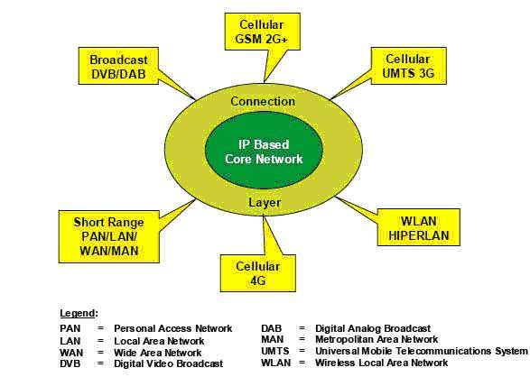
Applications:
Wifi,radio,tv etc
Conclusion:
With this paper we conclude that, using 4G-technologies machine-to-machine communication is achieved along with the machine-to-person communication. . And the theme of wireless communication....
Notes:
o

