Slide 1


Smart Plant Disease Detection And Treatment Recommendation System
Internal Guide:
Atul Kumar Ramotra
Associate Professor
Dept. of CSE (AI & ML)
Presented By:
Sri Krishna Chaitanya (24AG1A6641)
Janaki Raam (24AG1A6623)
Naga Sathwik (24AG1A6633)

Slide 2
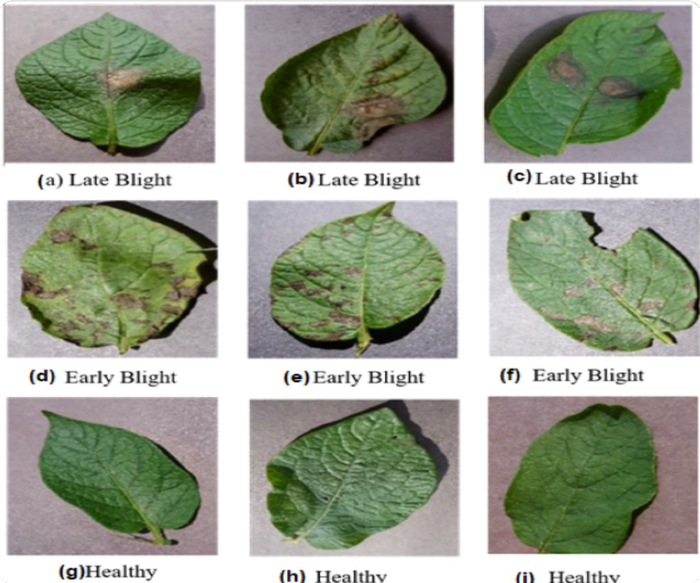
Introduction
K e y d i s e a s e s
Early blight
Caused by Alternaria solani, early blight affects tomato and potato plants. It appears as dark brown, concentric ring-shaped spots on older leaves, spreading to stems. Left untreated, it causes significant defoliation and yield loss.
Late blight
Caused by Phytophthora infestans, late blight produces water-soaked, dark lesions on leaves and stems that spread rapidly in cool, moist conditions. It was responsible for the Irish Potato Famine and continues to threaten crops globally.
Both diseases are primary targets of this detection system, enabling early identification and prompt treatment.
Plant diseases cause significant agricultural losses worldwide, threatening food security and farmer livelihoods.
Traditional detection relies on manual expert inspection - slow and inaccessible to most farmers. Early diagnosis is critical to minimizing crop damage and reducing economic losses.
Machine learning and image processing offer a scalable, low-cost alternative. This system targets small and large-scale farmers who need fast, reliable disease diagnosis without expert dependency.
Smart Plant Disease Detection System

Slide 3

E x i s t I n g s y s t e m
Criteria
Existing methods
Smart system
Detection speed
Days Slow turnaround
Instant Real-time results
Current methods rely on manual inspection and lab-based testing - both costly, slow, and inaccessible to most farmers.
Cost of diagnosis
$$$ Expert & lab fees
$ Low-cost access
Remote accessibility
✗
✓
Neither approach offers real-time detection or treatment guidance.
Automated detection
✗
✓
Treatment guidance
✗
✓
Scalability
✗
✓

Slide 4
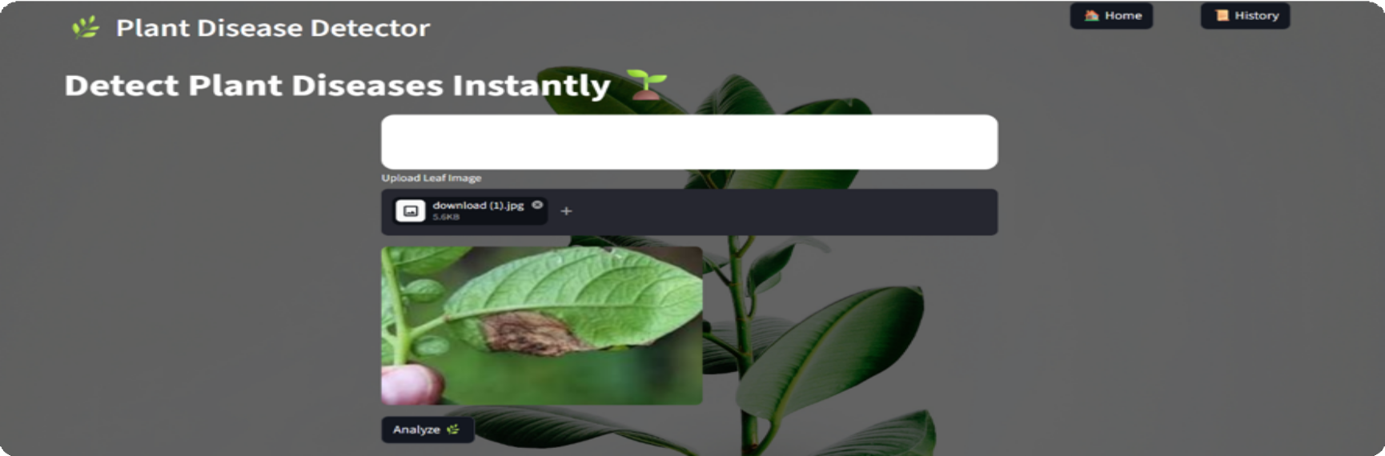
Proposed System
Farmer uploads a leaf image → AI classifies the disease → system returns the diagnosis and treatment instantly. Low cost. No expert needed. Works across multiple crops.

Slide 5
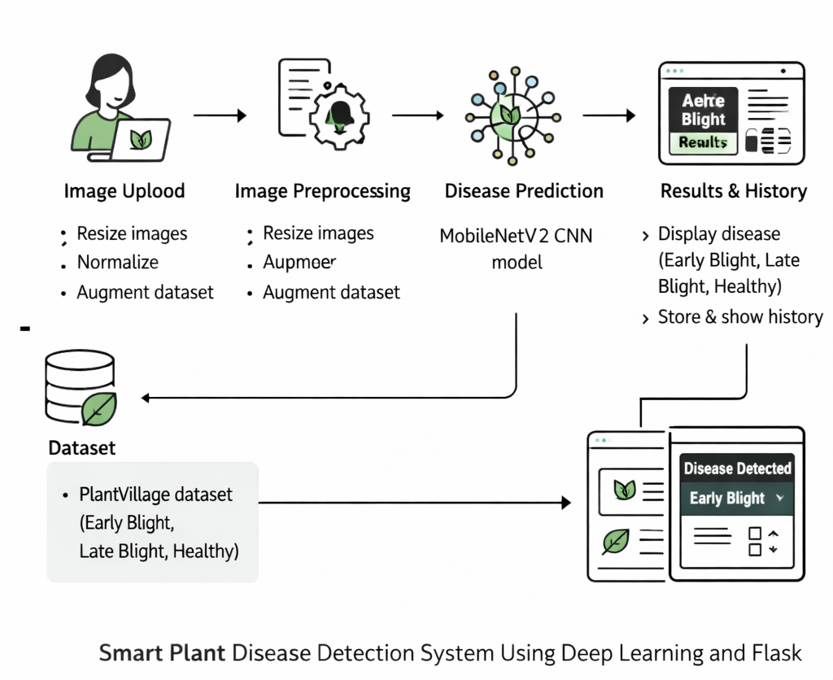
S y s t e m A r c h i t e c t u r e

Slide 6
01
How it works
I m a g e c a p t u r e
Farmer captures or uploads a photo of the affected leaf via smartphone or web interface.
02
P r e p r o c e s s I n g
Image is resized, normalized, and segmented to isolate the leaf for cleaner feature extraction.
03
F e a t ur e e x t r a c t I o n
Color, texture, and shape features are extracted from the leaf surface to identify disease patterns.
04
D I s e a s e c l a s s I f I c a t I o n
The CNN model analyzes extracted features and classifies the disease from a trained dataset.
05
T r e a t m e n t r e c o m m e n d a t I o n
System retrieves and displays targeted treatment options and preventive measures for the identified disease.

Slide 7


