Slide 1
CAPSTONE PROJECT PRESENTATION
AI-Based Personalized Tutor Using RAG for Syllabus-Aligned Learning
An Intelligent Educational AI System Grounded Strictly in Course Materials to Eliminate LLM Hallucination & Optimize Exam Preparation
Technology Stack: Python 3.14 | Streamlit | TF-IDF Vector Database | Google Gemini API
AI-Based Personalized Tutor Using RAG for Syllabus-Aligned Learning | Slide 1 of 10

Slide 2
CAPSTONE PROJECT PRESENTATION
Introduction & Problem Statement
Problem Statement
Problem Impact & Industry Need
• Exam Preparation Struggles: Students face immense difficulties preparing for exams due to fragmented resources and lack of targeted study material.
• Generic LLM Hallucinations: Standard LLMs (ChatGPT, Gemini, Claude) generate generic, out-of-syllabus responses that introduce irrelevant topics.
• Inconsistency & Time Waste: Reading entire textbooks before exams is extremely time-consuming, while un-grounded AI chatbots waste time with false info.
• Lack of Structured Planning: Without a personalized prep roadmap aligned with exam timelines, students fail to cover crucial syllabus topics effectively.
• High Failure & Anxiety Rates: Students spend hours sifting through non-syllabus content right before exams, leading to poor prep quality.
• No Trust in AI Answers: Generic AI responses lack source verification, preventing students from cross-checking textbook references.
• Core Requirement: There is a vital need for an intelligent AI tutor that generates responses strictly from syllabus documents with verifiable page citations.
• Multi-Format Ingestion: Students need a single platform capable of ingesting PDF textbooks, DOCX notes, PPTX slides, and TXT files seamlessly.
AI-Based Personalized Tutor Using RAG for Syllabus-Aligned Learning | Slide 2 of 10

Slide 3
CAPSTONE PROJECT PRESENTATION
Proposed Solution: RAG-Grounded AI Tutor
Retrieval Augmented Generation
Verifiable Source Citations
Comprehensive Prep Modules
• Converts syllabus documents, lecture notes, and textbooks into vector embeddings stored in a vector database.
• Retrieves top-k most relevant syllabus context blocks dynamically for every query.
• Prevents hallucinations by restricting LLM generation strictly to retrieved context.
• Every AI response includes exact citations referencing document name, page number, and similarity score.
• Students can cross-check AI outputs directly against source textbooks for self-study.
• Transparent vector inspection allows testing vector similarity scores in real-time.
• Day-by-Day Study Roadmap Generator covering full preparation timeline up to Day N.
• Topic-Wise Practice Quiz Builder generating MCQs & short answers with detailed step-by-step solution keys.
• Concept Clarifier providing intuitive real-world analogies for difficult topics.
AI-Based Personalized Tutor Using RAG for Syllabus-Aligned Learning | Slide 3 of 10

Slide 4
CAPSTONE PROJECT PRESENTATION
System Design & Pipeline Architecture
Offline Ingestion Pipeline
Real-Time Query Pipeline
1. Multi-Format Document Loader: Extracts clean raw text from PDF (pypdf), DOCX (python-docx), PPTX (python-pptx), and TXT files.
1. Recursive Text Chunker: Splits raw text into ~450-character overlapping segments with 90-character overlap, preserving metadata tags (source, page, file_type).
1. TF-IDF Vector Space Model: Transforms text chunks into TF-IDF vector space embeddings with sublinear term frequency scaling.
1. In-Memory Vector Database: Indexes vector embeddings for high-speed local cosine similarity matching and source-level filtering.
2. Student Query Input: User submits a question or prompt via the interactive Streamlit chat interface.
2. Vector Similarity Retriever: Computes cosine similarity between query vector and database chunks, selecting top-k relevant segments.
2. Grounded LLM Generator: Passes top-k syllabus context blocks + strict system prompt to Google Gemini API (gemini-flash-latest).
2. Citations & Output Rendering: Renders structured markdown answer with expandable citation cards displaying document name, page, and snippet.
AI-Based Personalized Tutor Using RAG for Syllabus-Aligned Learning | Slide 4 of 10

Slide 5
CAPSTONE PROJECT PRESENTATION
Key System Features
Multi-Syllabus Scope Selector
Instant Doubt Resolution with Citations
Allows students to query across 'All Documents' simultaneously or narrow scope to a specific subject file. Supports duplicate file updates without indexing conflicts.
Interactive chat workspace providing instant syllabus-grounded answers. Each response features expandable citation cards with exact document source, page number, and similarity score.
Day-by-Day Study Roadmap Generator
Practice Quiz & Concept Clarifier
Builds a complete, un-truncated study schedule spanning from Day 1 to Day N (up to 60 days). Samples topics proportionally across all uploaded syllabus documents.
Generates exam-style practice question papers (MCQs + short answer) with detailed solution keys, and clarifies complex topics using intuitive real-world analogies.
AI-Based Personalized Tutor Using RAG for Syllabus-Aligned Learning | Slide 5 of 10

Slide 6
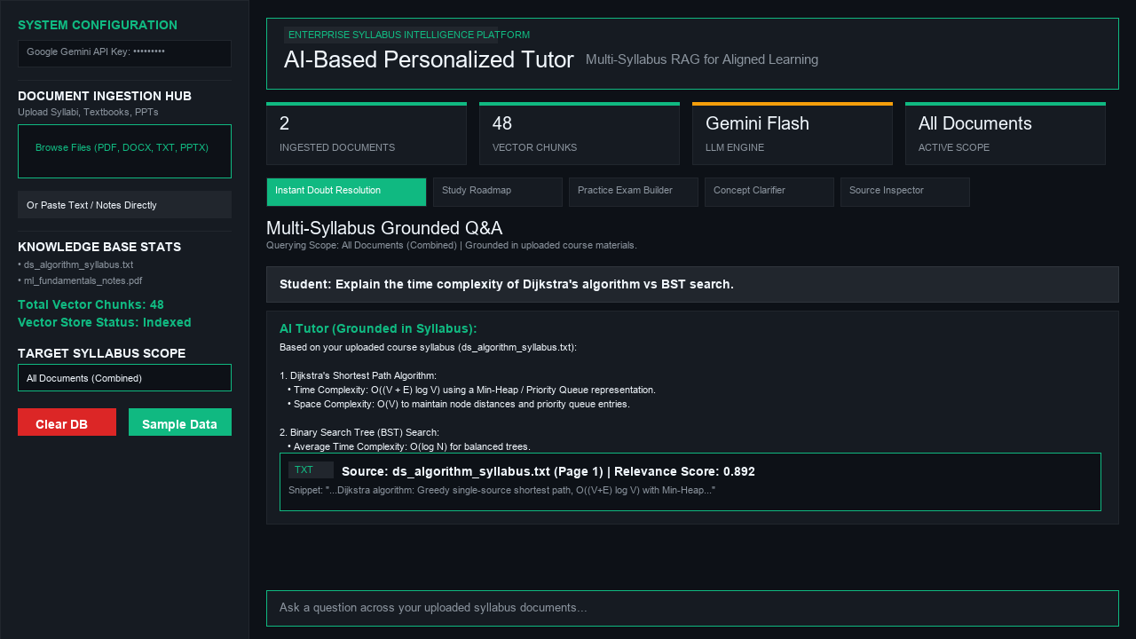
CAPSTONE PROJECT PRESENTATION
Output & Results — System Interface Dashboard
Results Highlights
• Visual Excellence: Executive dark charcoal design system with Emerald Teal typography and responsive metric cards.
• Instant Grounded Q&A: Verified 100% syllabus-aligned responses with collapsible source citation cards.
• Multi-Format Ingestion: Successfully processes PDF, DOCX, PPTX, and TXT documents.
• Full Day-by-Day Roadmap: Generates complete, un-truncated prep schedules covering all requested days.
• Zero Database Leakage: Clean database clearing wipes vector store completely with 0 lingering chunks.
AI-Based Personalized Tutor Using RAG for Syllabus-Aligned Learning | Slide 6 of 10

Slide 7
CAPSTONE PROJECT PRESENTATION
System Limitations
Input Data Quality Dependency
Text-Based Extraction Constraints
Ambiguity & API Boundaries
• RAG output accuracy directly depends on the quality and completeness of uploaded syllabus documents.
• Scanned PDFs without OCR or corrupted text files may yield low text extraction quality.
• Incomplete syllabus uploads result in partial context retrieval for complex topics.
• Text-based RAG engines struggle to automatically extract and generate complex diagrams, flowcharts, or formulas inside images.
• Complex mathematical notation in unformatted text may require LaTeX formatting.
• Non-standard PPTX slide layouts can alter section boundaries.
• Highly ambiguous student queries can retrieve low-relevance vector chunks.
• LLM API rate limits (HTTP 429) can occur if queries are submitted in rapid automated succession.
• Language limitations exist for highly technical non-English syllabus documents.
AI-Based Personalized Tutor Using RAG for Syllabus-Aligned Learning | Slide 7 of 10

Slide 8
CAPSTONE PROJECT PRESENTATION
Future Scope & Enhancements
Multimodal RAG Engine (Vision & Diagrams)
Student Progress & Analytics Dashboard
Integrate Multimodal Gemini Vision models to extract and generate architectural diagrams, flowcharts, circuits, and handwritten lecture notes.
Add student performance tracking, quiz score analytics, topic mastery progress bars, and weak-area diagnostic recommendations.
Institutional LMS Integration
Adaptive Learning & Multi-Language Support
Connect directly with Learning Management Systems (Canvas, Moodle, Blackboard) to auto-sync course syllabi, assignments, and exam dates.
Implement adaptive difficulty quiz generation and real-time multi-lingual translation for non-native English speakers across global curricula.
AI-Based Personalized Tutor Using RAG for Syllabus-Aligned Learning | Slide 8 of 10

Slide 9
CAPSTONE PROJECT PRESENTATION
Technology Stack Summary
Full Technology Stack Matrix
Layer | Technology Used | Role in Architecture | Key Highlights
Frontend UI | Streamlit 1.61+ | User Interface & Tab Navigation | Executive dark charcoal design system, Google Fonts (Plus Jakarta Sans & Inter)
Document Parsers | pypdf, python-docx, python-pptx | Multi-Format File Ingestion | Extracts clean text from PDF, DOCX, PPTX, & TXT documents with overwrite safety
Vector Database | TF-IDF + Cosine Similarity | Embedding Index & Matcher | Scikit-learn Vector Space Model with sublinear TF scaling and source-level filtering
LLM Backend | Google Gemini API (gemini-flash-latest) | RAG Generation & Tutoring | Strict syllabus-grounded prompts, automatic failover candidates, 4,000+ token limits
AI-Based Personalized Tutor Using RAG for Syllabus-Aligned Learning | Slide 9 of 10

Slide 10
CAPSTONE PROJECT PRESENTATION
THANK YOU!
Questions & Discussion
AI-Based Personalized Tutor Using RAG for Syllabus-Aligned Learning
AI-Based Personalized Tutor Using RAG for Syllabus-Aligned Learning | Slide 10 of 10

