Slide 1
PROJECT TITLE: SECURE DATA HIDING IN IMAGES USING STEGANOGRAPHY
CAPSTONE PROJECT
Presented By:
Student Name : Chaitanya Chandrakant Salunkhe
College Name & Department : Shree Ramchandra College Of Engineering, Pune.
Artificial Intelligence & Data Science Dept.

Slide 2
OUTLINE
Problem Statement
Technology used
Wow factor
End users
Result
Conclusion
Git-hub Link
Future scope

Slide 3
Problem Statement
In the digital era, secure communication is crucial to protect sensitive information from unauthorized access. Steganography enables data hiding within images, ensuring confidentiality without attracting suspicion. This project focuses on embedding and extracting hidden messages in images using encryption techniques, enhancing security. The goal is to develop a robust system resistant to detection and attacks.
In today's digital age, the need for secure communication has become increasingly vital. With the rise of cyber threats and privacy concerns, the protection of sensitive data is crucial. One of the most innovative and effective ways to secure information is through steganography, the practice of concealing data within digital media, such as images, audio, or video files. By hiding secret data in images, the data becomes indistinguishable from the image itself, ensuring both security and confidentiality.

Slide 4
Technology used
Programming Language: Python
Libraries:
OpenCV – Image processing
PIL (Pillow) – Image manipulation
NumPy – Numerical operations
Stegano – Steganographic encoding and decoding
Cryptography – Data encryption and decryption
Platforms:
Windows/Linux/macOS
Jupyter Notebook / PyCharm / VS Code for development

Slide 5
Wow factors
Advanced Encryption – Combines steganography with cryptographic algorithms for double-layered security.
High Imperceptibility – Hidden data remains undetectable to the human eye, ensuring secrecy.
Robust Error Handling – Ensures proper extraction of hidden data even in cases of minor image distortions.
Customizable Embedding – Users can choose different encryption levels and embedding techniques.
Cross-Platform Compatibility – Works on Windows, Linux, and macOS with an intuitive GUI.
Invisible Data Transmission - The ability to hide data in images such that it is completely imperceptible to the human eye is a fascinating aspect of steganography.

Slide 6
End users
Government Agencies – For secure communication and classified data transfer.
Cybersecurity Professionals – To enhance data privacy and protect sensitive information.
Journalists & Whistleblowers – To share confidential information discreetly.
Businesses & Corporations – For secure document exchange and intellectual property protection.
General Users – For personal data security and private messaging.
Law Enforcement - Law enforcement agencies may use steganography to track and uncover criminal activity.
Educational Institutions and Researchers - Universities and research institutions use steganography for teaching students and researchers about digital security, cryptography, and data privacy.

Slide 7

Results

Slide 8


Slide 9
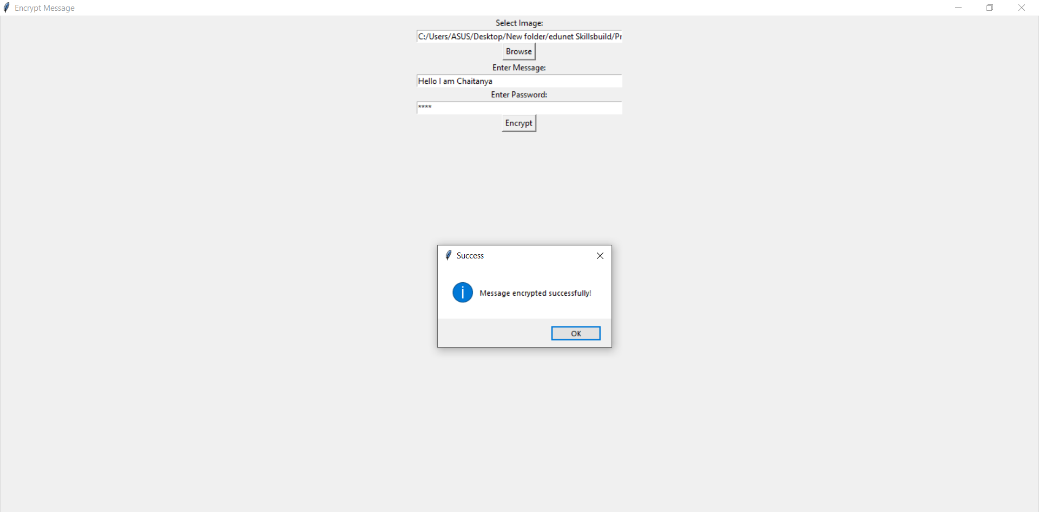

Slide 10
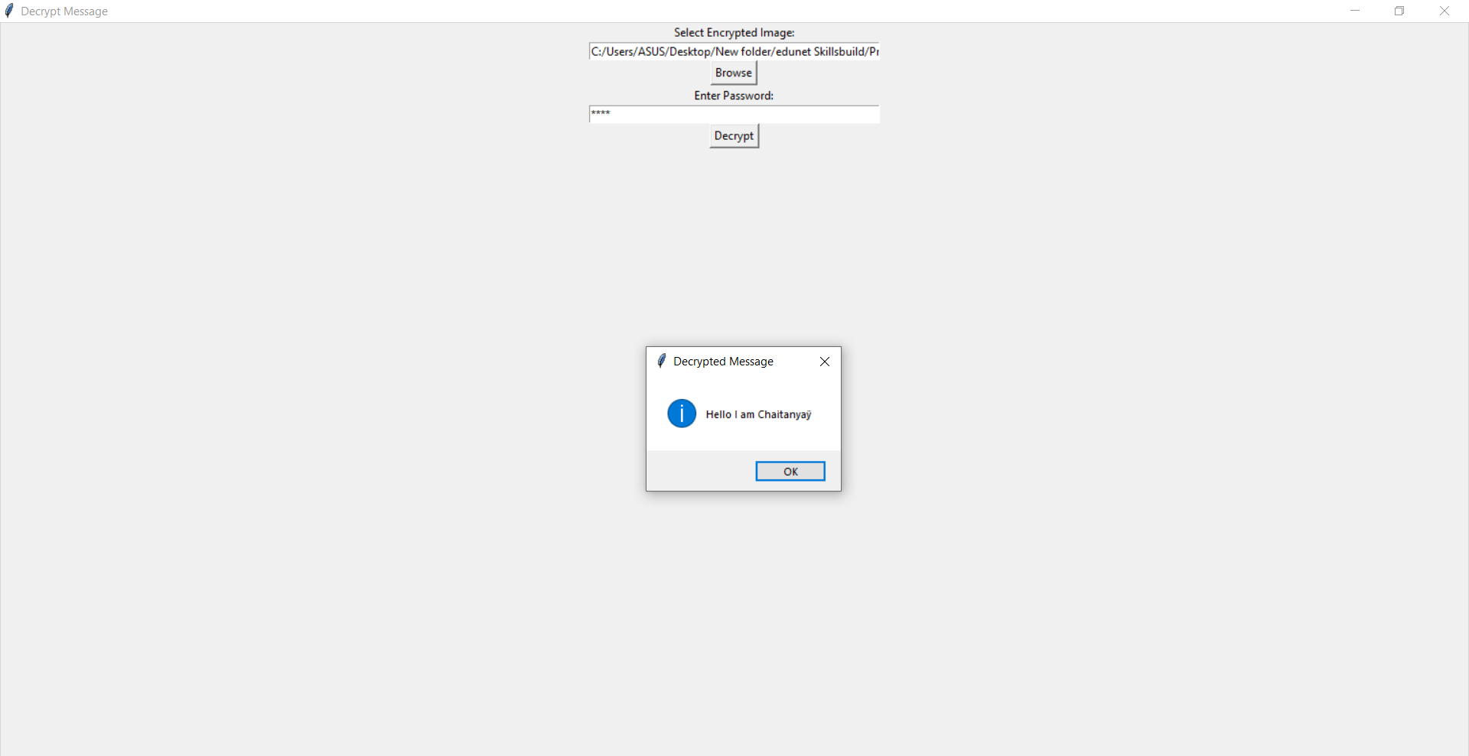

Slide 11
Conclusion
This project successfully implements secure data hiding in images using steganography, ensuring confidentiality and protection of sensitive information. By leveraging encryption techniques and advanced image processing, the system enhances security while maintaining the visual integrity of the carrier image. The solution is robust, efficient, and adaptable for various applications, making it a valuable tool for secure communication in both personal and professional domains.
Steganography, the art and science of hiding secret data within innocent-looking files such as images, audio, or video, plays a critical role in securing communication and protecting sensitive information. By embedding data in a manner that is imperceptible to the human eye, it provides a unique layer of security beyond traditional encryption methods. Steganography ensures that confidential information can be transmitted covertly without alerting potential eavesdroppers or attackers, adding both privacy and protection to digital communication.

Slide 12
GitHub Link
https://github.com/chaitanyaSalunkhe/Steganography.git
It includes different file such as :
Python file
Output Screenshots
Image to be encrypted
Encrypted Image
PPT

Slide 13
Future scope (optional)
Integration with AI – Enhance steganography with AI-based detection resistance techniques.
Support for Video & Audio – Extend the project to hide data in video and audio files.
Blockchain Security – Combine with blockchain for enhanced data integrity and traceability.
Cloud-Based Steganography – Develop a secure online platform for remote data hiding and retrieval.
Steganalysis Resistance – Improve techniques to prevent detection by advanced steganalysis tools.
Robustness Against Attacks - As image compression, resizing, and other manipulations become more common, future steganographic techniques will need to be increasingly resilient to these attacks.
High-Capacity and Lossless Steganography - One limitation of current steganographic methods is the small amount of data that can be hidden without noticeable degradation of the host file.

Slide 14
THANK YOU

