Slide 1
Data Analysis Agent
Objective
Create an AI-powered data analysis tool that allows users to analyze CSV data using natural language questions.
Democratize data analysis by removing technical barriers through conversational interface.
Enable quick insights without requiring SQL or programming knowledge.
Methodology
User-Centric Design: Intuitive interface guiding users from file upload to analysis insights without technical knowledge.
Modular Architecture: Clean separation between Next.js frontend and FastAPI backend with RESTful communication.
Intelligent Data Processing: Automated Validation, normalization, and loading of CSV data into DuckDB for efficient querying.
AI Powered Analysis: Llama 4 large language model(LLM) transforms natural language questions into optimized SQL queries.
Enterprise Ready Infrastructure: Secure session management, comprehensive error handling and cloud based deployment for reliability.
Impact
Reduces data analysis time from hours to minutes.
Makes data insights accessible to business stakeholders.
Non technical users can generate insights from the data without having any prior knowledge in SQL
Supports data-driven decision making across all organizational levels.

Slide 2
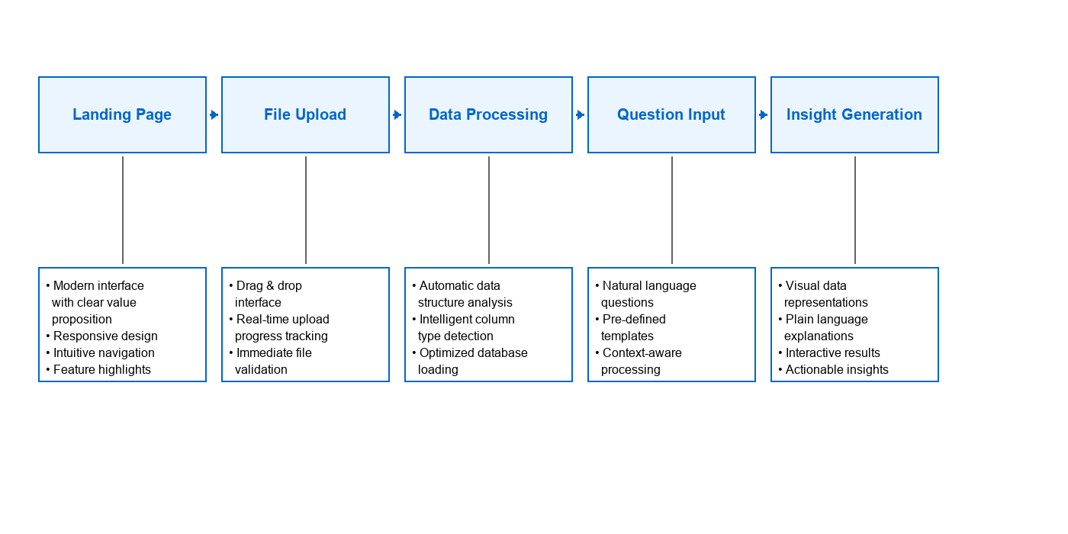
Project Architecture

