Slide 1


INTERNSHIP PRESENTATION
Virtual
Charity Drive
Fundraising Intern
ACADEMIC
INTERNSHIP
2026-27
Chaitanya Dev Rajput
25SCS1003002192
BTech CSE (AIML) , 2nd Semester
Organization: NayePankh Foundation
Duration: 05th May, 26 – 06th Jun, 26
NAYEPANKH FOUNDATION • INTERNSHIP PRESENTATION

Slide 2

ORGANIZATION OVERVIEW
About NayePankh
Foundation
A nonprofit organization focused on charitable initiatives and fundraising support—connecting committed people with causes that need sustained action.
PRASHANT SHUKLA
Founder & President
Society Reg No. KAP/04397/2021-2022
UP Govt. | 80G & 12A Registered
www.nayepankh.com
NAYEPANKH FOUNDATION • INTERNSHIP PRESENTATION

Slide 3
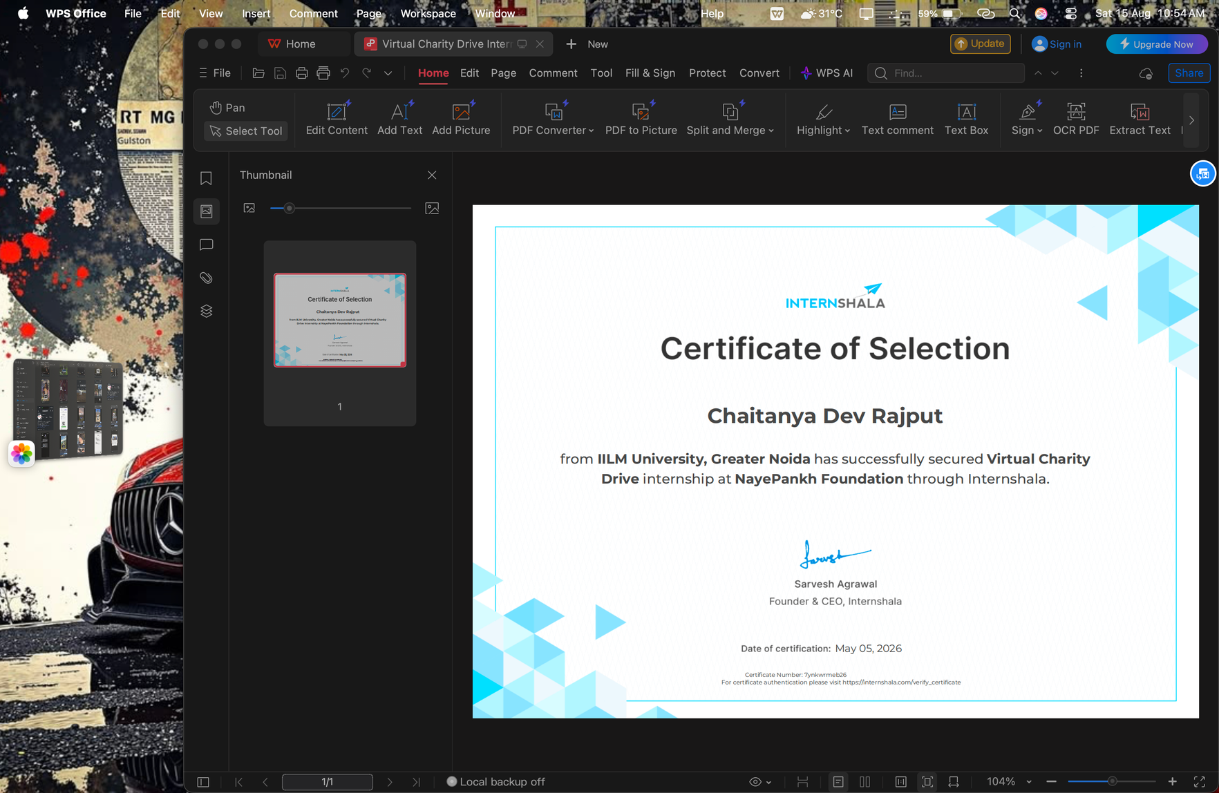
INTERNSHIP CERTIFICATE
Selection &
Certification
Platform
Internshala
Internship
Virtual Charity Drive
Organization
NayePankh Foundation
Intern
Chaitanya Dev Rajput
Selection & Certificate Date
Secured via Internshala portal
NAYEPANKH FOUNDATION • INTERNSHIP PRESENTATION

Slide 4
ROLE & PURPOSE
Internship Scope
Fundraising Intern
Support online fundraising efforts and strengthen outreach for charitable activities.
Virtual Charity Drive
ONE MONTH
DIGITAL COMMUNICATION
DONOR ENGAGEMENT
CAMPAIGN COORDINATION
05th May, 26 — 06th Jun, 26
NAYEPANKH FOUNDATION • INTERNSHIP PRESENTATION

Slide 5
FIVE-STAGE PROGRESSION
Virtual Charity Drive Workflow
01
02
03
04
05
Orientation
Planning
Outreach
Engagement
Review
Mission, goals & requirements
Channels, messaging & audiences
Virtual platforms & networks
Queries, participation & follow-up
Progress, results & learnings
NAYEPANKH FOUNDATION • INTERNSHIP PRESENTATION

Slide 6
KEY RESPONSIBILITIES
Work performed & supported
Aligned to the documented scope of the Virtual Charity Drive internship.
01
Promoting the drive through digital communication
02
Sharing fundraising information with prospective supporters
03
Supporting donor and participant engagement
04
Coordinating follow-ups and maintaining communication
05
Representing the Foundation’s mission professionally
NAYEPANKH FOUNDATION • INTERNSHIP PRESENTATION

Slide 7
REFLECTION
Learning & Professional Development
Experience gained
Professional skills developed
• Virtual fundraising and nonprofit outreach
• Practical exposure to social-impact work
• Understanding donor engagement
• Communication and persuasion
• Coordination and follow-up
• Time management
Effective fundraising combines a clear cause, consistent communication, and trust.
NAYEPANKH FOUNDATION • INTERNSHIP PRESENTATION

Slide 8
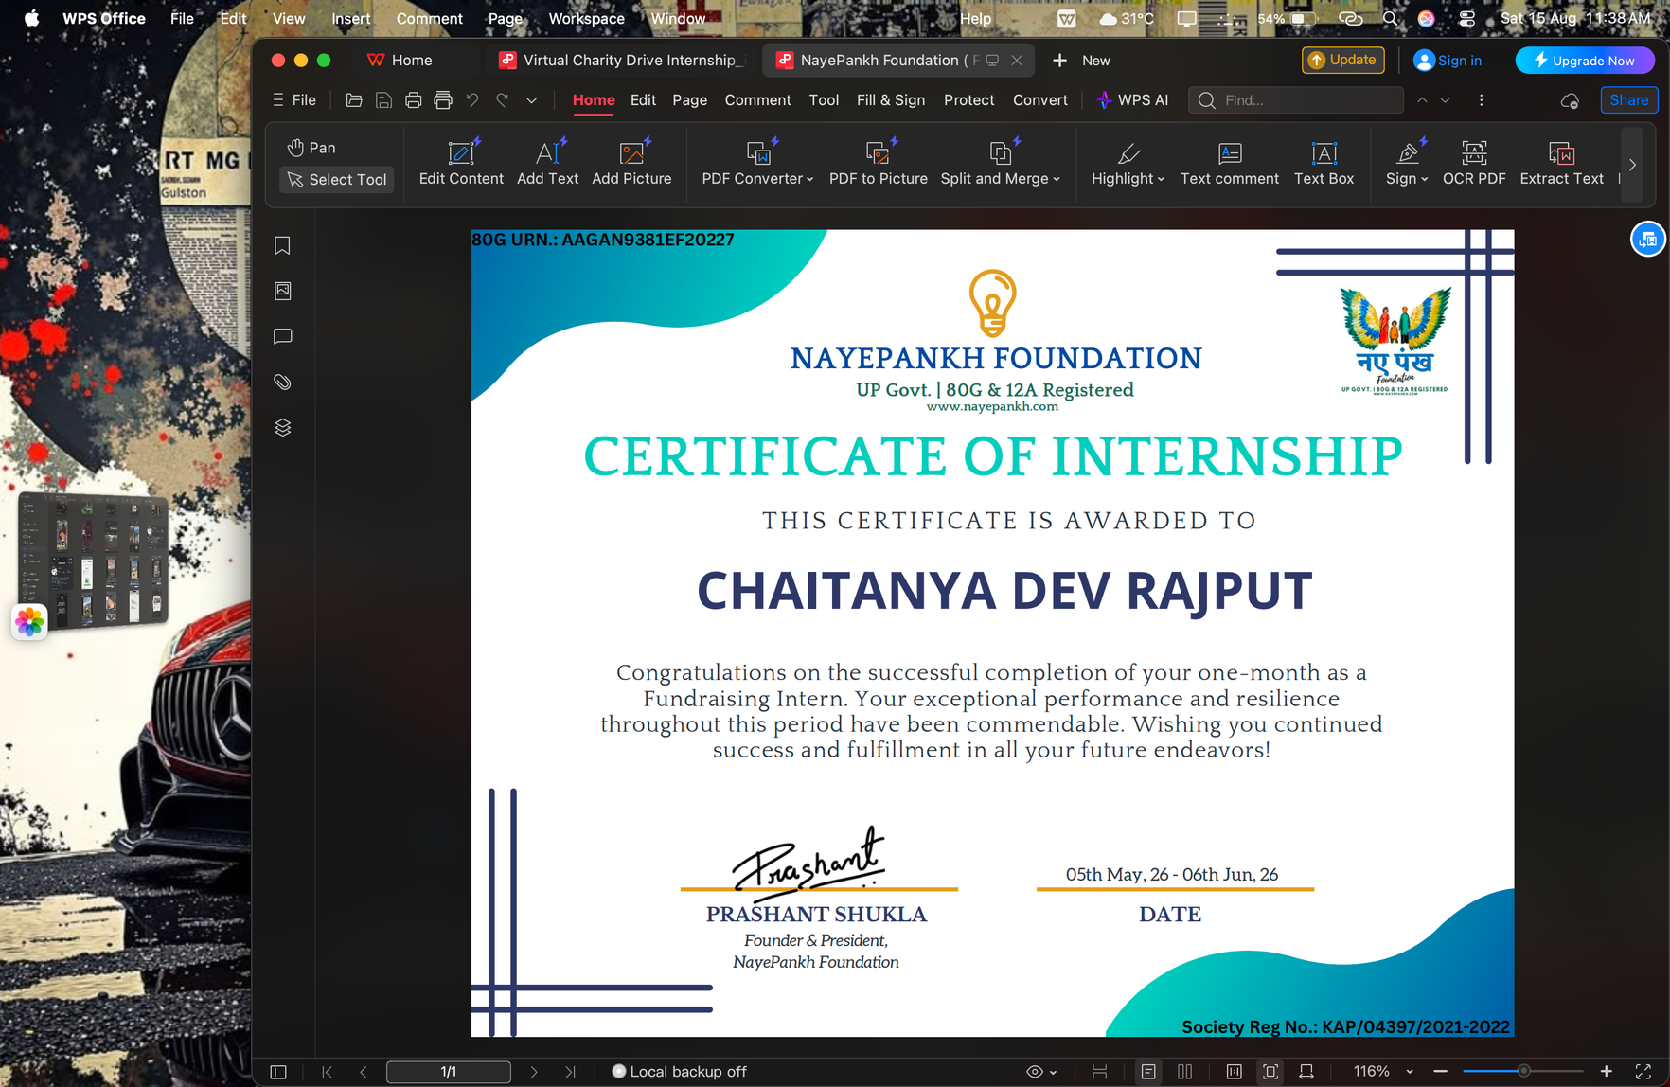
CERTIFICATE VERIFICATION
Internship validated.
Thank You
For your attention
NAYEPANKH FOUNDATION • INTERNSHIP PRESENTATION

