Slide 1
Alphashots.AI Currency Analysis
EUR/INR Currency Data Analysis
Chaitanya dhir

Slide 2
Introduction
Assignment 1: Analyzed the prediction algorithm used by Alphashots.AI to understand how historical patterns in financial data are interpreted.
Assignment 2: Conducted technical analysis on EUR/INR currency data by calculating key indicators—Moving Average, Bollinger Bands, and CCI—and used these metrics to make Buy, Sell, or Neutral decisions based on September 2024 data.

Slide 3
Assignment 1 - AI Prediction Algorithm
Alphashots.AI likely uses a historical pattern recognition algorithm, potentially powered by machine learning techniques in time-series analysis, such as pattern-matching models or similarity-based algorithms. By comparing current price patterns with past data, the algorithm identifies recurring trends and assigns probabilities to potential price ranges. This approach leverages historical data to forecast short-term price movements with statistical confidence

Slide 4
Assignment 2 - Technical Analysis of EUR/INR
The Python code used for this analysis is attached as required in the assignment. The script calculates three key metrics—Moving Average, Bollinger Bands, and CCI—to generate Buy, Sell, or Neutral recommendations for EUR/INR.
Indicators Used: Moving Average (20-Day) to analyze price trends for bullish or bearish signals, Bollinger Bands to assess overbought/oversold conditions, and Commodity Channel Index (CCI) to identify potential reversals based on statistical price deviations.

Slide 5
Indicator Decisions Table
Date | Indicators | Decisions
2024-09-24 | MA (20-Day): 92.89905 Bollinger Bands: 93.66 / 92.14 CCI: 2.11 | MA: Neutral BB: Neutral CCI: Neutral
2024-09-25 | MA (20-Day): 92.88485 Bollinger Bands: 93.59 / 92.18 CCI: 152.51 | MA: Buy BB: Neutral CCI: Sell
2024-09-26 | MA (20-Day): 92.86995 Bollinger Bands: 93.55 / 92.19 CCI: 82.08 | MA: Buy BB: Neutral CCI: Neutral
2024-09-27 | MA (20-Day): 92.89445 Bollinger Bands: 93.61 / 92.18 CCI: 120.85 | MA: Buy BB: Neutral CCI: Sell

Slide 6
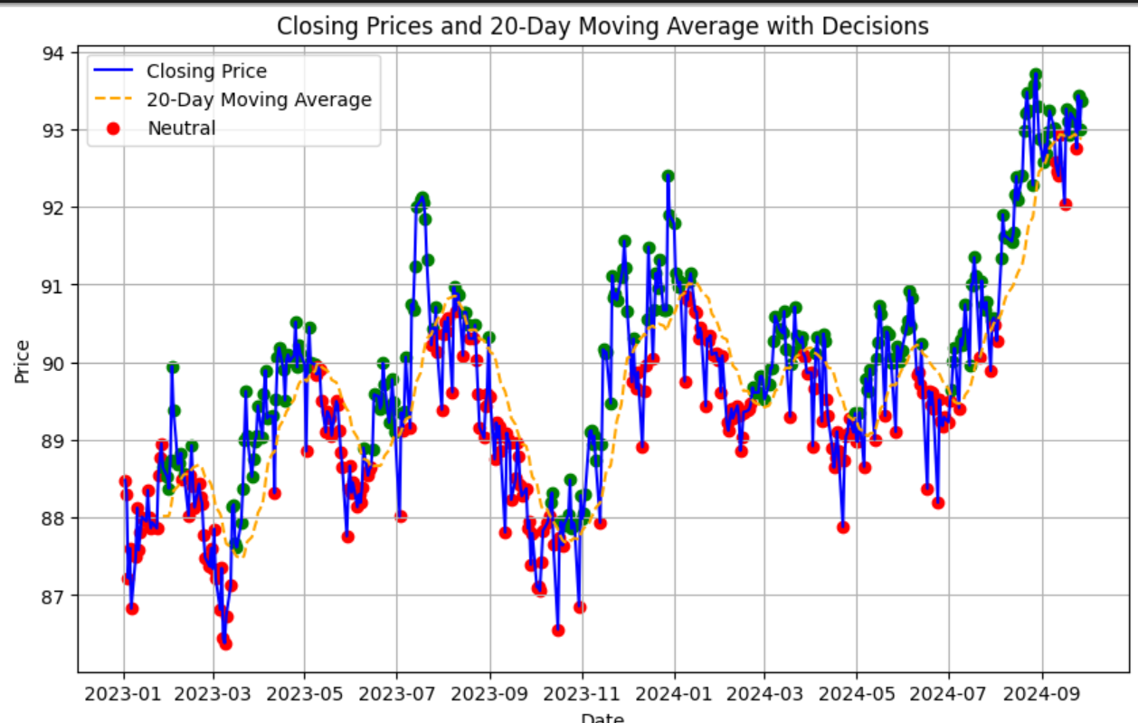
Graphs
Closing Prices and 20-Day Moving Average with Decisions

Slide 7
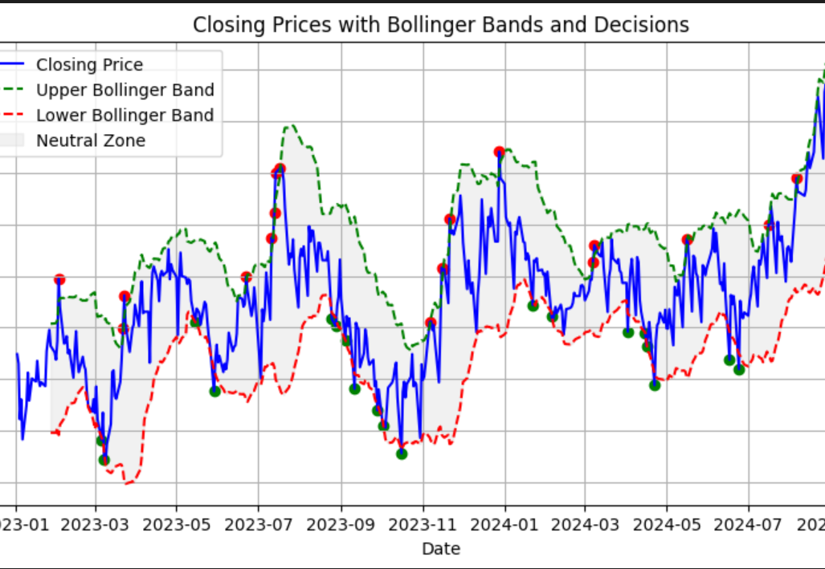
Graphs
Closing Prices with Bollinger Bands and Decisions

Slide 8
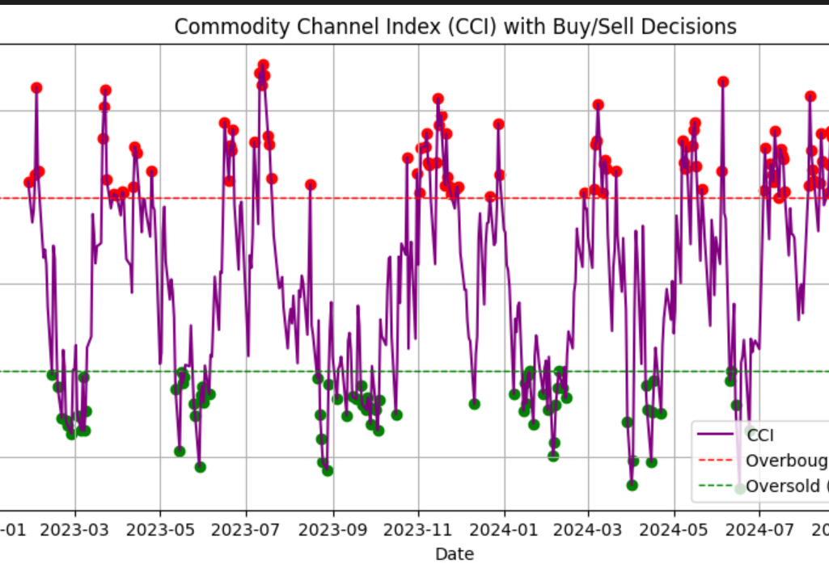
Graphs
Commodity Channel Index (CCI) with Buy/Sell Decisions

Slide 9
Assumptions
Data Cutoff: Calculations are based on available data up to September 27, 2024. Since data for September 28-30 or the next market opening is unavailable, decisions are derived from the metrics as of the last available date.
Decision Dates: Based on the assignment instructions and need for assumption, I chose September 20 and 27, 2024 as key dates for one-day and one-week analysis.
Non-Predictive Approach: The instructions did not mention creating a prediction model, so I focused on analyzing past data to make a decision for the next trading day.

Slide 10
Approach
Metric Calculation and Adjustment: All metrics (Moving Average, Bollinger Bands, and CCI) were calculated for one day and one week based on data up to September 27, 2024.
Initial Analysis in Jupyter Notebook: Conducted the initial analysis in a Jupyter Notebook for better data visualization and debugging, then transferred the necessary code to a .py file as required.
Decision Logic: Buy, Sell, or Neutral decisions are based on individual indicator signals, leveraging the final available metrics to guide next-day recommendations.

Slide 11
Conclusion
Analyzed Alphashots.AI’s prediction algorithm, focusing on its historical pattern recognition approach to forecast potential price ranges.
Analyzed EUR/INR data up to September 27, 2024, using Moving Average, Bollinger Bands, and CCI to make informed Buy, Sell, or Neutral decisions.
Created tables to display individual indicator decisions for selected dates.
Developed graphs to visually represent metric trends and decision points.
Potential for future analysis if more data becomes available or if predictive modeling is required for long-term forecasting.

