Slide 1
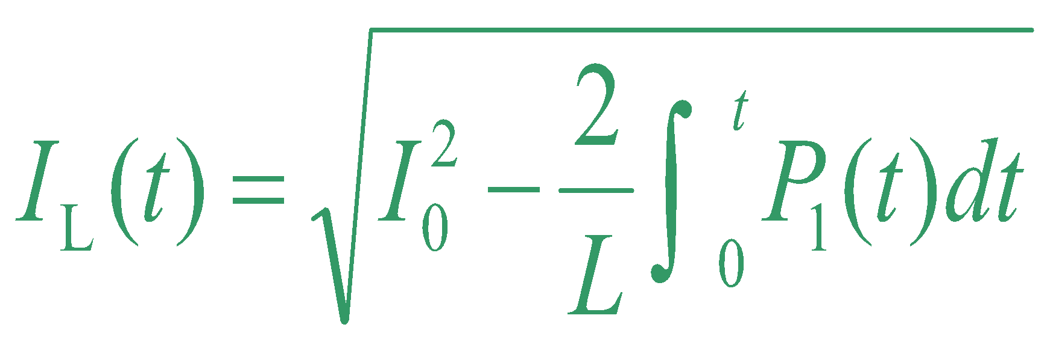
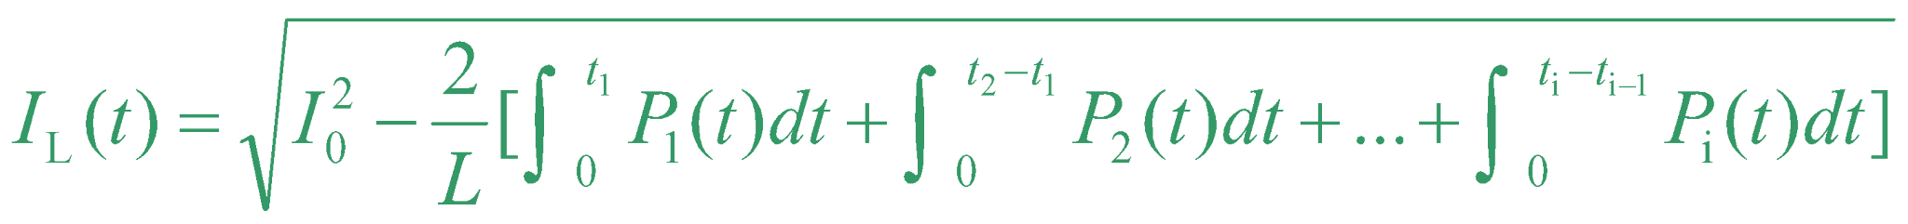
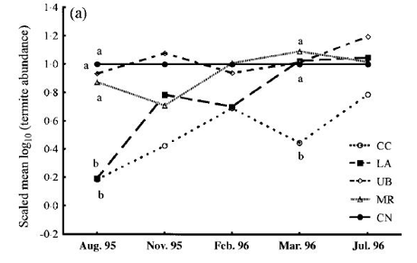



The Title of the Paper in (font, bold letters)
Size : Width 33.11 inches
height: 46.81 inches
A0 size
Date: 2XXX
ID: 1571XXX
Names of the Authors ( font, bold letters, one line only)
Authors’ Affiliation(s) ( point font, one line only)
I. Introduction (Times New Roman, 22point, bold letters )
This is the template for preparation of posters for 2026 IEEE India Geoscience and Remote Sensing Symposium, InGARSS 2026. Please use this document as a sample of the conference poster. (Times New Roman, 18)
You have to submit the poster at following format in Vinyl Flex before the day of presentation at InGARSS 2026.
IV. Methodology
The 2026 IEEE India Geoscience and Remote Sensing Symposium (InGARSS)
II. Literature Review
Describe the basic principle of your research works here.
Fig. 3. Park Hotel, Hyderabad
III. Problem Statement
This is the template for preparation of posters for InGARSS 2026. Please use this
document as a sample of the conference poster.
V. Results and Analyses
The outcomes of NISAR provides
A. Template of Font (20 point font)
All the items in your poster should be presented as an uniform layout. Do NOT
change the font sizes and font colors in the template.
Move the mouse to the beginning of the last column of each paragraph, press the key of “Enter” to interrupt the last column, and then make it LEFT align.
Other columns in each paragraph are recommended to be JUSTIFY align.
B. Template of Figures and Tables
More Figures and Tables are preferred for your poster to present your
outstanding works in Ingarss 2026.
Try to make your Figures are transparent to suit the light-blue
background of the poster. In addition, all the items in the Figures and Tables such as lines, words, symbols are recommended to be identical to the colour of the
TEXT in the template
(1)
Fig. 4. Title of the Figure. (16 point font)
(2)
VI. Conclusion & Future Scope
1. Technical Tours
Fig. 1. Title of the Figure. (16 point font)
Fig. 2. Title of the Figure. (16 point font)
References
[1] X.Y. Cole, Enter main references here, Apr. 15-18
[2] X.Y. Cole, How to prepare the poster in ASEM, ASEM, vol. 3, no. 1, pp. 1-4, 2023
Model | Feature extraction | Reprocessing | Classification
KNN | >200,000 flops | ~10 flops | ~200 flops
NN |  |  | ~10,000 flops
Table I. Heading of the Table. (16 point font)
• Enter your acknowledgements or sponsors here. (Optional) (14 point font)
2026 IEEE India Geoscience and Remote Sensing Symposium, InGARSS 2026
01st – 04th December 2026, Organized By: IEEE GRSS Hyderabad Chapter at The Park, Hyderabad

