Slide 1
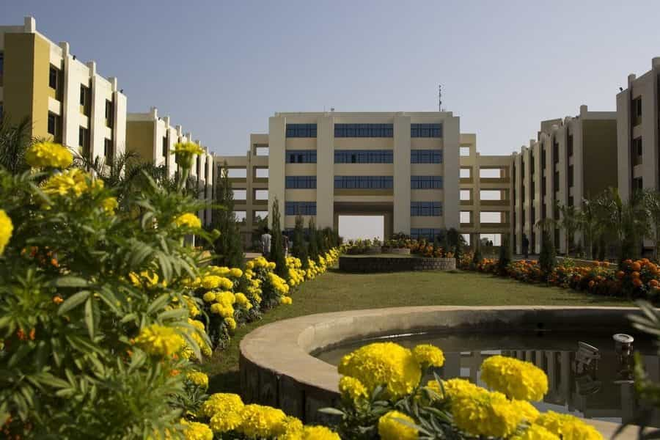

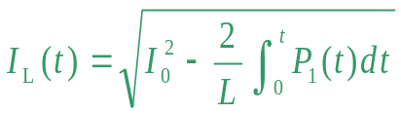
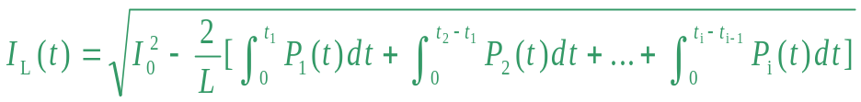
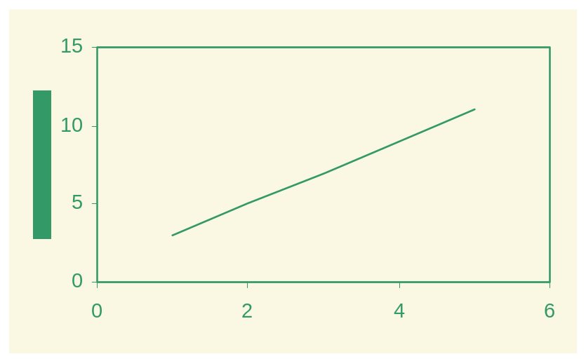
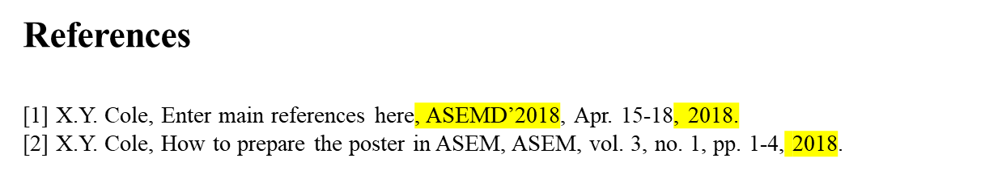




The Title of the Paper in (30-point font, bold letters)
Size : Height 5ft x Width 3 ft
Submit in Vinyl Flex, before the day of your presentation
Date: 2XXX
ID: 2XXX
Names of the Authors (24 point font, bold letters, one line only)
Authors’ Affiliation(s) (20 point font, one line only)
I. Introduction (Times New Roman, 22point, bold letters )
This is the template for preparation of posters for 2025 IEEE India Geoscience and Remote Sensing Symposium, InGARSS 2025. Please use this document as a sample of the conference poster. (Times New Roman, 18)
You have to submit the poster at following format in Vinyl Flex before the day of presentation at InGarss 2025.
IV. Methodology
The 2025 IEEE India Geoscience and Remote Sensing Symposium (InGARSS) is a prestigious platform dedicated to advancing research and innovation in geoscience and remote sensing technologies. Scheduled to take place in Bhubaneswar, this flagship event will bring together scientists, engineers, researchers, and industry leaders from across India and around the globe. InGARSS 2025 will feature keynote addresses by eminent experts, technical paper presentations, workshops, and panel discussions on emerging trends such as AI-driven remote sensing, climate monitoring, disaster management, and sustainable development. The symposium will also provide opportunities for collaboration, networking, and showcasing cutting-edge solutions that address pressing global challenges.
II. Literature Review
Describe the basic principle of your research works here.
Fig. 3. IIIT Bhubaneswar, Odisha, India.
III. Problem Statement
This is the template for preparation of posters for InGarss 2025. Please use this
document as a sample of the conference poster.
V. Results and Analyses
The outcomes of the INGSARSS 2025 study demonstrate significant improvements in the accuracy, reliability, and efficiency of SAR-based geospatial analysis. The experimental results, obtained using multi-temporal and multi-sensor SAR datasets, validate the effectiveness of the proposed methodology for detecting geophysical changes and monitoring environmental patterns.
A. Template of Font (20 point font)
All the items in your poster should be presented as an uniform layout. Do NOT
change the font sizes and font colors in the template.
Move the mouse to the beginning of the last column of each paragraph, press the key of “Enter” to interrupt the last column, and then make it LEFT align.
Other columns in each paragraph are recommended to be JUSTIFY align.
B. Template of Figures and Tables
More Figures and Tables are preferred for your poster to present your
outstanding works in Ingarss 2025.
Try to make your Figures are transparent to suit the light-yellow
background of the poster. In addition, all the items in the Figures and Tables such as lines, words, symbols are recommended to be identical to the colour of the
TEXT in the template (dark green)
(1)
Fig. 4. Title of the Figure. (16 point font)
(2)
VI. Conclusion & Future Scope
1. Technical Tours
Fig. 1. Title of the Figure. (16 point font)
Fig. 2. Title of the Figure. (16 point font)
Table I. Heading of the Table. (16 point font)
Model | Feature extraction | Reprocessing | Classification
KNN | >200,000 flops | ~10 flops | ~200 flops
NN |  |  | ~10,000 flops
• Enter your acknowledgements or sponsors here. (Optional) (14 point font)
2025 IEEE India Geoscience and Remote Sensing Symposium, InGARSS 2025
10th – 13th December 2025, Organized By: IEEE GRSS Kolkata Chapter at IIIT Bhubaneswar

