Slide 1
Memory Hierarchy analysis for sat solver
Chaitanya garg – 210050039
OMM AGRAWAL – 210050110
RISHIT SHRIVASTAVA - 210050136

Slide 2
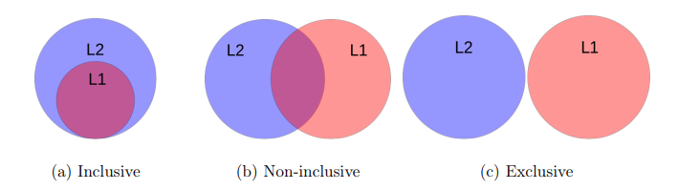
Inclusive policies
Non Inclusive nor exclusive(NINE) (default in Champsim)
Inclusive
Exclusive

Slide 3
Inclusive implementation
An inclusive cache level contains all data blocks from higher levels plus some other blocks
We implement this on top of NINE by making sure that whenever a line is evicted from a cache, it is also evicted from all higher cache level
If that line is dirty in a higher level, we ensure that the version of the line present in the highest cache level is written back to DRAM before eviction

Slide 4
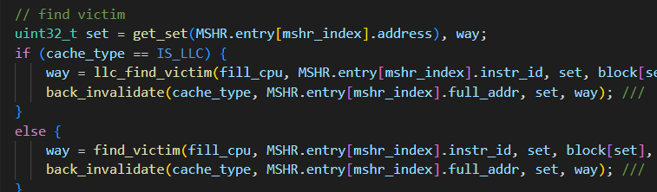
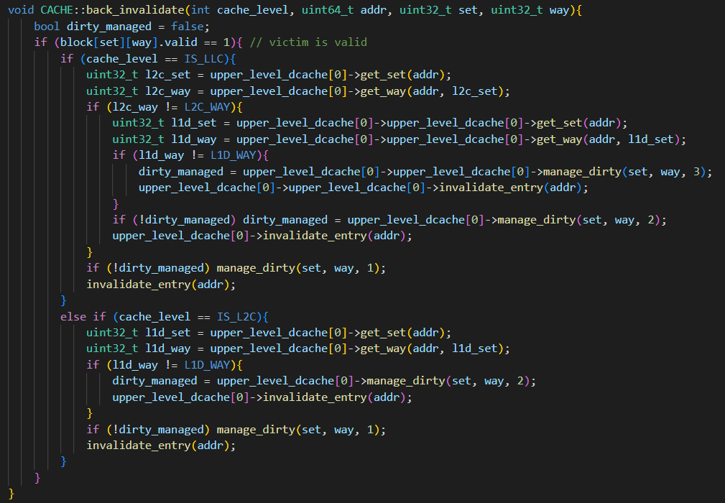
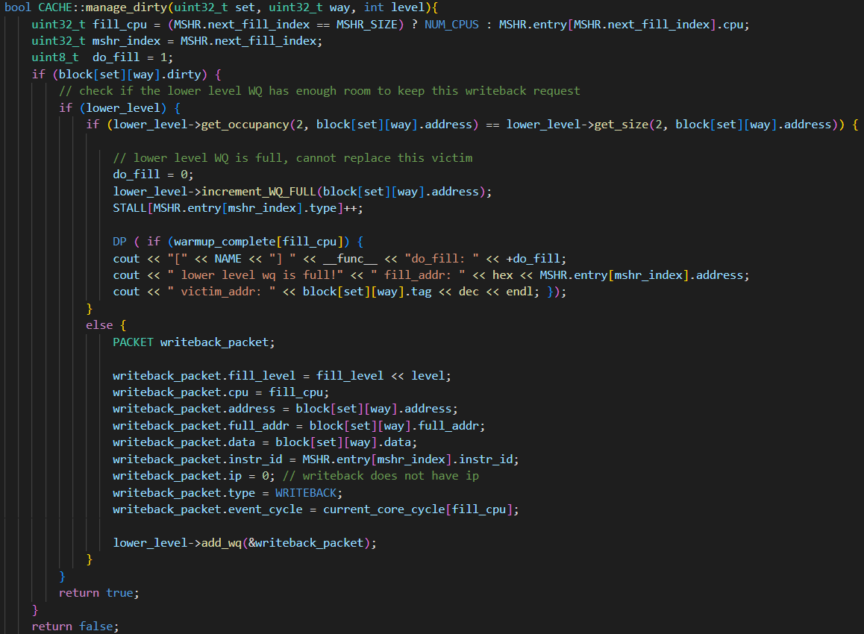

Slide 5
EXcluSIVE IMPLEMENtATION
An exclusive cache does not include any replicated block from higher levels
We implemented exclusivity between L2 and LLC while L1 and L2 are non inclusive of each other –
In handle_fill() : We always bypass the block on LLC fill and during L2 fill, we always send the victim block to LLC for allocation
In handle_read(): During LLC read, we invalidate the respective block after sending it to L2
In handle_writeback() : On eviction of a block from L2, we send it to LLC irrespective of whether it is dirty or not

Slide 6
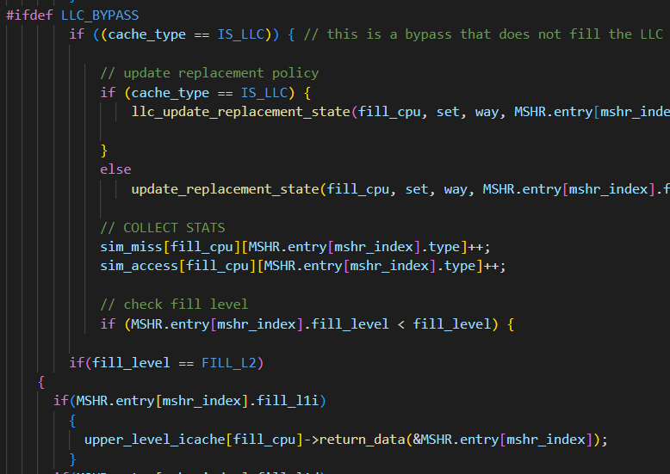
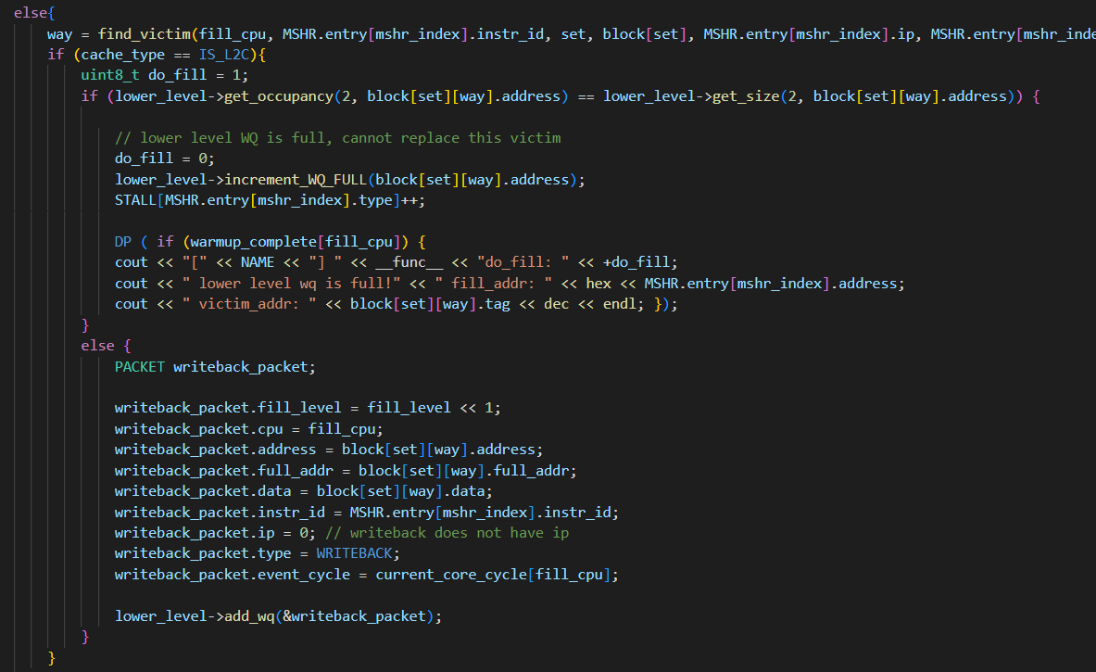
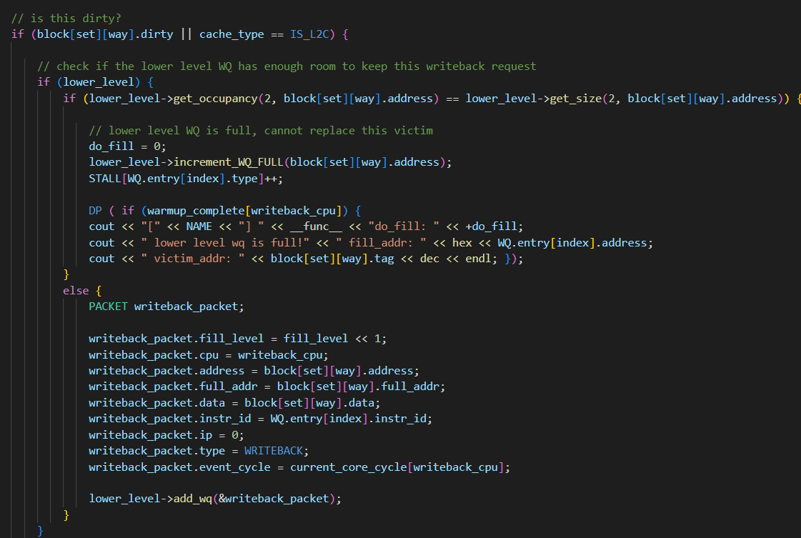


Slide 7
PLOTS

Slide 8
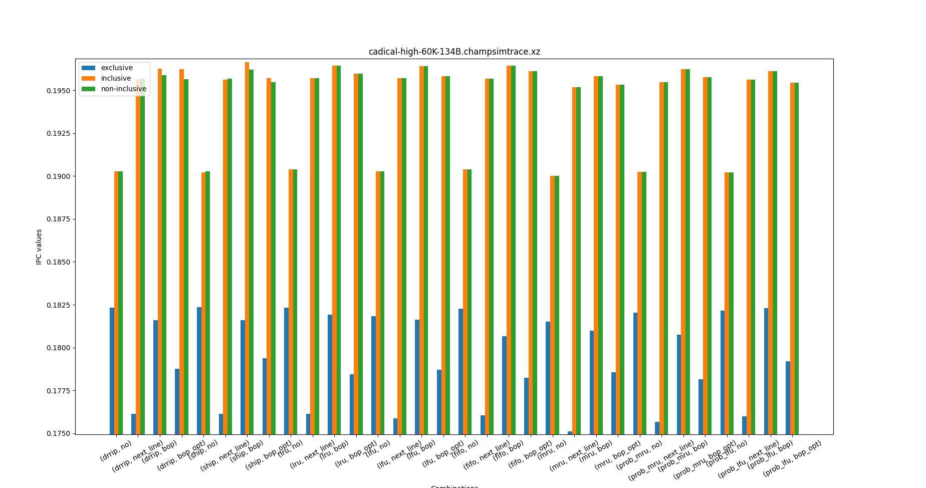

Slide 9
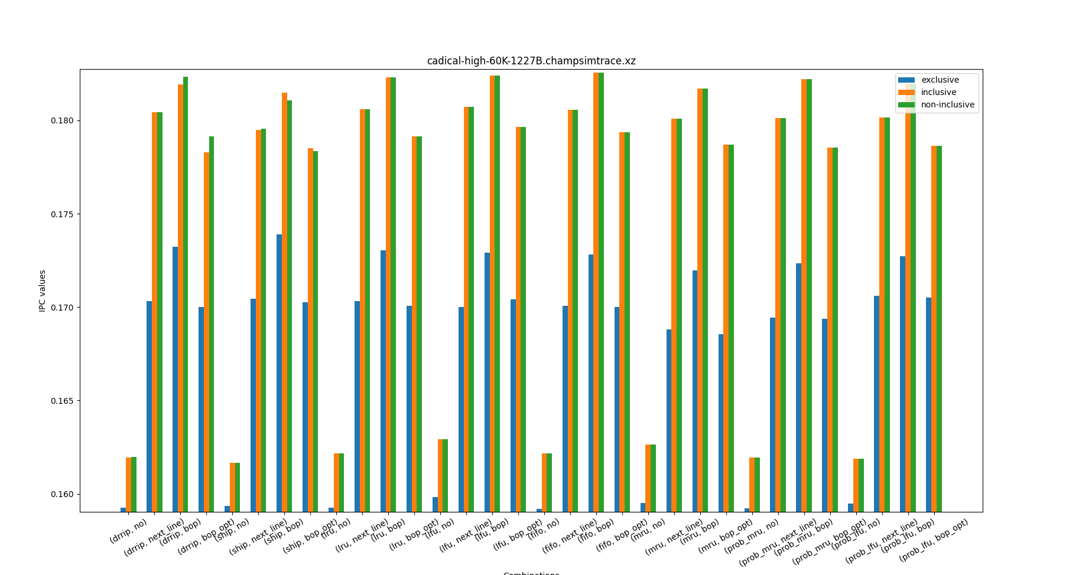

Slide 10
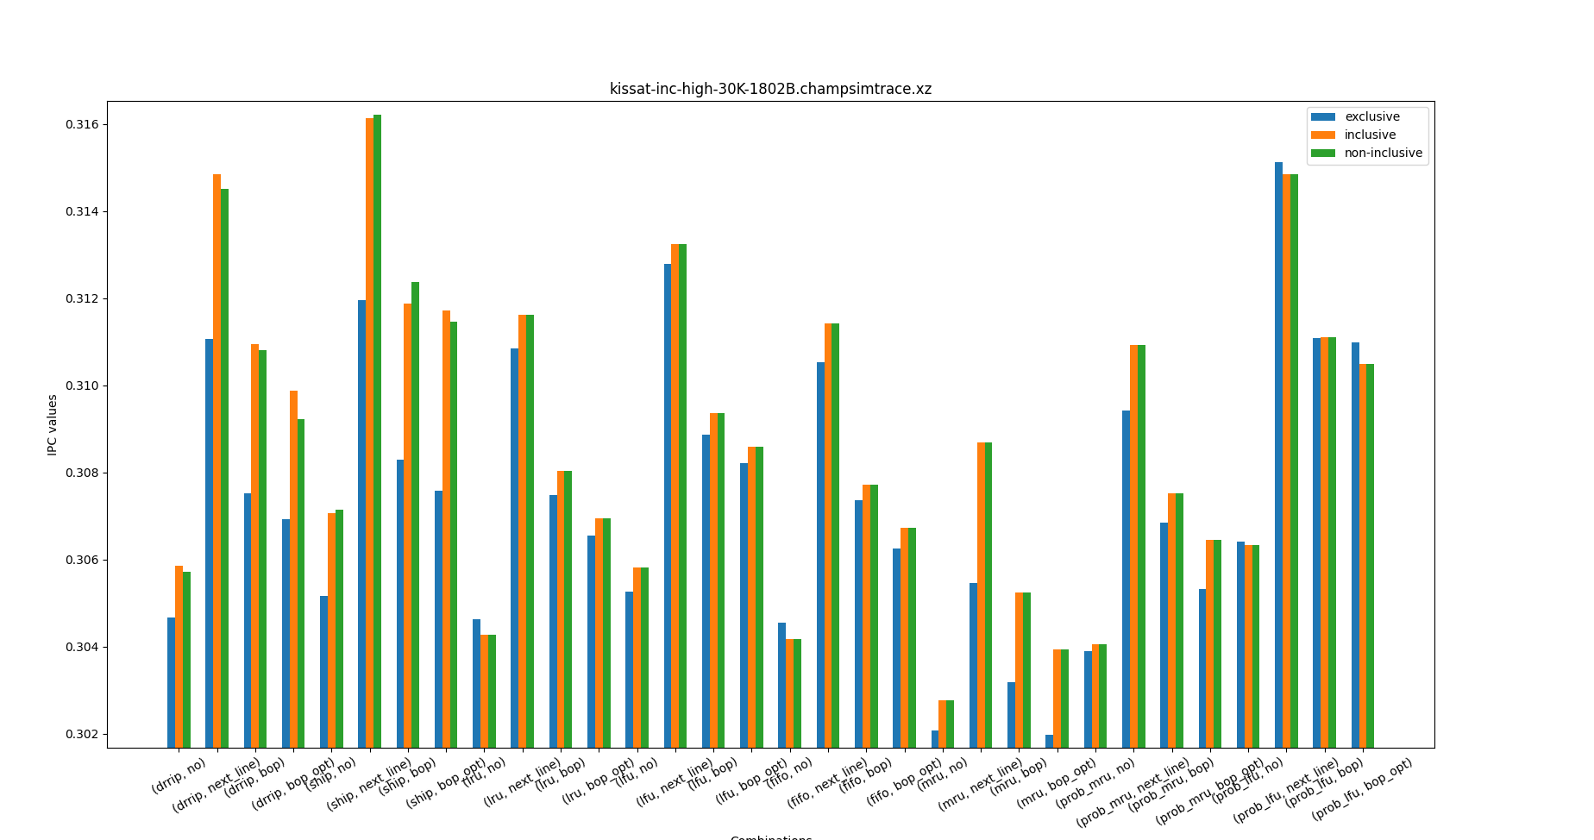

Slide 11
Observations and REasoning
We observe that exclusive implementation performs rather poorly.
This behaviour can be attributed to 2 factors
Exclusive Policy demands more data movement in general, thus degrading performance.
With SAT solvers having a large working set and irregular data access pattern, the eviction rate increases and the probability of reusing recently used victim cache lines is low.

Slide 12
REPLACEMENT POLICIES AND PREFETCHERS
We have used the following prefetchers
No prefetcher
Next line
Best Offset
Modified best offset
We have used the following replacement policies
DRRIP
SHIP
LRU
LFU
FIFO
MRU
Probabilistic MRU
Probabilistic LFU

Slide 13
Introduction to Probabilistic Version
The probabilistic LFU policy takes into account both the frequency of block accesses as well as the recency of the accesses. It uses an exponential decay function to assign a weight to each block's LFU value, with more frequent accesses being weighted more heavily. The sum of these weights is then used to compute the probability of each block being evicted, with blocks that have a lower sum of weights being more likely to be evicted.
Calculates weight for each valid cache line based on frequency
Weight is assigned to be exp(-frequency)
Normalizes weights into probabilities by summing all weights and dividing each weight by the sum
Generates random number between 0 and 1 to select victim cache line based on probabilities
By using a probabilistic model, the cache replacement policy becomes more intelligent and adaptive to the access pattern of the application, resulting in improved cache hit rates and overall system performance

Slide 14
MRU and its Probabilistic Version
MRU (Most Recently Used) is a cache replacement policy that replaces the cache element used most recently.
The probabilistic MRU victim selection algorithm works by assigning a probability to each valid cache line in the set, based on its MRU position. The cache line with the highest MRU position will have the lowest probability of being selected as the victim, while the cache line with the lowest MRU position will have the highest probability of being selected.
Calculates weight for each valid cache line based on MRU position
Weight = NUM_WAY - lru_position
Normalizes weights into probabilities by summing all weights and dividing each weight by the sum
Generates random number between 0 and 1 to select victim cache line based on probabilities
By using a probabilistic model, the cache replacement policy becomes more intelligent and adaptive to the access pattern of the application, resulting in improved cache hit rates and overall system performance.

Slide 18
Why lfu?
LFU can be particularly effective in conjunction with CDCL (Conflict-Driven Clause Learning), which is a widely used SAT solving algorithm that frequently accesses and updates the working set of clauses. By prioritizing the least frequently accessed clauses for caching, LFU can help reduce cache misses and improve the overall performance of the solver.
LFU ensures that least frequently accessed clauses are prioritized for caching, allowing the cache to adapt quickly to changes in the working set.
The LFU algorithm was working fine in SAT solvers, but the new probabilistic version which we designed is proving to be even better.
Let us see why the probabilistic version works better .

Slide 19
Impact of prefetchers
In the context of SAT solvers, cache misses can significantly impact performance. As a result, the use of prefetchers can be beneficial in reducing cache misses and improving the overall performance of SAT solvers.
Through our experimentation, we found that prefetchers do indeed improve performance in the context of SAT solvers. Specifically, we found that the BO prefetcher performed better than the next-line prefetcher in reducing cache misses.
Furthermore, we developed two BO prefetchers with optimizations in the learning phase, resulting in further performance improvements compared to using a standard BO prefetcher. In the optimized BOP, we implemented two modifications. First, we ensure that learning takes place regardless of whether there is a hit or miss, allowing for prolonged learning of the best offset. Second, we alternate between a no-prefetch condition and the original prefetching condition every 100 accesses to ensure that the limited capacity of RR does not hinder availability.

Slide 20
CACHE PARAMETERS
We varied the following cache parameters and observed their impact on the given SAT Solver traces
Block size – We varied the block size, keeping the total size of the cache as constant
Associativity – We varied the number of ways, keeping the total size of the cache as constant
Cache size – We varied the number of sets, effectively increasing the total size of the cache
These analysis are done independently for L1d, L2c and LLC caches

Slide 21
PLOTS for Variation in block size

Slide 22
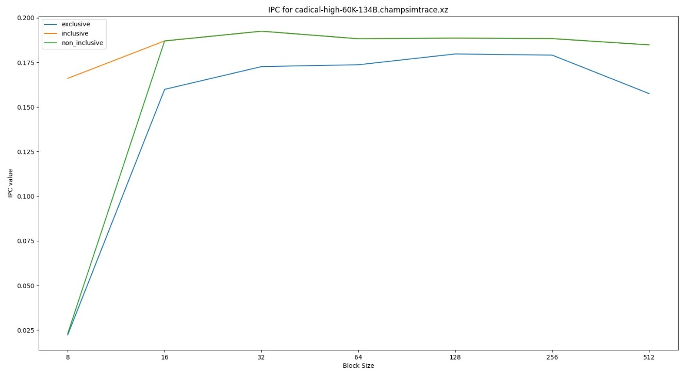
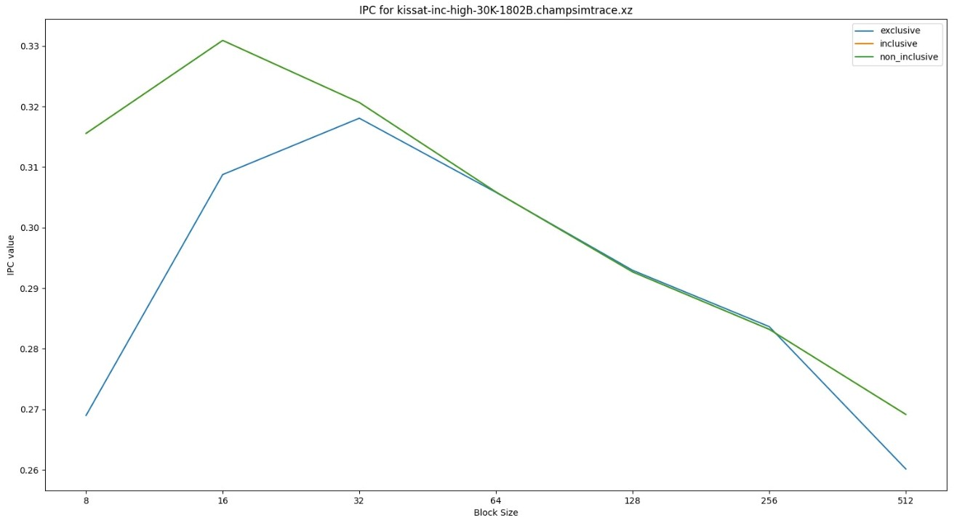
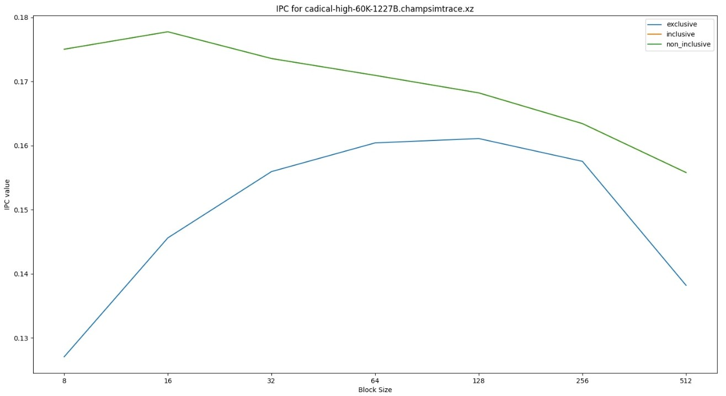

Slide 23
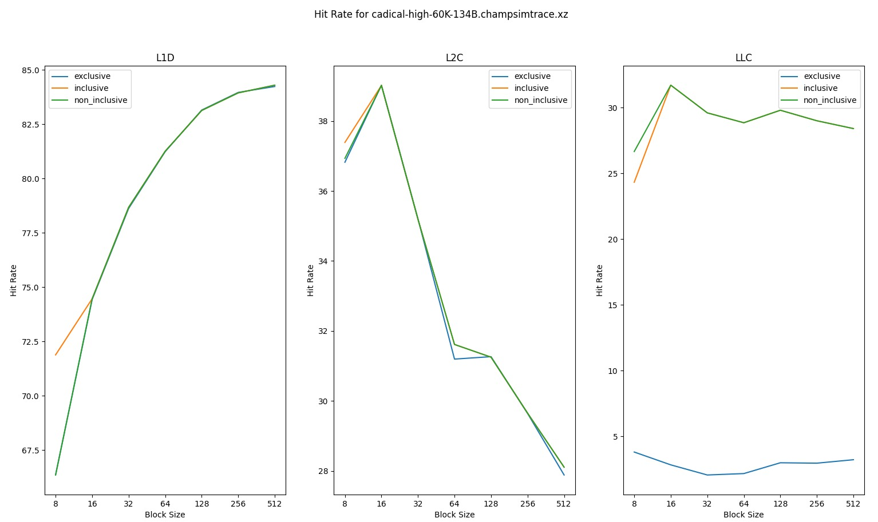

Slide 24
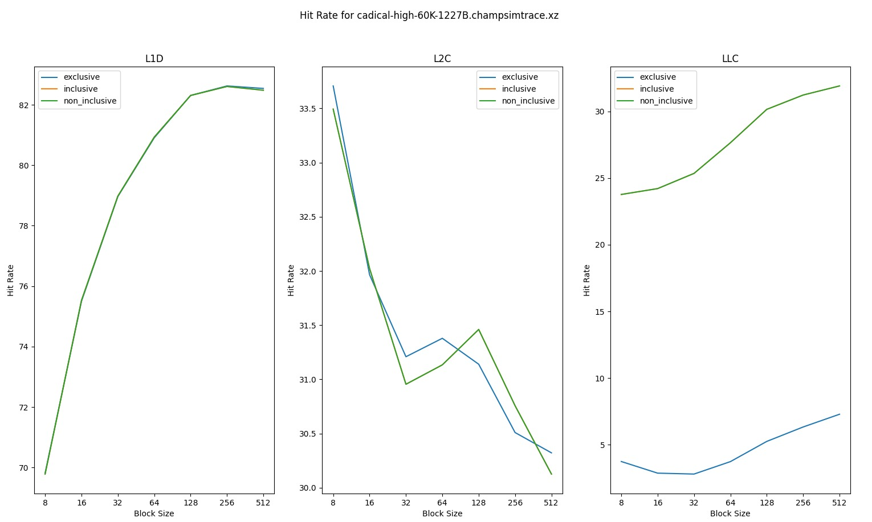

Slide 25
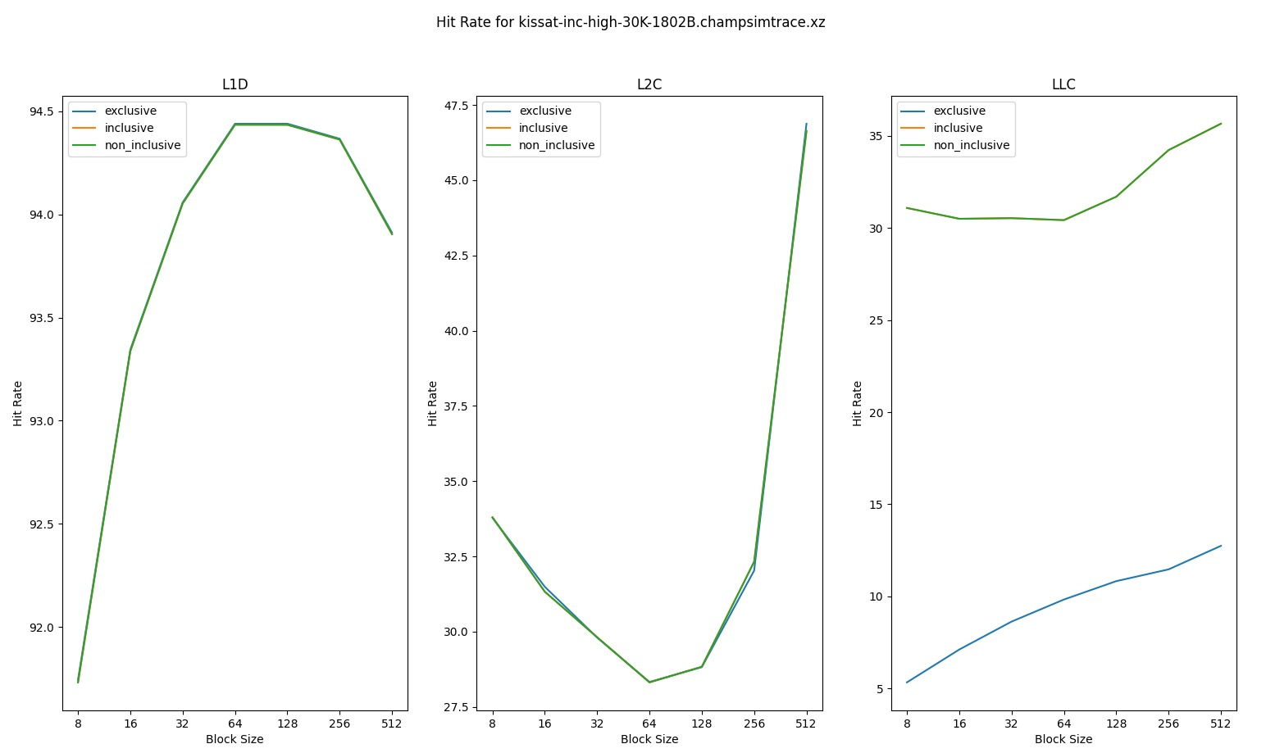

Slide 26
Observation and reasoning
A larger block size means that more data can be stored in a single cache line, resulting in fewer cache lines being used to store the same amount of data. As a result, the probability of accessing data that is already in the cache increases, resulting in a higher cache hit rate.
However, a larger block size also means that the cache lines are storing more data than the processor might actually need. This can result in cache pollution, where the cache lines are filled with data that the processor doesn't use, resulting in more cache misses. Additionally, larger block sizes can result in thrashing, where the processor repeatedly evicts cache lines from the cache because the cache is too small to hold all of the blocks that are being accessed
The behavior of these 2 conflicting factors determine the optimal block size

Slide 27
PLOTS FOR variation in associativity ( L1d )

Slide 28
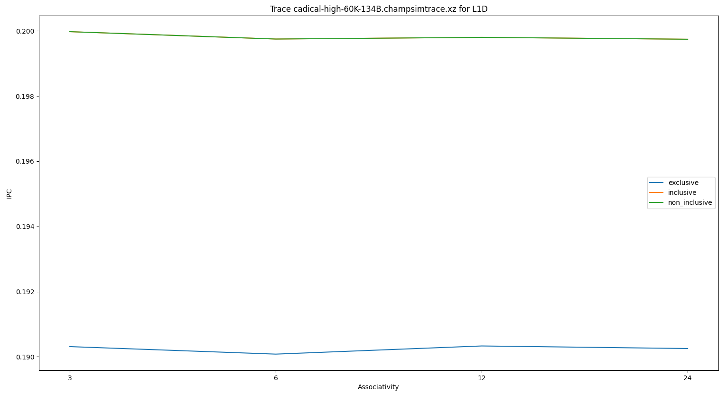
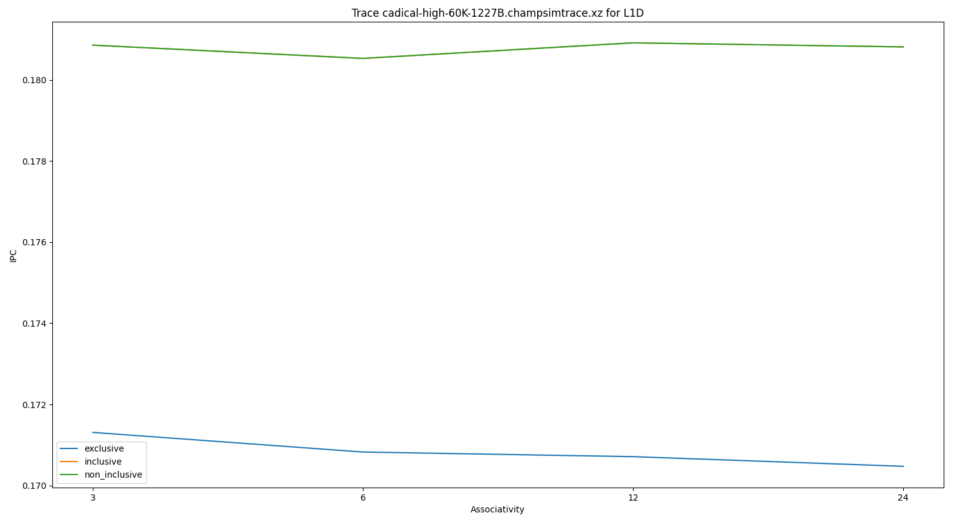
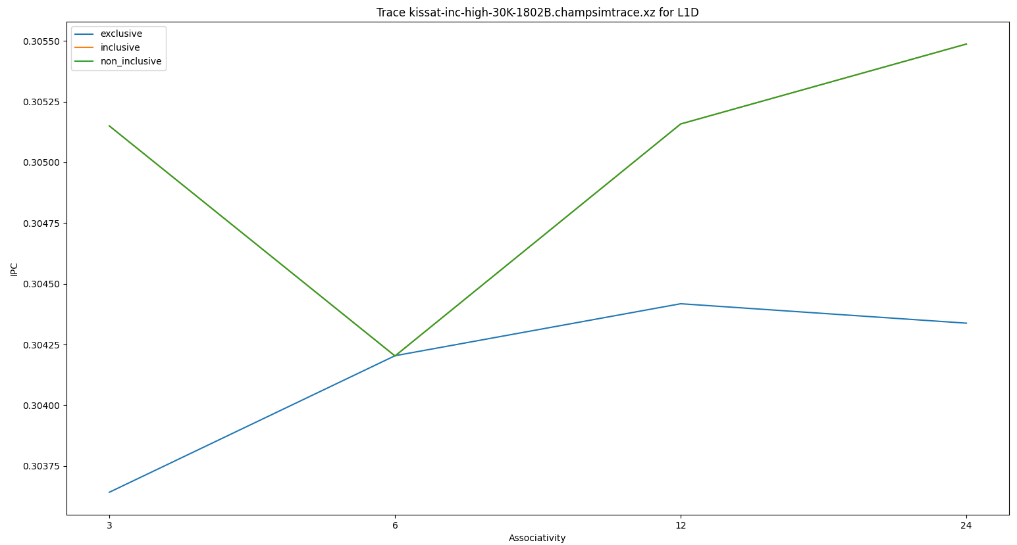

Slide 29
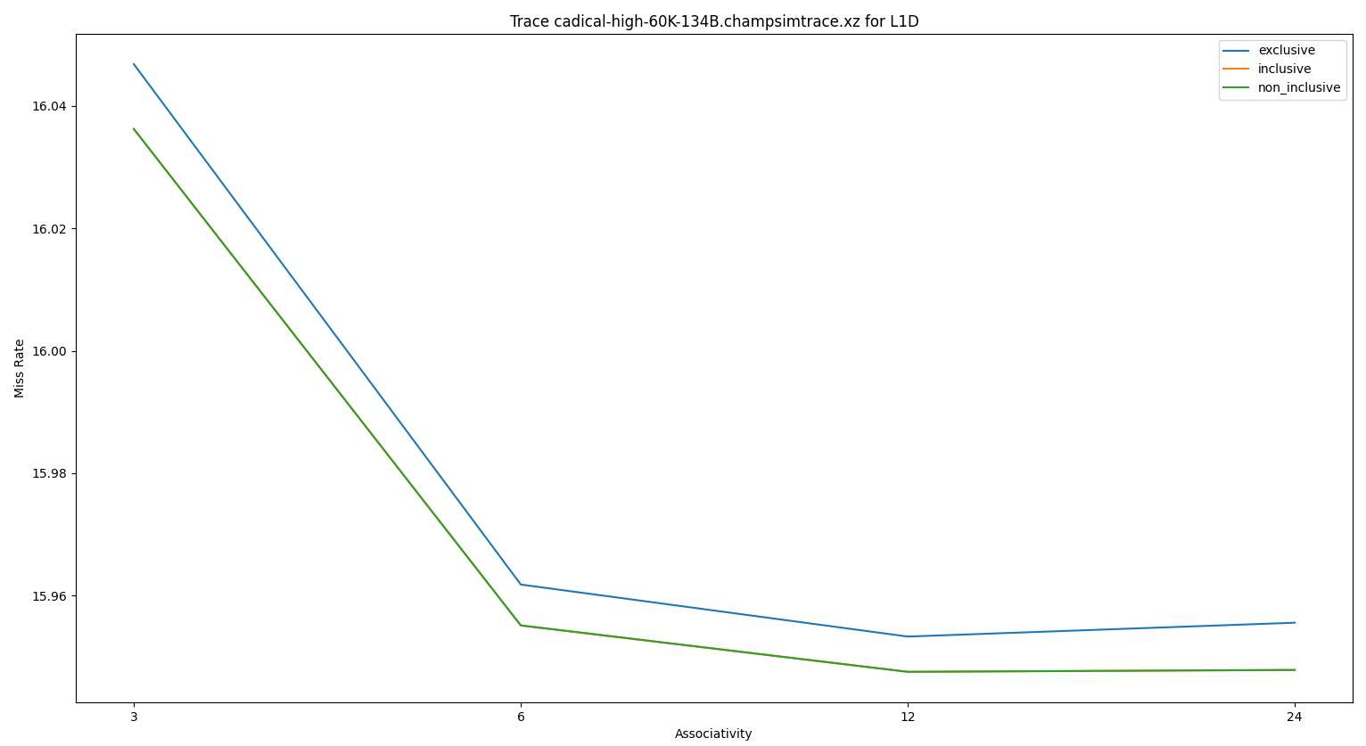
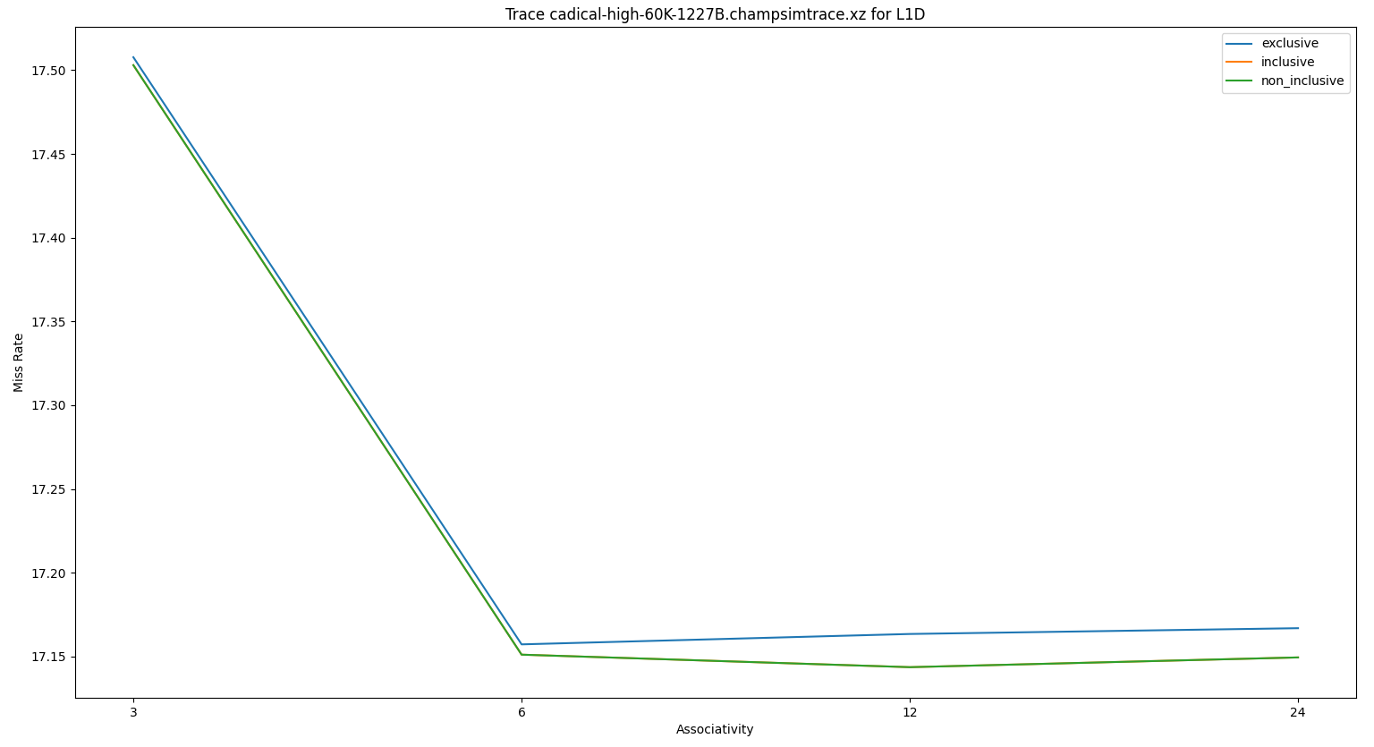
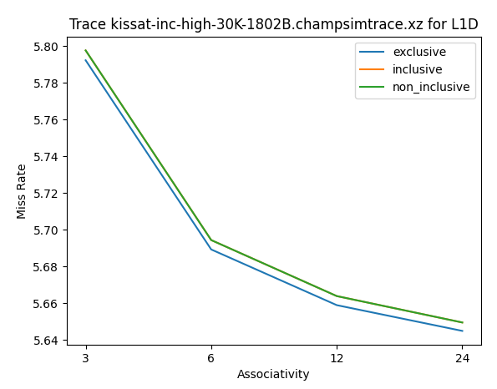

Slide 30
PLOTS FOR variation in associativity ( L2C )

Slide 31
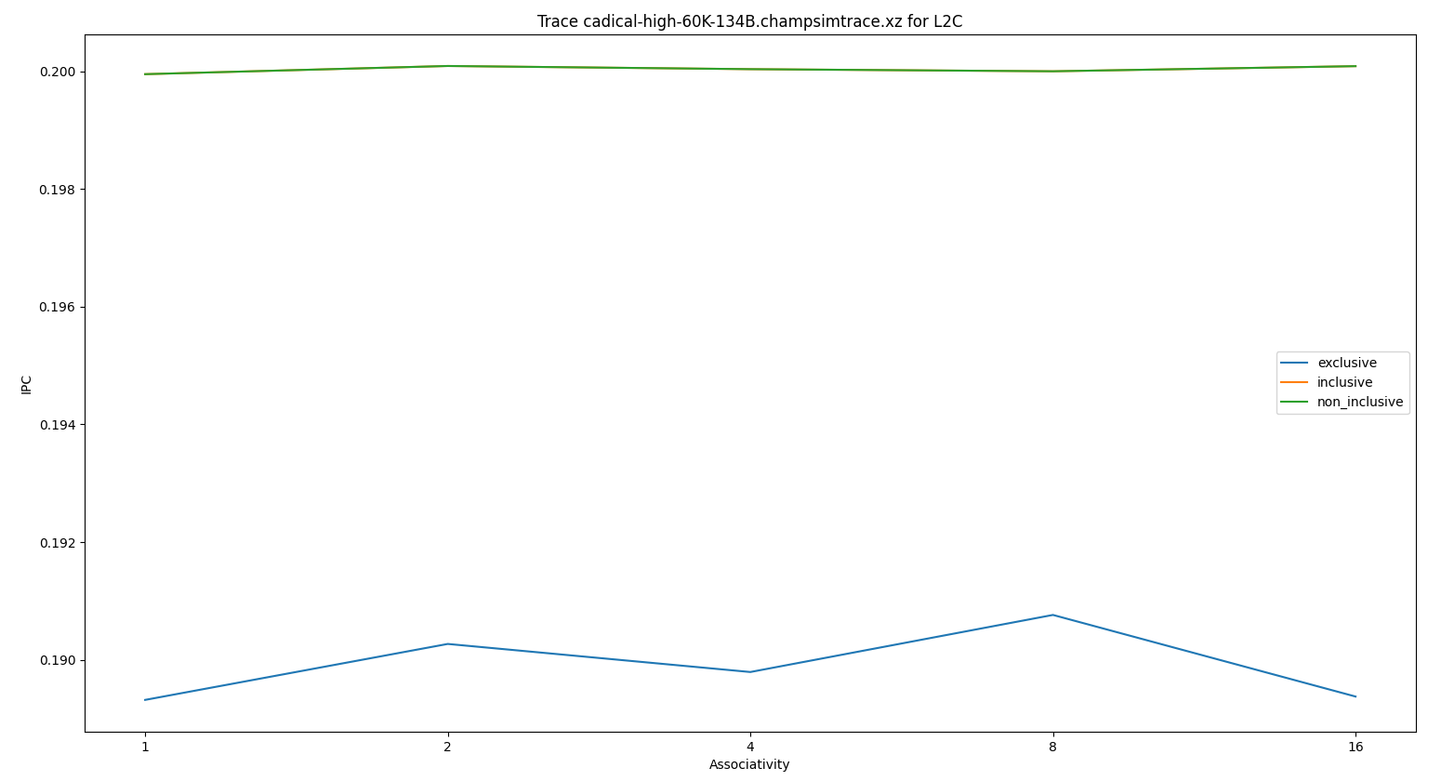
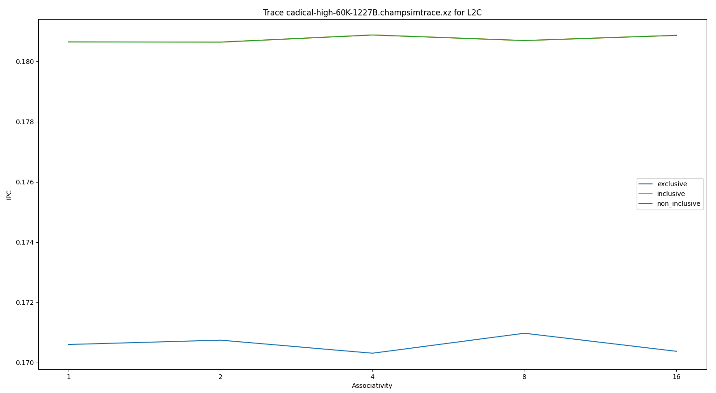
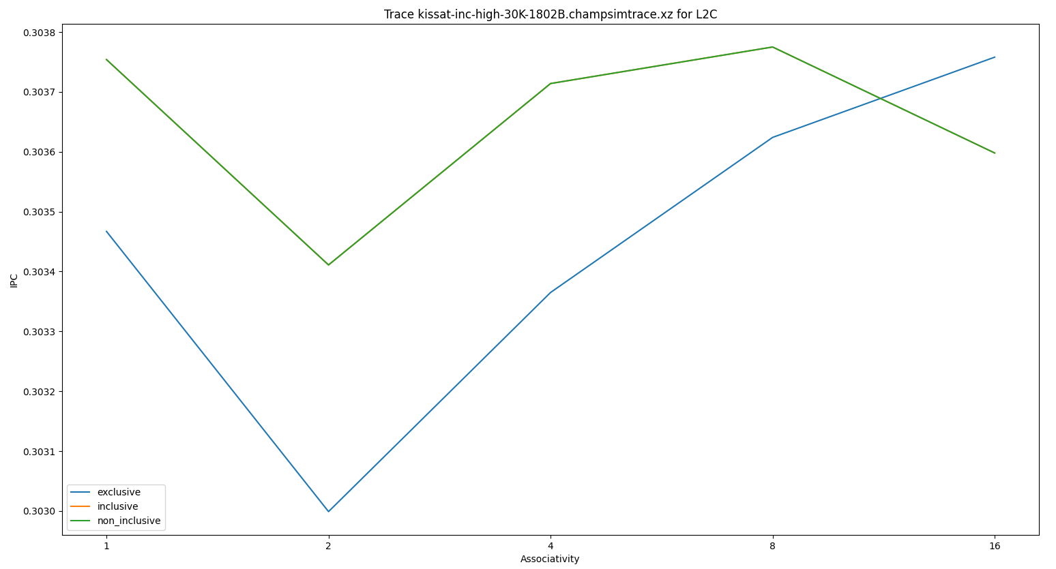

Slide 32
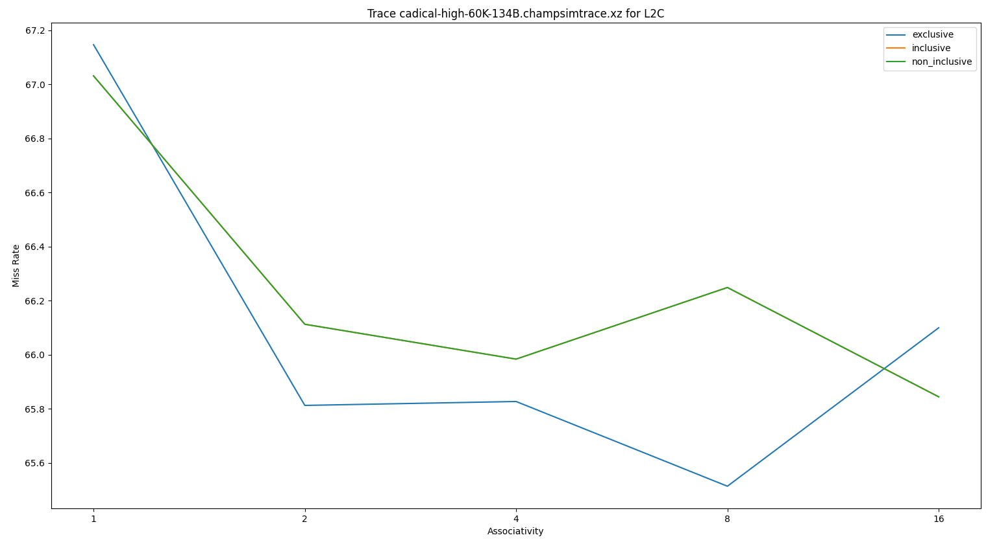
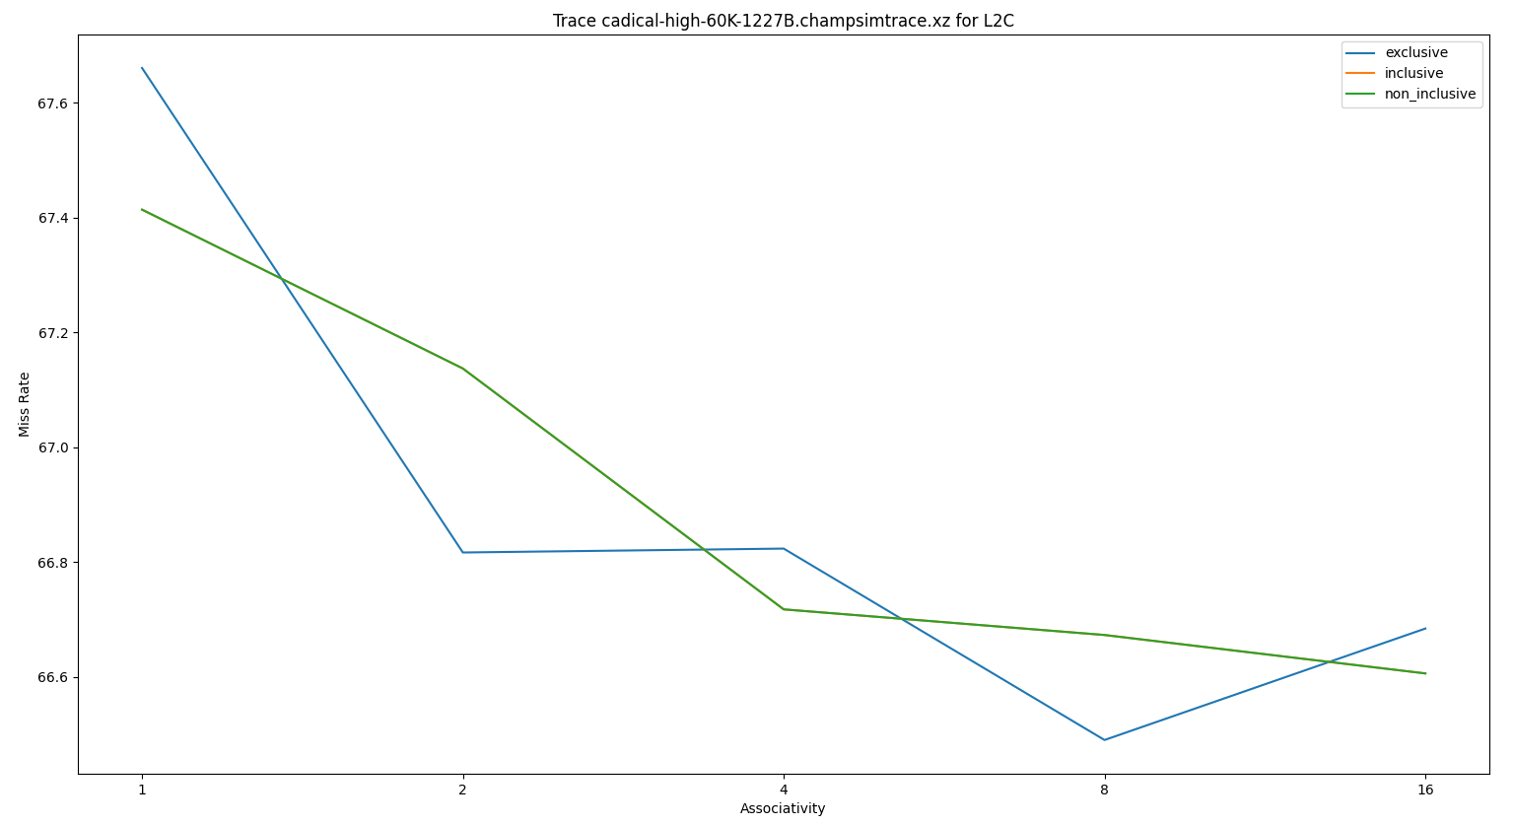
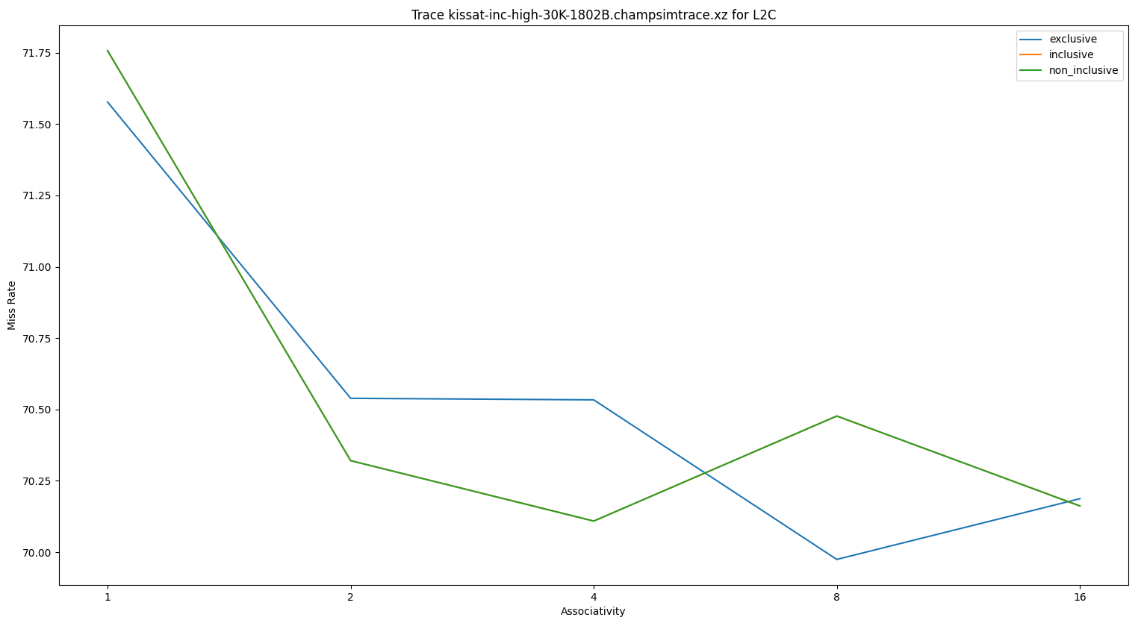

Slide 33
PLOTS FOR variation in associativity ( LLC )

Slide 34
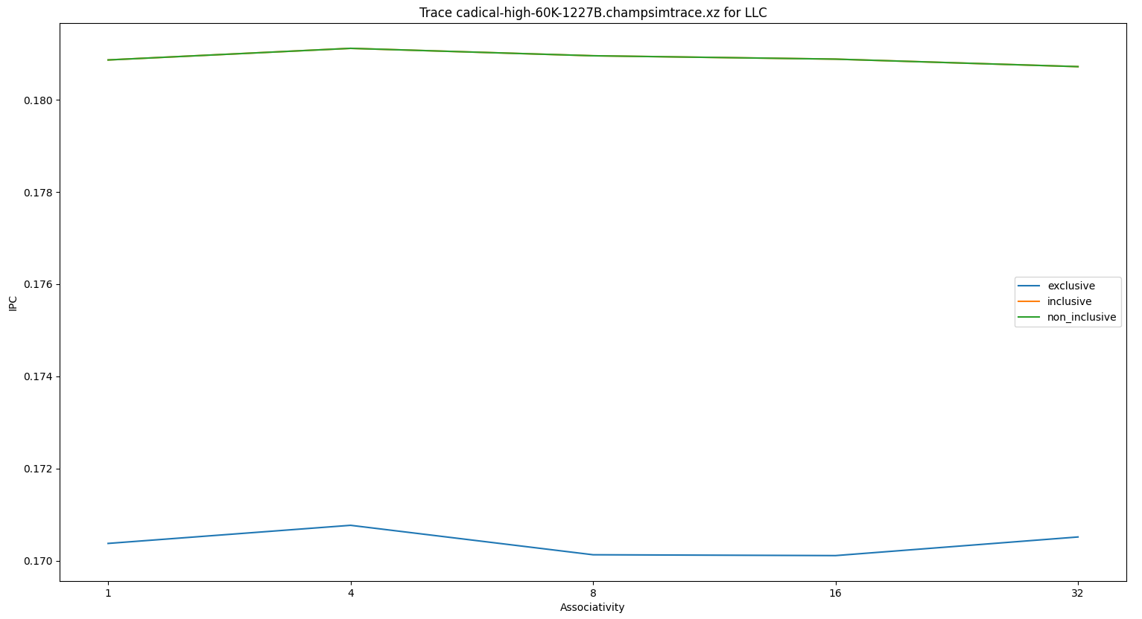
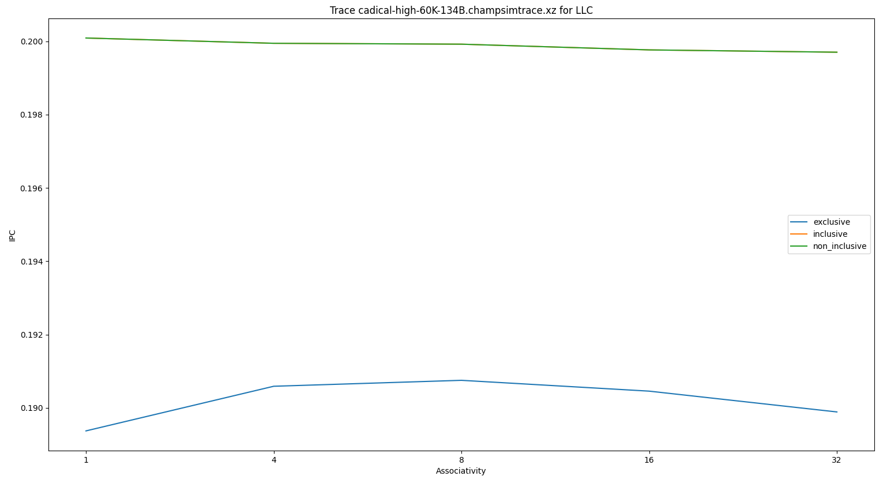
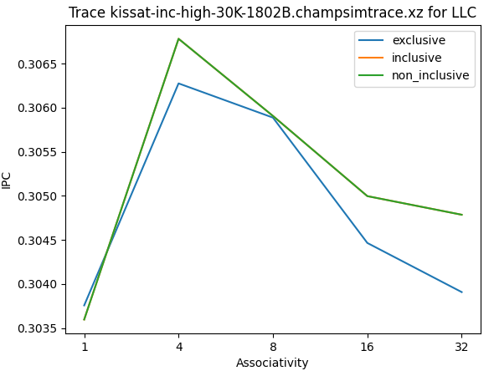

Slide 35
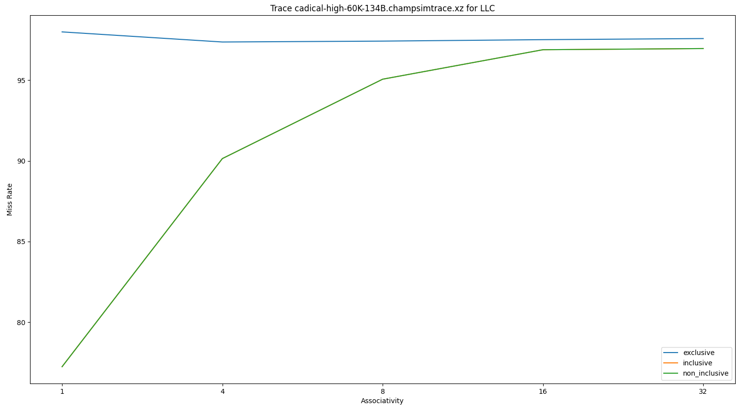
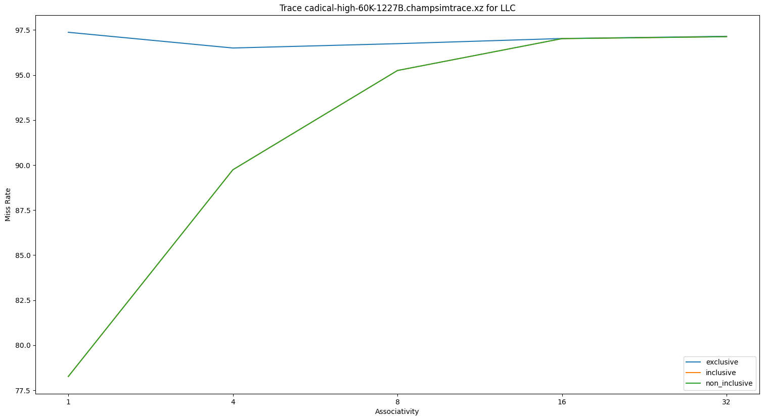
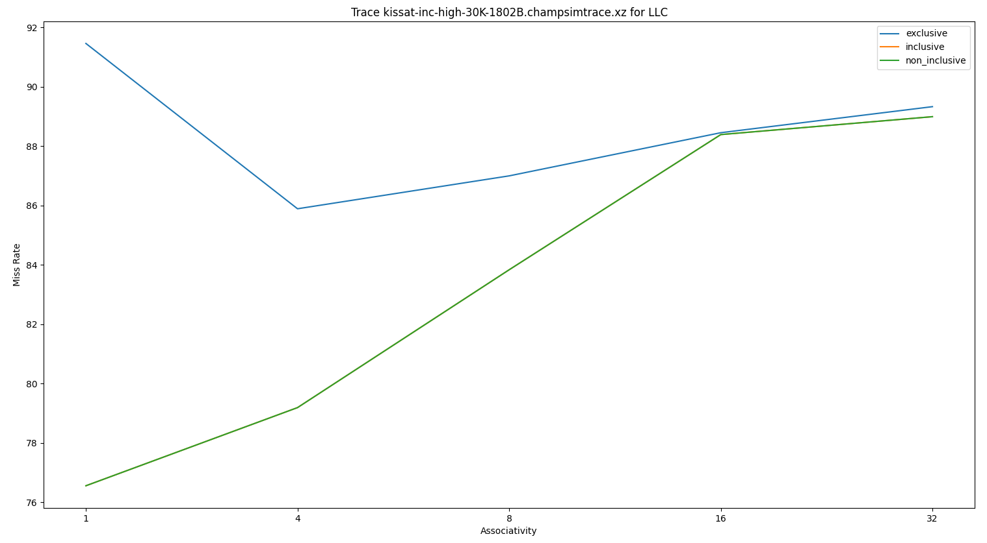

Slide 36
Observations and reasoning
With the increase in associativity, more cache blocks can be fit into a set without line eviction thus reducing conflict misses. This in turn decreases the miss rate.
Since LLC’s is primarily a cache to provide capacity, the data distributes on different sets rather than on different ways of a given set. Hence increasing associativity negatively impacts the miss rate by decreasing the number of sets.

Slide 37
PLOTS FOR variation in Cache size ( L1d )

Slide 38
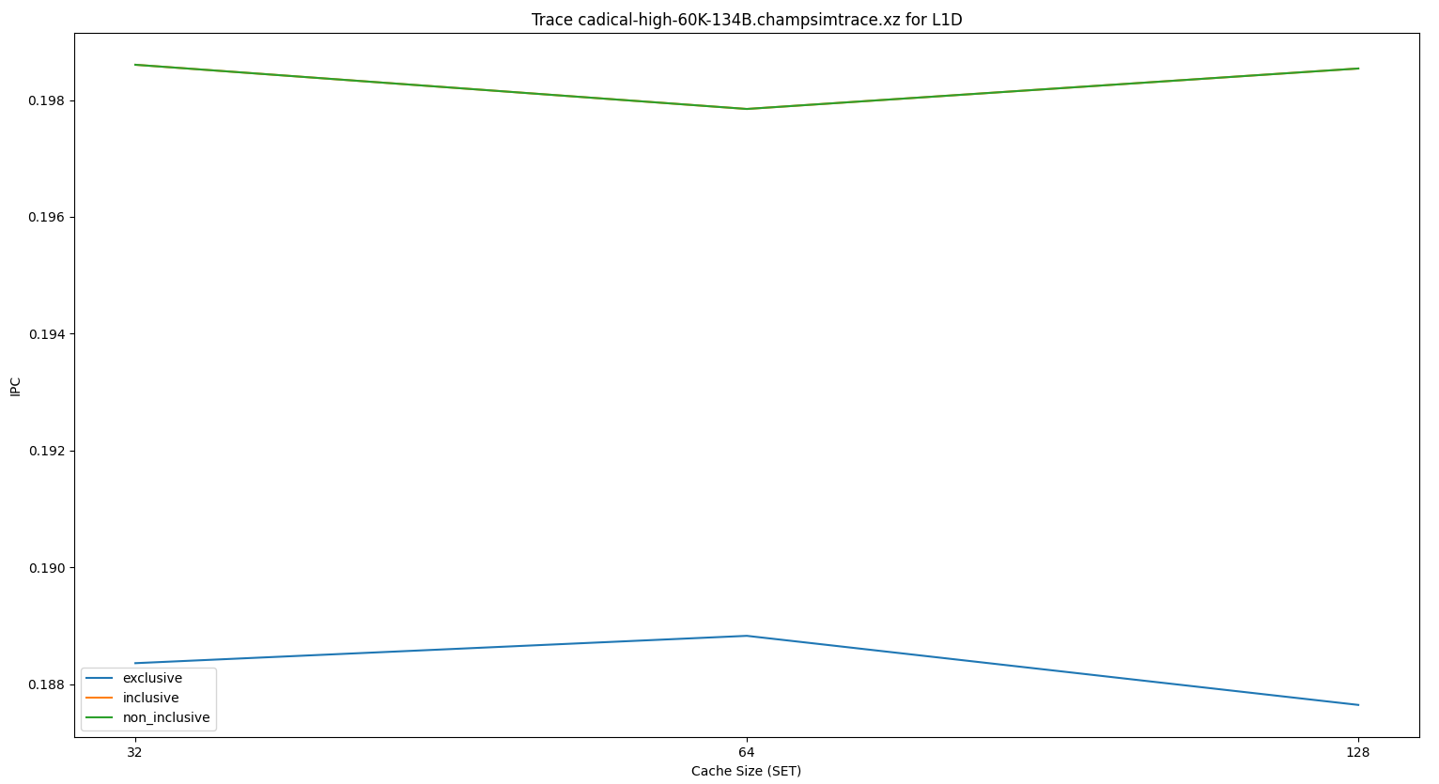
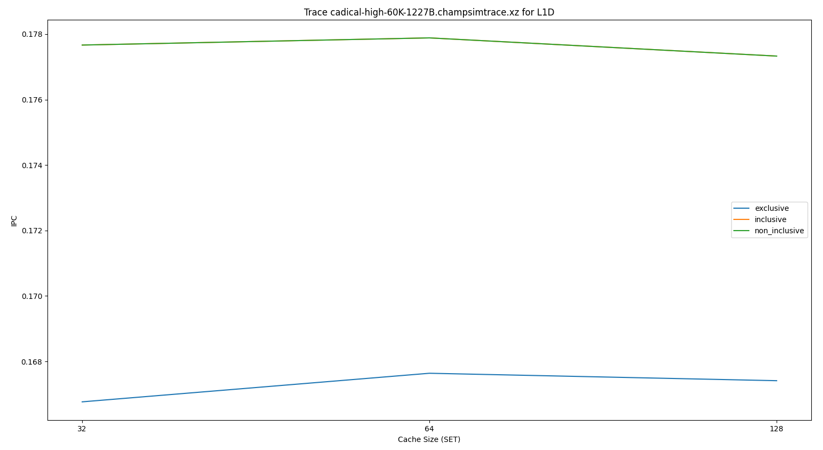
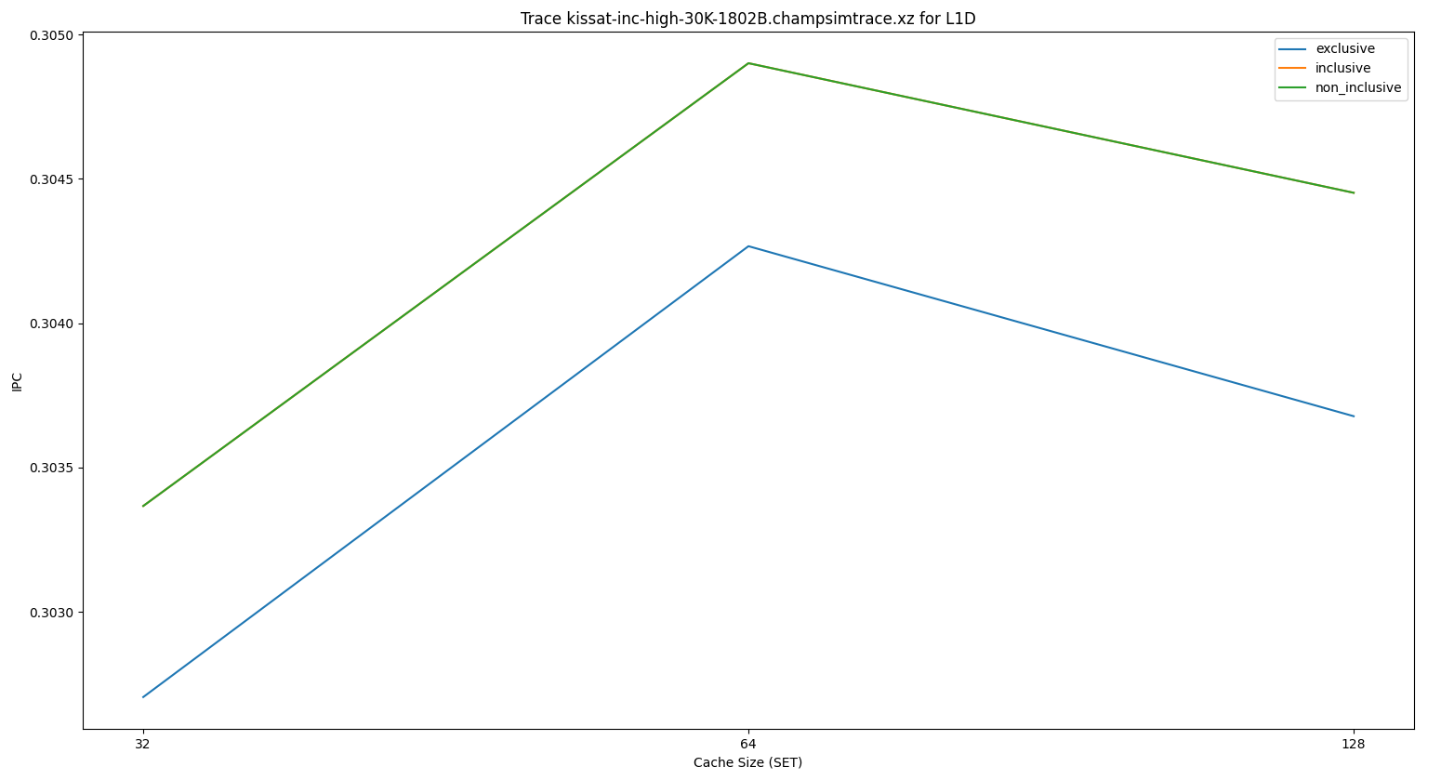

Slide 39
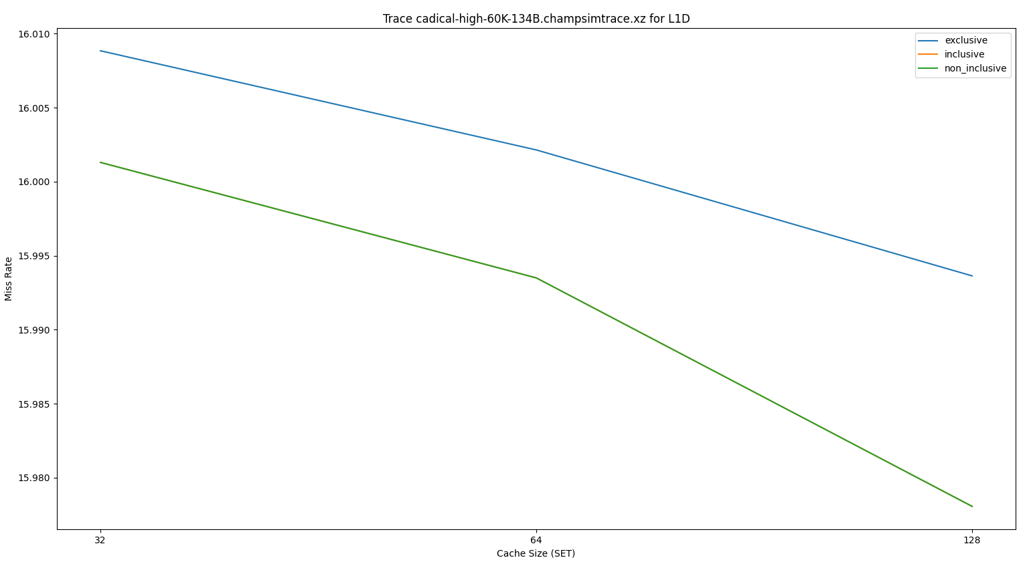
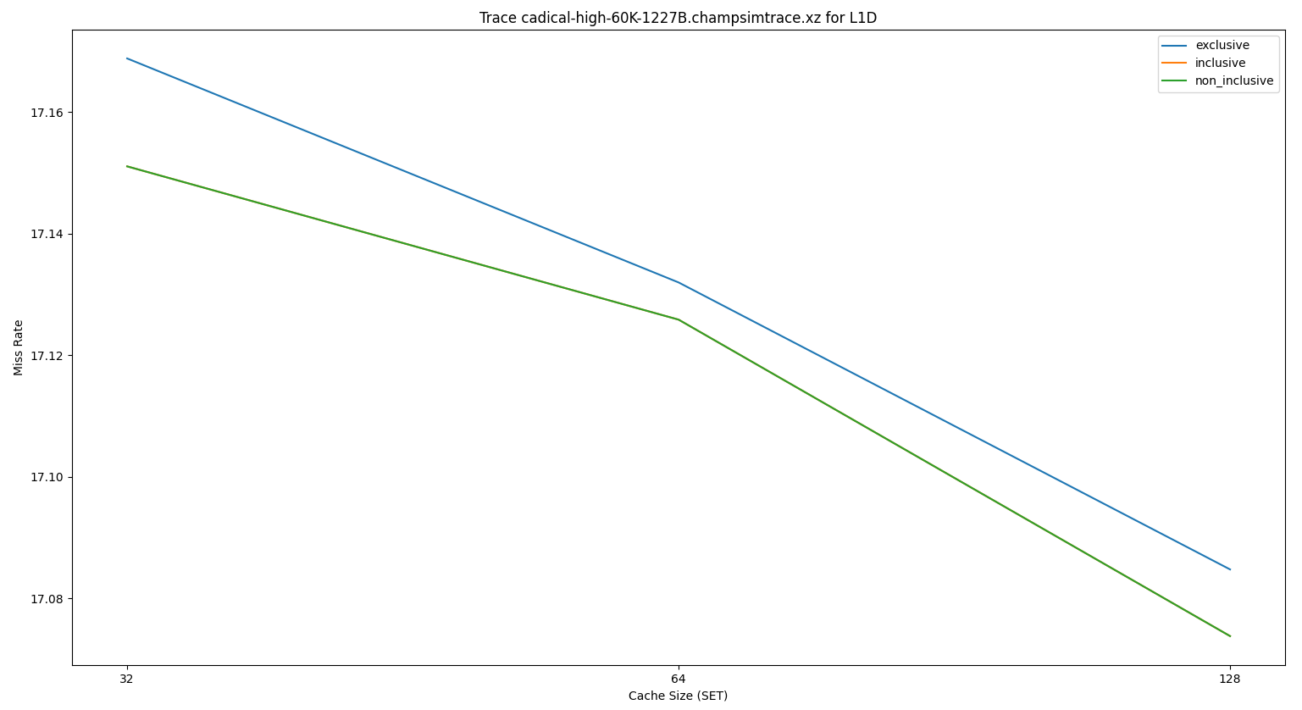
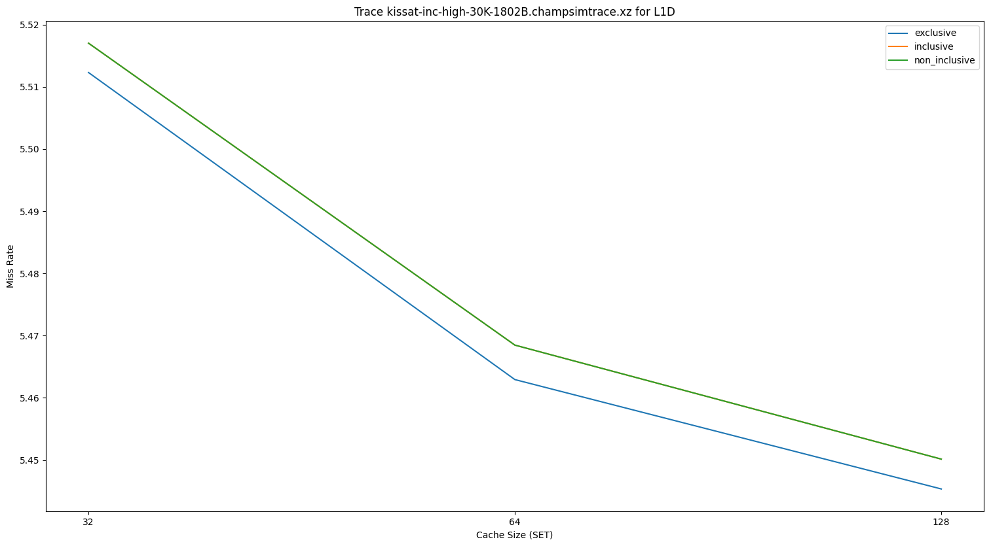

Slide 40
PLOTS FOR variation in Cache size ( L2c )

Slide 41
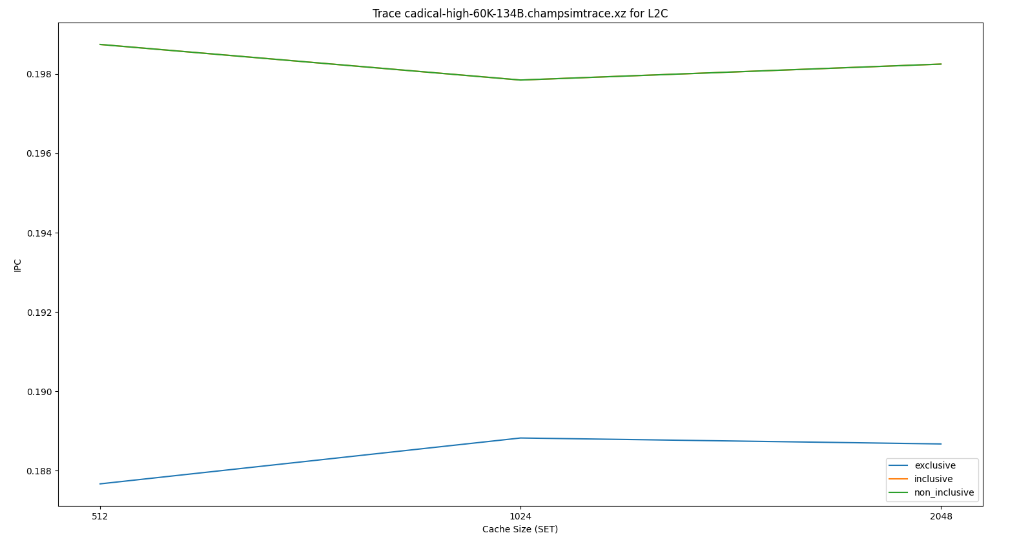
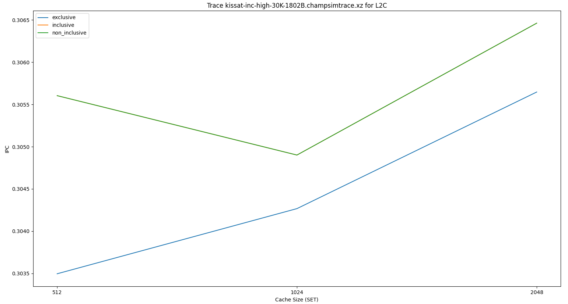
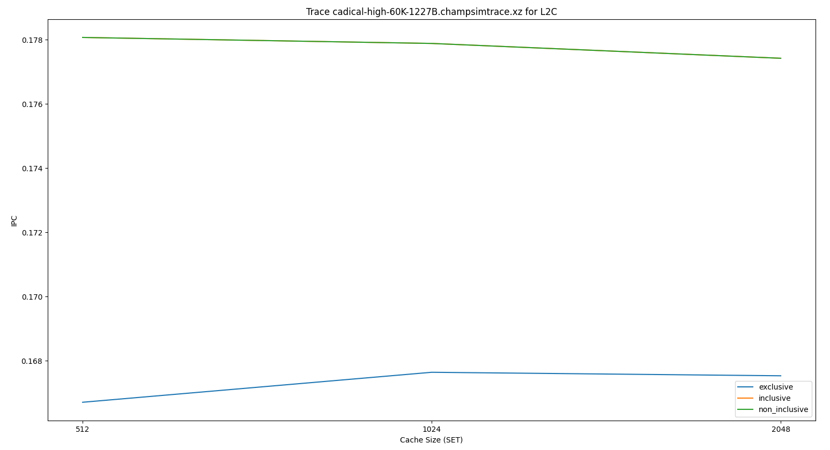

Slide 42
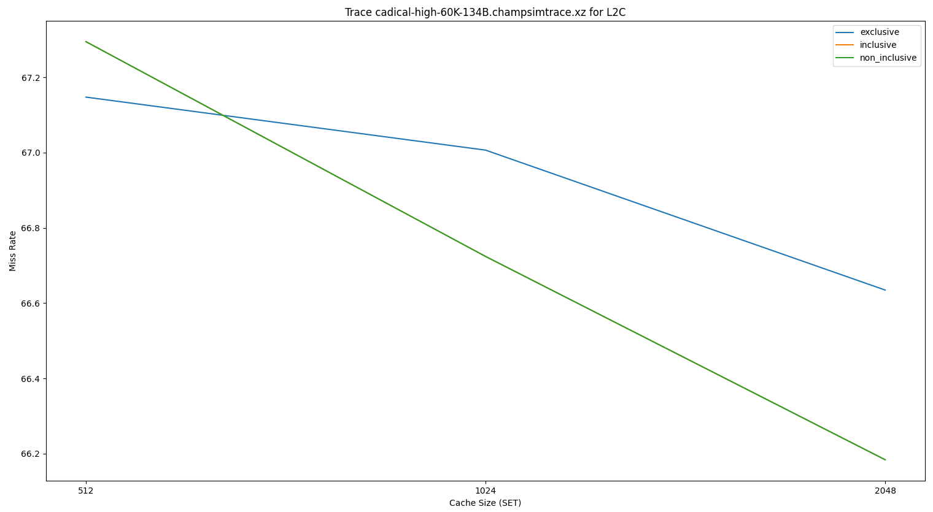
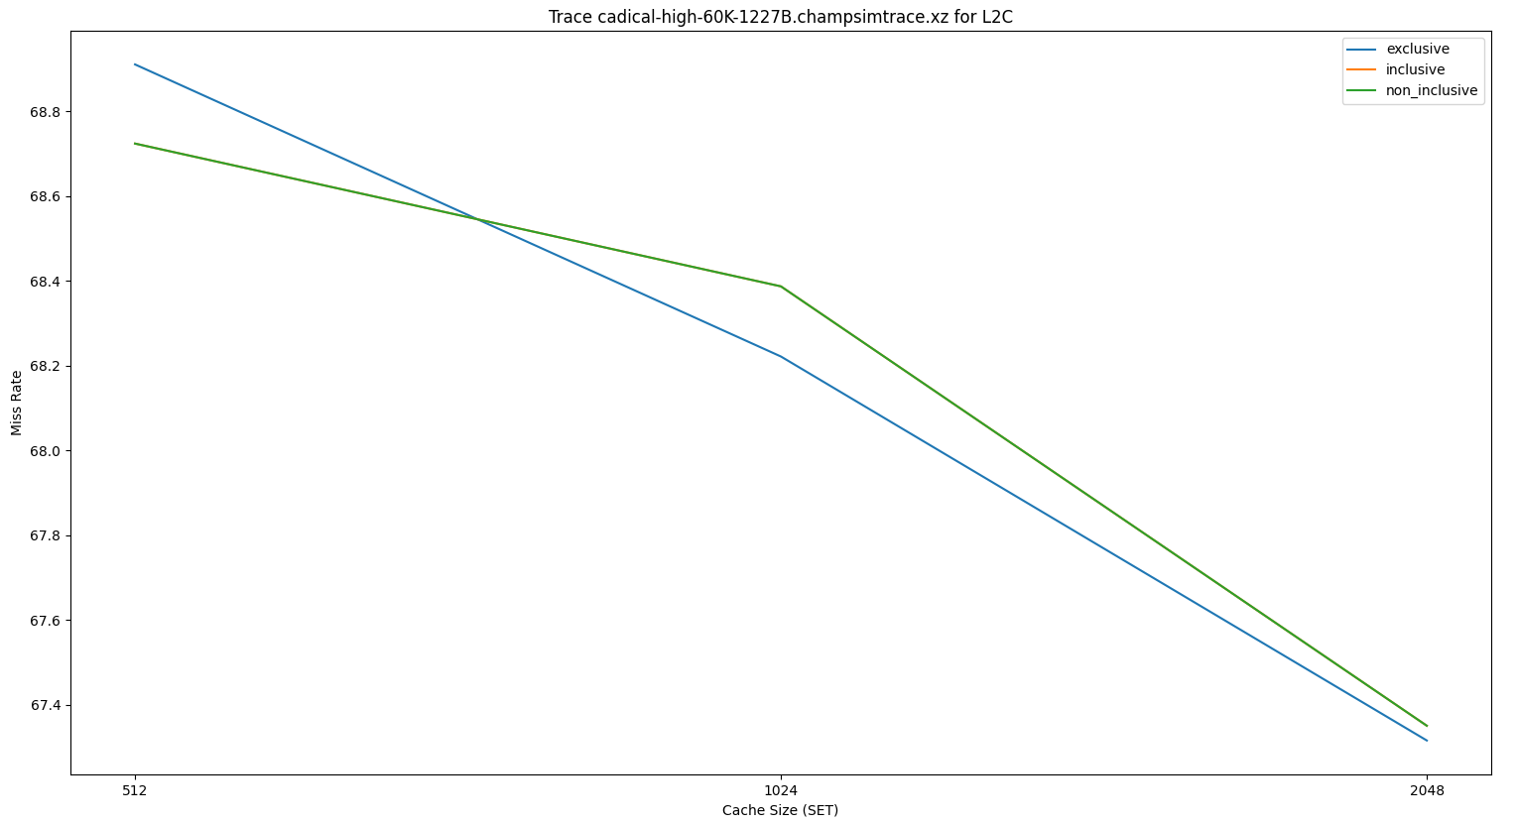
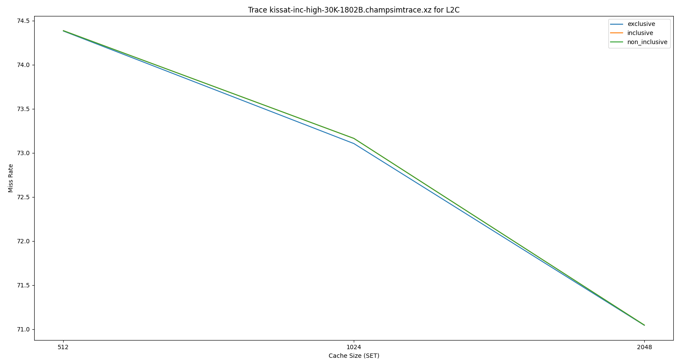

Slide 43
PLOTS FOR variation in Cache size ( Llc )

Slide 44
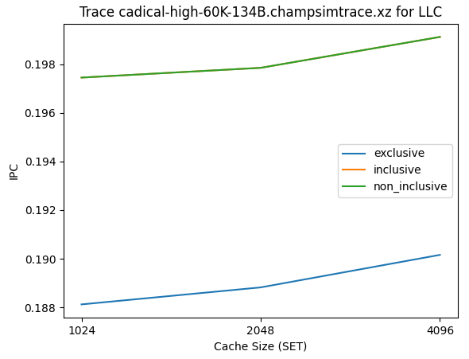
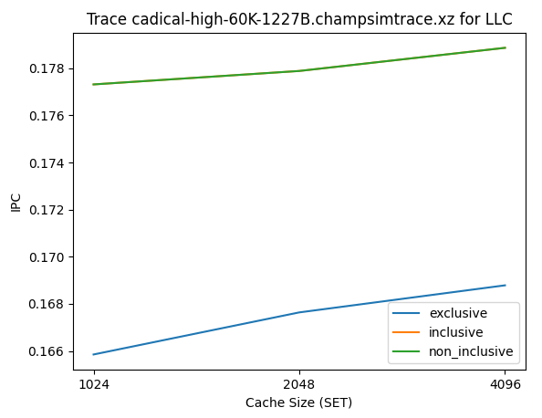
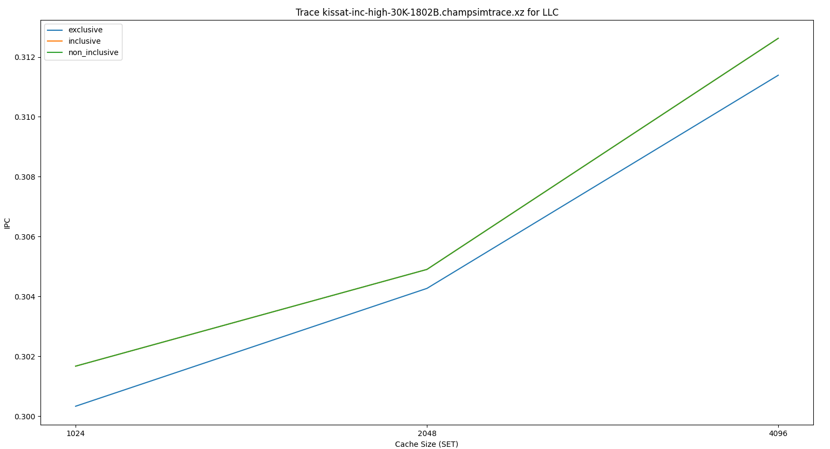

Slide 45
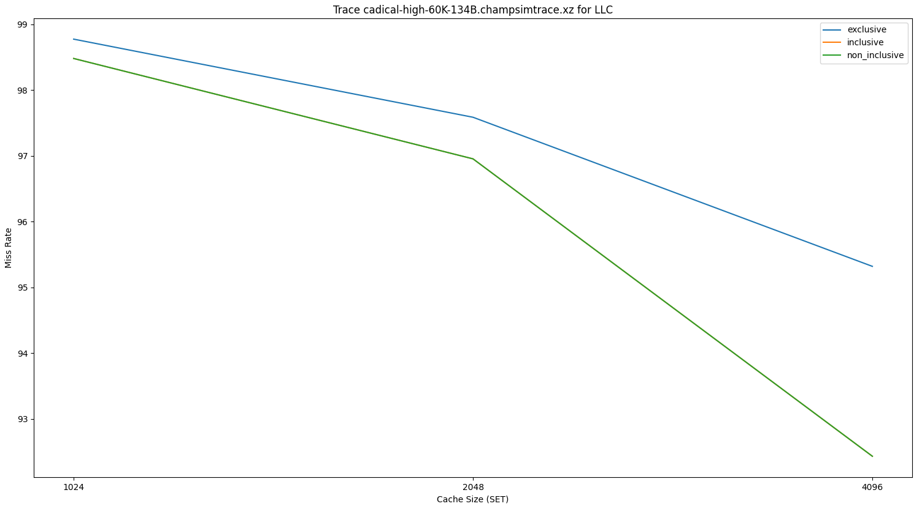



Slide 46
Observations and reasoning
On increasing cache size, the number of capacity misses decreases, hence decreasing the cache miss rate
The significant and continuous decrease in miss rate for increasing size of caches indicate that working set of SAT solvers is quite large
Since increasing the size of the cache also increases the cache access time, hence increase in cache size does not ensure speed up improvement

Slide 47
Final speedup
For final speedup, the parameters chosen are:
Neither Inclusive nor Exclusive
Probabilistic LFU Replacement Policy
Best offset Prefetcher
Block Size = 16
L1D_SET = 256, L1D_WAY = 24
L2C_SET = 4096, L2C_WAY = 16
LLC_SET = 32768, LLC_WAY = 4

Slide 48

Final Speedup
Average Speedup = 9.9965%

Slide 49
References
147122148.pdf (core.ac.uk)
https://ieeexplore.ieee.org/document/8975563
http://os.inf.tu-dresden.de/papers_ps/manthey-beleg.pdf

