Slide 1
EMOTION CLASSIFIER
-K CHAITANYA
(735061388)

Slide 2
AGENDA
Human emotions consist of myriad emotions and cannot be constrained to just being good, bad or neutral.
Understanding emotion behind a tweet.
Generating a model for customer satisfaction report.
Developing an interactive model with question answer capability.
Understanding manager-employee relationships from HR reports.
Creating a classification model.

Slide 3
PROCESS
Collection
Visualization
patterns
Pre-processing
prediction
modelling

Slide 4
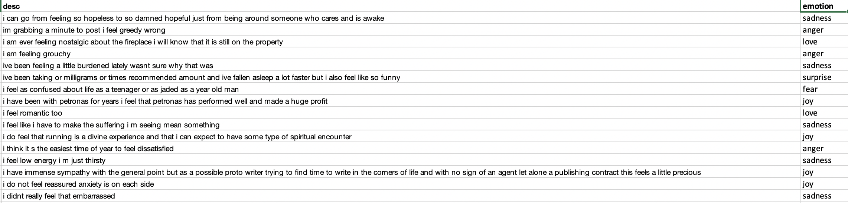
DESCRIPTION

Slide 5
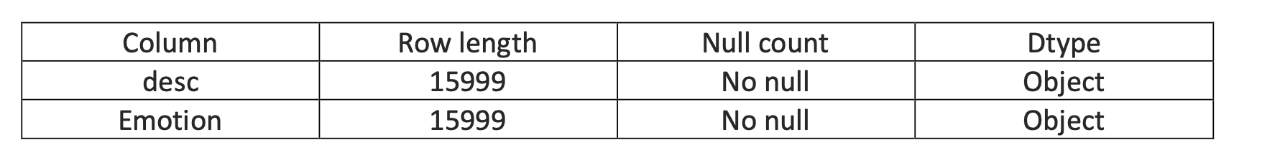
DESCRIPTION

Slide 6
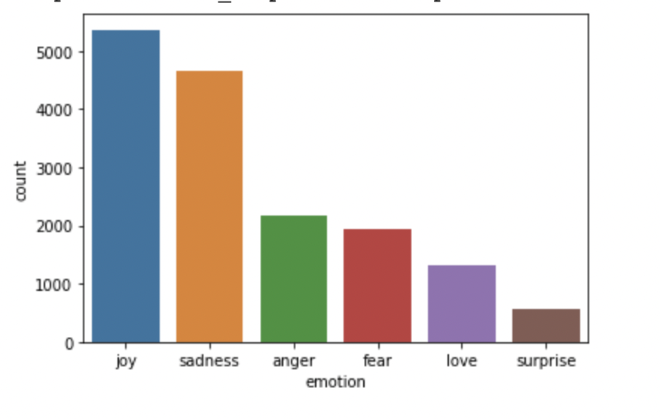
VISUALISATIONS

Slide 7
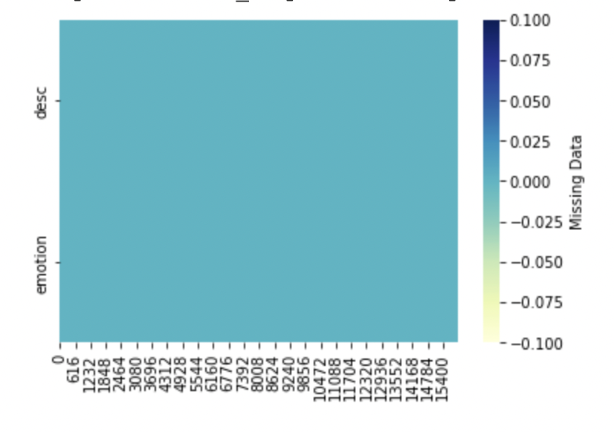
VISUALISATIONS

Slide 8
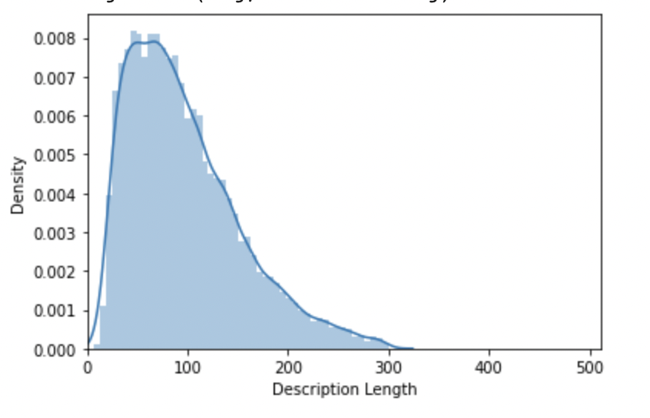
VISUALISATIONS

Slide 9

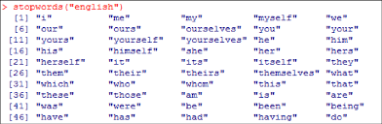
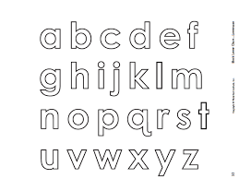
DATA CLEANING

Slide 10

ALGORITHMS

Slide 11
REPORT – First run
Algorithm | Accuracy | Precision | Parameters
Naïve bayes | 71.9 | 71.7 | Alpha = 1
KNN | 40.7 | 45.5 | 3 neighbors
Decision Trees | 30.9 | 37.3 | Criterion = entropy, Max_depth = 15
Random Forest | 86.7 | 86.9 | Max-depth = none, min_sample_leaf = 2, n_estimators = 800
SVM | 80.3 | 80.7 | c = 10

Slide 12
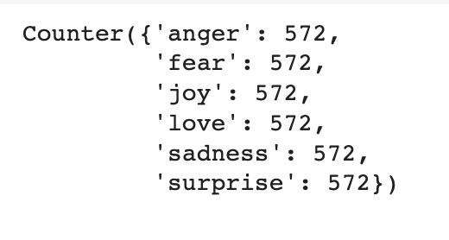
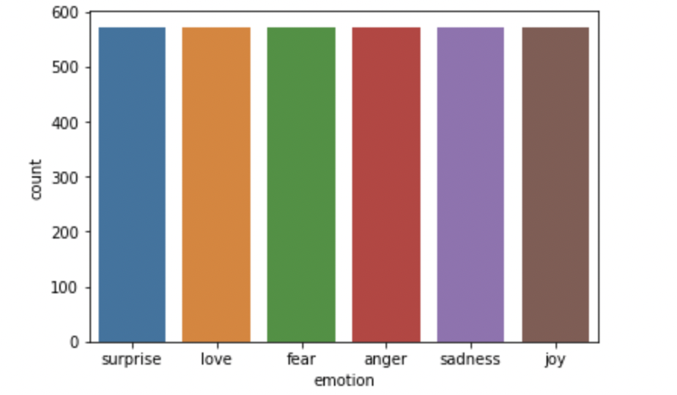
Balanced Data

Slide 13
REPORT – Final run
Algorithm | Accuracy | Precision | Parameters
Naïve bayes | 70.1 | 70.7 | Alpha = 1
KNN | 44.7 | 45.5 | N neighbors = 3
Decision Trees | 30.9 | 37.3 | Criterion = entropy, max_depth = 15
Random Forest | 88.2 | 88.2 | Max-depth = none, min_sample_leaf = 2, n_estimators = 800
SVM | 80.3 | 80.7 | C=10

Slide 14
Conclusion
Using Random forest model for our business idea
Using above model to generate customer perception
To be able to generate question answer model
Future scope
Applying test data for addition learning
Fine tuning with meticulous values

Slide 15
THANK YOU

