Slide 1

LEGAL CITATIONS
-ANAND VAMSI
-CHAITANYA KUNAPAREDDI
-PRIYAL BAMNIKER

Slide 2
AGENDA
PROBLEM STATEMENT
TEXT MINING METHODS
PROBLEM MODELLING
DATA COLLECTION
MODEL EVALUATION
CHALLENGES
ETHICAL CONCERNS
DESCRIPTION

Slide 3
PROBLEM STATEMENT
Understanding type of citations in case reports
Decision making based on type of case reported

Slide 4
Description
Dataset contains legal cases from FCA (Federal Court of Australia)
Cases from year 2006 to 2009 are considered for text mining purpose
Every document contains citation, catchphrase from previous case
Helping law firms in research to create strong assertions made in their case based on references from previous case
Brings motivation to the project by being a real time use case

Slide 5
TEXT MINING METHODS
Data profiling
Stopwords
Lemmatization
Balancing Data
Vectorization
TFIDF
Count vectorizer
Machine Learning
Classification
Clustering
Model Evaluation
Setting baseline
Confusion matrix
Cohens Kappa

Slide 6
Problem modelling
Classification
For a given description classifying the case citation type
The target variable has 10 classes which are skewed with most cases from “Cited” class
Cited, referred to, applied, followed, considered, discussed, distinguished, related, affirmed, approved are the target classes.
Clustering

Slide 7
Data Collection
Dataset has been collected from Kaggle with an inspiration on dealing cases with tactical solutions
Dataset contains 24985 cases with 10 labels
It is considerably larger and skewed dataset hence would be trimmed until classes are balanced.

Slide 8
Model evaluation
Confusion matrix
Accuracy
Precision
Cross validation

Slide 9
challenges
Data is highly infested with garbage words.
Contains lesser number of weighted words
Classified based on authors perspective
Cluster analysis shows vague labels due to less valuable information
Lack of domain knowledge to understand the cases in order to make any inference

Slide 10
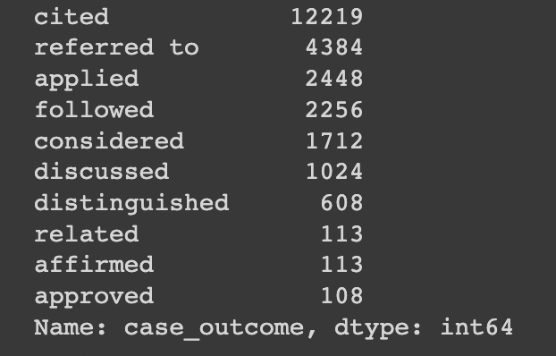

Slide 11
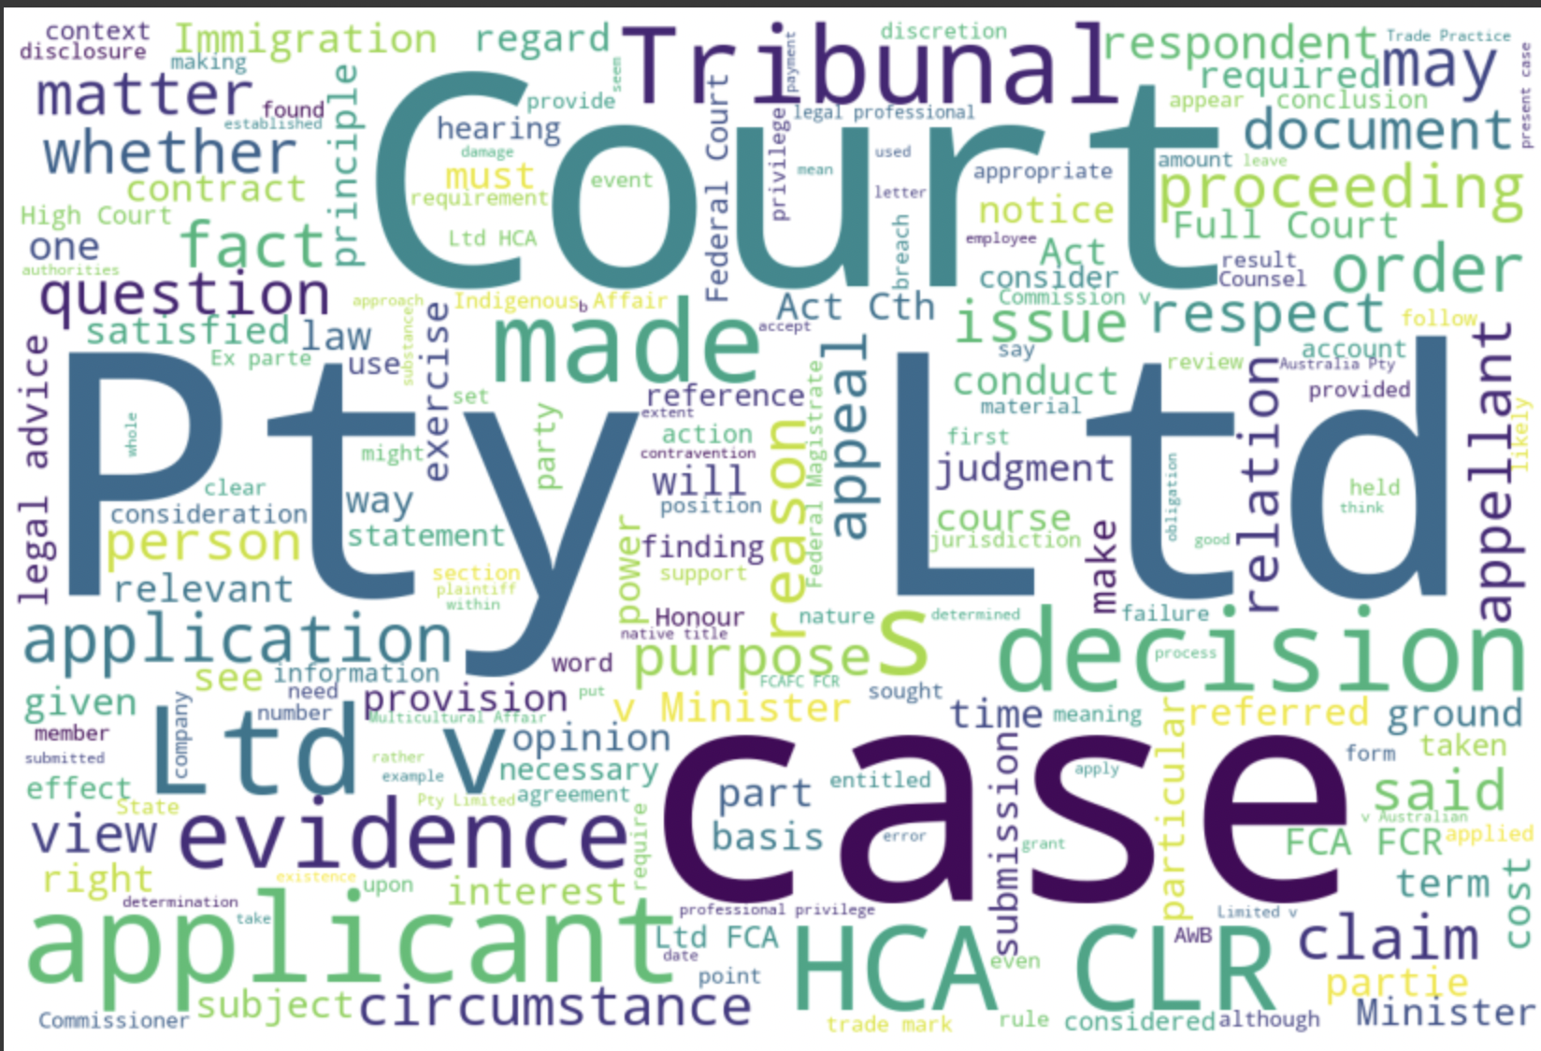

Slide 12
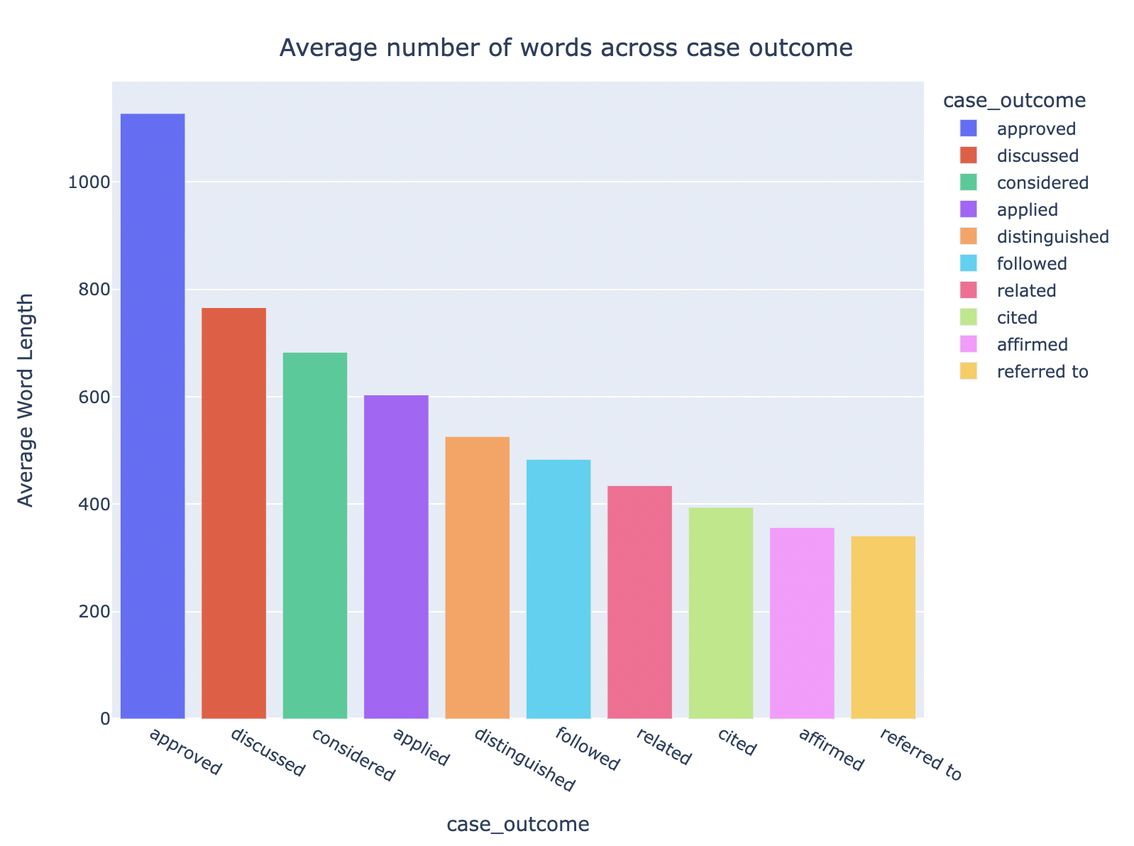

Slide 13
Ethical concerns
Overlapping categories could cause an issue because interpretation of cases and probability of outcome comes from years of experience from lawyers and attorneys. So , this should strictly be treated as a guide.

