Slide 1
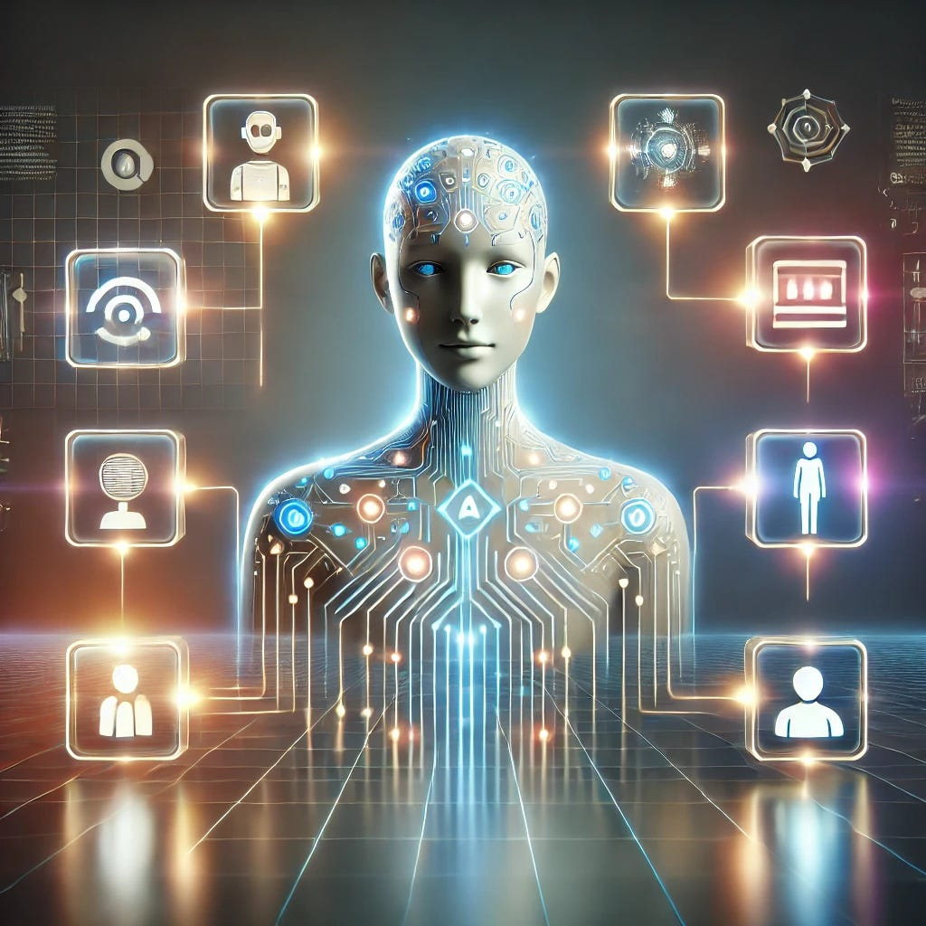

AI AGENTS
The Future of Intelligent Automation
How AI Agents think, learn, and act explained simply.
🤖 Autonomous
🧠 Intelligent
⚡ Fast

Slide 2
OVERVIEW
What We'll Cover
01
What is an AI Agent?
02
How AI Agents Work
03
Types of AI Agents
04
Real-World Applications
05
Benefits & Challenges
06
The Future of AI Agents

Slide 3
DEFINITION
What is an AI Agent?
An AI Agent is a software program that can:
Perceive its environment Make its own decisions Take actions to achieve a goal
Observes the result of each action
Repeats the cycle until the goal is met
Autonomous
💡 The key word is autonomy - the agent decides the next step, not you.
Goal-Oriented
The “intelligence” is the decision-making - not just knowing facts.
Intelligent

Slide 4
COMPARISON
AI Agent vs Regular AI
Regular AI (like ChatGPT)
AI Agent
✗ Answers one question at a time
✓ Plans & executes multi-step tasks
VS
✗ Waits for your next message
✓ Acts on its own without prompting
✗ No memory between chats
✓ Remembers context across tasks
✗ Can't use tools
✓ Uses tools: web, email, code, APIs
✗ You do the thinking
✓ It does the thinking FOR you

Slide 5




HOW IT WORKS
The Brain of an AI Agent
▶
▶
▶
PERCEIVE
THINK
ACT
REMEMBER
Takes in data:
Text, images,
websites, files
Uses AI to plan:
What is the goal?
What steps to take?
Executes actions:
Sends email, runs
code, searches web
Stores results:
Learns from past
actions & outcomes

Slide 6



TYPES
Types of AI Agents
Simple Reflex
Model-Based
Goal-Based
Reacts to current situation only. Like a thermostat if hot, turn on AC.
Keeps memory of past events. Tracks what happened to make better decisions.
Works towards a specific goal. Plans multiple steps to achieve the objective.
Utility-Based
Learning Agent
Multi-Agent
Picks the BEST option, not just any option. Maximizes a score or outcome.
Improves over time. Gets smarter with every task it completes.
Multiple agents working together as a team to solve complex problems.

Slide 7




COMPONENTS
Key Components of an AI Agent
LLM Brain
Memory
Thinks & reasons
Stores knowledge
Perception
Tools
AI
AGENT
Reads environment
Takes actions
Planning
Breaks into steps

Slide 8




APPLICATIONS
Where AI Agents Are Used Today
Customer Support
Coding Assistant
Finance & Trading
24/7 chatbots that resolve complaints, process refunds, and escalate complex issues automatically.
Writes, debugs, and tests code automatically. Tools like GitHub Copilot are AI agents.
Analyses market data in real-time and executes trades based on programmed strategies.
Research Agent
Travel Planning
Cybersecurity
Browses the web, reads documents, and compiles research reports without human effort.
Books flights, hotels, and creates itineraries by talking to multiple services simultaneously.
Monitors networks 24/7, detects threats, and automatically blocks suspicious activity.

Slide 9
DATA
AI Agent Adoption by Industry
Source: Gartner AI Adoption Report 2024–2025

Slide 10
LLM BRAIN
The Role of LLM in AI Agents
🧠 The Brain
LLMs (Large Language Models) like GPT-4, Claude, or Gemini serve as the thinking engine of AI Agents.
🔍 Understanding
They comprehend complex instructions, understand context, and generate logical responses.
🛠️ Tool Use
LLMs decide WHICH tools to use and WHEN to use them (web search, code execution, APIs).
📝 Planning
They break down multi-step tasks into actionable steps and reason through problems.
💡 Without an LLM, an AI Agent is just a dumb automation tool. With it, the agent becomes intelligent, adaptable, and powerful.
🔄 Adaptation
LLMs adapt responses based on feedback and improve agent behavior over time.

Slide 11
KNOWLEDGE ENGINE
RAG: Retrieval-Augmented Generation
What is RAG?
How RAG Works:
RAG is a technique that allows AI Agents to fetch relevant information from external knowledge bases before generating responses.
It prevents hallucinations and ensures answers are grounded in real data.
1. Retrieve
Search knowledge base for relevant documents
2. Augment
Add retrieved context to the LLM prompt
3. Generate
LLM produces response using actual data
Real-World Examples:
📚 Customer Support Agents (search company docs) | 🏥 Medical AI (access patient records & research papers) | 🔍 Legal AI (search case law & contracts)

Slide 12


TOOLS
AI Agents Use Tools Like Humans
Just like you use a calculator, Outlook, or Google AI Agents use tools to get things done.
Web Search
Code Executor
Database
Finds latest information online
Writes & runs Python, JS code
Reads & writes structured data
APIs
Email / Chat
File System
Connects to external services
Sends messages & notifications
Reads/writes files & documents

Slide 13
EXAMPLES
Popular AI Agents You Know
AutoGPT
Devin
Toran Bruce Richards
Cognition AI
First popular autonomous agent. Sets goals and completes them step by step on its own.
The world's first AI software engineer. Can build entire apps from a single prompt.
Claude Agents
GPT Actions
Anthropic
OpenAI
Multi-step reasoning, tool use, long-context planning for complex tasks.
Connects ChatGPT to apps like Gmail, Slack, and databases for automated workflows.
Copilot
AgentGPT
Microsoft
Open Source
AI agent inside Office 365. Drafts emails, creates slides, analyses Excel data.
Browser-based agent that autonomously researches, writes, and delivers results.

Slide 14
ADVANCED
Multi-Agent Systems: Teamwork!
Multiple AI Agents collaborate each specialising in one job, together solving complex problems.
Research Agent
Coder Agent
Writing Agent
Email Agent
MANAGER
AGENT
🌟 Example: A 'marketing campaign' task → Manager delegates research to Research Agent, writing to Writing Agent, and delivery to Email Agent all running in parallel!

Slide 15


BENEFITS
Why AI Agents Are Powerful
100x
99.9%
∞
faster
accuracy
scale
Speed
Accuracy
Scalability
Complete in seconds what takes humans hours.
No tired mistakes. Consistent, high-quality output.
One agent can handle 1,000 tasks simultaneously.
60%
24/7
↑↑↑
cost cut
uptime
grows
Cost Saving
Always On
Adaptability
Reduces operational costs significantly over time.
Works 24/7/365. No breaks, no vacations, no sick days.
Learns from new data and continuously improves.

Slide 16
CHALLENGES
Challenges & Limitations
⚠️ 01
Hallucinations
AI agents can sometimes make up incorrect information or take wrong actions confidently.
🔒 02
Security Risks
Agents with tool access can be manipulated by bad actors (prompt injection attacks).
💸 03
Cost
Running multiple LLM calls per task can be expensive at scale.
🤖 04
Over-Automation
Too much automation without oversight can lead to errors going unnoticed for too long.
🧩 05
Lack of Common Sense
AI agents lack human intuition and may fail at tasks requiring real-world understanding.
🛡️ 06
Privacy Concerns
Agents with access to personal data raise serious data privacy and compliance questions.

Slide 17
MARKET DATA
The AI Agent Market is Exploding
Projected to reach $102 Billion by 2028 growing at 45% annually.
Source: MarketsandMarkets AI Agent Report 2024

Slide 18
BUILD
How to Build a Simple AI Agent
1
Define the Goal
2
Choose the LLM Brain
3
Give It Tools
What should the agent do? Be specific.
Example: 'Answer customer emails automatically.'
Pick a model: GPT-4, Claude, Gemini.
This is the agent's thinking engine.
Connect tools: web search, database, email.
Each tool expands what the agent can DO.
4
Add Memory
5
Set Safety Rules
6
Test & Improve
Let it remember past conversations.
Use vector databases (Pinecone, ChromaDB).
Define boundaries. What should it NOT do?
Always have a human review loop for risky tasks.
Run real scenarios. Catch mistakes early.
Iterate based on real-world performance.

Slide 19
FUTURE
The Future of AI Agents
2024
Tool-using agents
Agents browse web, run code, read files
2025
Agentic workflows
Long-running multi-step autonomous pipelines
2026–27
Physical AI Agents
Robots controlled by AI agents in the real world
2028–30
Society-scale Agents
Agents managing cities, supply chains, healthcare
"Agents will do the work of a small company. Humans will manage agents, not tasks." Sam Altman, CEO of OpenAI

Slide 20
SUMMARY
Key Takeaways
🤖
AI Agents are autonomous programs that perceive, think, and act to achieve goals without step-by-step human instruction.
🔗
They use tools like web search, code execution, and APIs combining them intelligently to solve complex, multi-step problems.
🏭
Every major industry is adopting AI Agents from finance to healthcare, retail to cybersecurity.
💡
Key benefits: speed, accuracy, scalability, 24/7 availability, and cost savings at a scale humans simply cannot match.
⚠️
Challenges remain: hallucinations, security, cost, and the need for human oversight and safety guardrails.
🚀
The AI Agent market will reach $102B by 2028. Now is the time to learn, build, and leverage this technology.

Slide 21
Thank You!
The Age of AI Agents is Here.
🧠 Keep Learning
🔧 Start Building
🌐 Stay Updated
Follow AI news & build small projects
Try LangChain or AutoGPT today
AI moves fast never stop exploring

